Slide 1
Part 8 : Project Quality Management
8.2 – Perform Quality Control
8.3 – Perform Quality Assurance

Slide 2

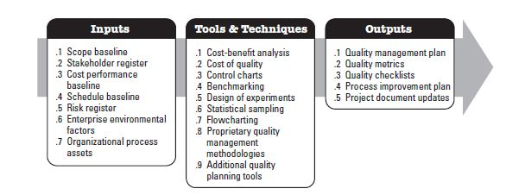
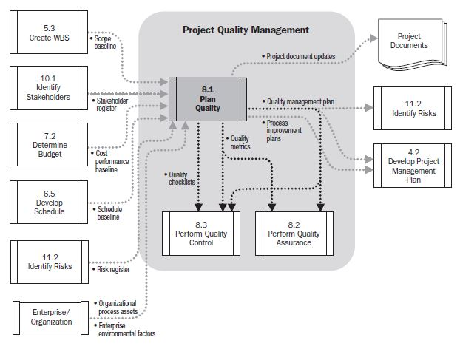
Planning Quality...

Slide 3
Perform Quality Control...
Process of “monitoring and recording results of executing the quality activities to assess performance and recommend necessary changes…”
Monitoring and Controlling Performance Group activity. Like control scope and control costs you look at the work performance info that is coming from the project and compare it to the plan. If there are problems, recommend a change.
Quality control activities identify causes of poor process or product quality and recommend and/or take action to eliminate them!
Performed by a separate department (Quality control dept) or similarly titled organizational unit.

Slide 4
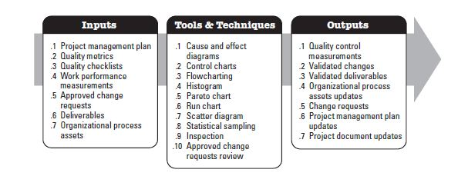
Perform Quality Control...

Slide 5
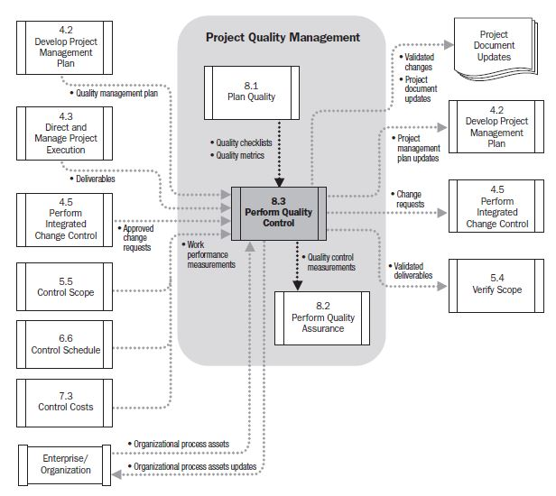
Perform Quality Control...

Slide 6

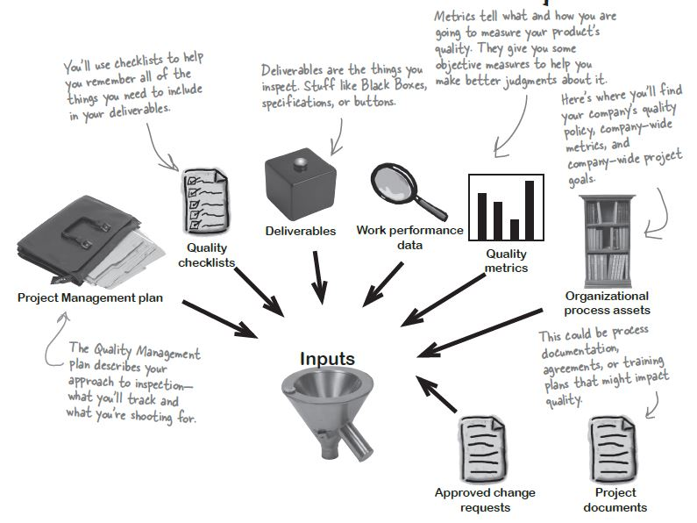
Perform Quality Control - Inputs

Slide 7
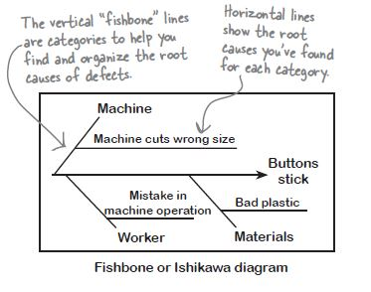
Perform Quality Control – Tools & Techniques
7 Basic tools of Quality
Common quality control charts & tools :
Cause & Effect Diagrams :
Known as Ishikawa or fishbone diagrams.
Used to figure out what caused a defect.
List all the categories of defects that are identified and write the possible causes of the defect from each category

Slide 8
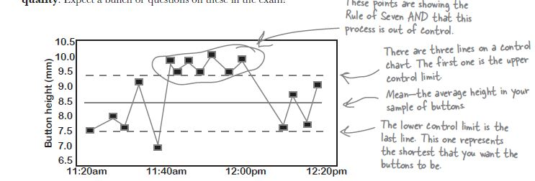
Perform Quality Control – Tools & Techniques
7 Basic tools of Quality
Rule of Seven : Old marketing concept. The prospective buyer should hear or see the marketing message at least seven times before they buy it from you.
Common quality control charts & tools :
2) Control charts:
How processes are doing over time and when a process is subject to special cause variation, resulting in an out-of-control variation.
Sample button height measurements of boxes produced…

Slide 9
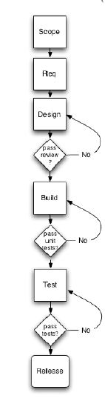
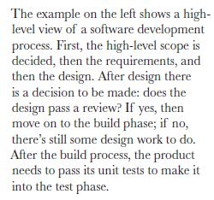
Perform Quality Control – Tools & Techniques
7 Basic tools of Quality
Common quality control charts & tools :
3) Flowcharts:
How processes work visually and the tasks interrelate among themselves.
A picture of whole process.

Slide 10
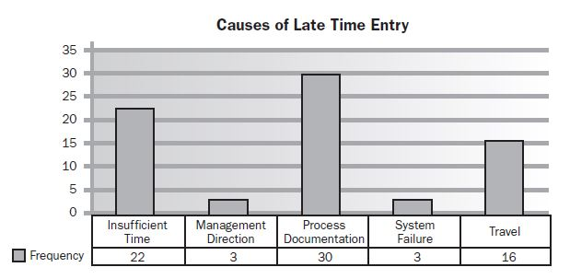
Perform Quality Control – Tools & Techniques
7 Basic tools of Quality
Common quality control charts & tools :
4) Histograms:
A vertical bar chart showing how often a particular variable state occurred. Each column represents an attribute or characteristic of a problem/situation. Height of each column represents the relative frequency of the characteristic.

Slide 11
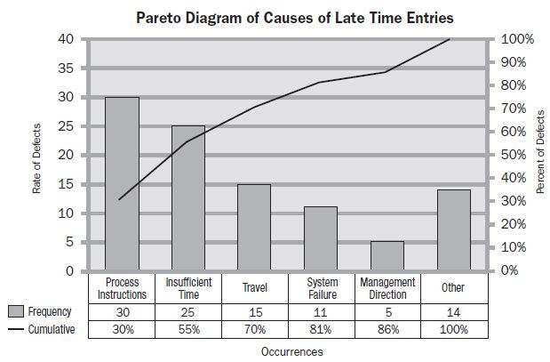
Perform Quality Control – Tools & Techniques
7 Basic tools of Quality
Common quality control charts & tools :
5) Pareto Charts:
Large number of problems are caused by a small number of causes!
80/20 rule : 80% of defects are caused by 20% of the causes.
Click here to learn more about on Pareto Charts...
10
* Process Instructions and Insufficient time’s cumulative percentage is 55%

Slide 12
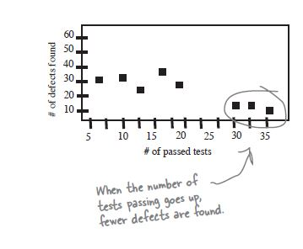
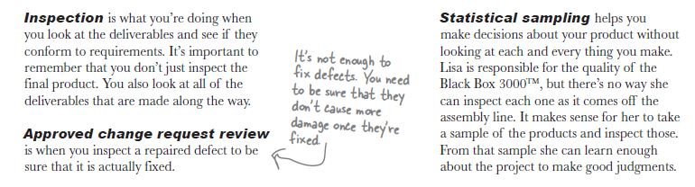
Perform Quality Control – Tools & Techniques
7 Basic tools of Quality
Common quality control charts & tools :
6) Scatter Diagrams:
Relationship between two variables.
Study and identify the possible relationship between changes observed in two variables.

Slide 13
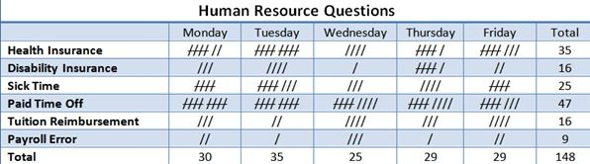
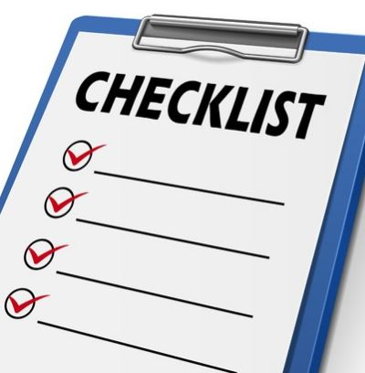
Perform Quality Control – Tools & Techniques
7 Basic tools of Quality
Common quality control charts & tools :
7) Check List /Check Sheet
A check sheet is a basic quality tool that is used to collect data. A check sheet might be used to track the number of times a certain incident happens.
As an example, a human resource department may track the number of questions by employees, per category, per day. In this particular check sheet the tools shows the total number of questions received by the human resources department.
This information helps that department identify opportunities to proactively share information with employees in an effort to reduce the numbers of questions asked.

Slide 14
Perform Quality Control – Outputs
Quality control measurements:
All results of inspections ; number of defects found, number of tests that passed or failed etc.
Verified deliverables and validated changes
Every single deliverable on the project needs to be inspected to make sure it meets the quality standards. If there are defects, the team needs to fix them and this process should also be checked.
Change Requests
Project Document Updates
Project Management Plan Updates
Quality Management Plan & Process Improvement Plan
OPA
Lessons Learned Updates
Completed Checklists

Slide 15

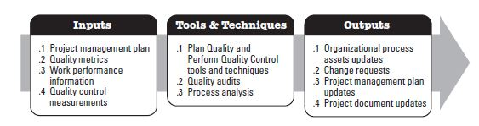
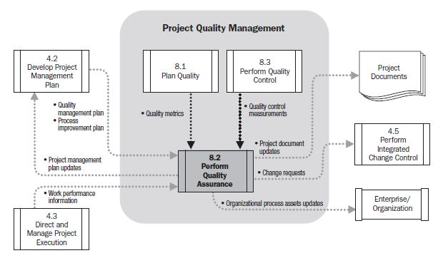
Perform Quality Assurance
Taking all of the outputs from Plan Quality Management & Control Quality and looking at them to see if there are ways to improve the process.

Slide 16
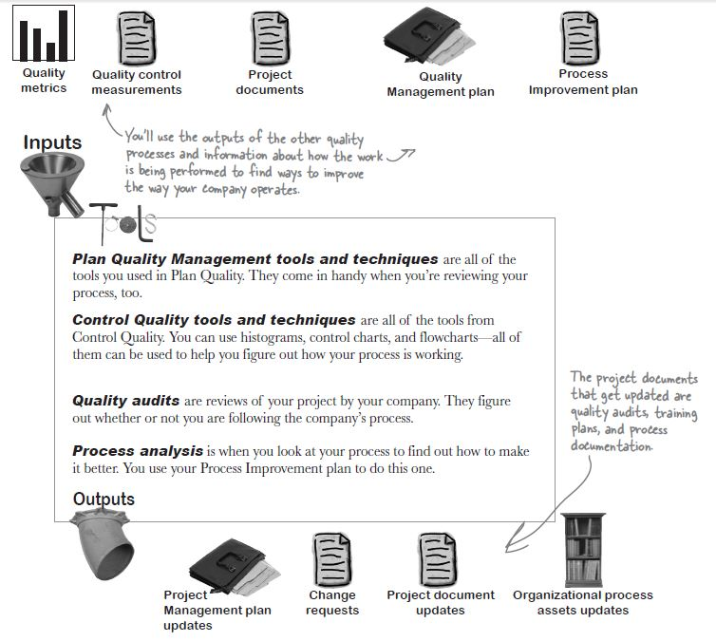
Perform Quality Assurance
Fixing the bugs in the process…

