Slide 1
Are We Macro-free Yet?
Sep 19, 2019
Zhihao Yuan <lichray@gmail.com>
SimpleRose Inc
Notes:
Hi, welcome to the talk: Are we macro-free yet? I'm Zhihao Yuan, a Parallel Computing Engineer at SimpleRose Inc, which is a start-up developing mathematical solvers in C++17. This company's codebase uses no #if, no #ifdef, and no #define, other than the places where the include guards present. So we are not introducing any macros, but still using a few provided by third-party libraries. And this talk is mainly about how we did it.

Slide 2
Schedule
Background
The macros that we eliminated: #if
The macros that we have not eliminated
The macros that should be prioritized for elimination
Notes:
The plan for today is I will start with some background about the title and some history about C++ vs. macro. And then, we will focus on a whole category of the macros we eliminated: conditional compilation with #if. In the rest of the time, I will talk about the macros that we are still using. And finally, given these experience, I will advise about the uses of macros that you may want to eliminate first.

Slide 3
Areweyet
A Mozilla tradition to track top-level progress metrics using “are we” sites.
Are we web extensions yet? http://arewewebextensionsyet.com/
Are we Chrome yet? http://arewechromeyet.com/
Rust folks inherited this tradition.
Are we async yet? https://areweasyncyet.rs/
Are we web yet? http://www.arewewebyet.org/
Are we IDE yet? https://areweideyet.com/

Slide 4
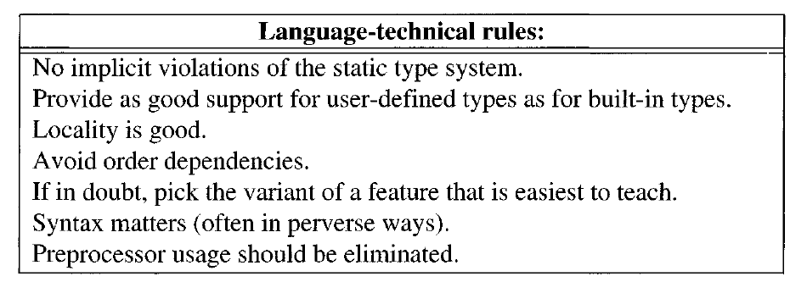
Why asking “Are we macro-free yet?”
Notes:
But why "macro-free." If you ask this question to C++ the language, there is a short answer:
But here what do I mean is that, as a developer, you should also ask "Are we macro-free yet?" against your projects.

Slide 5
Ask “Are we macro-free yet,” or ask
cublasHandle_t p;
assert(cublasCreate(&p) == CUBLAS_STATUS_SUCCESS);
“Why does the handle become uninitialized in Release build?”
Notes:
The reason is that, at the time when I didn't ask the question, I was asked: "Why does the handle become uninitialized in Release build?" I give you 5 seconds to look the code. Found the problem? The root cause is that when a C++ programmer like us is reading code, our mental model for the language will tell us: the parameter to "assert" has been evaluated. It is not the case for macros.

Slide 6
…or ask
#define PRINT(out, a) out << #a " :\n"; out << a;
PRINT(out, indices);
+ if (matrix.dimensions() != 0)
+ PRINT(out, matrix);
“Why did I think people will take a glance at the macro definition?”
Notes:
Here is another incident that happened. If we don't ask, "Are we macro-free yet," there will be someone regretting, "Why did I think people will take a glance at the macro definition?" I have to confess that I wrote this piece of code, and I forgot how did I define the macro when I was reusing it a week later. Of course, I know the do...while(0) trick, but it's not the root cause.

Slide 7
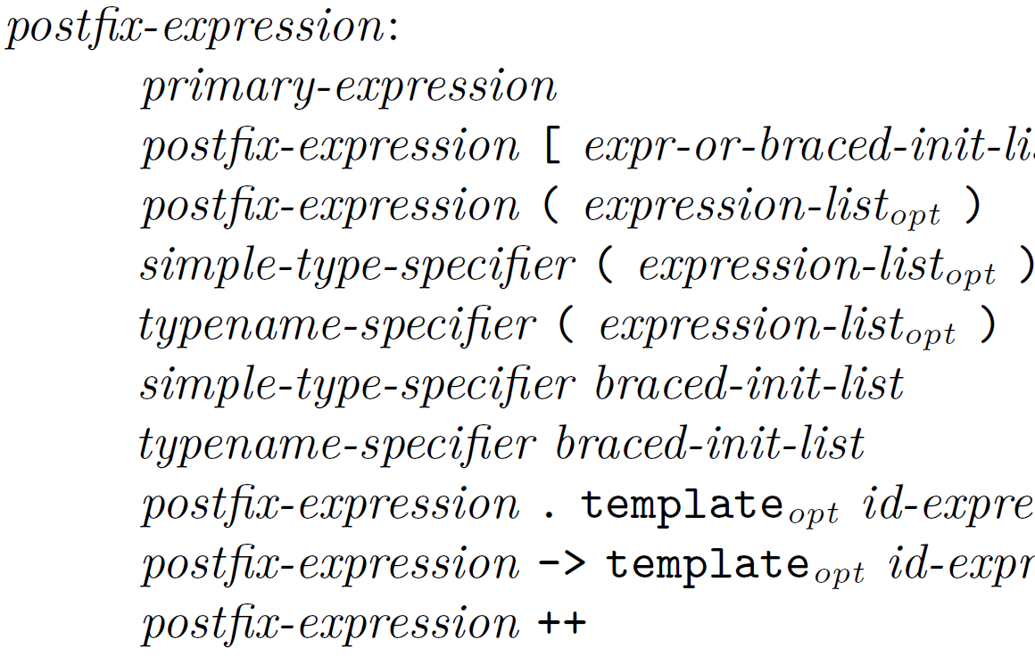
Code involving macro isn’t C++
C++ Grammar
My Code
PRINT(out, indices);
if (matrix.dimensions() != 0)
PRINT(out, matrix);
Notes:
The real problem is that code involving macro isn't in C++.The function-like macro in this example is parsed as C++ but does not refer to any entity in C++.
This tells us C++ implies no macro. In recent years, we have been talking about Modern C++ a lot. And Modern C++ is still C++, which, in my opinion, ⏩ should also imply no macro.

Slide 8
Modern C++ implies no macro
# define smart_ptr(Kind, Type, ...) \
({ \
struct s_tmp { \
CSPTR_SENTINEL_DEC \
__typeof__(Type) value; \
f_destructor dtor; \
…
# define shared_ptr(Type, ...) smart_ptr(SHARED, Type, __VA_ARGS__)
# define unique_ptr(Type, ...) smart_ptr(UNIQUE, Type, __VA_ARGS__)
“Modern C” may imply the opposite
Notes:
But Modern C, if there is such a thing, may imply the opposite. I have an impression that there is a trend in C to replicate C++ features with all the macros plus all the vendor-specific extensions. The code piece shown on the screen is from a C project called "lib C Smart Pointers." They simulated shared_ptr and unique_ptr under the same names! I have to say, that's a very heroic effort.

Slide 9
A long history of fighting macros
Replace local function-like macros with lambdas
inline short functions
Supersede <tgmath.h> with function overloading
Alias parameterized types with alias templates
Define constants with (inline) constexpr
Replace NULL with nullptr
Repeat code with templates
Replace literal creation macros (INT64_C) with UDL
Standardize attributes such as [[noreturn]]
Replace TYPEOF with decltype
…
“One of C++’s aims is to make C’s preprocessor redundant because I consider its actions inherently error prone.”
Stroustrup, B. (1994). The Birth of C++. In The Design and Evolution of C++ (pp. 63-108). Reading, MA: Addison Wesley.
Notes:
The difference in acceptance of macros in C and C++ can literally, trace back to the birth of C++. In The Design and Evolution of C++, chapter 3, The Birth of C++, Bjarne wrote: "One of C++..." C++ has a long history of fighting macros. Nowadays, we are benefiting from a number of victories in this battle.
Since C++11, you can replace local... and that's what I did to the PRINT macro in the previous slides. You are encouraged to inline short functions. C++ doesn't need <tgmath.h> "Type Generic Math Functions." You are lucky if you don't know what that is. And you can alias... so that you don't need function-like macros to do so. constexpr variables replaced #define constants. NULL has no role in C++. We can repeat code without macros in loop unrolling. User-defined literals, great. We also standardized a number of attributes so that you don't have to #define the vendor-specific ones. Even decltype got rid of a macro -- the TYPEOF macro from the Boost library if you still remember. Ah, that's a typical example of prototyping next-generation language features with macros. And now I understand why C loves simulating C++ features with macros: next-generation C is C++. But next-generation C++ should be? C++23.

Slide 10
What about conditional compilation?
Why #if is bad?
What constexpr if statement can do to conditional compilation?
Understanding constexpr if statement
Scoping conditional compilation
Notes:
You may have noticed that an elephant was missing in the last slide -- conditional compilation, #if. ⏩ What's the problem with it? Is C++17 constexpr if statement an answer to that? These are nontrivial questions. Let's first look into both features.

Slide 11
What happens if HAVE_BLAS is a typo?
#ifdef HAVE_BLAS
cblas_daxpy(…);
#else
std::transform(…);
#endif
Notes:
What if... Sounds unlikely? How about what if you didn't expect that this macro is spelled HAVE_CBLAS in your build system. Or it is an old name, and the code base is migrating away from it. All these can cause the condition to be always undefined, and the else branch to always be taken. And the program silently compiles, runs, until you found a performance regression.

Slide 12
What this is testing?
#if defined(_MSC_VER) && _MSC_VER < 1900
…some definitions
#endif

Slide 13
What this is testing again?
#if __cpp_deduction_guides >= 201907L
…some declarations
#endif
Notes:
Some libraries give these conditions meaningful names, but the "names" will still be macros, which carry another set of problems.

Slide 14
Is that still C++ code?
#if defined(_WIN32)
int fd;
if (_sopen_s(&fd, fn, _O_RDONLY, _SH_DENYWR, 0) == 0)
#else
if (auto fd = ::open(fn, O_RDONLY))
#endif
return …;
Notes:
That looks like two consecutive if statement heads.

Slide 15
Begging for goto fail
#if defined(_WIN32)
if (bypass_wchar_conversion()) {
// …
} else
#endif
ok = swritew_b(s, d) and sflush() and

Slide 16
Problems with #if
There is no guarantee that building all combinations of configurations can reveal a logic error in the conditions
Encouraging testing conditions without semantics
Inviting obscure code structure
Notes:
And you need to remember that in each of the examples we were only testing one macro. How can this scale to multiple macros, nested #if? So to sum up the problems, I face with #if:

Slide 17
My brain is not a preprocessor

Slide 18
What about conditional compilation?
Why #if is bad?
What constexpr if statement can do to conditional compilation?
Understanding constexpr if statement
Scoping conditional compilation
Notes:
#if is bad. What constexpr if can do then.

Slide 19
Understanding constexpr if statement
template<class T>
bool close_handle(T x)
{
if constexpr (std::is_same_v<T, int>) // dependent
return ::close(x) == 0;
else
return ::CloseHandle(x);
}
Notes:
The standard says, "During the instantiation of an enclosing templated entity, if the condition is not value-dependent after its instantiation, the discarded substatement (if any) is not instantiated." Template entity is the function template here. Value-dependent, ⏩ as its name implies, the value of the condition depends on the arguments to the template. Discarded statement is the false branch which we don't know yet. The critical information here is that constexpr if can customize instantiation for a template.

Slide 20
Customize instantiations?
template<class T>
bool close_handle(T x);
Notes:
What structure in C++ can customize instantiations?

Slide 21
Like partial specializations
template<class T, bool = std::is_same_v<T, int>>
bool close_handle(T x);
close_handle<*, true>
close_handle<*, false>
†Functions don’t have partial specializations.

Slide 22
If the template used to look like this…
template<class T, bool = std::is_same_v<T, int>>
bool close_handle(T x)
{
if constexpr (std::is_same_v<T, int>)
return ::close(x) == 0;
else
return ::CloseHandle(x);
}
WARNING: just a way for you to understand. Constexpr-if is not a syntax sugar.

Slide 23
Specializations happening locally
template<class T>
bool close_handle<T, true>(T x)
{
if (true)
return ::close(x) == 0;
else
return ::CloseHandle(x);
}

Slide 24
With discarded statement
template<class T>
bool close_handle<T, false>(T x)
{
if (false)
return ::close(x) == 0;
else
return ::CloseHandle(x);
}

Slide 25
Discarded statement (1/2)
Every program shall contain exactly one definition of every non-inline function or variable that is odr-used in that program outside of a discarded statement; no diagnostic required. ([basic.def.odr]/10)
Implies: A function or a variable that is odr-used inside a discarded statement may have zero definitions.
Such a function or a variable still must be declared, otherwise the name is not introduced, nor the interpretation and semantic properties to come with the name.
Notes:
Discarded statement isn't equivalent to empty-statement. You wrote it in C++, so it has semantics, just with new properties. The standard says [...] odr-use is like, you called CloseHandle in code in the previous slide, then CloseHandle has to obey one definition rule. The above implies that [...] But you still have to have declarations of the entities you used. Otherwise, the language doesn't know what "CloseHandle" is.

Slide 26
Understanding constexpr if statement
int close_fd(int fd)
{
if constexpr (have_iso_conformant_api) // non-dependent
return _close(fd);
else
return ::close(fd);
}
Notes:
Now, what if the condition is non-dependent.

Slide 27
If this used to be a template…
template<bool = have_iso_conformant_api>
int close_fd(int fd)
{
if constexpr (have_iso_conformant_api)
return _close(fd);
else
return ::close(fd);
}

Slide 28
Customized with explicit specializations
template<bool = have_iso_conformant_api>
int close_fd(int fd);
We can explicitly define the following specializations:
close_fd<true>
close_fd<false>

Slide 29
Locally
template<>
int close_fd<true>(int fd)
{
if (true)
return _close(fd);
else
return ::close(fd);
}

Slide 30
With discarded statement
template<>
int close_fd<false>(int fd)
{
if (false)
return _close(fd);
else
return ::close(fd);
}

Slide 31
What about conditional compilation?
Why #if is bad?
What constexpr if statement can do to conditional compilation?
Understanding constexpr if statement
Scoping conditional compilation
Notes:
Look at the demand, categorize the scenarios where conditional compilation kicks in

Slide 32
Scoping conditional compilation
Replacement within function definitions
Replacing class definitions
Notes:
We found two scenarios.
⏩ The first one is relatively simple.

Slide 33
Replacement within function definitions
void daxpy(double a, span<double const> x, span<double> y)
{
#ifdef HAVE_CBLAS
cblas_daxpy(…);
#else
std::transform(…);
#endif
}
Interface
Implementation
Notes:
What makes this scenario simple is that, ⏩ the interface is not touched, we are only manipulating the ⏩ implementation details. This may not hold true when macros were used for replacing class definitions. We will get to that later.
⏩ So how did we replace this use of #if with constexpr if?

Slide 34
Test variables, not macros
void daxpy(double a, span<double const> x, span<double> y)
{
if constexpr (have_cblas)
cblas_daxpy(…);
else
std::transform(…);
}
Hard error if have_cblas is never defined
Notes:
The first thing we do is to test variables, not macros. A big benefit is that, ⏩ you get a hard error.
Now where and how we defined this variable. Recall what I said in the beginning of this talk,…

Slide 35
Breaking it down: condition
build_config.h:
constexpr bool have_cblas = ??;
Notes:
This variable, delivers information about your build, which means you have a build problem. Then just…

Slide 36
Introduce variables without macros
build_config.h.in:
constexpr bool have_cblas = @HAVE_CBLAS@;
Let build systems solve build problems.

Slide 37
CMake example
find_package(BLAS)
if(BLAS_FOUND)
set(HAVE_CBLAS true)
else()
set(HAVE_CBLAS false)
endif()
configure_file(build_config.h.in build_config.h @ONLY)
build_config.h.in:
constexpr bool have_cblas = @HAVE_CBLAS@;
build_config.h if BLAS not found:
constexpr bool have_cblas = false;

Slide 38
Unconditionally introduce the names
#include <algorithm> // for std::transform
extern "C" void cblas_daxpy(int n, double alpha,
double const* x, int incx,
double* y, int incy);

Slide 39
Conditional operations
#ifdef HAVE_CBLAS
cblas_daxpy(…);
#else
std::transform(…);
#endif
Notes:
What we saw is a simple case in a simple scenario.

Slide 40
Conditional declarations?
#ifdef HAVE_ZLIB
gzFile fp = gzopen(filename, "r");
#else
FILE* fp = fopen(filename, "r");
#endif

Slide 41
Immediately invoked lambdas
auto fp = [&] {
if constexpr (have_zlib)
return gzopen(filename, "r");
else
return fopen(filename, "r");
}();
‡Declaration of gzopen is available on zlib website.

Slide 42
Discarded statement (2/2)
If the declared return type of the function contains a placeholder type, the return type of the function is deduced from non-discarded return statements, if any, in the body of the function. ([dcl.spec.auto]/3)
Implies: Discarded statements do not contribute to return type deduction.

Slide 43
Limitation of constexpr-if in practice
int64_t get_file_size(char const* filename)
{
#if defined(_WIN32)
struct _stat64 st;
_stat64(filename, &st);
#else
struct stat st;
::stat(filename, &st);
#endif
Definition of struct _stat64 is required to define variables
Notes:
We do find limitations of constexpr if in practice.
Can this be rewritten with constexpr if?

Slide 44
When a complete type is required but conditionally available
Define the type by yourself
ODR violation when including the corresponding header
Rethink about the function – can it be deemed disjointed implementations?
If so, we can replace the implementations with build systems
Notes:
You can’t use it in constexpr-if’s discarded statement. Note that the gzFile type in the last example isn’t such a case. gzFile is a typedef to a pointer to an incompletely type, so it’s a complete type and is unconditionally available.

Slide 45
Breaking it down: Translation units
src/win32.cc:
int64_t
get_file_size(char const* filename)
{
struct _stat64 st;
_stat64(filename, &st);
return st.st_size;
}
src/posix.cc:
int64_t
get_file_size(char const* filename)
{
struct stat st;
::stat(filename, &st);
return st.st_size;
}

Slide 46
CMake example
if(WIN32)
list(APPEND mylib_srcs src/win32.cc)
else()
list(APPEND mylib_srcs src/posix.cc)
endif()
target_sources(mylib ${mylib_srcs})
Notes:
And build one or the other. This solution is old school, but it’s the basis of the next hammer that we are going to create.

Slide 47
Scoping conditional compilation
Replacement within function definitions
Replacing class definitions

Slide 48
Replacing class definitions
struct DirStreamCore {
#if defined(_SYS_MSVC_) || defined(_SYS_MINGW_)
Mutex alock; ///< attribute lock
::HANDLE dh; ///< directory handle
std::string cur; ///< current file
#else
Mutex alock; ///< attribute lock
::DIR* dh; ///< directory handle
#endif
};
typical reason: data members are different

Slide 49
“High-level components should not depend on low-level components”
struct DirStreamCore {
#if defined(_SYS_MSVC_) || defined(_SYS_MINGW_)
Mutex alock;
::HANDLE dh;
std::string cur;
#else
Mutex alock;
::DIR* dh;
#endif
};
Interface?
Implementation?
Notes:
You can't replace translation units now, because this appears in a header, which supposes to be an interface, ⏩ but then it carries implementation details. That makes the interface depends on implementation -- at build time.Time for some Object-Oriented Design Principle. "High-level components should not depend on low-level components."

Slide 50
Answer: Dependency inversion
“High-level components should not depend on low-level components.”
Remove low-level dependency from class definition – PImpl
“Both should depend on abstractions.”
Create an implicit, non-virtual interface (abstraction) that allows substitution of implementations – Type erasure
Notes:
Yes, that's dependency inversion principle. The first sentence, [...] The second sentence, [...]

Slide 51
Before
class DirStream {
public:
explicit DirStream();
~DirStream();
bool open(const std::string& path);
bool close();
bool read(std::string* path);
private:
void* opq_;
};
bool DirStream::close() {
#if defined(_SYS_MSVC_) || defined(_SYS_MINGW_)
DirStreamCore* core = (DirStreamCore*)opq_;
…
C-style “Type erasure”
Notes:
It turns out that the library in question is already using some "type erasure." The type was erased, I can't say it didn't.

Slide 52
After
class DirStream {
public:
bool open(const std::string& path) { return this_->open(path); }
bool close() { return this_->close(); }
bool read(std::string* path) { return this_->read(path); }
private:
struct DirStreamInterface {…};
template<class T>
struct DirStreamCore final : DirStreamInterface {…};
std::unique_ptr<DirStreamInterface> this_;
};
Notes:
Let's apply our changes.I only kept the common structure here. There is an abstract class that serves as the interface, a concrete type to implement the interface using a member object of type T. Store an object to that and refer to it with a dynamic type.

Slide 53
PImpl
include/mylib/win32dirstreamcore.h:
struct Win32DirStreamCore {
bool open(const std::string& path);
bool close();
bool read(std::string* path);
private:
class impl;
unique_ptr<impl> impl_;
};
include/mylib/posixdirstreamcore.h:
struct PosixDirStreamCore {
bool open(const std::string& path);
bool close();
bool read(std::string* path);
private:
class impl;
unique_ptr<impl> impl_;
};

Slide 54
Type erasure
Tomorrow afternoon,
Back to Basics: Type Erasure
from Arthur O’Dwyer, 13:30 - 14:30.

Slide 55
Flexibility of dependency inversion
Build target (OS, Toolchain, etc.) bonded implementations
Selecting a single implementation at build time
Selecting implementation at runtime from a set of implementations determined at build time
Test a set of implementations determined at build time
Notes:
Dependency inversion is a hammer.
There is a 1-to-1 relationship between a build target and a choice of implementation.

Slide 56
Build target bonded implementations
The choice of implementation is implied for a given target.
using DirStreamCoreImpl =
std::conditional_t<have_win32_api,
Win32DirStreamCore,
PosixDirStreamCore>;
Notes:
compute it, emplace DirStream erasure

Slide 57
Select one implementation at build time
enum class backend { tbb, openmp, cuda };
…
template<backend v>
using select_backend = typename select_backend_imp<v>::type;
// build_config.h.in
constexpr backend backend_to_use = @MYLIB_BACKEND@;
# CMakeLists.txt
set_property(CACHE MYLIB_BACKEND PROPERTY STRINGS tbb openmp cuda)
Notes:
I can enumerate the implementations I have, map enum members to types, let the people who builds the library choose from the C++ enum in CMake UI, compute the implementation to use in code.

Slide 58
CUDA & Conditionally available toolchains
Heterogenous toolchains are flexible
Apply on optional libraries rather than optional translation units
add_library(mylib …)
if(CMAKE_CUDA_COMPILER) # check_language(CUDA)
add_library(mylib-parallel …)
target_link_libraries(mylib mylib-parallel)
endif()
Share your PImpl header in both libraries
Notes:
Here are some notes for CUDA and other conditionally available toolchains. Heterogeneous toolchains are flexible. You probably want to see some familiar diagnosis messages from the native toolchains, for example. But what if the secondary toolchain is optional. Easy. You can build a side library and link it conditionally. After that, make sure your pimpl header can be shared in both libraries.

Slide 59
Determine a set of implementations
So that we can select from them at runtime.
// a type list
using implementations = std::conditional_t<
have_cuda_toolkit,
std::tuple<tbb_impl, openmp_impl, cuda_impl>,
std::tuple<tbb_impl, openmp_impl>>;
Notes:
Let's continue with more uses. We can determine a set of implementations and select an implementation from it at runtime. Here I’m showing what this set of implementations looks like. There are lots of ways to match something compile-time with a runtime value. What I did was merely mapping command-line options to factory functions that return the type-erased backend from each tuple member. Pattern matching can do that better.

Slide 60
Run unit tests on implementations determined at build time
doctest³ example:
TEST_CASE_TEMPLATE_DEFINE("simple", T, test_simple)
{
auto x = mylib::algorithm_backend(in_place_type<T>);
REQUIRE(…);
}
DOCTEST_TEMPLATE_APPLY(test_simple, mylib::implementations);
Notes:
Here is the last case of the flexibility of dependency inversion. How to test all the implementations that you can build? Here I'm using doctest, a unit test framework that uses macros. But which unit test framework doesn't use macros? I will get to that later. Go back to the slides. This macro, DOCTEST_TEMPLATE_APPLY, is different because it interacts with the C++ type system. It understands that [...] is a type list, and applies the type-parameterized test case on all the implementation classes.

Slide 61
More macros to kill?
Include guards
Logging
Metadata macros (e.g. Q_OBJECT)
Unit testing framework
Notes:
Conditional compilation, done. Let's talk about the macros we didn't introduce, but are still using.

Slide 62
Include guards
Least harmful macros. Visually do not interact with code.
Modules will eliminate them one day.

Slide 63
A typical logging macro
// LOG_F(2, "Only logged if verbosity is 2 or higher: %d", some_number);
#define VLOG_F(verbosity, ...) \
((verbosity) > loguru::current_verbosity_cutoff()) \
? (void)0 \
: loguru::log(verbosity, __FILE__, __LINE__, __VA_ARGS__)
When to evaluate?
Notes:
Two things differ from a function: the double-underscore macros to capture source information and lazy evaluation.

Slide 64
Macro-free logging
Some users want to optionally track file names and line numbers
C++20 std::source_location will address that
Some users may want lazy evaluation of formatting arguments
This is not the mental model when we are reading warning("Only logged if verbosity is high: %d", fp.fileno());
A std::format (C++20) based macro-free logging framework would behave similar to spdlog and Python standard library’s logging module
Notes:
And that’s arguably bad.

Slide 65
Metadata macros
Complicates codegen but less so on code reading
What static reflection meant to replace:
iterating over struct fields, enum members
What metaclasses (generative programming) meant to replace:
generating declarations
Disclaimer: I’m not promising anything. Watch Andrew Sutton’s talks.

Slide 66
Macro-free unit testing framework
This afternoon,
Next generation unit testing using static reflection⁵
from Manu Sánchez, 14:00 - 15:00.
Notes:
And here comes the challenge we mentioned before.

Slide 67
What macros to eliminate first?
The macros that interleave with program logic in any form
conditional code blocks, token soup
function-like or object-like macros that substitute into expressions
The macros that hijack interface with implementation details
don’t take over build systems’ job
consider a better design
Think about how to migrate away before introducing a macro
Notes:
Nobody's fulltime job is to get rid of macros in their project, so there has to some priority if you want to try something from this talk. So [...] Because it's problematic for readers' brain to operate in parallel on two languages. The macros that [...] are second to that. Build time dependency is still dependency, and usually, there is a better design. And think about [...] because you want to reduce the rate of adding while you are eliminating.
At last, I hope, in the future, if I see a use of macro in code review, I can comment: "Can we write C++?“
Thank you.

Slide 68

Questions?
@lichray

Slide 69

Demo
lichray/macrofree-demo

Slide 70
CAST
Smart pointers for the (GNU) C programming language https://github.com/Snaipe/libcsptr
Kyoto Cabinet: a straightforward implementation of DBM https://github.com/cloudflarearchive/kyotocabinet
doctest: The fastest feature-rich C++11/14/17/20 single-header testing framework for unit tests and TDD https://github.com/onqtam/doctest
loguru: A lightweight C++ logging library https://github.com/emilk/loguru
unittest: C++ unit testing and mocking made easy https://github.com/Manu343726/unittest

