Slide 1
SDR Metadata: Coding/Decoding process
IOV Galileo PFM satellite payload testing on E5a

Slide 2
Outline
Data collection system scenario
Data collection equipment
Metadata creation and decoding block scheme
Data processing results

Slide 3
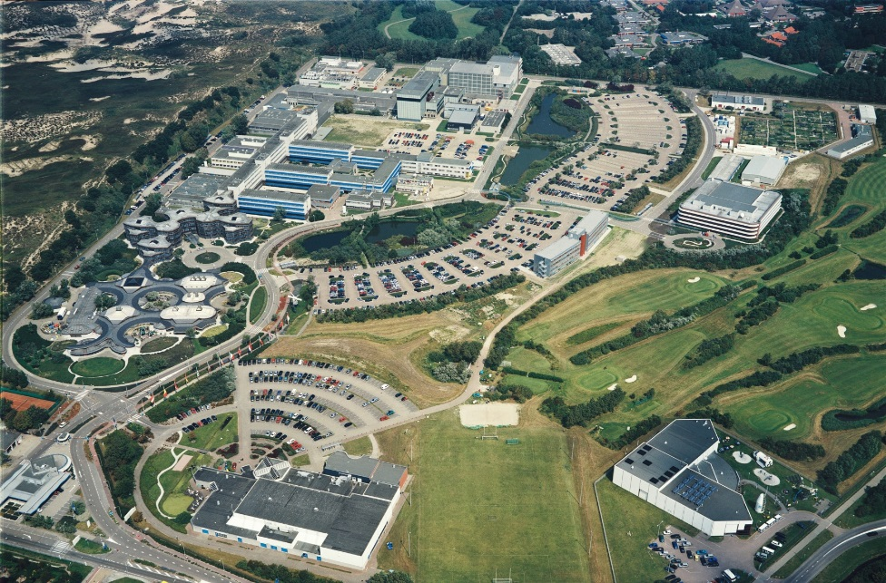
Data collection system: Scenario
Location: European Space Research and Technology Centre (ESA/ESTEC)
Campaign: “IOV Galileo PFM satellite payload testing on E5a frequency band”
Date: 14/12/2011
Time of data collection: 12:25:58 CET
Antenna Position: 46.86°, 7.24°, 17 m

Slide 4
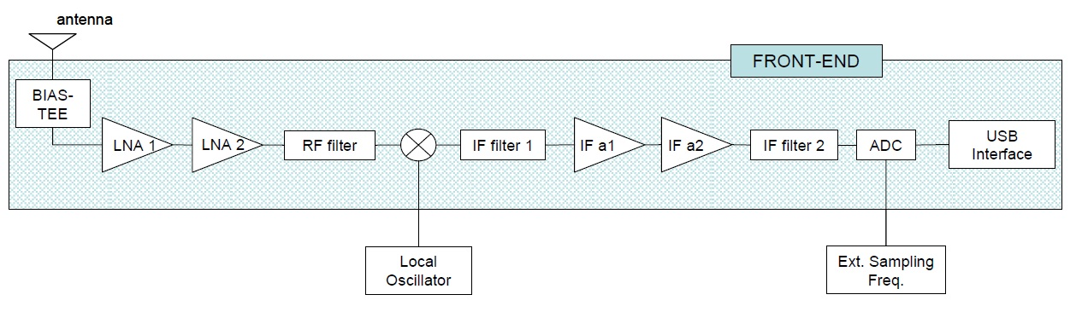
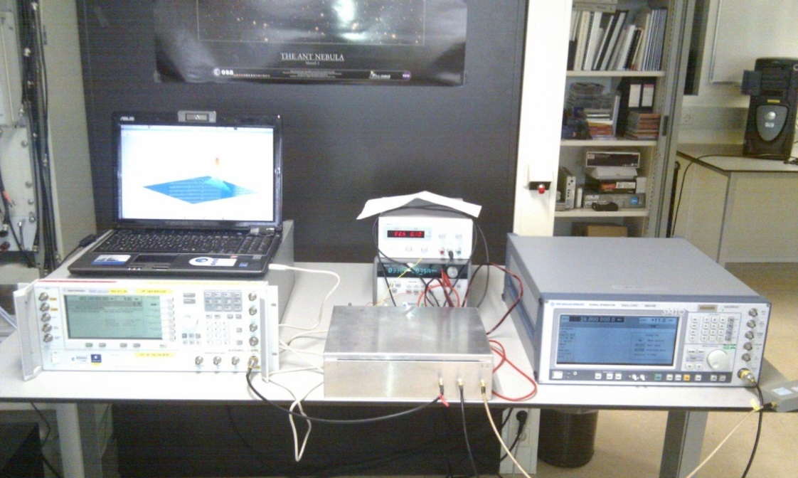
Data collection equipment
Front-end realized with COTS components
FRAUNHOFER_20111214_122558_raw.grab
RF front-end section
RF center frequency: 1176.45 MHz
RF filter bandwidth: 20 MHz
Digital IF front-end section
IF filter 2 bandwidth: 18 MHz
Sampling frequency: 36 MHz
IF frequency : 9 MHz
Quantization: 8 bits
Packed Bits: 8 bits
Format: ‘BIN’ (binary integer)

Slide 5

GalileoE5a-GPSL5.xml
Describes all signals/sources present in the data collection
Splits the data collection in a number raw data files as described in the Metadata (es. GPS L1, L2, L5, Galileo Ea, Eb, etc.)
API
generates
Metadata file
customizes
Converter
knows
Data Collection
Splits data
collection
FRAUNHOFER_20111214_122558_raw.grab
E5aL5.dat
Data processing: GNSS software receiver

Slide 6
Data processing Results: Spectrum
FRAUNHOFER_20111214_122558_raw.grab
E5aL5.dat

Slide 7
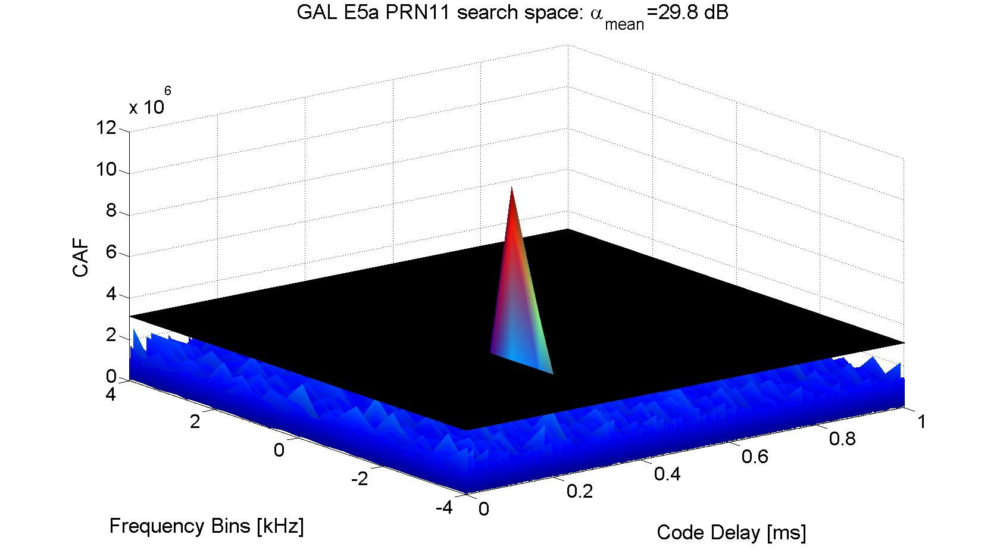
Data processing Results: Search Space PRN11
FRAUNHOFER_20111214_122558_raw.grab
E5aL5.dat

