Slide 1
Class
Author: Mohamed

Slide 2
Basics
What is a class?
A class is a blueprint for creating objects.
What is an object?
A collection of related functions and properties. For example a phone is an object which has different functionalities and properties.
What is the naming convention for a class?
Class names are CamelCased

Slide 3
Basics
Every function in class must take the word self as the first parameter, even if that function doesn’t take any parameters.
When you want to access functions or properties from inside of the class, you must prefix it with “self.” Ex:
self.start()
self.name
When you want to access functions from outside of the class, you must prefix it with the variable name. If you created an object named car, then you can do the following:
car.start()
car.name

Slide 4
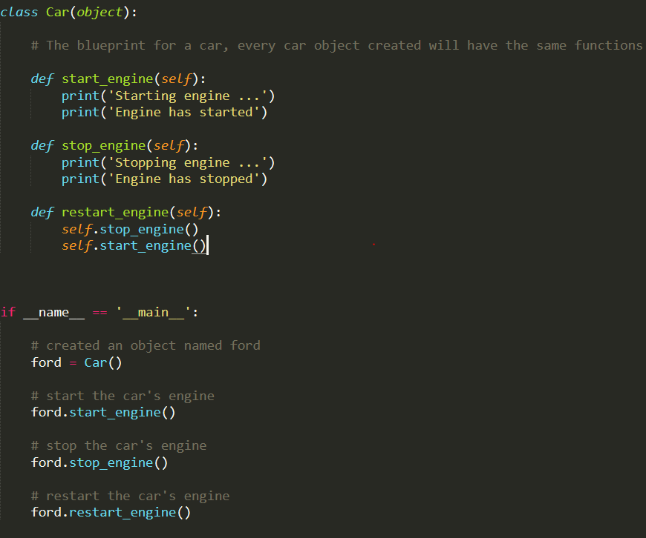
Simple Example

