Slide 1
Inheritance
Author: Mohamed

Slide 2
What is it?
Inheritance allows an object to get attributes and properties from another object.
Just like how a child can inherit attributes and properties from his parents, objects in OOP can do the same.
Warning: be careful with inheritance, it’s very easy to abuse it.

Slide 3
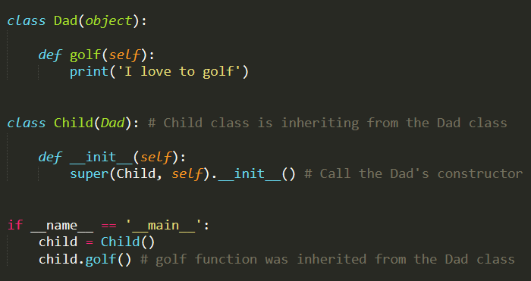
Simple Inheritance

Slide 4
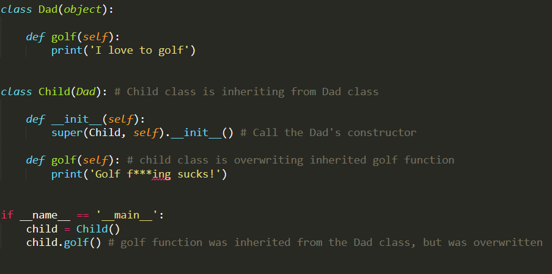
Overwrite

