Slide 1
Args & Kwargs

Slide 2
What are they?
Arguments(args)
All args will be saved into a tuple
def my_func(a, b, c):
pass
The parameters a, b, c are the args
Key-word arguments(kwargs)
All kwargs will be saved into a dictionary
def my_func(a, b, c=None):
pass
The parameters a, and b are args, and c is a kwargs.
Args are any parameters that are positional
Kwargs are any parameters that are optional

Slide 3
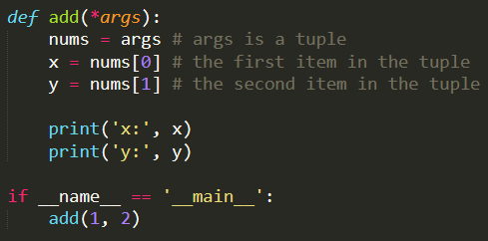
Args example

Slide 4
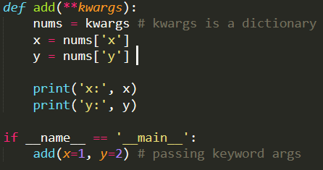
Kwargs example

Slide 5
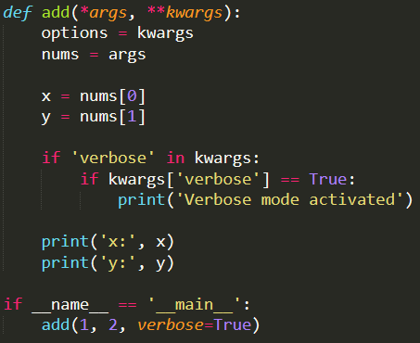
Mixture

