Slide 1
Variables
Author: Mohamed Sheikh

Slide 2
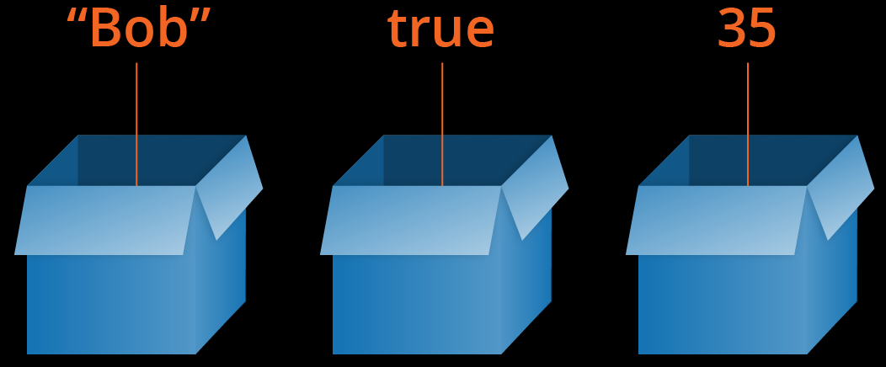
What is a variable?
A variable is something that is used to store data. It is a name that refers to some sort of value in memory. A variable is a container, just like a box.

Slide 3
Invalid Variables
A variable that start with a number
A variable that start with a symbol other than an underscore
A variable that contains a symbol other than an underscore
A variable that contains a space
Examples of invalid variables
Starting with numbers
2day = “Wednesday”
7days = “days”
Starting with a symbol
*king = “Sami”
$money = “Time”
Contains a symbol
d@ys = “7 days”
fan$ = “Summer”
Contains a space
my name = “Sami”
my age = 20

Slide 4
Valid Variables
Examples of valid variables
_2day = “Wednesday”
_7days = “days”
king = “Sami”
money = “Time”
days = “7 days”
fans = “Summer”
my_name = “Sami”
my_age = 20

Slide 5
Bad Variable Name
A variable can be valid, but it can have a bad variable name.
A bad variable name is a name that is ambiguous or isn’t a real word
Examples of bad variable names
Ambiguous variable names
n = 5
k = “Sami”
Unreal variable names
ngn = “Jet”
bvgm = “Black Ops III”

Slide 6
Good Variable Name
Unambiguous variable names
number = 5
king = “Sami”
Real world names
engine = “Jet”
best_video_game = “Black Ops III”

Slide 7
Case Sensitive
Variables are case sensitive. Which means
name does not equal Name
age does not equal Age

Slide 8
Type Of Cases
camelCase
daysOfTheWeek = 7
amountOfPeopleWorking = 3
PascalCase
DaysOfTheWeek = 7
AmountOfPeopleWorking = 3
snake_case
days_of_the_week = 7
amount_of_people_working = 3

Slide 9
Naming Conventions
Variables in Python are snake_cased
my_favorite_color = “Blue”
my_favorite_hobby = “Sleep”
Functions in Python are also snaked_cased
start_process
stop_process
Classes in Python are PascalCased
EngineManager
SessionHandler
Constants in Python are capitalized snake_cased
MAX_ENGINE_SPEED = 9800
MIN_ENGINE_SPEED = 5000

