Slide 1
While
Author: Mohamed

Slide 2
What is it?
A while loop is a loop that repeats the same thing while a certain condition is True.
Once the condition is no longer True, the loop will stop

Slide 3
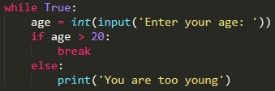
Break statement
Enter your age
age > 20
False
True
You’re too young
break

Slide 4


Keep incrementing num until it’s not less than 5
Start
num = 0
num < 5
True
print(num)
False
num += 1
Exit loop

Slide 5
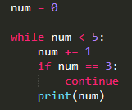
Continue Statement
Start
num = 0
num < 5
print(num)
True
True
False
num == 3
False
num += 1
Exit loop

Slide 6
Cheat sheet
What is a while loop used for?
a while loop is used to repeat the same thing
What is a break statement used for?
a break statement is used to force the loop to stop
What is a continue statement used for?
a continue statement is used to force the loop to skip to the next iteration

