Slide 1
List comprehension
Author: Mohamed

Slide 2
What is it?
List comprehension is used for creating a list on a single line.
List comprehension can be useful when you are concerned about lines.

Slide 3
Structure
[ <item to append into the list> <loop> <if statements> ]
Your list comprehension doesn’t have to have an if statement
Your list comprehension can not have the assigned symbol in it, you can’t assign variable inside a list comprehension

Slide 4
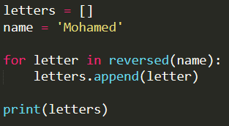

Simple example
Normal
List comprehension

Slide 5
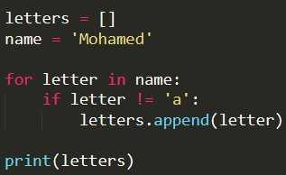
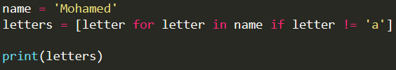
If statements
Normal
List comprehension

