Slide 1
__init__
Author: Mohamed

Slide 2
What is it?
Init is short for initialize.
Init is function is the constructor(builder) of a class; every time a file is being created, the constructor of the class is called.
The init function is the constructor of a class

Slide 3
What else does the init function do?
All of the global variable inside the class are defined in the init function.
When creating an object, the parameters are taken by the init function.

Slide 4
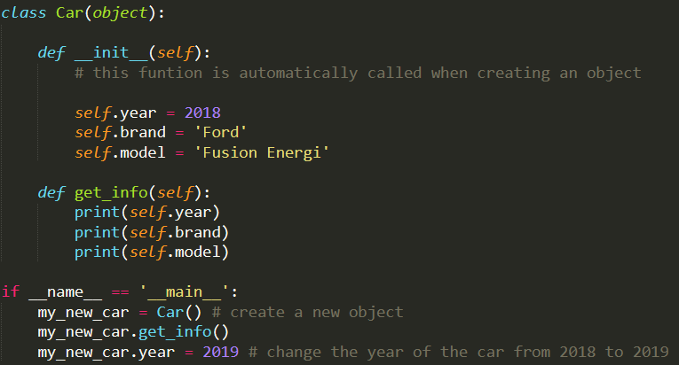
Class without parameters

Slide 5
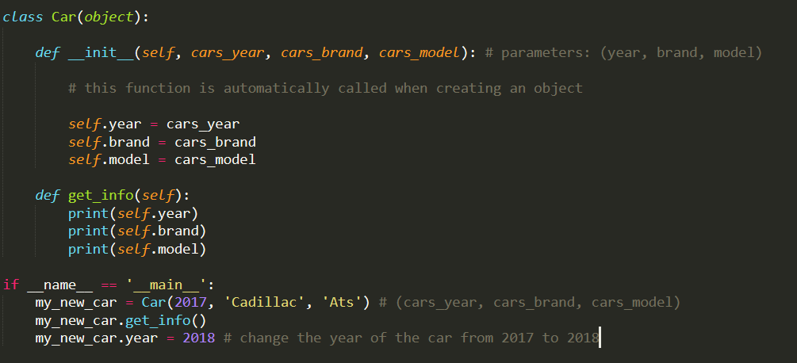
Class with parameters

