Slide 1
Queue
Author: Mohamed

Slide 2
What is it?
A queue is a first in first out data structure, also known as a line.
The first item in a queue would be the first item out, just like how the first person in the line would be the first person served.

Slide 3
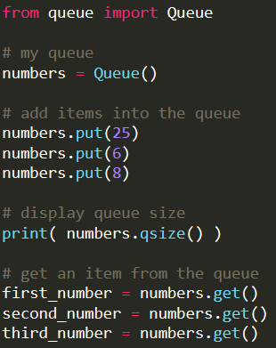
Python’s queue library

