Slide 1
Multithreading
Author: Mohamed

Slide 2
What is multithreading?
Multithreading allows programs to do multiple things at the same time. Like running multiple while loops at the same time.

Slide 3
The Thread class
This class is from the threading module
This class is used for creating new threads
Import this class using the following command
from threading import Thread

Slide 4
Thread terminologies
What is a target?
It is the function you wish to create the thread for.
You can only create threads to run a functions.
What is args?
It the arguments that the function will take, they have to be in a list or tuple.
What is start?
It is used to start a thread, once a thread is setup and ready you can start it calling its start function.
What is join?
Join is used to wait for a thread to finish executing.
What is daemon?
Daemon allows the thread to run in the background; that way when the user terminates the program, the program doesn’t have to wait for the thread to terminate before terminating.
A daemon must be set before starting the thread
What is RLock?
RLock is another class from the threading module
RLock is used for queueing up threads functions. If there were two threads, one that writes to the file named log.txt and another that read from the same file, you would need to use RLock to allow the threads to wait for one another.
The Rlock object is used using a with statement

Slide 5
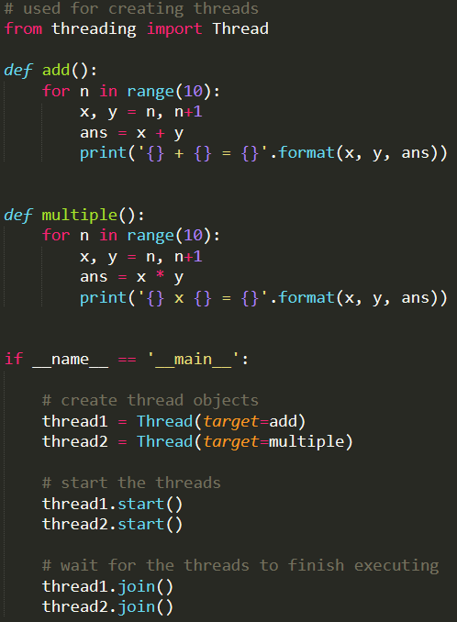
Simple Thread example

Slide 6
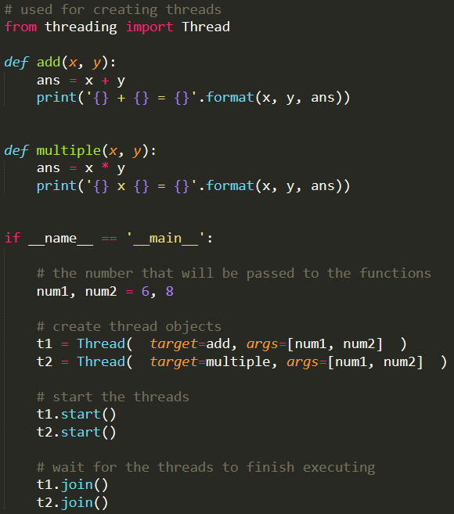
Passing arguments to a Thread

Slide 7
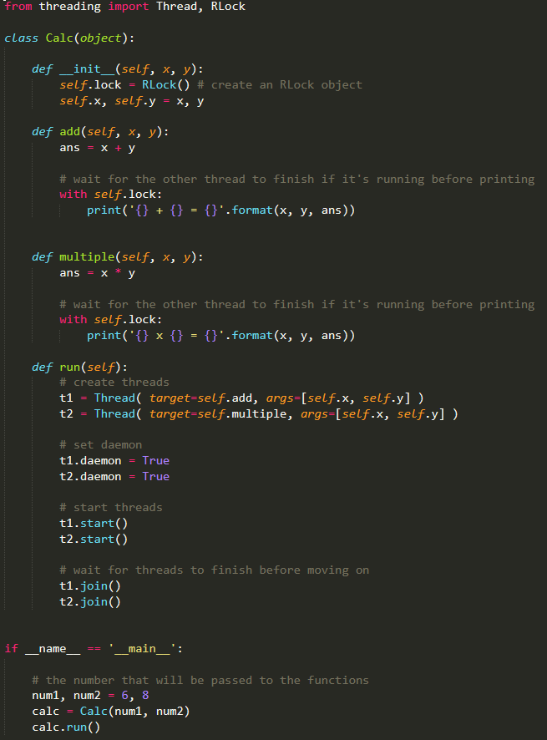
Thread with RLock & daemon

