Slide 1

Using Embedded QA to Build Rock-Solid Software Blake Niemyjski

Slide 2

Agenda
Why use Embedded QA?
Track bugs, fixes real problems.
Exception Driven Development
Process, ROI, Implications
Basic Levels of Embedded QA
From loggers to Error Reporting Services
Error Reporting Services & Tools
Analysis of common tools.
Questions & Answers
Example: Is that a picture of Burger Time?

Slide 3

“If you're waiting around for users to tell you about problems with your website or application, you're only seeing a tiny fraction of all the problems that are actually occurring.
The proverbial tip of the iceberg.”
~ Jeff Atwood

Slide 4
Why use
Embedded QA?

Slide 5

Questions
…that you never want to ask.
Ask Yourself:
Without an automated means to collect errors from deployed applications, how do you know that your application is performing as expected?
Ask Your Users:
What version are you running?
When did you first notice this?
Can you tell me how to repro?

Slide 6

Best Practices
Here they come to save the daaaay!
Embedded QA
Track every error with details to characterize, prioritize, and fix it fast.
Exception Driven Development
Allocate resources toward fixing problems real users are having with your software based on cold hard data.

Slide 7
Exception Driven
Development

Slide 8
EDD
(Exception Driven Development)
Ship your software.
Get as many users using it as possible.
Collect the error logs they generate.
Fix the top THREE errors.
Use the error logs to find your problematic code.
Prioritize your errors based on number of occurrences.
Deploy again.
Repeat the process and iterate rapidly.
From the users’ perspective, you’ll have a rock solid application in a handful of iterations.

Slide 9

Proof of ROI
(Windows Error Reporting Service Statistics)
“Broad-based trend analysis of error reporting data shows that 80% of customer issues can be solved by fixing 20% of the top-reported bugs. Even addressing 1% of the top bugs would address 50% of the customer issues. The same analysis results are generally true on a company-by-company basis too.”

Slide 10
Implications
(This is the last “theory” slide, I swear!)
Is it ok to ship buggy software?
No, but it is going to happen.
The question isn’t how many bugs you will ship with, but how fast can you fix those bugs?
What about TDD?
TDD is still awesome and completely encouraged.
EDD is about fixing bugs that are problems in practice, rather than in theory.
Exception logs are user feedback.
User opinions about problems are subjective, error logs are purely objective.

Slide 11

The Theory Is Over!
…and there was much rejoicing!

Slide 12
Basic Levels Of
Embedded QA

Slide 13
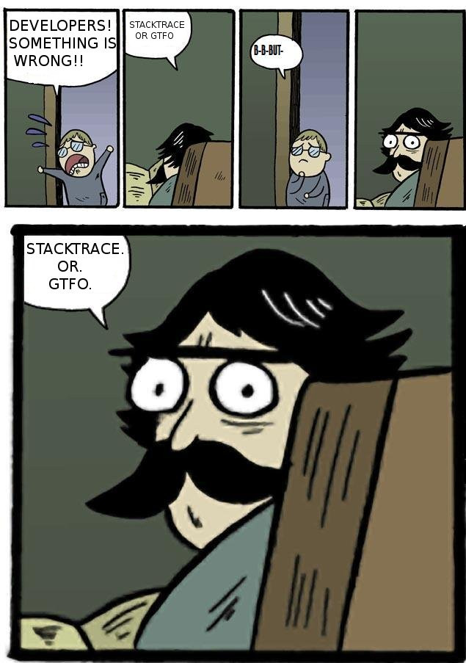

Slide 14
1. Primitive Logger
Pros
You get some logging.
Cons
Only get a string worth of data.
Not good for distributed applications.
Tends to turn into a bottom less pit.

Slide 15
2. Error Reporting Service
Pros
Reports remotely.
Get details with error logs.
Can organize and prioritize issues.
Discover the issues that affect end users.
Contextual error information.
Know if your software is getting better or worse.
Cons
Still tends to turn into a bottom less pit.
Notes:
Business Values (needs to be narrowed down, refined and additional copy)
Track and report errors in real-time allowing you to correct issues before they cause unhappy users and lost revenue.
Organizes errors into simple actionable data allowing you to spend your time effectively fixing the top issues and creating the best experience.
Get instant notifications of critical errors allowing you to contact users and restore faith.
Visibility into how your software is treating your users.
Know the true cost of bugs in your software.
Do you know if you are losing customers? Know when and how your software fails and have the necessary information to fix it.
Visibility into error trending and knowing if your software is getting better or worse.
Ability to contact users that have experienced issues and restore faith.

Slide 16
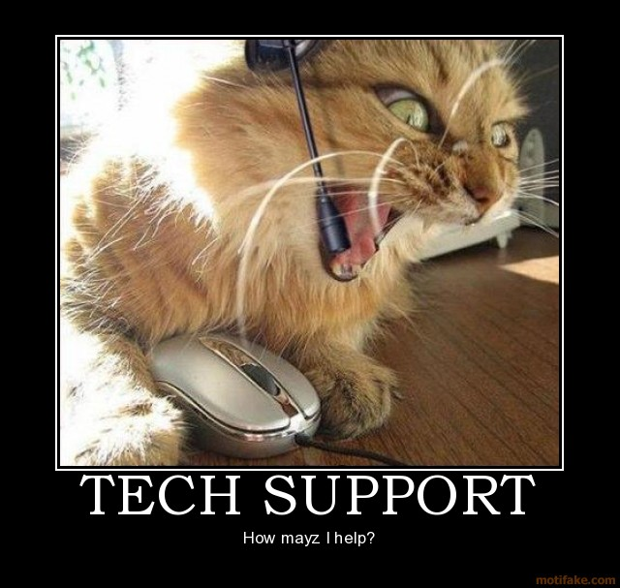
Insert Humor Here
(To prevent my Slide-to-Joke ration from falling.)

Slide 17
Error Reporting
Services & Tools

Slide 18
Roll Your Own!
File, New, Project…Invented Here
Pros
It’s invented here!
Will (hopefully) meet your personal needs!
Cons
Takes time to create and maintain.
Could have been time spend on improving your actual application instead of writing yet another logger that you have probably already done like a google-plex of times before and still never created a generic enough solution to meet both you and your company’s ever changing needs.

Slide 19
Enterprise Library
“Application Blocks of goodness.”
Pros
It’s free.
Has logging and exception handling.
Is open source.
Highly customizable.
Cons
With regard to error reporting, it’s just a logger.
“Crazy complex” to configure.

Slide 20

ELMAH
Error Logging Modules and Handlers
Pros
It’s free.
Includes detailed exception report.
Has notification system via email and twitter.
Web UI for remote log viewing.
Cons
Only compatible with ASP.NET
Is essentially just a logger.
“My name is Scott Hanselman, and I approve this message.” *
* Scott Hanselman did not actually approve this message. **
** But he totally would have if he were here. ***
*** Seriously, he would.

Slide 21
Exceptionless
Error Reporting Service
Pros
Compatible with WinForms, WPF, Webforms, ASP.NET MVC, .NET 3.5, 4.0 and 4.5
Includes stack traces, loaded modules, request information, trace information, extended data.
Intelligently stacks duplicate exceptions, includes filters.
Track and report errors in real time.
Rich email notifications.
Cons
Not a dedicated issue tracker (E.G., Jira).

Slide 22
Demo Time
...and there was much rejoicing!

Slide 23
Questions & Answers
Blake Niemyjski
@blaken
github.com/exceptionless/Exceptionless

