Slide 1
Kernel Based Security Solution Morgan Stanley
Kelvin Chan
Windows Client And Kernel Security Engineer
Tencent

Slide 2
WHO AM I?
Kelvin
Windows Kernel Based Solution Researcher
For Protecting Tencent Games in different layer.
…..

Slide 3
Overview
Ideal Security Solution Architecture
What is kernel Based Solution?
Why kernel Based is necessary?
Who can be protected ?
What data / behavior can be obtained ?
Black Case – Keylogging
Black Case – APT Attack
Black Case – Game Cheat
White Case – 360 Anti-Virus
White Case – NProtect GameGuard
White Case – Tencent QQ
Difficulties for development
Further Research – Virtualization Technology
Notes:
1111

Slide 4
Ideal Solution Architecture
Suitable for enterprise internal
Suitable for product protection
Attacker hard to know who is trapped
Who is attacker?
Which part is being attacked?
Good for security data analysis
Question:
How to ensure monitoring and confrontation is good enough?
Defensing
Monitoring
Security Solution

Slide 5
What is kernel Based Solution?
Kernel Based Solution always included different component
Usual including :
A Dynamic Link Library (DLL) for interact with protected target
Different Function Driver which is running in kernel space
Solution
User Mode API
Driver1
Driver2
Driver3

Slide 6
Why kernel is a good start point ?
System API
Kernel
CPU
Moving a confrontation to the lower level
A critical API is finally executed by kernel
Such as , OpenProcess, CreateFile, ReadFile, etc.
Kernel behavior is transparent to API
Good for hiding itself from the attacker , prevent attacker hack the solution
Ensuring the correctness of data , prevent faked data by attacker

Slide 7
Why kernel based solution is necessary?
System API
Kernel
CPU
Malware is moving to kernel (Rootkit)
Kernel may also be infected , solution may easily be faked
Most widely attack coverage
Protection is not limited to specific attack
Protection is not limited to specific process
Providing Good Prevention
– such as, file locking, kernel attacker can totally unlock it very easily
Provide most accurate behavior and data
Independent to the system, ensure the target execute environment is acceptable.
Best User Experience for client , nothing need statically blocked, more flexible

Slide 8
Who can be protected ?
Online Game
– protecting the client , prevent illegal attack to the game
Bank
– protecting the account key-logging
Enterprise Internal security / staff behavior audit
– Whole Operating System itself can be strongly monitored

Slide 9
What data / behavior can be obtained ?
All data is first hand, before dispatch to application:
File Access , which files is going to be R/W , who is the accessor
Network Access , packet filtering before the packet dispatch / send out of computer
CPU execution , which function is going to be executed
Memory Access , who is trying to access the memory, modify the memory.
USB / Any PlugPlay Device Access, including the data transfer.
Graphic Access – who is trying to make a screen capture ?

Slide 10
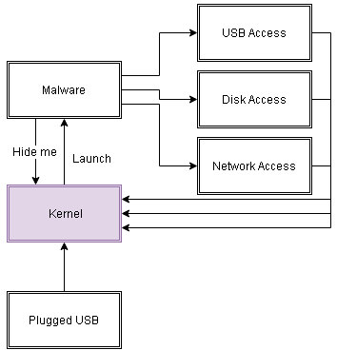
Black Case - APT Attack
Background:
A Bank has attacked by internal staff (Real Case)
No record
Abuse to whitelist process (notepad.exe)
Hidden itself from user mode(but kernel mode)
It always on, and transferring a file.
It is late when it discover
Problem:
- The bank is hard to make a auditing for the lost during the attacking period
- The bank has no idea how the malware come
- The bank security system has no any response since it just a user-mode protection solution
- The System record of USB Plug-Play is deleted by attacker

Slide 11
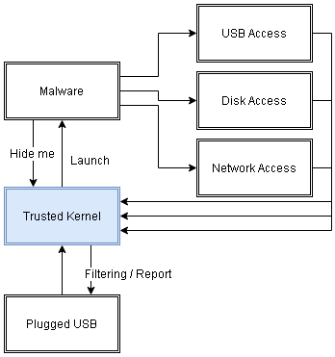
Black Case - APT Attack
Kernel Solution:
- Enumerating the process which is running in a computer entirely everyday and report it , for reducing the lost
- Monitoring and Report Every USB Plugged event to server, instantly
- Monitoring from kernel when the malware process is created, and stop it instantly

Slide 12
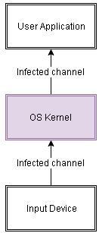
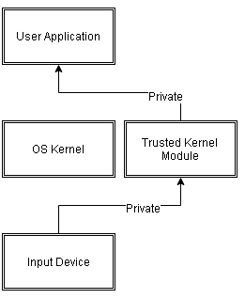
Black Case - Keylogging
Background :
Key-logging for e-banking process
A banking e-banking keylogging Trojan deployed in the client computer
The banking is protected by the User Mode Security Solution, it is only able to detect the User Mode Key-log
It intercept the user input from kernel
Result :
Lost a lot of client (~100k) e-banking password
Need to stop the system instantly , when it already boom.
Problem:
Totally lack of protection for the client
It shouldn’t believe for the input path from OS , assume all OS is infected
Kernel Mode Solution:
Provide a private input channel from hardware (keyboard / mouse) directly to e-banking application

Slide 13
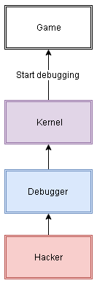
Black Case - Game Cheat (巨商)
Background :
Good example for explaining the importance of kernel mode safety protection
Over 1milion player game surround the world (Real Case)
Many type of cheat was created at 2015
These Cheat is totally damage a fair of the game.
It operates about 10years with strong user base. The cheat is come, it closed.
Many hacker try to analysis the game (debugging), do a input emulation , account stolen so on.
Problem:
Game Cheat is totally damaging a fair of the game.
Lack of Anti-Game Cheat from kernel, it has very weak protection
Easily to debugging (disassembly analysis) it

Slide 14
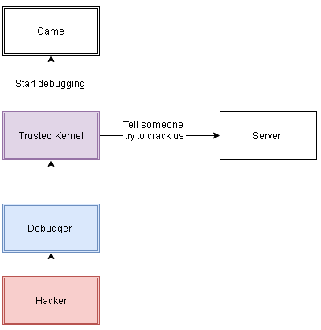
Black Case - Game Cheat (巨商)
Solution:
Anti-debugging from kernel
Speedy check
Anti-Input emulation
Provide a private input channel from hardware to the game
Client-Safety monitoring

Slide 15
White Case – 360 Anti-Virus
Loading Driver Detection
Critical File Deleteion

Slide 16
White Case – NProtect GameGuard

Slide 17
White Case – Tencent QQ

Slide 18
Difficulties for development

Slide 19
Further Research – Virtualization Technology

