Slide 1
EXPLOIT DEMO

Slide 2

INFECTION SHELL SCRIPT
For all .js files: add a function triggered by the DOMContentLoaded state that inserts the iframe before the body’s end.
For all .html, .htm, .jsp, .php files: find an occurrence of a closing body tag, and add the iframe before it.

Slide 3
OVERVIEW
DEMO 1
Attack a Tomcat server using path traversal to compromise a Tomcat manager account. Use the obtained credentials to deliver a shell using Metasploit. Run the infection shell script.
DEMO 2
Attack a Jenkins server using user enumeration and password brute forcing to compromise a Jenkins account. Create a Jenkins job to run the infection shell script.
DEMO 3
Attack a Spring server using path traversal to compromise a Tomcat manager account. Use the obtained credentials to deliver a shell using Metasploit. Run the infection shell script.
DEMO 4
Attack a Spring server using path traversal to compromise a Tomcat manager account. Use the obtained credentials to run the custom script as root using Tomcat’s catalina.out vulnerability.

Slide 4
DEMO 1
Compromise Tomcat manager account
Tomcat 6.0.16
CVE-2008-2938
python (custom)
Deliver remote shell
Metasploit (grey-box)
Run injection script
Metasploit (custom)
Run infection script
shell (custom)

Slide 5

DEMO 1
Debian 8
Metasploit latest
exploit.py
deploy.sh
after.rc
inject.rb
Ubuntu 14
Java 5
Tomcat 6.0.16
Possible ekit

Slide 6
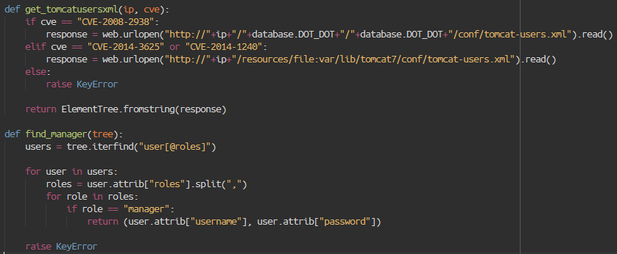
DEMO 1 - PATH TRAVERSAL

Slide 7
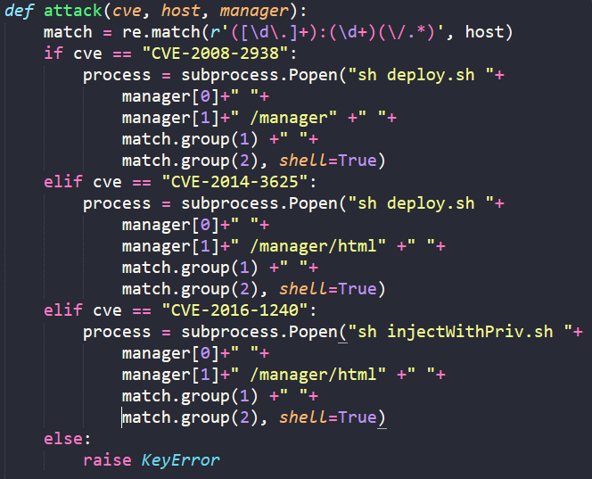
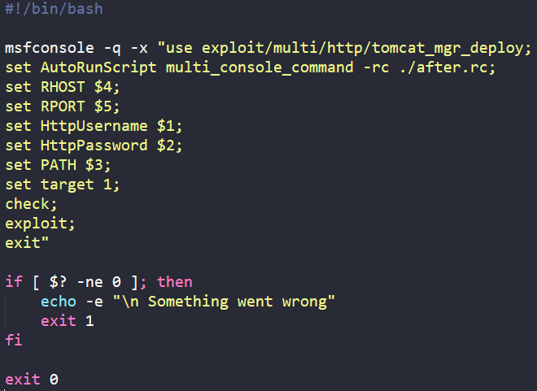
DEMO 1 – REMOTE SHELL

Slide 8
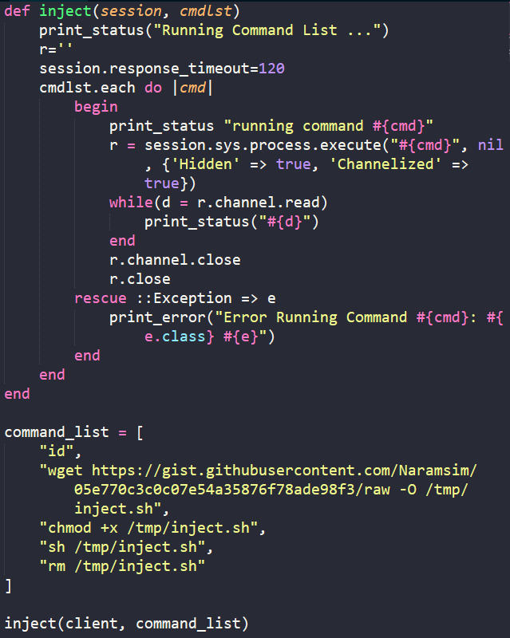
DEMO 1 – INJECTION SCRIPT

Slide 9
DEMO 1 – INFECTION SCRIPT

Slide 10
DEMO 2
Enumerate users
Jenkins 1.531
CVE-2014-2064
node.js (custom)
Brute force password
node.js (custom)
Create and run Jenkins job
node.js (custom)
Remove Jenkins job
node.js (custom)
Run infection script
shell (custom)

Slide 11
DEMO 2
Ubuntu 16
node.js latest
secure.js
Ubuntu 16
node.js latest
brute.js
Ubuntu 16
Java 7 latest
Jenkins 1.531
Possible ekit

Slide 12
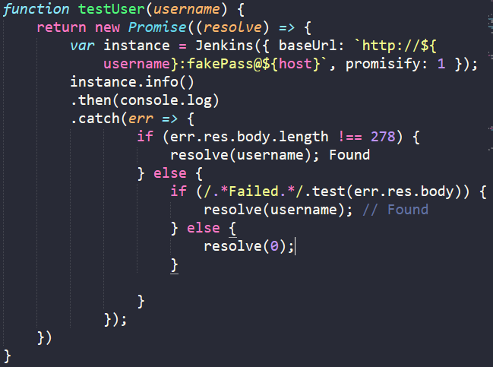
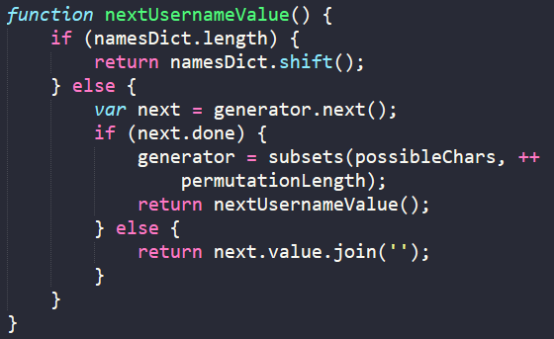
DEMO 2 – ENUMERATE USERS

Slide 13
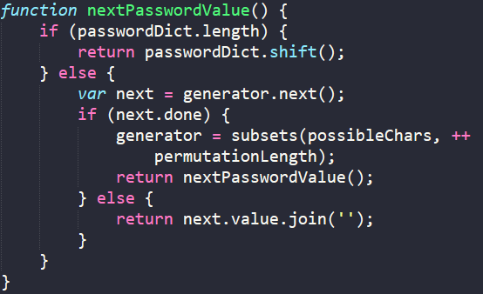
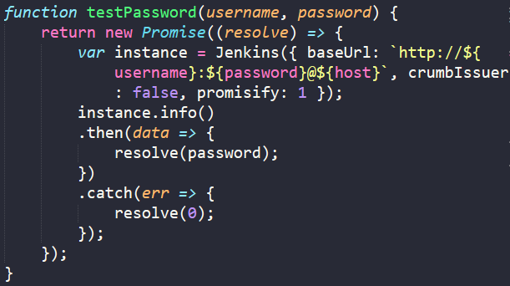
DEMO 2 – BRUTE FORCE

Slide 14
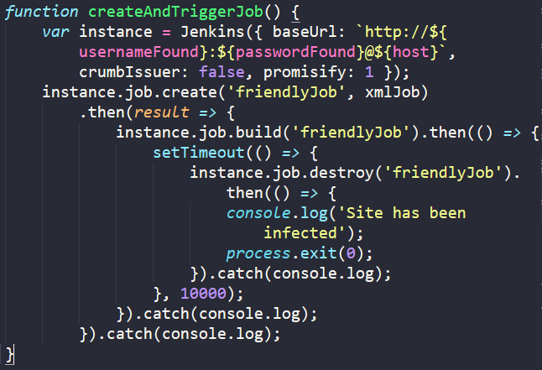
DEMO 2 – ADD JENKINS JOB

Slide 15
DEMO 2 – INFECTION SCRIPT

Slide 16
DEMO 2 – REMOVE JENKINS JOB

Slide 17
DEMO 3
Compromise Tomcat manager account
Tomcat 7.0.68 (apt-get)
Spring 4.1.1
CVE-2014-3625
python (custom)
Deliver remote shell
Metasploit (grey-box)
Run injection script
Metasploit (custom)
Run infection script
shell (custom)

Slide 18
DEMO 3
Debian 8
Metasploit latest
exploit.py
deploy.sh
after.rc
inject.rb
Ubuntu 16
Java 8 latest
Tomcat 7.0.68
Possible ekit

Slide 19
DEMO 3 - PATH TRAVERSAL

Slide 20
DEMO 3 – REMOTE SHELL

Slide 21
DEMO 3 – INJECTION SCRIPT

Slide 22
DEMO 3 – INFECTION SCRIPT

Slide 23
DEMO 4
Compromise Tomcat manager account
Tomcat 7.0.68 (apt-get)
Spring 4.1.1
CVE-2014-3625
python (custom)
Listen for reverse shell on 443
Metasploit (grey-box)
Deliver remote shell on 8080
Metasploit (custom)
Run infection script
shell (custom)
Run injection script
CVE-2014-3625
shell (custom)
Start reverse shell on 443
bash (custom)

Slide 24
DEMO 4
Debian 8
Metasploit latest
exploit.py
injectWithPriv.sh
escalate.rc
injectPrivileged.rb
Ubuntu 16
Java 8 latest
Tomcat 7.0.68
cron
watchdog.sh
Possible ekit

Slide 25
DEMO 4 - PATH TRAVERSAL

Slide 26
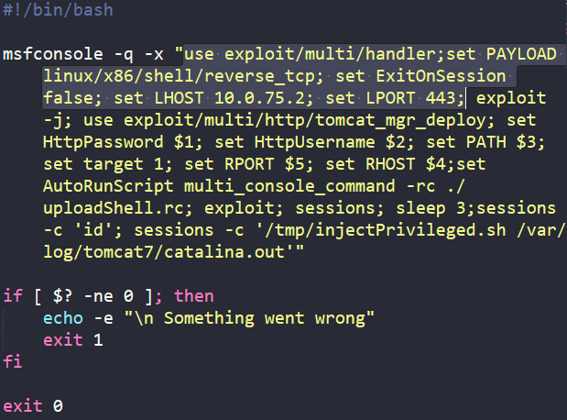
DEMO 4 - LISTEN REVERSE SHELL

Slide 27
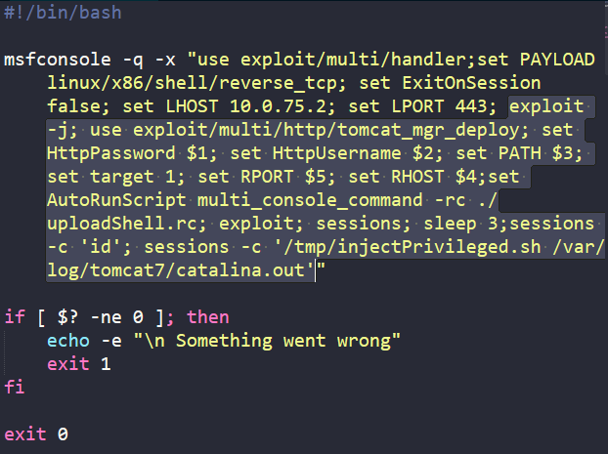
DEMO 4 – REMOTE SHELL

Slide 28

DEMO 3 – START REVERSE SHELL

Slide 29
DEMO 3 – INJECTION SCRIPT
Create a bash copy that will have its privileges elevated
Create a .so shared library that chowns the bash copy
Link catalina.out to ld.so.preload
Run infection script
Run any command to invoke the shared library
Kill Tomcat and wait for its restart

Slide 30
DEMO 4 – INFECTION SCRIPT

