Slide 1


Security Analysis of the Computer Architecture *OR* What a software researcher can teach you about *YOUR* computer
Rodrigo Rubira Branco (BSDaemon)
rodrigo *noSPAM* kernelhacking.com
https://twitter.com/bsdaemon
BSDaemon

Slide 2
Disclaimers
I don’t speak for my employer. All the opinions and information here are of my responsibility (actually no one ever saw this talk before);
The talk focus mostly in Intel Skylake Architecture (Wikipedia says it will be released 2015-2016). I’ll try to generalize as much as I can though – in that, probably many mistakes might happen, so…
Interrupt me if you have questions or important comments at any point.
IMPORTANT: No, I’m not part of the Intel Security Group (Mcafee)

Slide 3
Start answering questions
I already anticipate a few questions:
RNG -> I have no idea how strong it is, I believe it is not as strong as a specialized hardware but probably stronger than usual random generation mechanisms existent in the platform
AMT -> I’ll talk a bit about the ME, but I’ll let the AMT research by Insinuator [0] to continue ;)
[0] http://www.insinuator.net/2014/03/how-to-use-intel-amt-and-have-some-fun-with-mainboards/

Slide 4
Arch x uArch
Architecture The collection of features of a processor (or a system) as they are seen by the “user”
User: a binary executable running on that processor, or
assembly level programmer
μArchitecture The collection of features or way of implementation of a processor (or a system) that do not affect the user.
Features which change Timing/performance are considered microarchitecture.

Slide 5
Arch and uArch elements
Architecture
Registers data width (8/16/32/64)
Instruction set
Addressing modes
Addressing methods (Segmentation, Paging, etc...)
Protection
etc…
μArchitecture
Bus width
Physical memory size
Caches & Cache size
Number of execution units
Execution Pipelines, Number & type execution units
Branch prediction
TLB
etc...
Timing is considered μArchitecture (though it is user visible!)

Slide 6
Your computer
External Graphics
Card
PCI express ×16
2133-1066 MHz
DDRIII
Channel 1
Memory controller
Cache
GFX
System Agent
Mem BUS
Core
DDRIII
Channel 2
Core
Display link
4×DMI
Line out
Audio Codec
Line in
South Bridge (PCH)
D-sub, HDMI, DVI, Display port
S/PDIF out
S/PDIF in
exp
slots
BIOS
PCI express ×1
Super I/O
LPC
Lan
Adap
USB
SATA
SATA
Parallel Port
Floppy
Drive
PS/2 keybrd/ mouse
mouse
DVD
Drive
Hard
Disk
Serial Port
LAN

Slide 7
Computer Complexity
IOMMU (Intel VT-d)
What is it?
How does it work -> Is it a chip or a software?
Where is it located?

Slide 8
Easy, another one…
How many processors your machine runs? (4? 8? 2 x 4 threads?)
Well…
Your cpu’s (and threads)
Your ME (Manageability Engine)
INTERRUPT RECEIVED!!

Slide 9
Interrupt Handler
DAL [1] (Dynamic Application Loader)
Runs Java (permits 3rd part applications)
ARC Processor
Complete real-time OS
IRET
[1] http://developers.txe.iil.intel.com/discover

Slide 10
Processors…
PCU (Power Control Unit)
Pure assembly OS (similar, but not fully compatible x86 ISA)
Mainly comprises watchdogs for voltage failures (trying to recover or reset)
Harvard Architecture (separate RAM/ROM)
PMC (Power Management Controller)
Your PCH PCU
GPCU (Graphics PCU)

Slide 11
Processors…
Your gigabit card
Uops, research already done in that [2]
[2] http://www.alchemistowl.org/arrigo/Papers/Arrigo-Triulzi-PACSEC08-Project-Maux-II.pdf
VCU (Validation Control Unit)
BMC (servers)… [3]
[3] https://community.rapid7.com/community/metasploit/blog/2013/07/02/a-penetration-testers-guide-to-ipmi

Slide 12
Tricky? Lets make it easier then…
How many execution modes your processor has?
Real-mode?
Virtual-8086 mode?
Protected mode?
SMM Mode? [4]
[4] My troopers talk and Phrack article on the subject
POC || GTFO 0x03
Net Watch: System Management Mode is not just for Governments

Slide 13
Modes…
Where are the x64 folks?
32e mode?
64-bit mode?
Those are more like ISA-related modes, similar to ARM Thumb I and/or II modes
More??
VT-x anyone?
SGX (Software Guard Extensions) anyone?
More on this later

Slide 14
Modes…
So, I’m bul*********?
One is new (SGX is not even available yet) and the other is not exactly a mode…
What about cram mode then??
Anyone? Note: CRAM != CAR (Yeap, I love Intel acronyms)

Slide 15
Modes…
What about TXT? (GETSEC[SENTER]) to execute SINIT ACM -> AMD PRESIDIO?
I’ll discuss this later as well ;)
ACM (Authenticated Code Modules) run in CRAM mode
Memory Areas protected by VT-d PMR or DPR (DMA Protected Region)
Any code can be called and execute a MLE (Measured Launch Environment)
BTW: Interesting ACM to have a look at: SCLEAN (clean system memory)
Probe mode anyone?
For debugging with hardware debugger (ITP – In-Target Probe)
Supports JTAG standard/protocol
No regular instruction fetch (IP register not in use)
PIR (Probe Mode Instruction Register)
PDR (Probe Mode Data Register)
Probe-mode special instructions
PROBEMODE (to specify each core in PM or NOT)
WRSUBPIR (to send instruction to CPU)
READPDRT (read PDR)
MSRs exclusive to probe mode (not real hardware register, only ucode functions)
prob_lt_sp_cyc – Access LT private space
prob_change_pg_bit – Disable/enable paging in 64 bit mode
SMM special relation (Enter Probe mode thru Redirection)
ICECTLPMR (redirection configuration bits) – MSR available in probe mode
SMM_ENTER, SMM_EXIT, MC_ENTER, INIT, IR (interrupt)

Slide 16
Yeap, life was easy… ;)

Slide 17
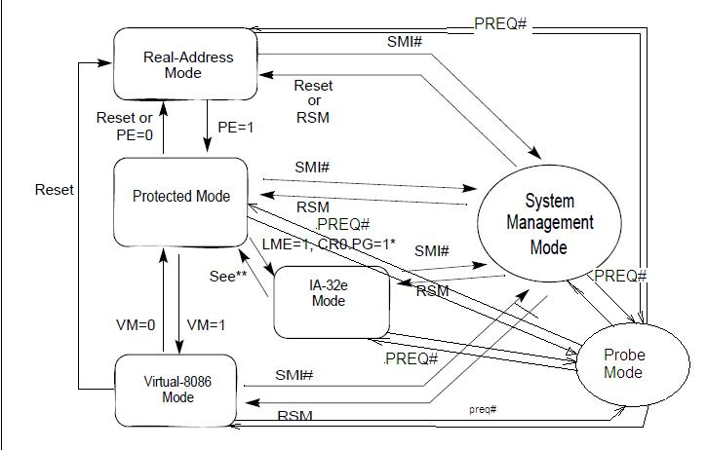
Still missing a few we discussed

Slide 18
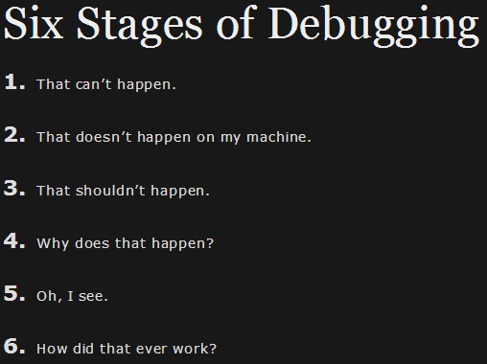
Now it is very clear

Slide 19
Software, software, software
That gets even better…:
How much of your hardware is actually software?
The ‘exported’ ISA is not exactly the same behind the wheels
What about uCode patches? (who here don’t love cpu erratas?)
Your ISA is translated to uCode, which has uInstructions that depend on the uArch (and parts of the process are bare metal)

Slide 20
So, there are any backdoors?
Fair response (which I once heard but don’t remember the author to give the proper credits):
None that I’m aware of (in my case I actually read the entire mov implementation)… but if you ask me again next Troopers (I’m sure you will not want to miss the next one after coming to this one, do you?) and I say I prefer to not comment, you might take your own conclusions ;)

Slide 21
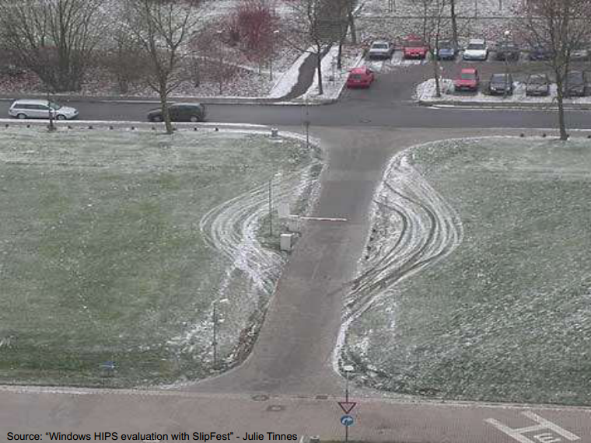
The feeling about security?

Slide 22
TCB (Trusted Computing Base)
I don’t think considering vendor backdoors in Hardware by the big players should be in any TCB since:
There are other (easier) ways to get access without involving a complex and difficult to hide and change hardware component
Logistics interception
Exploiting vulnerabilities (at this point I believe everyone agree that giving the complexity, the number of issues published is *SUPER* small – yeap, the teams at the companies are doing a good job, but still)

Slide 23
What you can do to improve?
Work on validating your systems using FREE and WIDELY available technologies:
TXT to get an image of what you have and compare with other companies that use different supply chains and are in different countries (this protects you against supply chain hijacks)
Intel has a software called MtWilson that helps you do that (it also integrates with VM-based environments to collect data on kernel components of it) -> Honestly, I don’t even know what (if any) is the cost of it, but there are an open-source version (also made by Intel) [5]
[5] https://github.com/OpenAttestation/

Slide 24
Suggestion for a Project
Maybe a nice project to have is to share integrity values around the world, like nowadays people starting to share IOCs?
Different BIOSes integrity values
Different VMMs
This helps everyone finding already compromised systems, force the manufactures to publish such information and avoids supply chains hijacks ;)

Slide 25
And what about the future?
Pointer Lookout
SDE (Software Development Emulator) [6]
Patch already available on GCC
[6] http://software.intel.com/en-us/articles/intel-software-development-emulator
SGX (Software Guard Extensions) [7] [8]
Secure Enclaves
[7] http://software.intel.com/en-us/blogs/2013/09/26/protecting-application-secrets-with-intel-sgx
[8] https://sites.google.com/site/haspworkshop2013/workshop-program

Slide 26
SGX and what it tries to solve
App
App
Malicious
App
X
X
X
OK
Bad
Code
OS
Attack
Attack
… and apps from each other …
… UNTIL a malicious attacker gains full privileges and then tampers with the OS or other apps
Apps not protected from privileged code attacks

Slide 27
SGX details
Very different architecture (compared to ARM’s TrustZone):
A Memory Encryption Engine (MEE) exists to encrypt memory data
This protects a given memory region from hardware-based access
Even with Intel privileged access, the keys are not exposed (they are erased if an unlock happens)
OS is part of the TCB and thus seem as a malicious element

Slide 28
SGX
Protected execution environment embedded in a process.
SECS
OS
Enclave Code
With its own code and data
Provide Confidentiality
Enclave Data
Provide Integrity
Enclave
Blob (dll)
Enclave
Controlled Entrypoints
App Data
TCS (*n)
Supports multi-threading
App Code
With full access to app memory

Slide 29
SGX – Attack Surface
X
Proxy
App
Proxy
App
Proxy
App
X
X
OS
VMM
Hardware
Attack Surface today
Attack Surface with SE

Slide 30


How SE Works: Protection vs. Software Attack
Application
Untrusted Part of App
Trusted Part
of App
Call Gate
App is built with trusted and untrusted parts
App runs & creates enclave which is placed in trusted memory
Trusted function is called; code running inside enclave sees data in clear; external access to data is denied
Create Enclave
Execute
CallTrusted Func.
SSN: 999-84-2611
Other SW

Slide 31
How SE Works: Protection vs. Software Attack
Application
Untrusted Part of App
Trusted Part
of App
Call Gate
App is built with trusted and untrusted parts
App runs & creates enclave which is placed in trusted memory
Trusted function is called; code running inside enclave sees data in clear; external access to data is denied
Function returns; enclave data remains in trusted memory
Create Enclave
Execute
Return
CallTrusted Func.
m8U3bcV#zP49Q
(etc.)
Other SW

Slide 32
SGX - MEE
CPU Package
Security perimeter is the CPU package boundary
Data and code unencrypted inside CPU package
Data and code outside CPU package is encrypted and integrity checked with replay protection
External memory reads and bus snoops see only encrypted data
Attempts to modify memory will be detected
Cores
System Memory
Cache
^{Jco3lks937weu0cwejpoi9987v80we}
^{AMEX: 3234-134584-26864}
Snoop
Snoop

Slide 33
Life Cycle of An Enclave
Build
Virtual Address Space
Application is launched by OS
Application calls SE driver to allocate enclave
Driver calls ECREATE to allocate SECS
Application calls SE driver to add enclave pages to EPC
Driver calls EADD to add pages to EPC
Driver calls EEXTEND to extend measurement with initial contents of pages
Application calls SE driver to initialize enclave, providing SIGSTRUCT and LICTOKEN
Driver calls EINIT with SIGSTRUCT and LICTOKEN
Application enters enclave with EENTER
Enclave returns control to the application with EEXIT
Upon application exit, driver reclaims EPC pages with EREMOVE
Code/Data
Code/Data
Code/Data
Enclave
Code/Data
Code/Data
Code/Data
Code/Data
ECREATE (Range)
ECREATE (Range)
Before Entering
Enclave
EADD (Copy Page)
EADD (Copy Page)
EEXTEND
EEXTEND
EINIT
EINIT
EENTER
EENTER
EEXIT
EEXIT
EREMOVE
EREMOVE

Slide 34
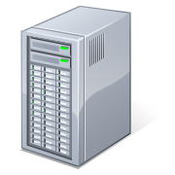

Example: Secure Transaction
Client Application
Remote Platform
Enclave
1
4
Authenticated Channel
Intel
✓
3
2
Enclave built & measured against ISV’s signed manifest
Enclave requests REPORT from HW
REPORT & ephemeral key sent to server & verified
A trusted channel is established with remote server

Slide 35
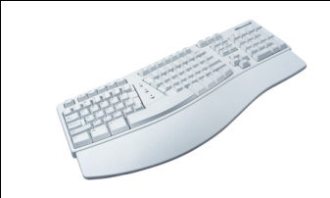

Example: Secure Transaction
6
ID
Client Application
Remote Platform
Secure Input
Enclave
1
4
Platform
SW
Enclave
5
Authenticated Channel
3
2
7
Enclave built & measured against ISV’s signed manifest
Enclave requests REPORT from HW
REPORT & ephemeral key sent to server & verified
A trusted channel is established with remote server
A trusted channel is similarly established with secure input via the PSW enclave
User info sent securely to server
Application Key provisioned to enclave

Slide 36
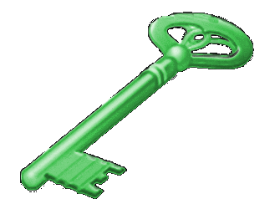
Example: Secure Transaction
6
Client Application
Remote Platform
8
Secure Input
Enclave
1
4
Platform
SW
Enclave
5
Authenticated Channel
7
3
9
2
Enclave built & measured against ISV’s signed manifest
Enclave requests REPORT from HW
REPORT & ephemeral key sent to server & verified
A trusted channel is established with remote server
A trusted channel is similarly established with secure input via the PSW enclave
User info sent securely to server
Application Key provisioned to enclave
Enclave requests the HW Enclave-platform Sealing Key
Application Key encrypted using Sealing Key & stored for successive sessions

Slide 37
SGX
EPC: Decrypted code and data space with
SE access control
Located in system memory space
Implementation as stolen main memory (protected by MEE)
Protected from SW by range registers
Protected from HW by encryption and integrity protection
EPCM: Provide meta data for each EPC page
SE1 Instructions: 12 new operations
ECREATE, EADD, EEXTEND, EINIT, EENTER, EIRET, EEXIT, EREMOVE, EDBGRD, EDBGWR, EREPORT, EGETKEY
2 Opcodes: 1 privileged; 1 unprivileged

Slide 38
SGX Ring 0 Instructions
EAX | Leaf Function | Description
0x0 | ECREATE | Sets up the initial state environment, sets up the measurement, adds SECS page to EPC, measures attributes and xsave mask
0x1 | EADD | Adds a page to the enclave. Page can be used as enclave control, application data, code, stack, or heap
0x2 | EINIT | Verifies permit and marks the enclave ready to run
0x3 | EREMOVE | Removes pages from an enclave
0x4 | EDBGRD | Reads 8 bytes from a debug enclave
0x5 | EDBGWR | Writes 8 bytes to a debug enclave
0x6 | EEXTEND | Extends the measurement of the enclave with a measurement of an additional chunk of memory

Slide 39
SGX Ring 3 Instructions
EAX | Leaf Function | Description
0x0 | EREPORT | Demonstrates cryptographically what was placed inside the enclave
0x1 | EGETKEY | Provides access to system secrets & user level keys
0x2 | EENTER | Transfers control to a predefined entry point within the enclave
0x3 | EIRET | Resume execution from its interrupt / exception point
0x4 | EEXIT | Returns from the enclave to the application

Slide 40
BIOS, ACPI, others
Yes, huge code base!
Lots of OEM capabilities
Already been exploited by three letter agencies
Chipsec: https://github.com/chipsec/chipsec
Recently announced in CanSecWest (past week?)

Slide 41
ISA Extensions?
AES-NI
AVX (SIMD)
Nice to discover huge NOPs in older systems:
66 66 0F 1F 84 00 00 00 00 00

Slide 42
Conclusions
Folks, I could just keep going but I believe I made my points clear, but just to reinforce them:
Your computer is actually a network of computers, running lots of software (Sergey Bratus and Langsec here at Troopers!)
Modern architecture provides a way for you to generate a hardware attestation (TXT) and this is your way to protect against supply chain based attacks (sorry NSA, but I’m Brazilian)
We need efforts on the community to use features that are already present and that solve many platform-related problems:
Central base for sharing known good attestations?
Software to manage and gather attestation information in networks, comparing to known good states and previously saved ones (OpenAttestation?)

Slide 43
Thank You
Rodrigo Rubira Branco (BSDaemon)
rodrigo *noSPAM* kernelhacking.com
https://twitter.com/bsdaemon
BSDaemon

