Slide 1
DATA SCIEnCE databases / SQL

Slide 2
I. Databases iI. SQL / Nosql III. SQL Examples IV. JOINS
agenda

Slide 3
I. databases
DATA SCIENCE

Slide 4
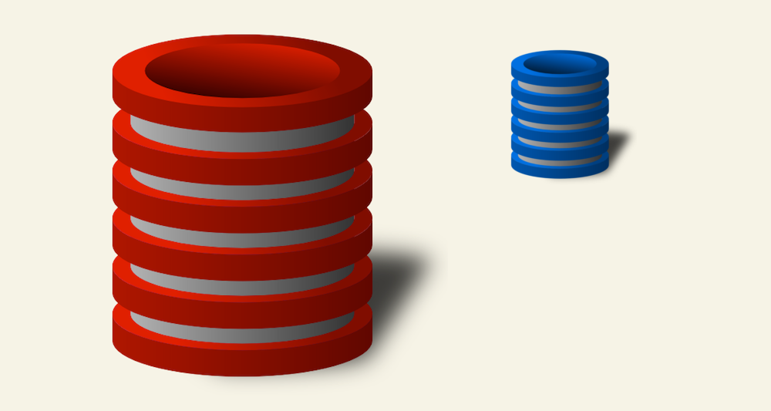
databases
An organized collection of data
Organized using a schema (like a blueprint of a database)
Organized into tables with different sets of data

Slide 5
databases
Why even USE a database?
Easy to store and more importantly, retrieve data
Generally has a structured language for interacting with the data
Reliable and scalable
Access large amounts of data relatively quickly

Slide 6

databases
How can you visualize a database?

Slide 7
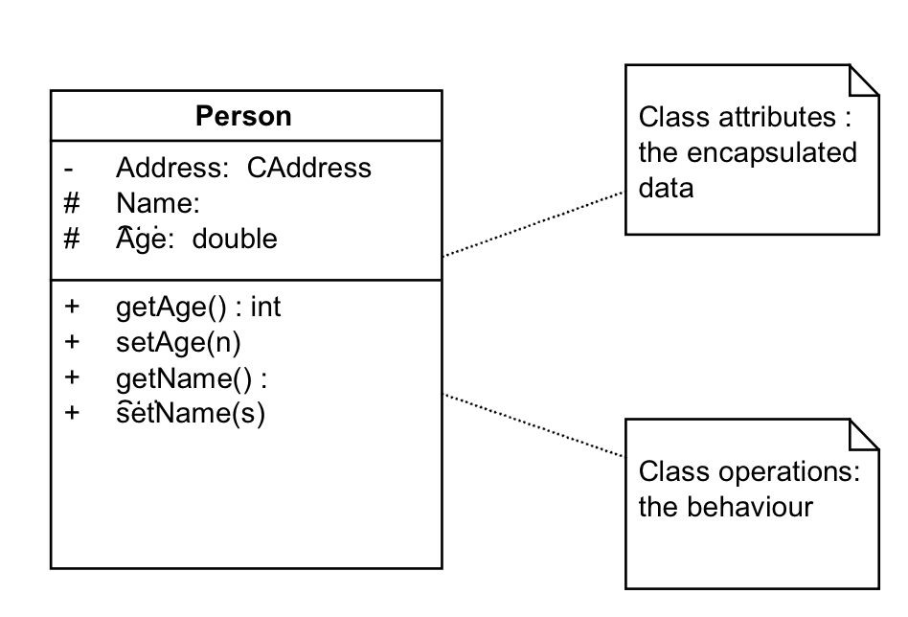
databases

Slide 8
II. SQL / Nosql
DATA SCIENCE

Slide 9
databases
Relational
NoSql
Traditional rows and columns data
Strict structure / Primary Keys
Entire column for each feature
Industry standard
No well defined data structure
Works better for unstructured data
Cheaper hardware
Popular among Startups

Slide 10
databases
Relational
NoSql
Examples
Examples
MySQL
Oracle
Postgres
SQLite
MongoDB
CouchDB
Redis
Casssandra

Slide 11
databases
S
Q
L

Slide 12
databases
Structured
Query
Language
Is a language for database communication

Slide 13
Introduction to Databases
Data Types
BOOLEAN/TINY INT – 0/1
INT – any whole number
FLOAT(<n>,<m>) – number with n digits before the decimal and m digits after the decimal
DATETIME, TIMESTAMP, and DATE – various date and time combinations
CHAR(<length>) – text with a fixed length
VARCHAR(<length>) – text with a given maximum length
And many more…

Slide 14
Star Schemas
The star schema consists of one or more fact tables referencing any number of dimension tables.
A fact table contains “event” data. You can think of this as the type of information that we are really measuring (“measurements, metrics, or facts of a business process”).
A dimension table contains meta data or information that enhances “event” data (“structured labeling information”).
Source: Wikipedia

Slide 15
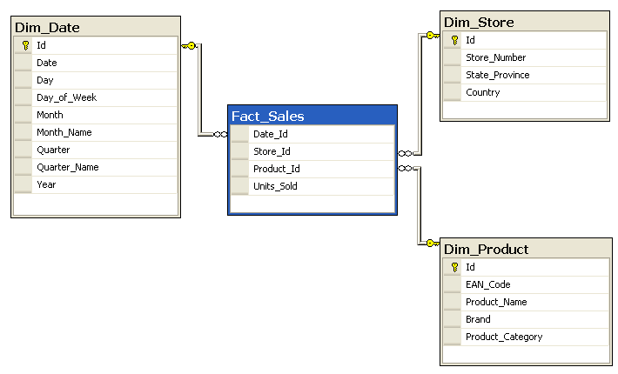
Star Schemas
Source: Wikipedia

Slide 16
IV. Joins
DATA SCIENCE

Slide 17
Joins
Joins in sql
Easy way of combining rows from separate data tables

Slide 18
Types of joins in sql
Joins in sql
INNER JOIN: Returns rows when there is at least one match in BOTH tables (may not contain nulls)
LEFT JOIN: Returns rows from the left table, and the matched rows from the right table (may contain nulls)
RIGHT JOIN: Returns rows from the right table, and the matched rows from the left table (may contain nulls)
FULL JOIN: Returns rows when there is a match in AT LEAST ONE of the tables (may contain nulls)

Slide 19
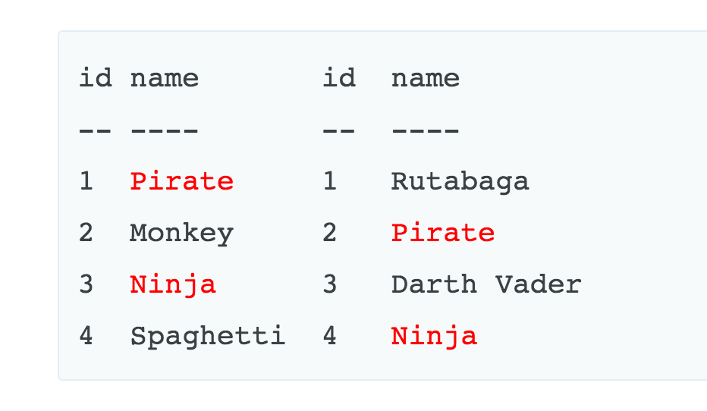
Joins in sql
Table A
Table B
Source: http://blog.codinghorror.com/a-visual-explanation-of-sql-joins/

Slide 20
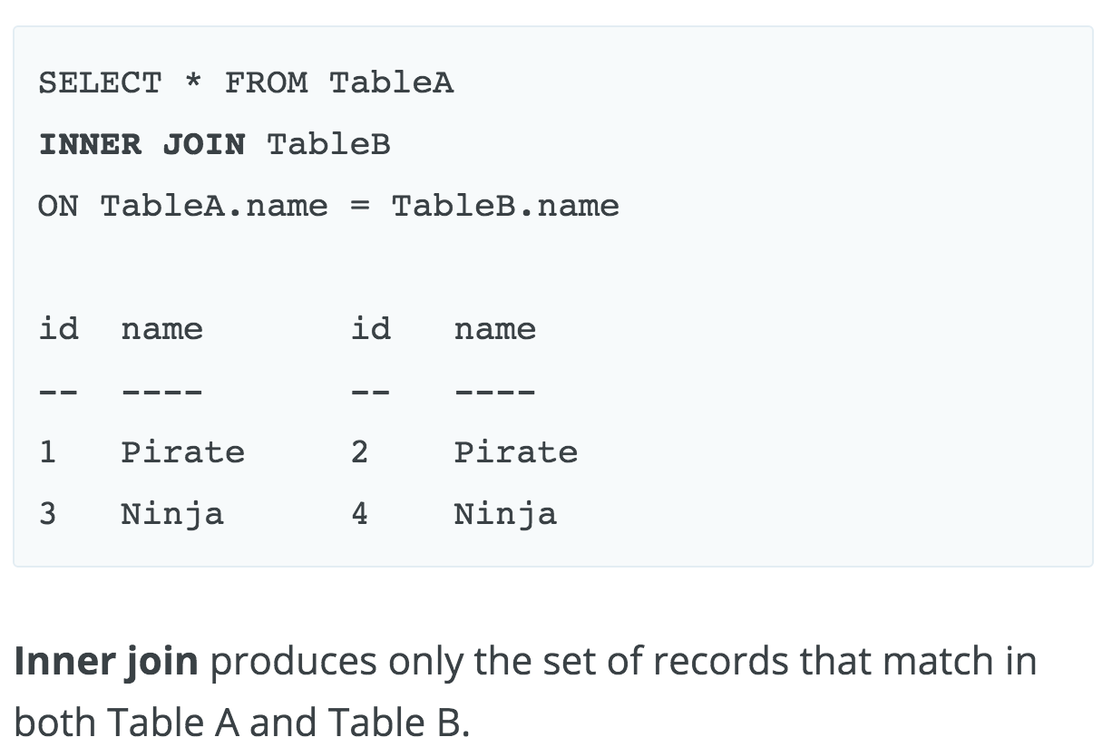
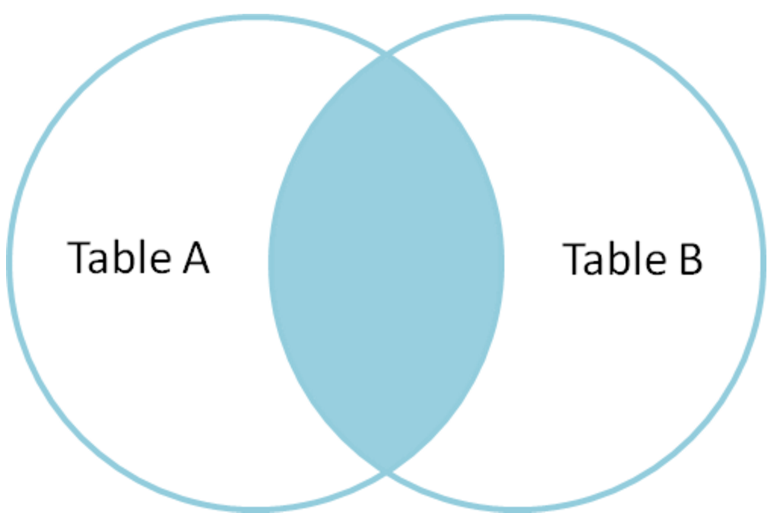
INNer join
Table A
Table B

Slide 21
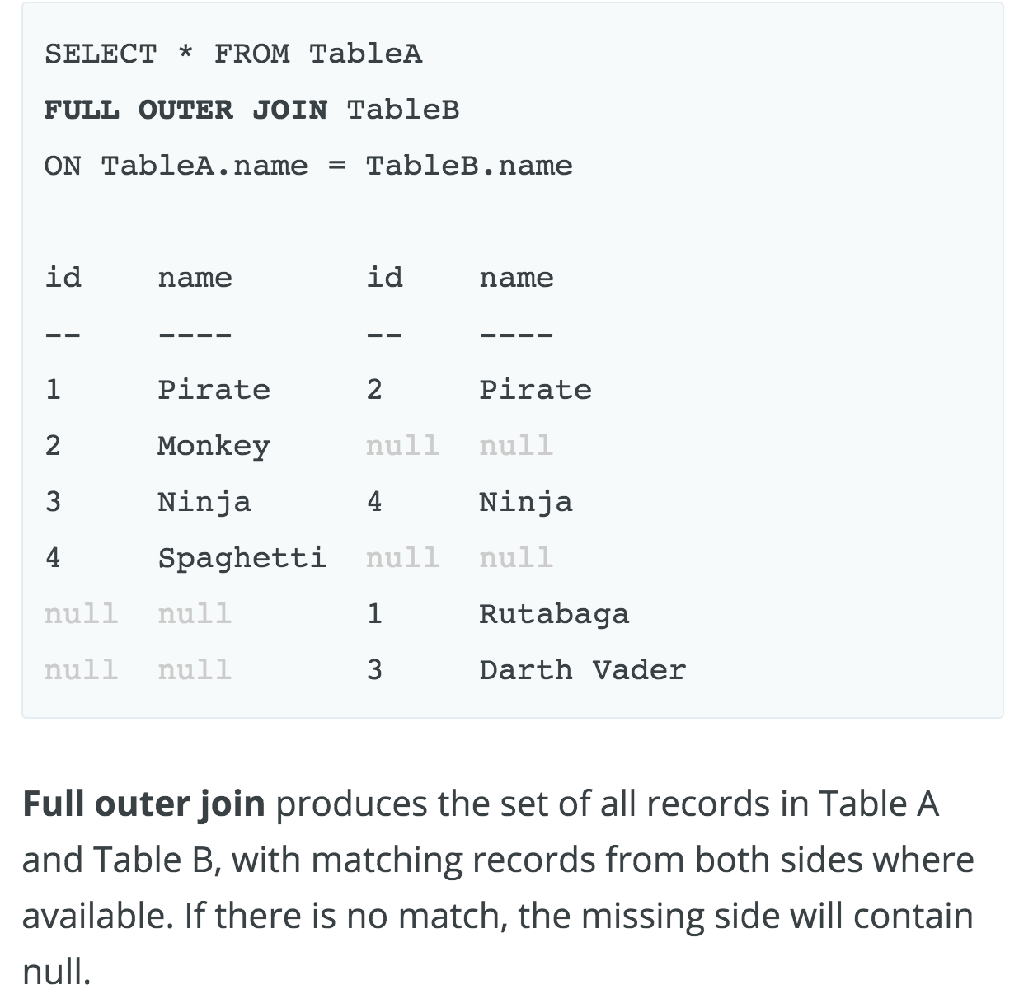
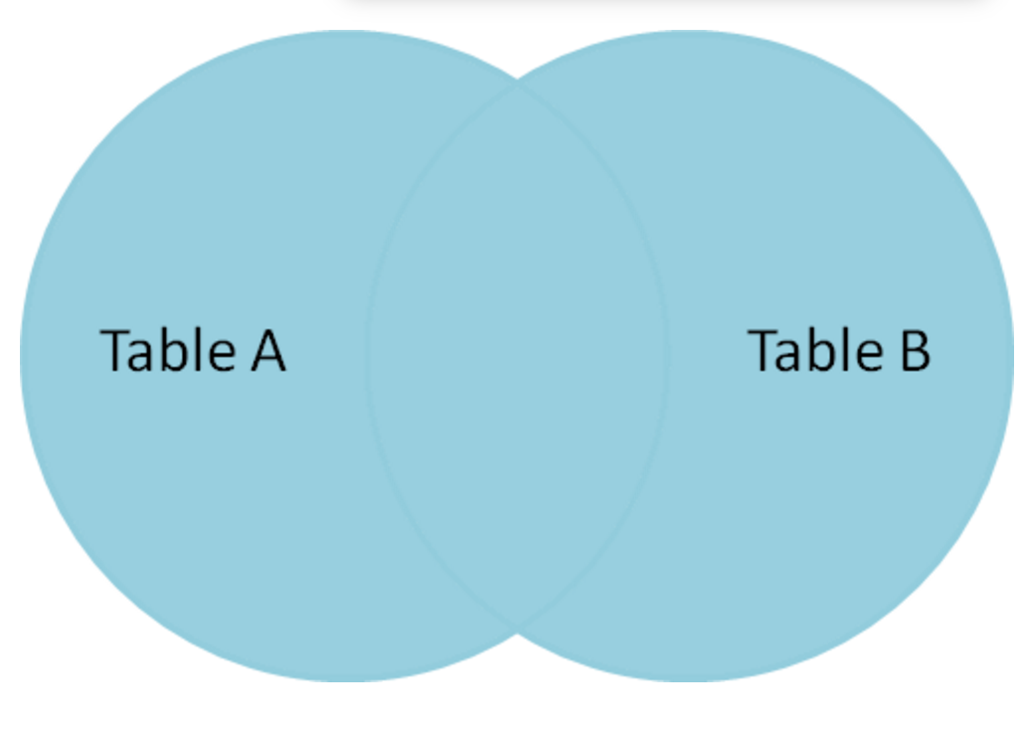
Outer join
Table A
Table B

Slide 22
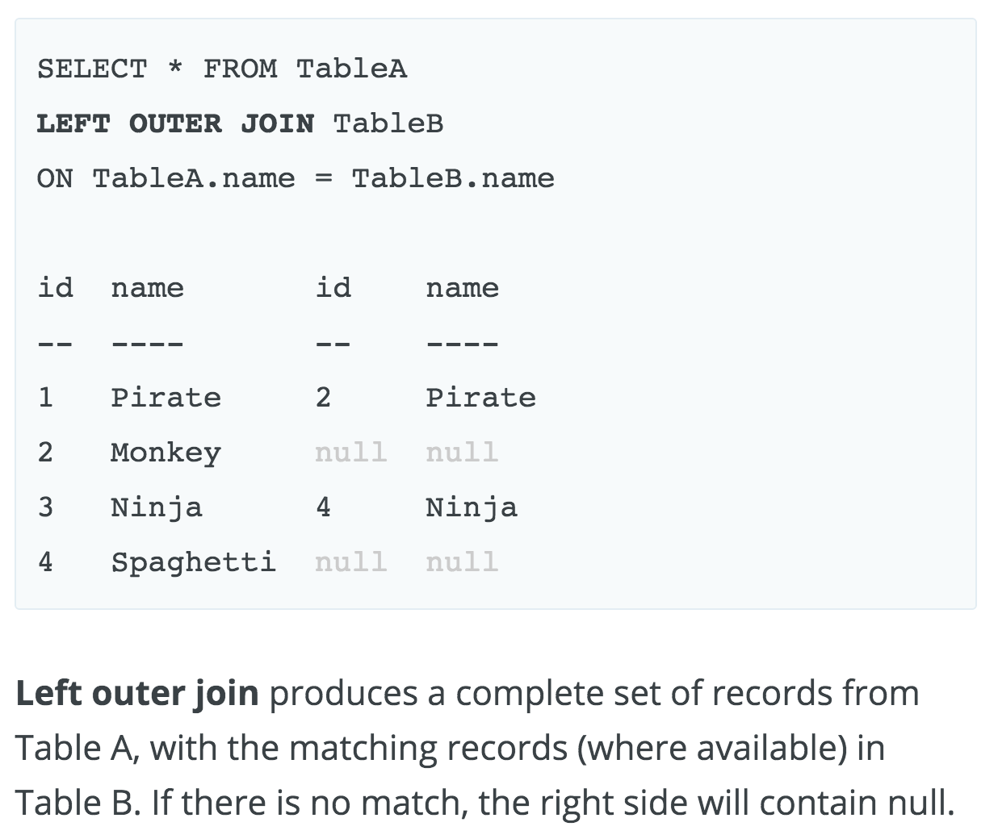
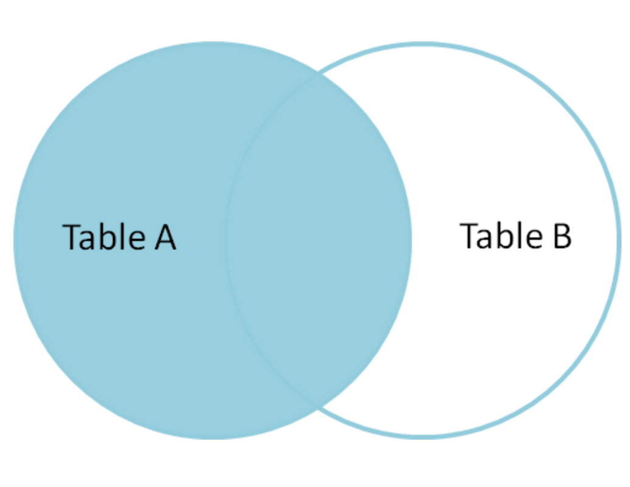
Left join
Table A
Table B

Slide 23
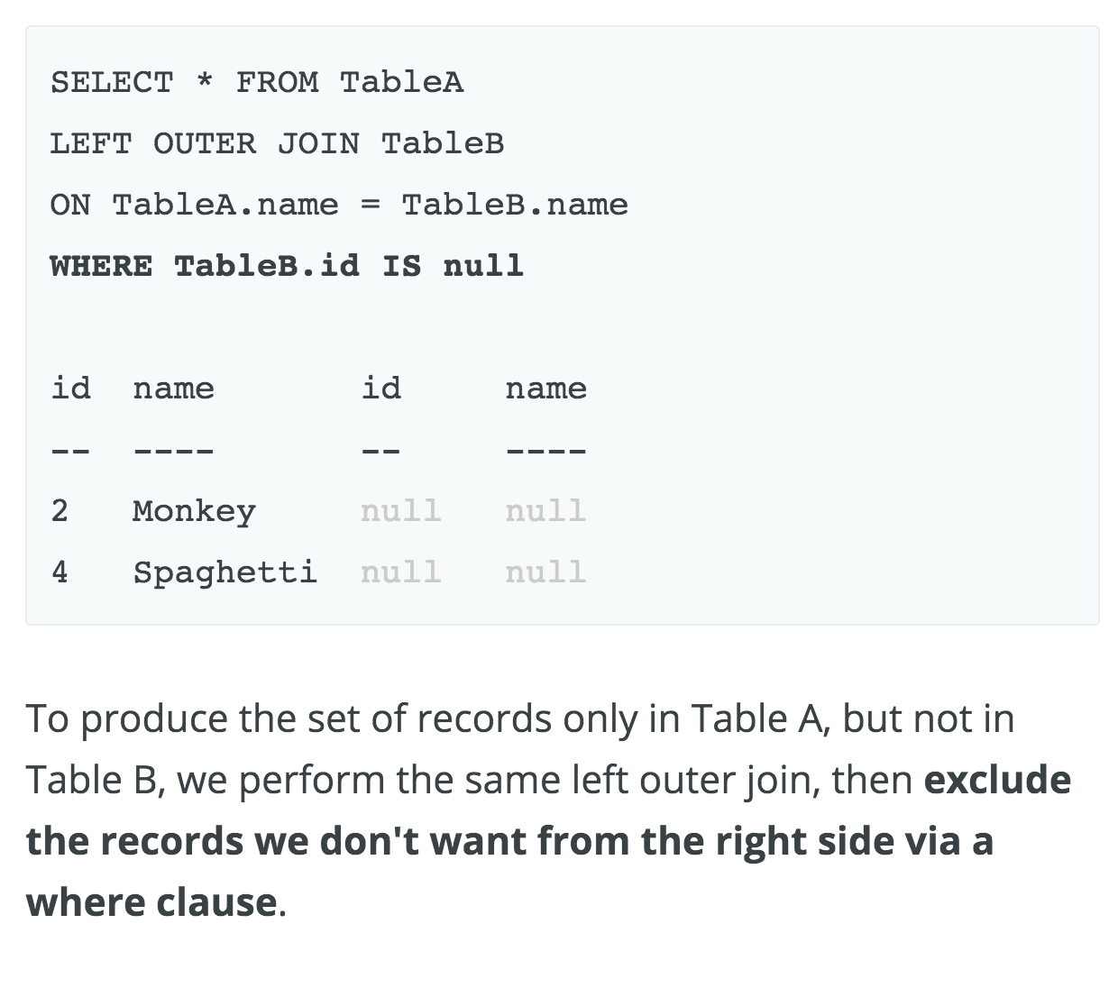
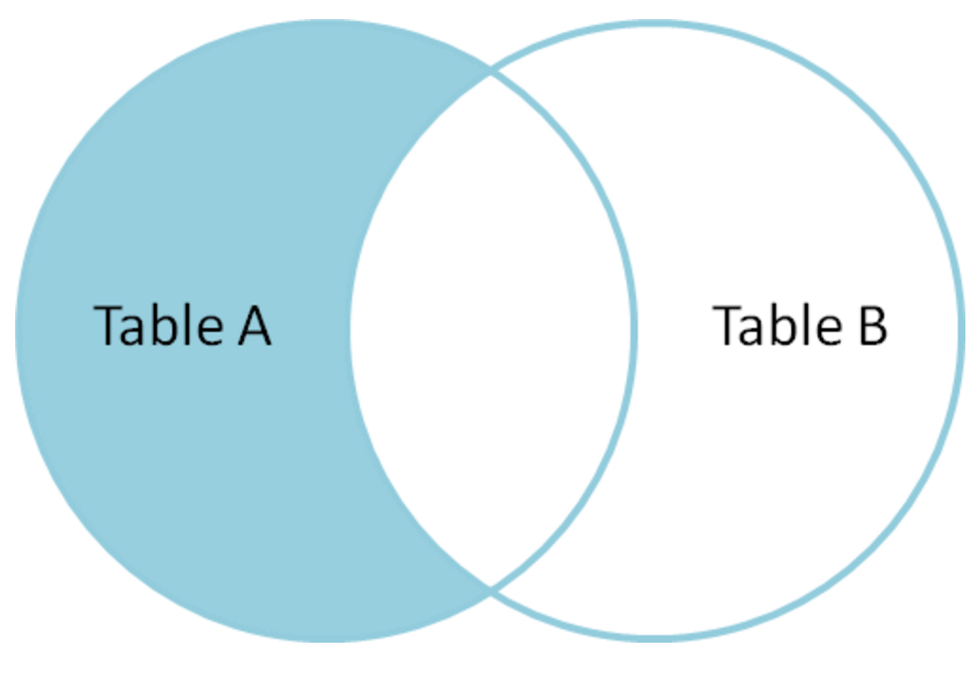
Left join continued
Table A
Table B

