Slide 1
Capture the Flag Results
OWASP BASC 2012
October 13, 2012
Ming Chow
mchow@cs.tufts.edu

Slide 2
Why Have a CTF Game?
Learning opportunity
Apply skills
Have fun
FYI, OWASP BASC 2012 registration statistics: of the people who answered the question about level of experience (only 180 out of the 263 registered)
24%: new to web application security
43%: somewhat familiar with web app sec
37%: very familiar

Slide 3
How the Game Was Designed
Many thanks to Eric Schulman for donating server(s) for game!
Custom, deliberate insecure web application
Allow liberties to players
Have a number of different flags and opportunities
Test a number of obvious techniques including XSS and SQL injection
Have a opportunity to use Metasploit
Content of game will be open sourced at https://github.com/mchow01/Security

Slide 4
Observations and Results
12,806 hits to www; 3,137 SQL injection attempts
Lots of players were using or depending on an automated tool, particularly AppScan…
…alas, creating a lot of noise
Who placed the redirect to micrmsoft.com?
It was brought to my attention that players were fooled to play some other CTF game at 107.20.44.91

Slide 5
The Flags, Opportunities
Cross Site Scripting (XSS)
Just type in the name of the file (i.e., /var/www/) [FLAG 1]
SQL injection [FLAG 2]
Take advantage of PHP eval() [FLAG 3]
You can use Metasploit for this one, image on next slide
Read the source of index.php [FLAG 4]
Dump of board.users table in MySQL [FLAG 5]
Look in test.notes table in MySQL [FLAG 6]
Local storage [FLAG 7]
Steganograpy [FLAG 8]
Look in / [FLAG 9]
Buffer overflow (must SSH into server as the user “lrrr”) [FLAG 10]
Look in /etc/php5/apache2/php.ini [FLAG 11]

Slide 6
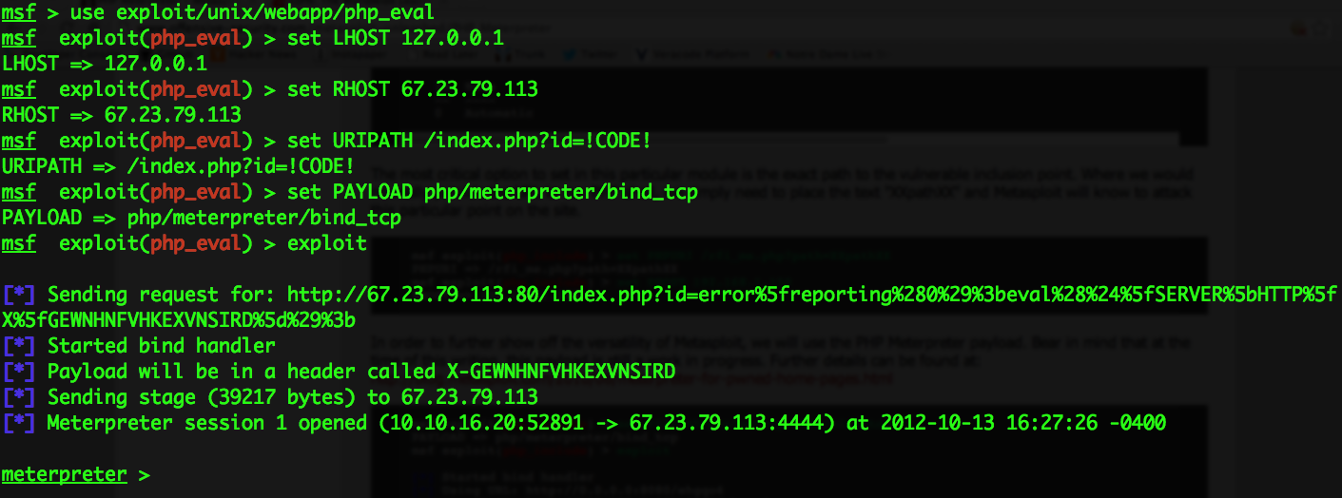

Slide 7
Resources
http://www.metasploit.com/modules/exploit/unix/webapp/php_eval
http://www.offensive-security.com/metasploit-unleashed/PHP_Meterpreter

