Slide 1



Demystifying SharePoint Security
Michael “codingO“ SKELTON
PowerShell within this talk has been posted to: github.com/codingo/SharePoint-Security along with resources used throughout the research process.
Disclaimer: There are multiple ways to make these scripts faster however they have been designed for readability and simplicity assuming users aren’t all SharePoint Administrators. These scripts also haven’t been tested on a production environment – please review them before applying to your own systems. Pull requests are more than welcome.
github.com/codingo
twitter.com/codingo_

Slide 2
Why Sharepoint?
Difficult to get right, harder to maintain
Rarely used as intended – HR Processes, travel portals, service account password storage, etc’
Often misunderstood – regularly used in place of a CRM or more complete development process.
Hard to know who has what access, cumbersome to manage existing permissions.

Slide 3
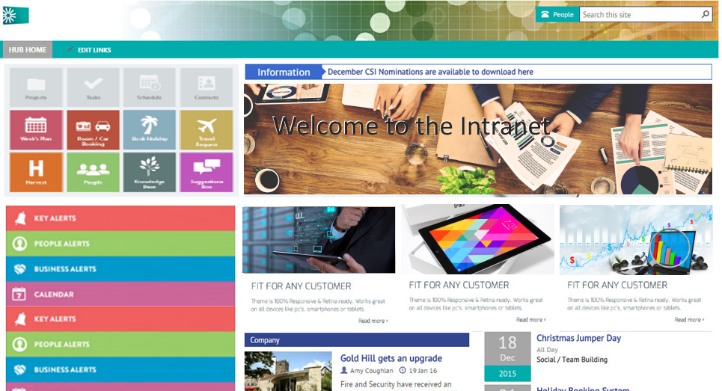
INTRANET Landing pages
Source: http://www.amtevolve.com/news/sharepoint-2016-intranet/

Slide 4
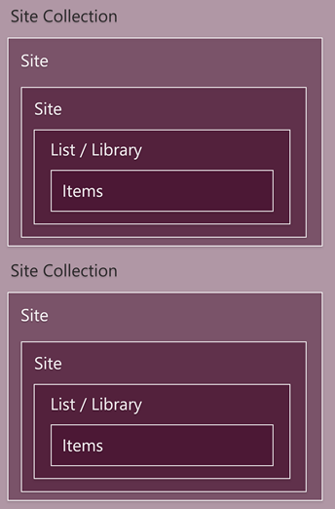
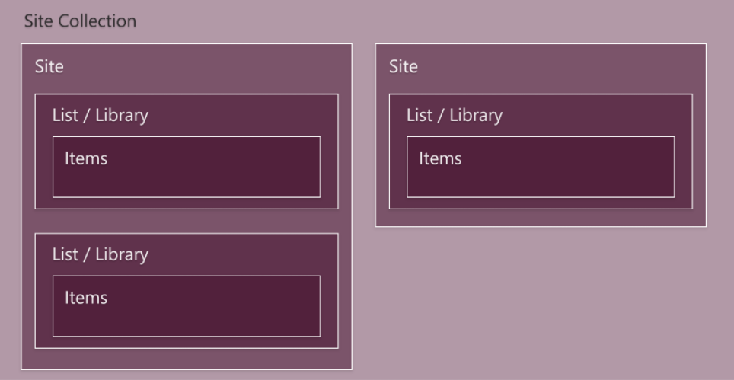
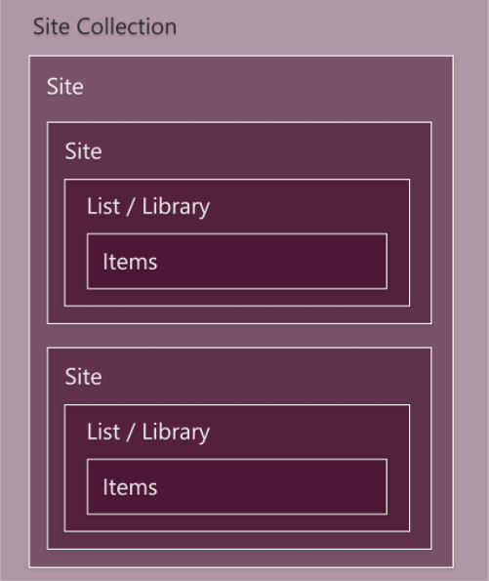
Structure of a SharePoint tenant
This could looks like this…
Or more like this…
Gathered into Site Collections
Site collections consist of sites which can take the format of Wiki’s, Blogs, Teams, Doc, Meetings and more, however most common format is a “Team Site”
Sites contain lists and libraries which hold items. These are filtered by views which can be shared, or personal.
Or this…

Slide 5
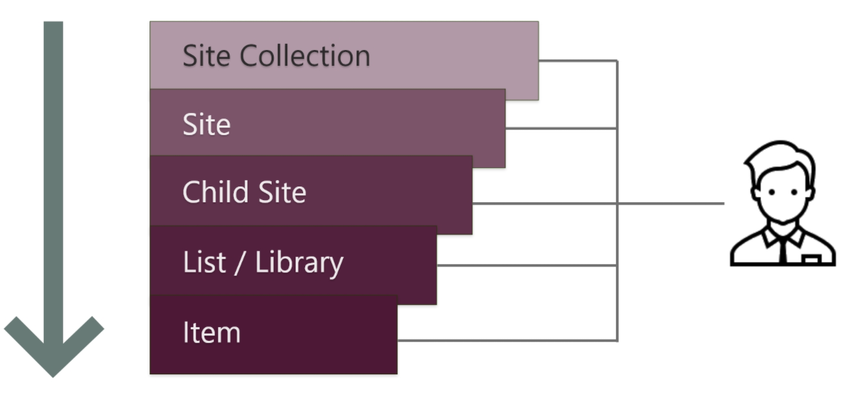
SharePoint permissions
Inherit by default
A user can be added to an item lower down the stack, without being added to the top level item. For example: you can add a user to an item, without them having site access.

Slide 6

The Process of Enumeration
Enumeration to Perform
Check the MicrosoftSharePointTeamServices header if present – a major version of 14 (such as 14.0.0.7125) indicates SharePoint 2010, whilst a major version of 15 indicates SharePoint 2013. This carries into DLL dependencies used for SharePoint App development.
Wordlist for identifying interesting URL’s, such as open web services: https://github.com/codingo/SharePoint-Security/blob/master/Interesting-Urls.txt
Identify custom deployments (front pages, dashboards)
Identify workflows and custom views
Reviewing Permissions, with a focus on unique permissions
Previous CVE’s
SharePoint 2007 has an RCE, Metasploit has a module for this exploit/windows/misc/ms10_104_sharepoint
Some SharePoint 2013 On-Premise instances may still be vulnerable to CVE-2017-8514 (proof of concept and detailed explanation here: http://respectxss.blogspot.com.au/2017/06/a-look-at-cve-2017-8514-sharepoints.html)

Slide 7
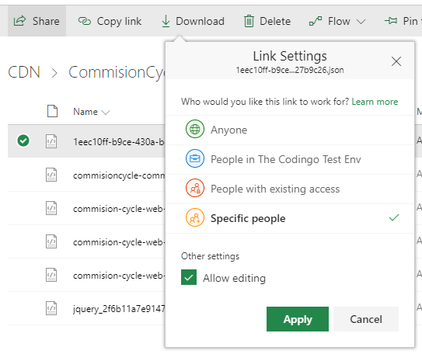
Unique Permissions
Any good permissions system is often broken by lazy (or naïve) users of SharePoint adding permissions for other users directly instead of placing them within an appropriate group. This is particularly encouraged in SharePoint Online via the “Share” feature on items and sites.
Identifying these is key to finding areas where a permission model has broken, but there’s no easy means to do so directly in SharePoint

Slide 8
Identifying unique permissions with PowerShell
PowerShell Script Process
Fetch all web applications
then loop all web applications and fetch all site collections
then loop all site collections and fetch all subsites
then all lists
then all items
if any of these have unique permissions and it is given directly as user, not a group, log to csv
SharePoint Online: https://github.com/codingo/SharePoint-Security/blob/master/Identify-SharePoint-Online-Permissions.ps1
SharePoint On-Premise: https://github.com/codingo/SharePoint-Security/blob/master/Identify-SharePoint-On-Premise-Permissions.ps1
Note: if ShareGate or ControlPoint have been purchased and are available in the tenant, these kinds of reports can be run from there.

Slide 9
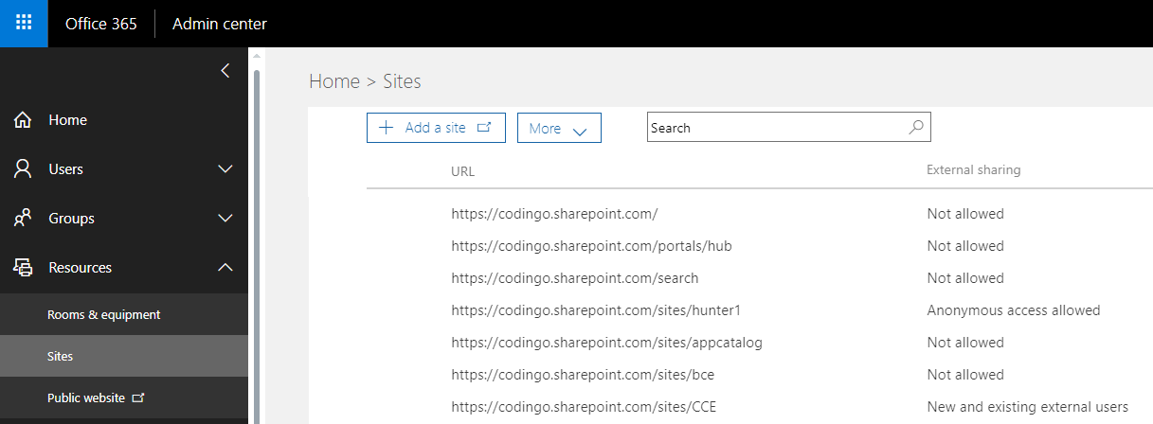
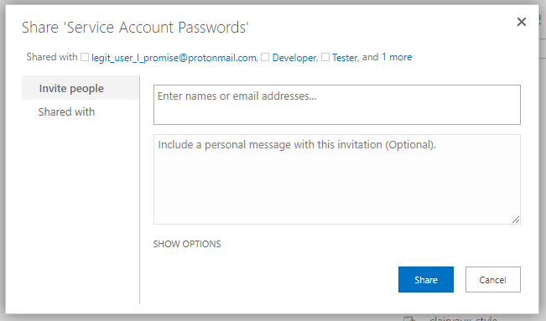
External Sharing
Disable for a site: Set-SPOSite –Identity https://codingo.sharepoint.com/sites/hunter1 -SharingCapability Disbaled
Disable for entire tenant: https://github.com/codingo/SharePoint-Security/blob/master/Disable-Sharing-For-Tenant.ps1
View external users with access to site: Get-SPOExternalUser –SiteUrl https://codingo.sharepoint.com/sites/testing
Allows users to Create links for editing files externally

Slide 10
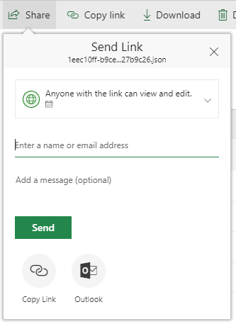
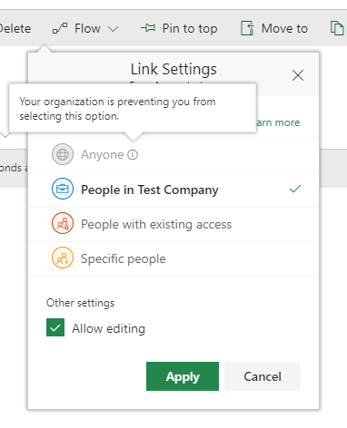
What does it look like when sharing a file?
The left shows when external sharing is open, allowing any user to create a link for editing externally.
The right shows when external sharing has been appropriately controlled.

Slide 11
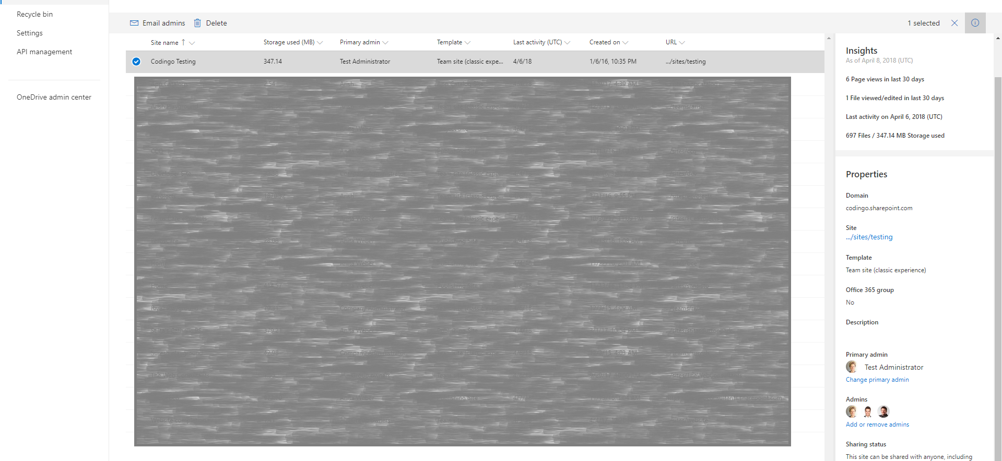
New Portal – Can you spot the sharing options?

Slide 12
Orphaned Users
Often claimed as a medium/high risk issue in a tenant on the basis that a user remains present in SharePoint once removed from Active Directory.
Users are also expected to remain present in people picker parts, as well as list and site information.

Slide 13
Orphaned users research summary
Orphaned Users Testing Process:
Create a user in Active Directory
Assign user to a site administrator role
Assign user to a SharePoint list directly (no inheritance)
Assign user to a document (creator)
Delete User from Active Directory
Check if user is still listed in SharePoint permissions for site administrator, list and document creator
Re-create user in Active Directory
Login and see if able to re-create permissions

Slide 14
Orphaned Users – Research results
SharePoint Version | Still Listed as Site Administrator Once Orphaned | Still Listed as List and Document Owner Once Orphaned | Able to Regain Permissions when Re-created
SharePoint 2007 On-Premise | Yes | Yes | No
SharePoint 2010 On-Premise | Yes | Yes | No
SharePoint 2013 On-Premise | Yes | Yes | No
SharePoint Online (2013 collections) | Yes | Yes | No
Conclusion: When we create new user with the same name as an orphaned one it does not have the same permissions assigned to a previous user with the same name.
Therefore the user does not inherit permissions and is treated as brand new separate user, with fresh permissions.
This said, users remained listed as site administrators under their previous account when re-created, leading to some confusion surrounding this issue.

Slide 15

Delete Orphaned Users
PowerShell for SharePoint 2010, 2013, SPO: https://github.com/codingo/SharePoint-Security/blob/master/Delete-Orphaned-Users.ps1
Sometimes additional actions will also be required…
Doesn’t resolve users being stated in workflows where they have been added directly, and not via a group.
Can’t be removed if still present as a site administrator.

Slide 16
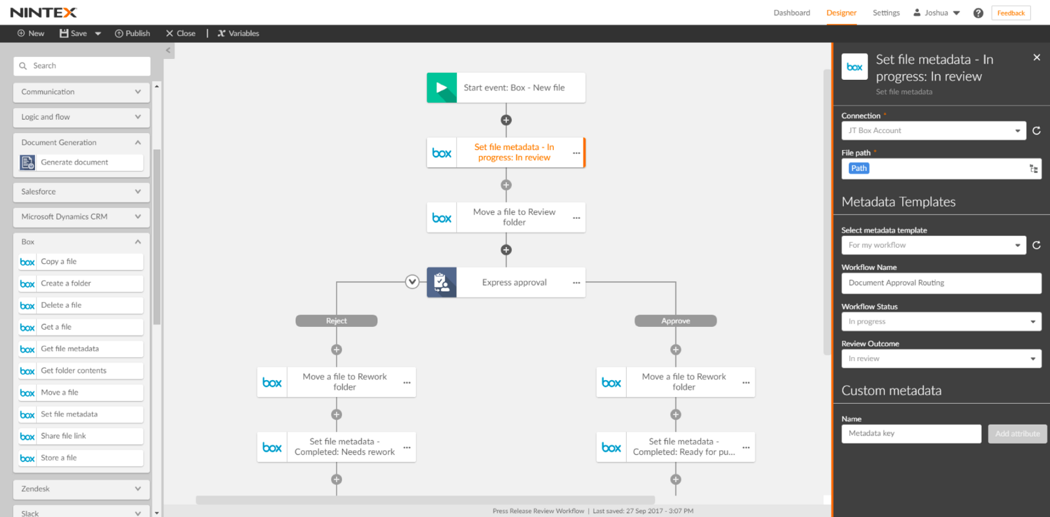
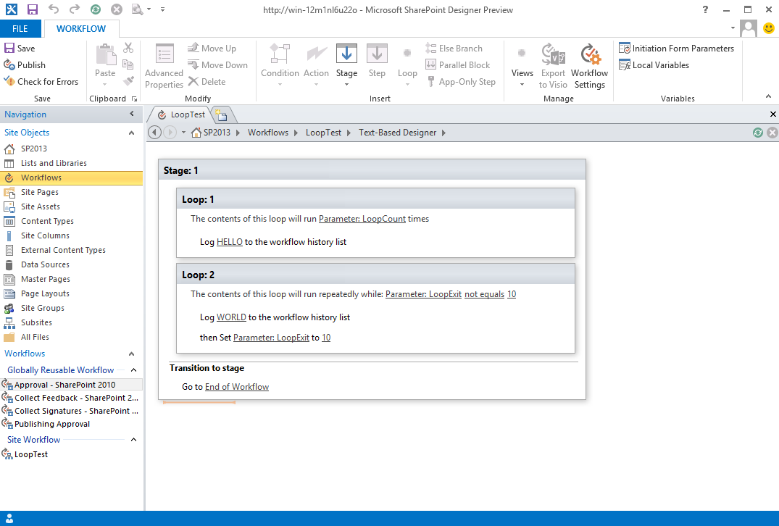
Workflows
List all workflows in a tenant: https://github.com/codingo/SharePoint-Security/blob/master/List-All-Workflows.ps1

Slide 17
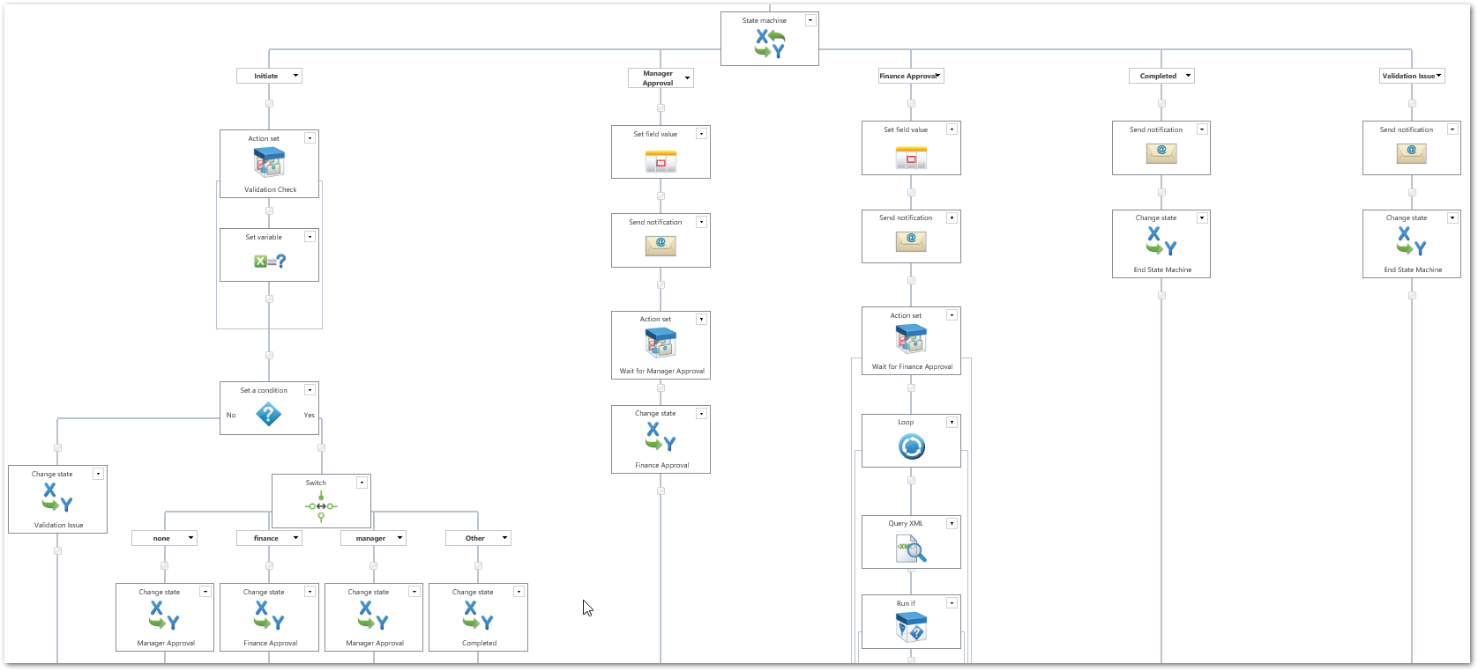
These get complicated quickly…

Slide 18
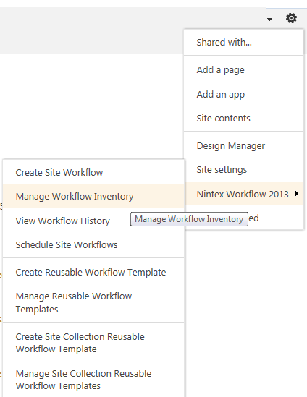
List all Nintex Workflows For a site

Slide 19
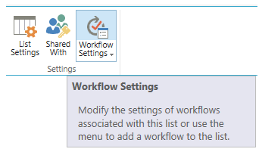


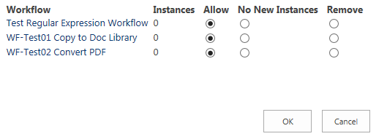
List All Nintex Workflows for a List

Slide 20
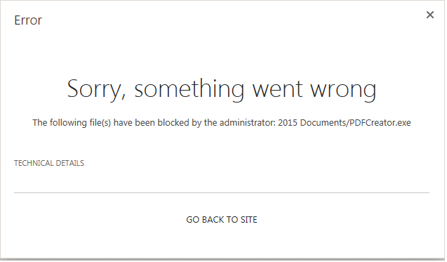
Blocked File Types
SharePoint uses an exception list, not a whitelist. Blocked file types will restrict file uploads to SharePoint but doesn’t necessarily impact on custom applications within SharePoint, or workflows using third party additions. It is prudent to perform additional testing even after reviewing blocked file types.
SharePoint 2010/2013 On-Premise
Review Using Web Services: http://[site]/_admin/BlockedFileType.aspx
View, edit or update using PowerShell: https://github.com/codingo/SharePoint-Security/blob/master/Add-Or-Remove-Blocked-Filetypes.ps1
SharePoint Online
On the Operations page, in the Security Configuration section, click Blocked file types.

Slide 21
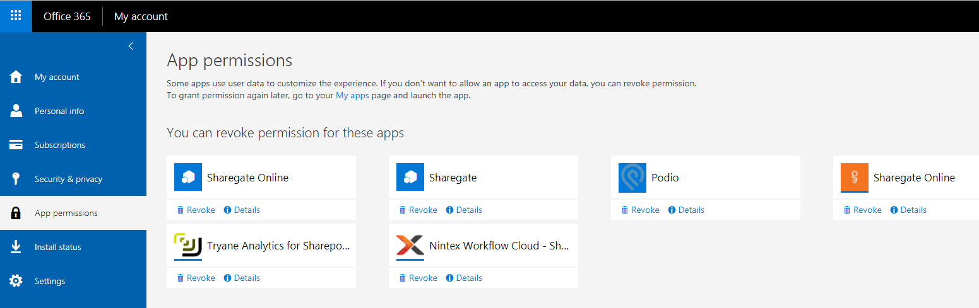
Excessive App permissions
Outside applications can be given access to SharePoint. A number of these are often added by administrators and they should be reviewed to see if they are deemed excessive, or have known flaws of their own.

Slide 22
Reviewing Patch Levels
Review Patch Levels
$spprod = Get-SPProduct $spprod.Servers | select ServerName, Products, InstallStatus
Identify Missing Patches
$spprod.Servers | ? { $_.InstallStatus -eq "InstallRequired" } | % { $_.RequiredButMissingPatches }

Slide 23

Test for yourself
SharePoint 2013 virtual machine download https://gauravmahajan.net/2014/08/17/sharepoint-server-2013-sp1-virtual-machine-download/
SharePoint 2016 virtual machine download https://gauravmahajan.net/2017/10/06/sharepoint-server-2016-virtual-machine-download/

Slide 24
Thank-you!
Michael “codingO“ SKELTON
PowerShell within this talk has been posted to: github.com/codingo/SharePoint-Security along with resources used throughout the research process.
github.com/codingo
twitter.com/codingo_

