Slide 1

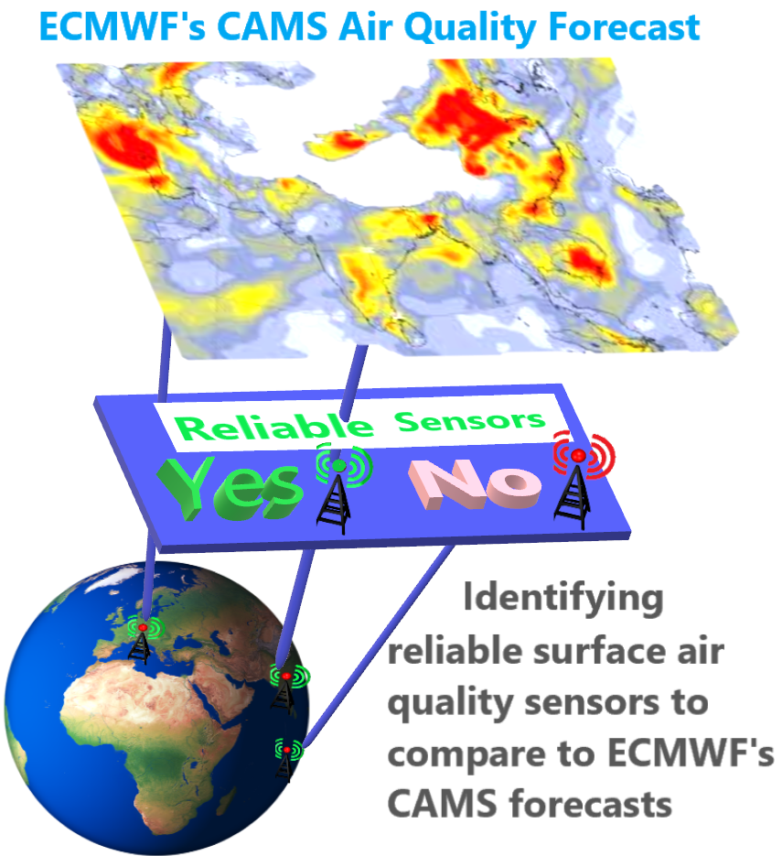
Challenge #24 - A Simple Global Air Quality Data Classification - Milestones ECMWF Summer of Weather Code 2020 challenges
Gordon Rates
OpenAQ evaluation
ECMWF Mentors: Johannes Flemming and Miha Razinger

Slide 2
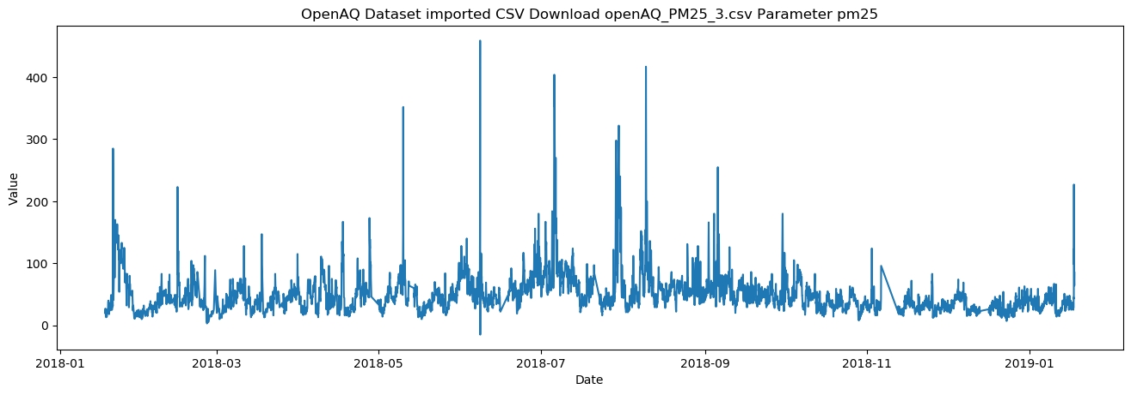
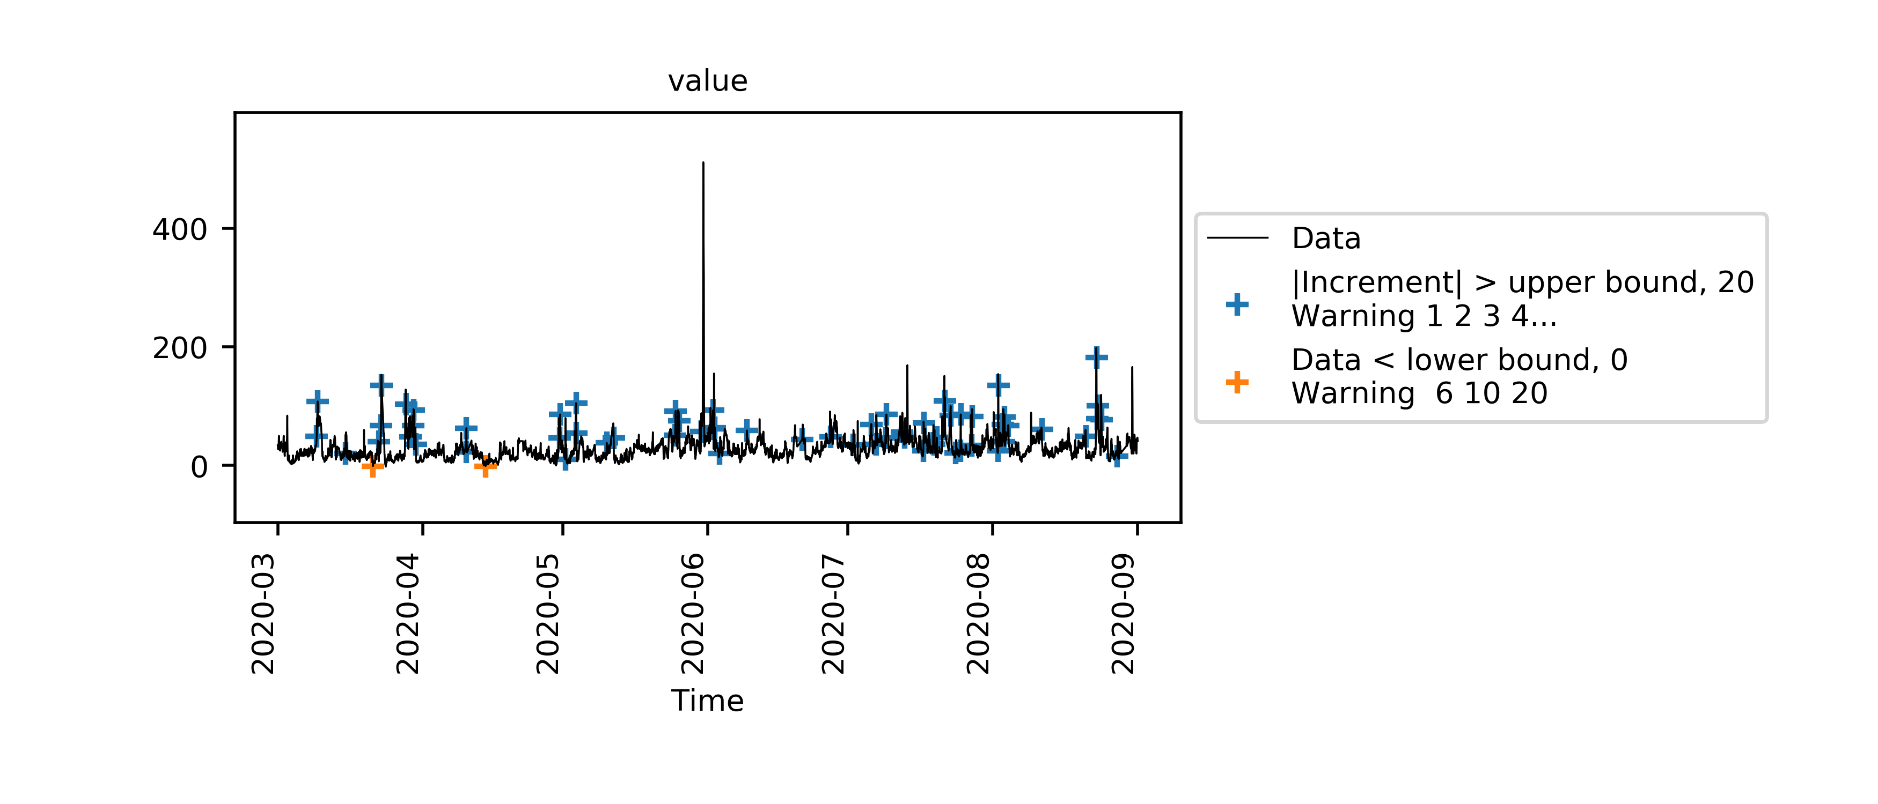
ECWMF ESoWC Challenge #24 - A Simple Global Air Quality Data Classification - Overview
Aim
Quality Control Evaluation of Air Quality Datasets
Find Outliers and Errors
Search for Errors over Countries, Regions and individual stations
Search over differing Time Schedules (6 months, 8 months etc)
Report performance per AQ Station

Slide 3
Challenge #24 - A Simple Global Air Quality Data Classification - Overview
Visual Analytics
Find Outliers and Errors
Report Reliability

Slide 4
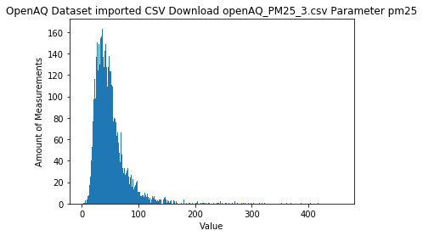
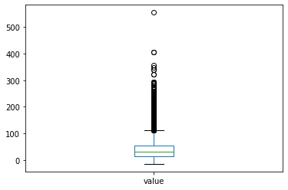
Challenge #24 - A Simple Global Air Quality Data Classification - Overview
Output
Step 1 Import AQ Dataset from OpenAQ
Step 2 Data Wrangling and Visual Analytics
Line Plot Histogram Boxplot
Step 3 Pecos Quality Control Evaluation
Plot of Outliers Outliers and Timestamps Imported Dataset
Web page and Excel spreadsheet Excel spreadsheet

Slide 5
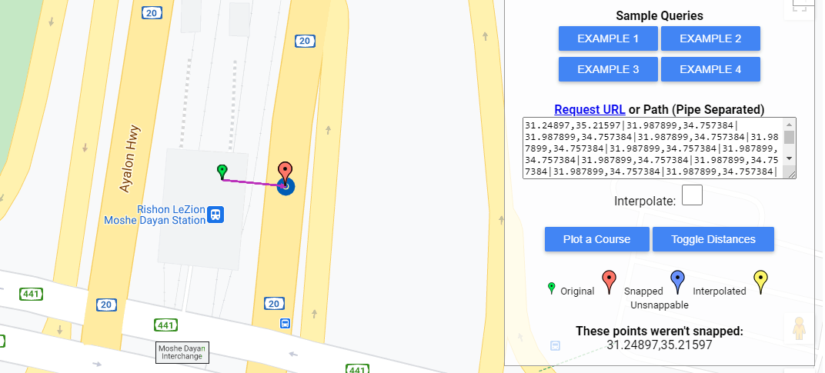
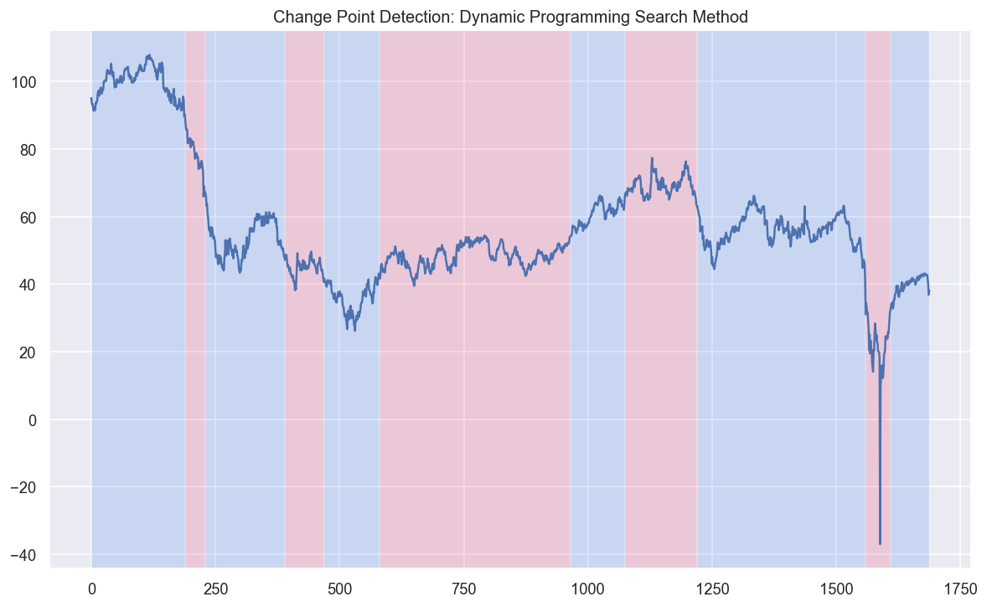
Challenge #24 - A Simple Global Air Quality Data Classification - Overview
Output
Step 4 Attributes about Stations
Nearest Highway to OpenAQ Station compared to mean
Step 5 Trend Analysis
Change Points in Selected Dataset

Slide 6
Challenge #24 - A Simple Global Air Quality Data Classification - Overview
Questions Answered
Reliability of Stations for selected OpenAQ Air Quality Datasets
How possible to use OpenAQ to compare to ECMWF CAMS forecasts
Evaluation of Stations means and Distance to Nearest Highway

