Slide 1
The ARES High-level Intermediate Representation
Nick Moss, Kei Davis, Pat McCormick
11/14/16

Slide 2
About ARES
HLIR is part of the ARES project (Abstract Representations for the Extreme-Scale Stack)
Inter-operable tools and approaches for programming next-generation architectures
LANL (Pat McCormick) + ORNL (Jeffrey Vetter)
Funded by: Advanced Scientific Computing Research, Office of Science, of the United States Department of Energy

Slide 3
HLIR Motivation
LLVM remains a purely sequential representation while parallel programming is becoming increasingly ubiquitous with the end of Moore’s law.
Parallel functionality is often achieved through libraries, but use of libraries alone lead to missed optimization opportunities and programmability challenges.

Slide 4
HLIR Motivation
Essential information about high level structures of the program is lost such as loops and typically has to be reconstructed from IR.
Approaches such as Clang’s OpenMP perform analysis/transformations in the front-end. It would be preferable to write such parallel transformations once in the backend for targeting by multiple frontends.

Slide 5
HLIR Motivation
Adding parallel extensions directly to LLVM is a challenging problem; adds complexity and would be very disruptive to core features of LLVM, e.g. control flow graph analysis and other types of analysis
IR alone is perhaps too low-level; sequential may not be the best form; we posit the need for an AST-like representation

Slide 6
HLIR
To address these concerns and needs we created HLIR (High Level Intermediate Representation)… to allow multiple frontends to target parallel functionality
HLIR is an extension of LLVM, taking advantage of LLVM’s broad capabilities and infrastructure – HLIR can be viewed as a superset of LLVM.
HLIR = representation + code generation / runtime interface

Slide 7
Parallel Constructs
Our current implementation supports:
tasks
parallel for
parallel reduce
communication and synchronization building blocks

Slide 8
HLIR Features
Extensibility
Ease of use
Human readable and in-memory representations
Targetable by diverse types of frontends: C++, Fortran, … any language that uses LLVM for code generation
Nested/hierarchical to represent AST-like structures such as parallel for loops
Mutability and successive transformation

Slide 9
HLIR Flow

Slide 10
HLIR Module
HLIR module – one-to-one correspondence with IR module
HLIR module provides methods for creating parallel constructs, e.g. parallel for, contains top-level metadata
For example, in the case of parallel for/reduce, HLIR sets up an outlined function and provides entry points for the body to be defined or induction or reduce variables retrieved

Slide 11
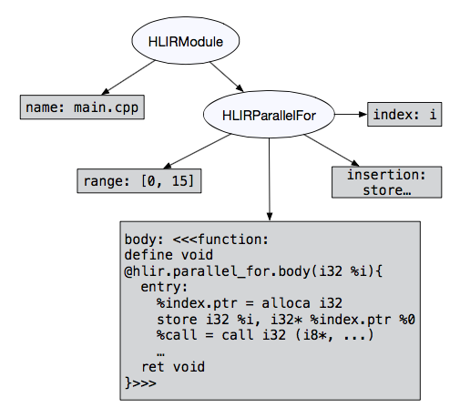
Sample HLIR Representation

Slide 12
HLIR nodes
Leaf nodes: symbol, string, floating, integer, IR Value, IR Type, arbitrary sequence of IR wrapped in function, etc.
Dynamic/flexible, nested nodes – heterogenuos types – vector, symbol map
Constructs: Parallel For/Reduce, Task, etc. Constructs have key-mapped values, e.g: body, induction var, return type, etc.

Slide 13
Data Dependencies & Capturing
One of the important benefits/abstractions that HLIR provides is capturing of data dependencies and bundling them up into a struct so that can be queued along with a function ptr to outlined function to our thread pool.
A front-end performing code generation can conveniently neglect that values appearing within, e.g. a task body were defined externally.

Slide 14
Runtime
Simple prototype runtime. Defines runtime call interface which is potentially swappable with a different runtime
Uses Argonne Argobots user-level threads => yield(), solves recursion problem, thread waits while occupying
Thread pool, depth, synch
Synchronization – barrier, “virtual” semaphores
Communication building blocks – channels, message handlers

Slide 15
Tasks Implementation
Body specified by frontend => outline, data capturing
Transform calls to task-marked functions into HLIR intrinsic for task launch
The return value becomes a future, HLIR pass looks for uses of this value and turns them into runtime calls to yield/await this future.

Slide 16
Parallel For/Reduce Implementation
Body specified by frontend => outline, data capturing, same machinery as task
Nested parallel for/reduce loops add complexity, data dependencies are unwrapped, and re-queued at each level
Parallel Reduce – divide and conquer – entire algorithm code generated

Slide 17
Clang-based Frontend
We implemented a proof of concept frontend by extending Clang to target HLIR. Adds first-class support for tasks and parallel for/reduce
Only required <= approximately 100 lines of code added to Clang for each construct

Slide 18
Clang-based Frontend - Tasks
task int fib(int i){
if(i <= 1){
return i;
}
return fib(i− 1) + fib(i− 2);
}

Slide 19
Clang-based Frontend – Parallel For
float A[SIZE];
for(auto i : Forall(0 , SIZE)){
A[i] = i;
}

Slide 20
Clang-based Frontend – Parallel Reduce
float sum = 0.0;
for(auto i : ReduceAll(0 , SIZE, sum)){
sum += 1.0;
}

Slide 21
Related Work
Open64
Diderot
GCC Gimple
OpenARC
OpenCL SPIR
Scout, Kokkos Clang (LANL)

Slide 22
Future Work
Additional parallel constructs, e.g. data layout and memory placement, data parallel, etc.
Distributed functionality, integrate with communication infrastructure, tasks: data dependence
Optimize execution/runtime, depth, priority, chunking parallel for, etc.
Next phase: targeting/extending HLIR with OpenMP/OpenACC/pragma-based semantics

Slide 23
Conclusion
Multiple frontends can target HLIR to benefit from a central, optimized lowering and runtime system, retain parallel semantics in backend
Target at a high-level while attaining benefits of low-level code generation and optimization
Flexible and hierarchical, extensibility, starting point

Slide 24
Questions?
Thanks for your time!
ARES HLIR can be found at:
https://github.com/losalamos/ares
Questions?

