Slide 1

Enlarge your burp
or how not to be afraid of JavaDocs
Igor Bulatenko
Ivan Elkin

Slide 2

Sources
https://goo.gl/oYjBTg (python)

Slide 3
#whoami
#videns
Head of QIWI application security department
Former security software developer
CTF player and organizer (TechnoPandas)
JBFC Member ☺

Slide 4
What is all about
Why people (us) use burp
Burp 101
Official info
Other presentations
Internals
Plugins

Slide 5
Is it good?
#1 among web scanners *
Crossplatform
Good for manual vulnerabilities testing
Can scan whole internet
Has plugins
Most popular vulnerability checks
Gartner challengers for AST

Slide 6
Unofficial infos
http://www.slideshare.net/jasonhaddix/bsides-final
http://www.slideshare.net/AugustDetlefsen/burp-extensions
http://www.slideshare.net/marcwickenden/burp-plugin-development-for-java-n00bs-44-con
http://www.agarri.fr/docs/HiP2k13-Burp_Pro_Tips_and_Tricks.pdf
http://www.youtube.com/watch?v=Q2WK5LpDbxw
http://www.youtube.com/watch?v=N-IKHmGjf2c
https://twitter.com/everythingburp
http://www.slideshare.net/AugustDetlefsen/appsec-usa-2015-customizing-burp-suite

Slide 7
Why improve it?
Not correct use of API
Scan fullness
Time for implementing new techniques

Slide 8
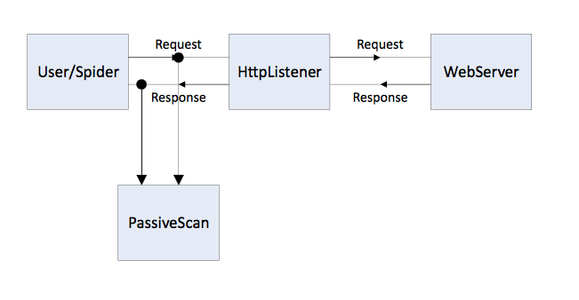
How it works (spidering)

Slide 9
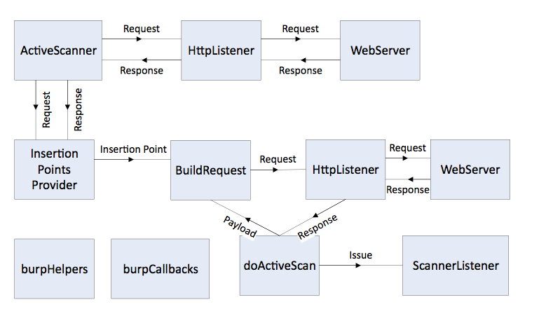
How its works (active scan)

Slide 10
Demo 01
Simplest Plugin
Show logging functionality (stdout, stderr)
Log InsertionPoints info
Nested InsertionPoint
DoActiveScan
How to debug in python (jython)

Slide 11
Demo 02
DoActiveScan
Building request for attack
How requests are counted (scanner tab)
Send requests via callbacks or via jython
Highlighting in request/responses

Slide 12
Demo 03
Error message check (http://virvales.blogspot.ru/2015/08/burp-stacktrace-sniffer.html)
HttpListener
Manual adding scan issue

Slide 13
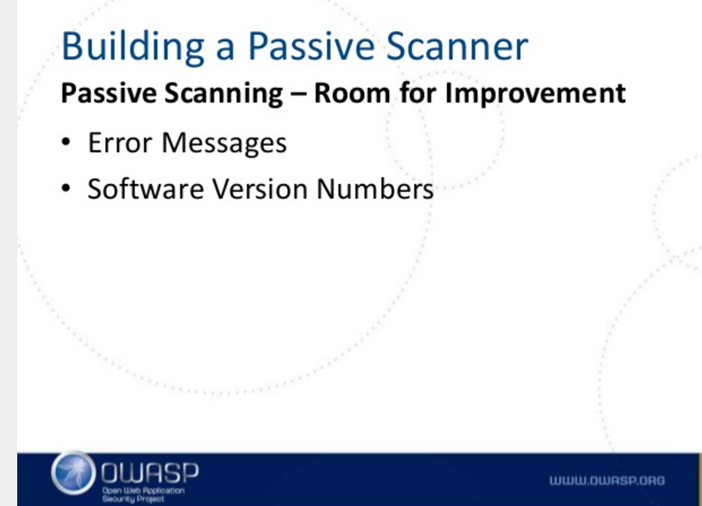
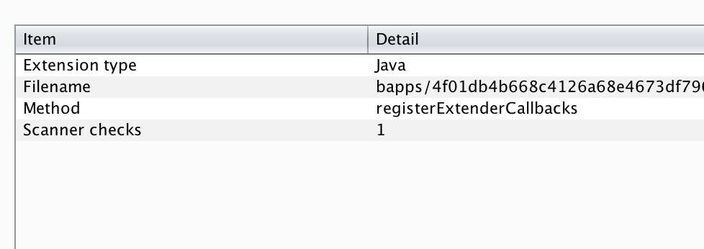
You’re doing it wrong

Slide 14
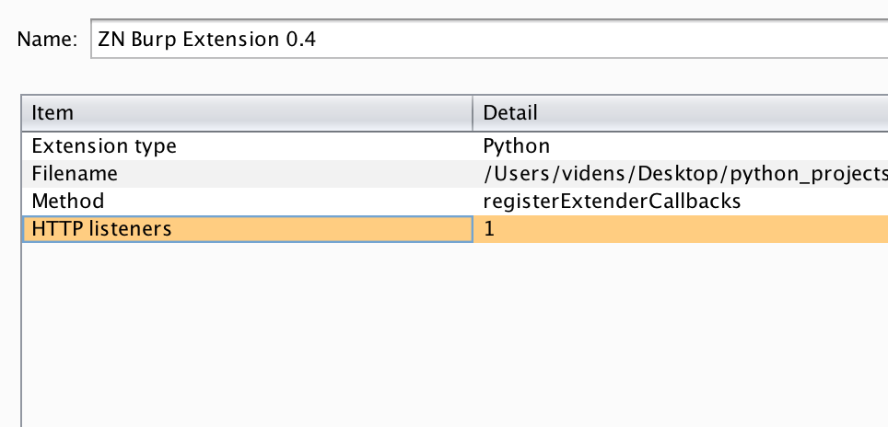
Right way

Slide 15
Demo 04
Insertion Point Provider Custom Insertion Point, necessary methods
Logging payloads

Slide 16
The end (part 1)

