Slide 1
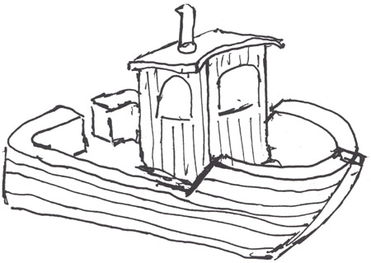
CSjark
Automated generation of protocol dissectors for Wireshark.

Slide 2
Outline (sketch)
The team and the customer.
The task.
Choices we made.
The sprints
Demo
Questions and answers.

Slide 3
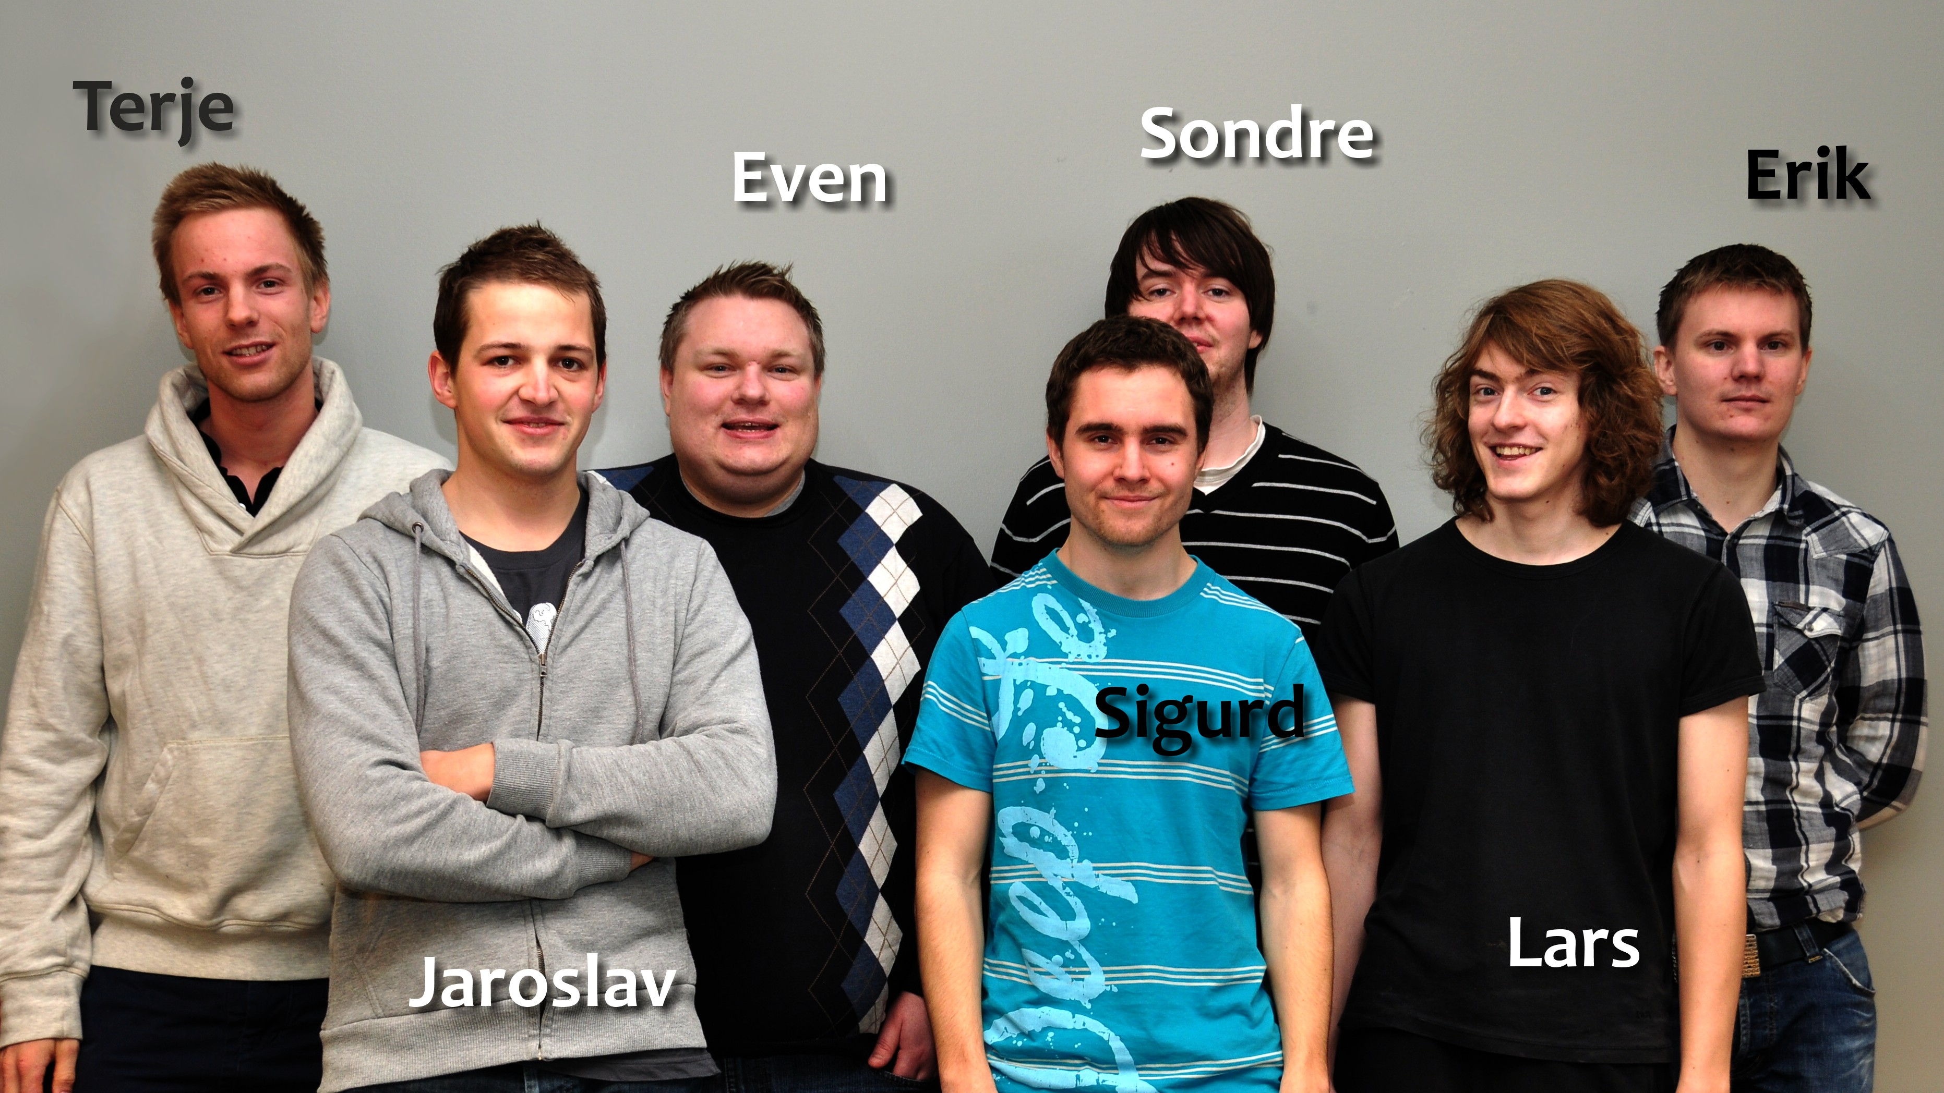
The team

Slide 4
Group goals
Improve programming skills.
Learn to develop software efficiently.
Learn to work in a realistic enviroment.
To fulfil the needs of the customer.

Slide 5

The customer
Thales
Specializes in security and mission critical components
Both military and civil customers.

Slide 6
The customer’s situation
Their product relies on communication between processes.
C structs are used as a container for this.
Debugging requires interception of messages.
Wireshark is a way to to this.

Slide 7
Process 1
Process 2
struct message {
int a = 5;
int b = 6;
char* = ‘abc’;
};
1001101010
struct message {
int a = 5;
int b = 6;
char* = ‘abc’;
};
Wireshark
1001101010
struct message {
int a = 5;
int b = 6;
char* = ‘abc’;
};

Slide 8
Dissectors
Wireshark can be extended with dissectors.
A dissector knows the structure of the message and and can represent it beautifully.
Takes from 15 minutes – 1 hour to make.
Hard or and tideous for large and complex structs.
Requires knowledge about C memory layout and Wireshark API.

Slide 9
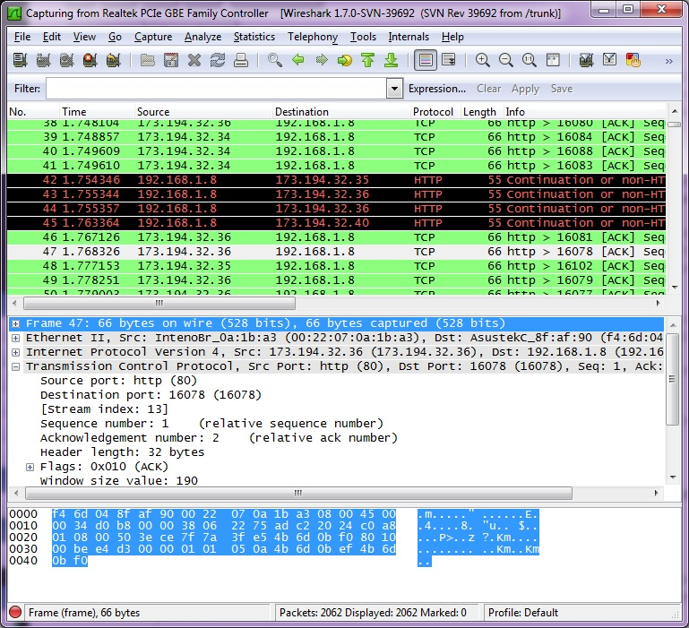
Wireshark

Slide 10
The Task
Thales currently has 3000 C header files containing struct defintitions.
Writing dissectors by hand too time consuming.
Therefore they want a utility that can:
Read the header files.
Find the struct definitions.
Generate dissectors for these dissectors.
Be able to configure extra semantics for certain structs and struct members.

Slide 11
Pre-study
Reading C headers requires something like a pre-processor and a parser.
Configuration also needs a parser, along with a format.
Programming language.
We needed to choose a development methodology.

Slide 12
Parser
Hard to make.
Many open source third-party libraries available.
Pycparser, written in python was the best parser.
Made it convinient to choose python as the programming language.

Slide 13
Configuration
Yaml

Slide 14
The process
Scrum
4 sprints

Slide 15
Sprint 1
Making a solid design foundation for the utility.
Beeing able to generate dissectors for simple structs.
Support primitive C types.
Handling #include directives.

Slide 16
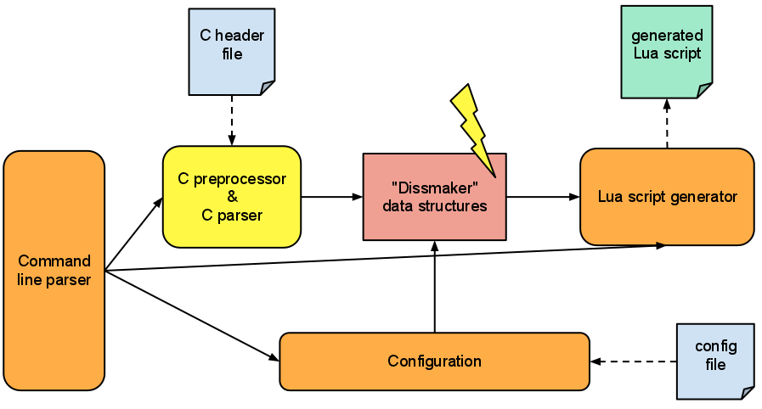
Preliminary design

Slide 17
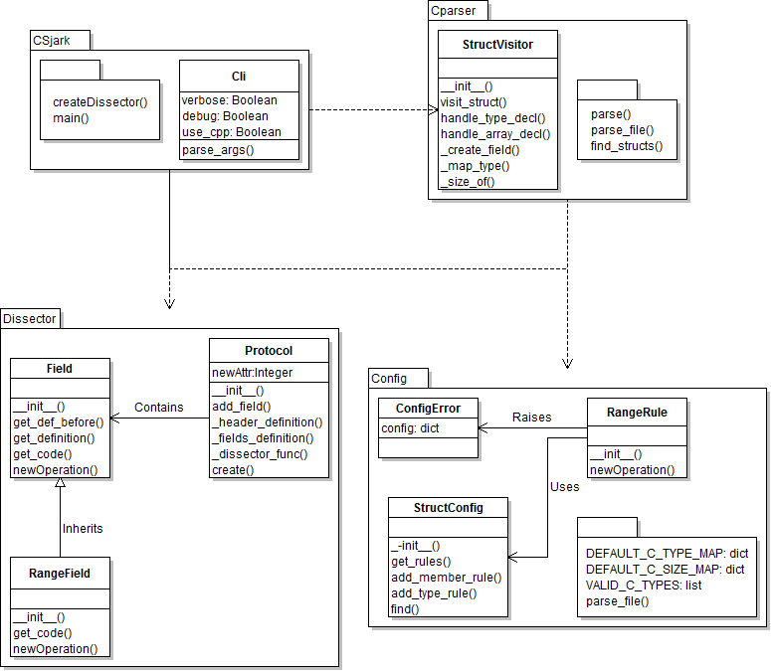
4 modules

Slide 18
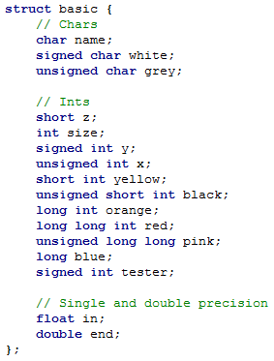
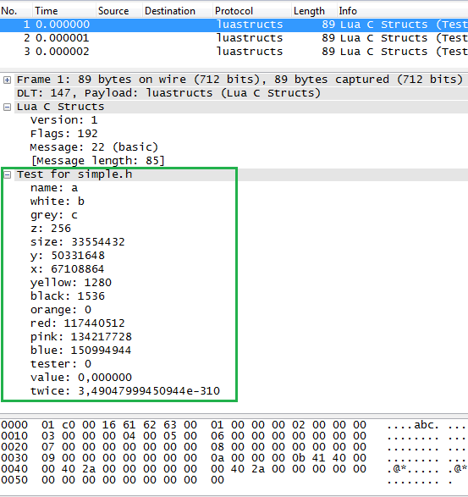
Header and Wireshark

Slide 19
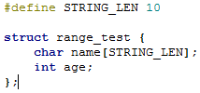
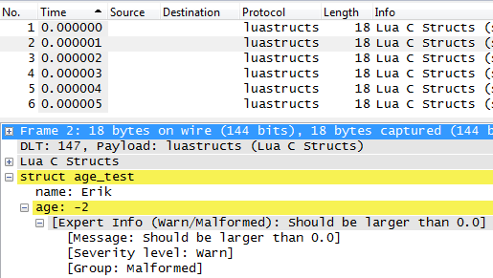
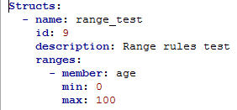
Config of range limit

Slide 20
Testing
No access to real test input or results
Customer has provided some examples
Most rest data must be hand made

Slide 21
Sprint 1 retrospect

Slide 22
Sprint 2
Support for non-primitive C types
Configuration of type and member semantic
Support for 3. party dissectors to decode trailers of a message
Refactor code from sprint 1

Slide 23
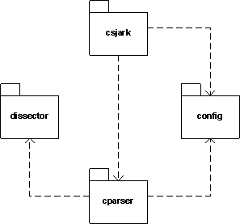
Moduler

Slide 24
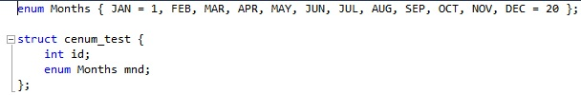
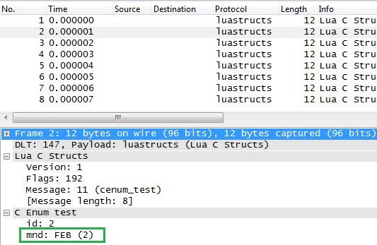
Support for enum

Slide 25
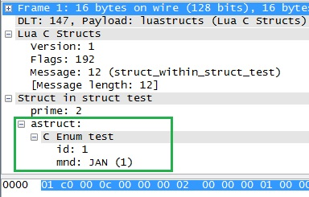
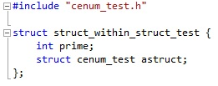
Struct in struct

Slide 26
Sprint 2 retrospect
Better, but not sufficient planning
Raised effort
Documentation was postponed
Lack of feedback to the advisor

Slide 27
Sprint 3
Support for multiple platforms
Endian
Member size
Memory alignment
Get utility to work on customers target code

Slide 28
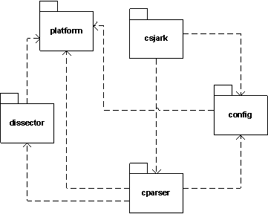
Module design

Slide 29
Sprint 3 - Testing
Availebility of alignment support meant that we could have a C program generate test data.
Needed to change all previous test data.

Slide 30
Sprint 3 retrospect
A better process
More effort
Too many taskes planned
Time used for project management underestimated

Slide 31
Sprint 4
Find missing includes

Slide 32
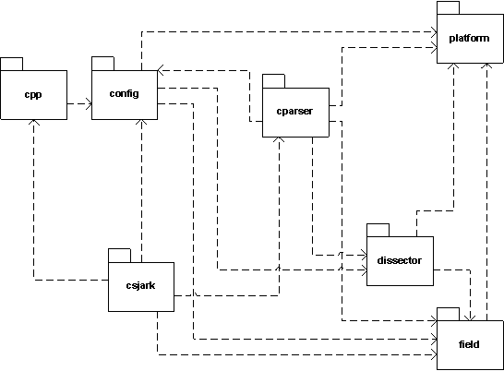
Module design

Slide 33
Limitations
Thales has the military as a customer, so the code is confedential.
Wireshark’s lua integration is under development, and buggy.

Slide 34
CSjark
A command line tool.
Takes header files, configuration files and some C macroes as input.
Gives lua dissectors as output.
Lua dissectors can be used together with Wireshark on Windows, Linux, Mac and Solaris.
Output semantics are very configurable.

Slide 35
The architecture.
Csjark consists of 6 major modules.
Csjark
CPP
CParser
Config
Dissector
Platform

Slide 36
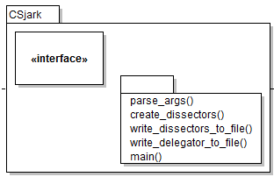
CSjark
Takes in command line arguments
Distributes these arguments to the right place.
Calles operations on the other modules.

Slide 37
CPP
Prepares the header files for parsing by feeding them to a C pre-processor.
Adds platform specific arguments for platforms.
Adds certain

Slide 38
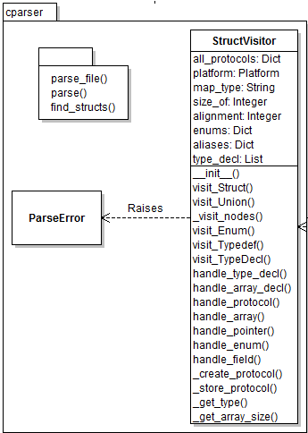
CParser
Parses the header files with the help of pycparser.
Finds the different c declerations.
Makes prototypes that represents the structs.

Slide 39
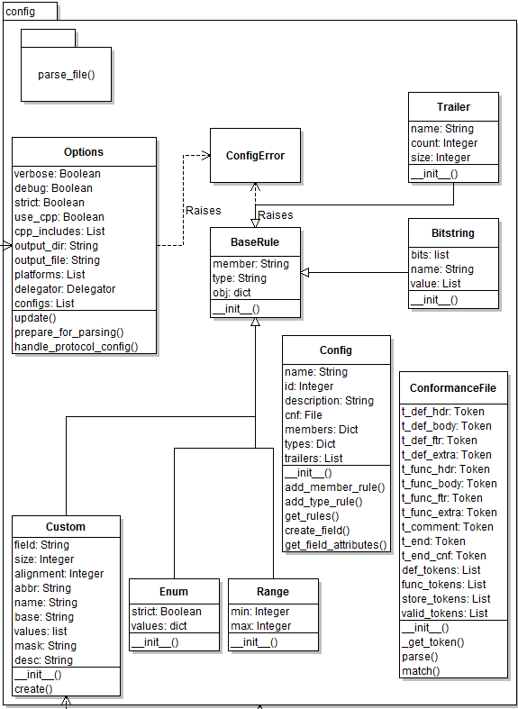
Config
Parses configuration files.
Extracts rules from these files.
Store the rules for later.

Slide 40
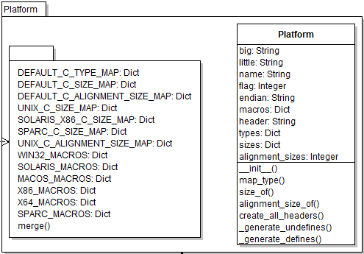
Platform
Contains information about different platforms.
The CParser and Dissector module uses this to make the dissectors conform with the specified platforms.

Slide 41
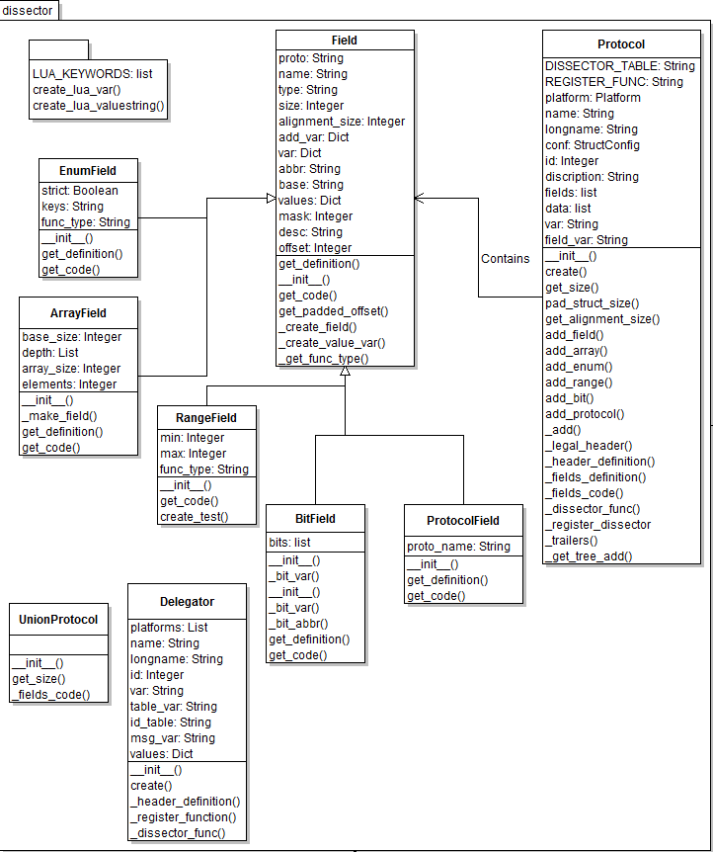
Dissector
Defines the Protocol class, that is used to represent a dissector.
Contains methods for writing the dissector.

Slide 42
Conclution
Automatic generation saves time.
No dependence of intimate C knowledge.
Less dependence on key personal.
Having dissectors reduces time spent on debugging.
Easier to debug remote locations.

