Slide 1
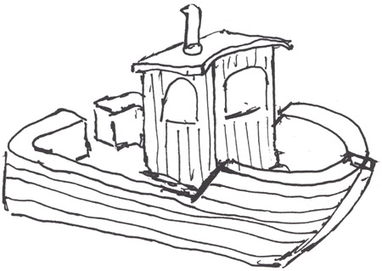
CSjark
Automated generation of protocol dissectors for Wireshark.

Slide 2
Agenda
The team
TDT4290 Customer driven project
The task
The process
Demo
Questions and answers.

Slide 3
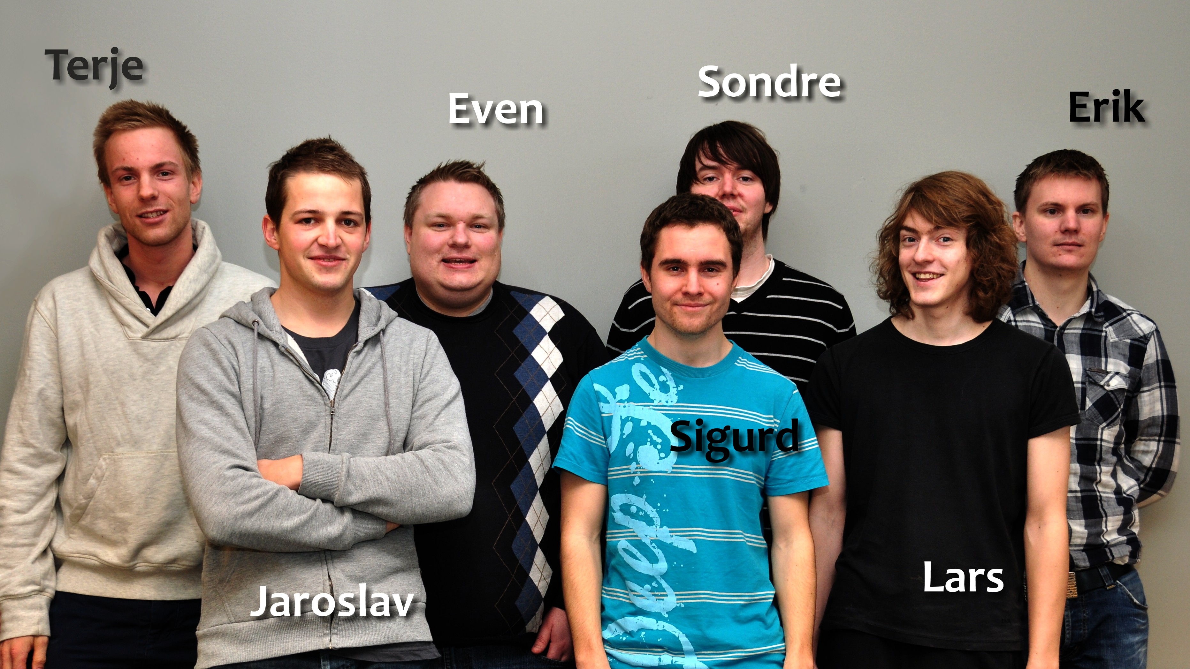
The team

Slide 4
TDT4290 Customer driven project
Experience in a realistic work environment
External customer defines the task
6 – 7 students
Product and report

Slide 5
Inter-process communication
Process 1
Process 2
struct message {
int a = 5;
int b = 6;
char* = ‘abc’
}
1001101010
struct message {
int a = 5;
int b = 6;
char* = ‘abc’
}
Wireshark
1001101010
struct message {
int a = 5;
int b = 6;
char* = ‘abc’;
}

Slide 6
The task
Generate Lua dissectors for C structs automatically
Provide configuration options for the dissectors

Slide 7
Dissectors
Wireshark can be extended with dissectors
Decodes the structure of a message
Takes from 15 minutes – 1 hour to make
Requires knowledge about C memory layout and Wireshark API.

Slide 8
The process
Pre-study
Libraries for preprocessing, parsing and configuration.
Python
Scrum
4 sprints
Incremental releases
Continues feedback

Slide 9
CSjark
A command line tool written in python
Takes header files, configuration files and some C macroes as input
Outputs Lua dissectors
Output semantics are highly configurable

Slide 10
Demo

