Slide 1
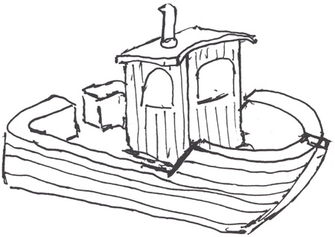
CSjark
Automated generation of protocol dissectors for Wireshark.

Slide 2
Outline (sketch)
The team and the customer.
The task.
Choices we made.
The sprints
Demo
Questions and answers.

Slide 3
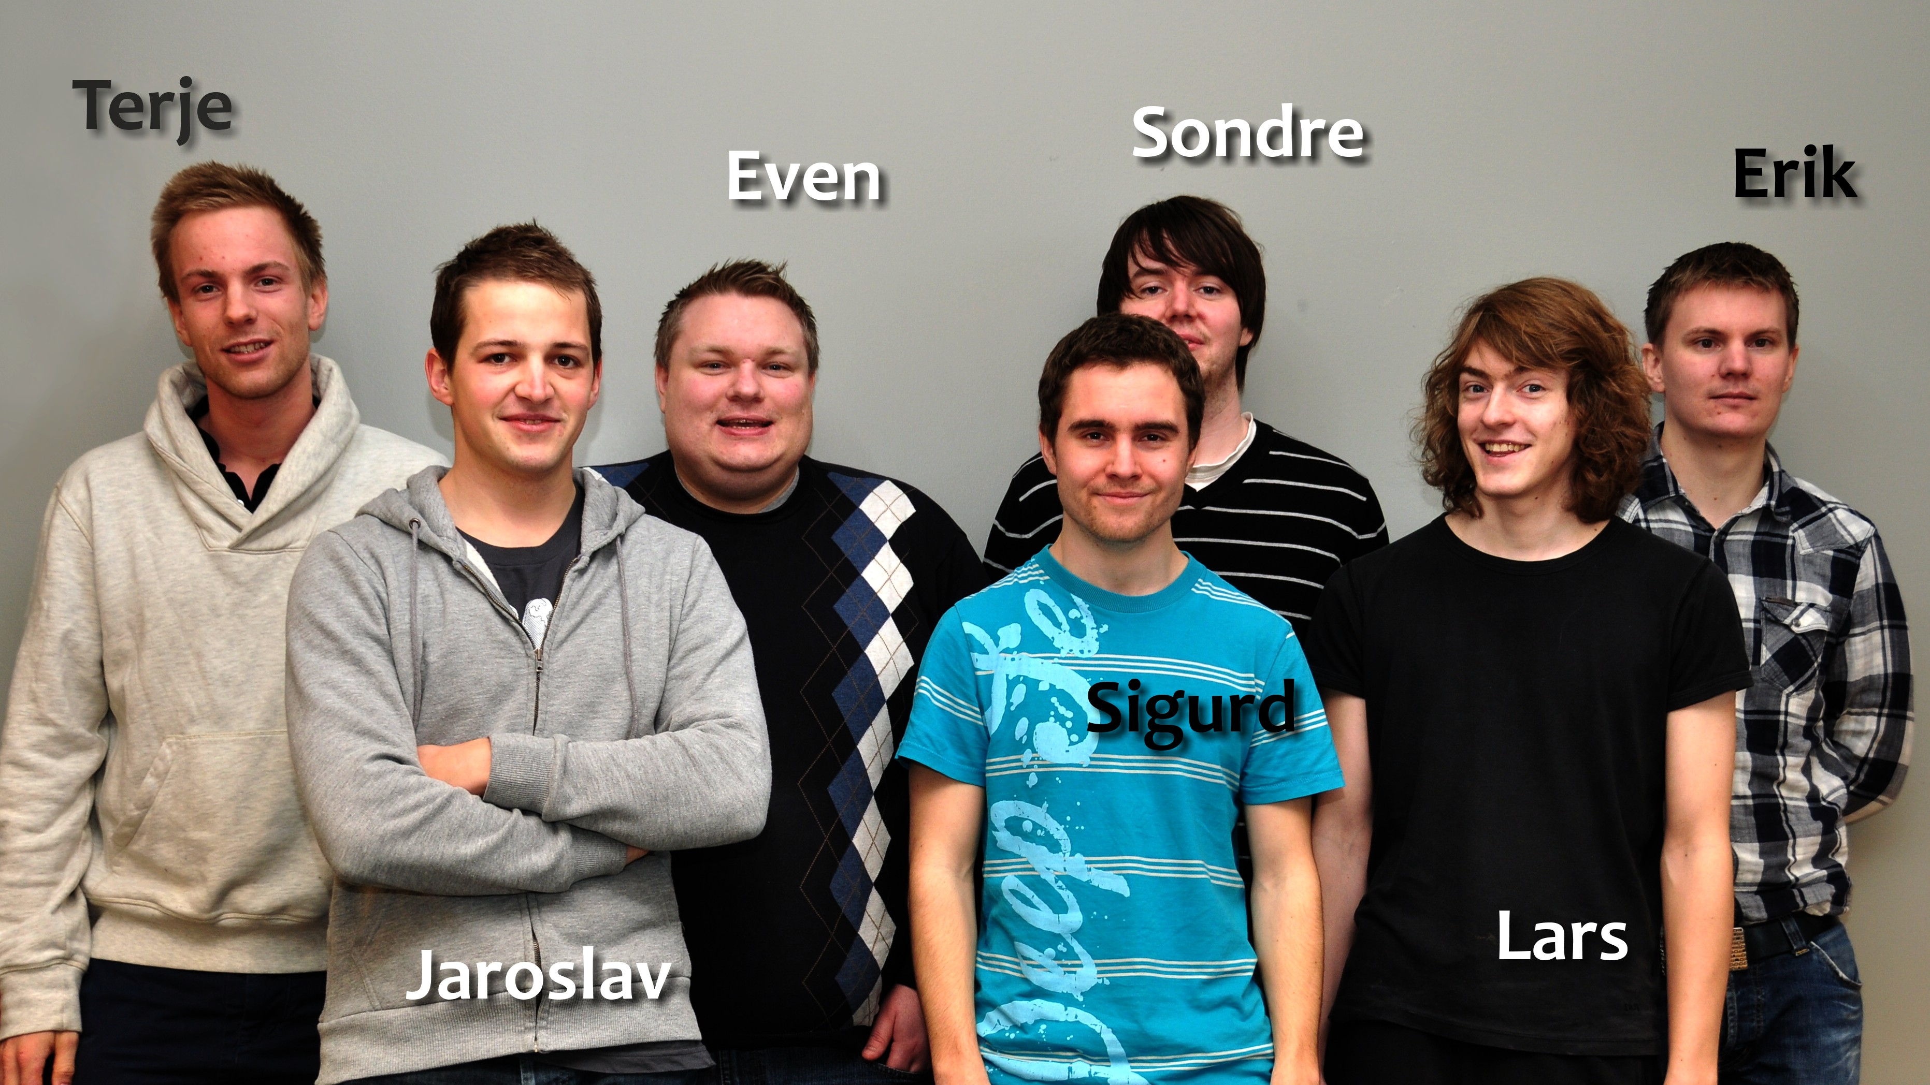
The team

Slide 4
Group goals
Improve programming skills.
Learn to develop software efficiently.
Learn to work in a realistic enviroment.
To fulfil the needs of the customer.

Slide 5

The customer
Thales
Specializes in security and mission critical components
Both military and civil customers.

Slide 6
The customer’s situation
Their product relies on communication between processes.
C structs are used as a container for this.
Debugging requires interception of messages.
Wireshark is a way to to this.

Slide 7
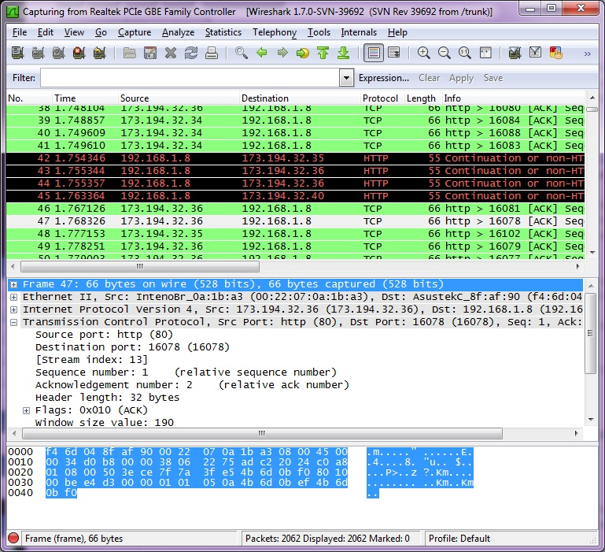
Wireshark

Slide 8

Wireshark
A network protocol analyser.
Can capture network traffic or display a live view.
The user can browse individual messages.

Slide 9
Process 1
Process 2
struct message {
int a = 5;
int b = 6;
char* = ‘abc’;
};
1001101010
struct message {
int a = 5;
int b = 6;
char* = ‘abc’;
};
Wireshark
1001101010
struct message {
int a = 5;
int b = 6;
char* = ‘abc’;
};

Slide 10
Dissectors
Wireshark can be extended with dissectors.
A dissector knows the structure of the message and and can represent it beautifully.
Takes from 15 minutes – 1 hour to make.
Hard or and tideous for large and complex structs.
Requires knowledge about C memory layout and Wireshark API.

Slide 11
The Task
Thales currently has 3000 C header files containing struct defintitions.
Writing dissectors by hand too time consuming.
Therefore they want a utility that can:
Read the header files.
Find the struct definitions.
Generate dissectors for these dissectors.
Be able to configure extra semantics for certain structs and struct members.

Slide 12
Pre-study
Reading C headers requires something like a pre-processor and a parser.
Configuration also needs a parser, along with a format.
Programming language.
We needed to choose a development methodology.

Slide 13
Parser
Hard to make.
Many open source third-party libraries available.
Pycparser, written in python was the best parser.
Made it convinient to choose python as the programming language.

Slide 14
Configuration
Yaml

Slide 15
The process
Scrum
4 sprints

Slide 16
Sprint 1
Making a solid design foundation for the utility.
Beeing able to generate dissectors for simple structs.
Support primitive C types.
Handling #include directives.

Slide 17
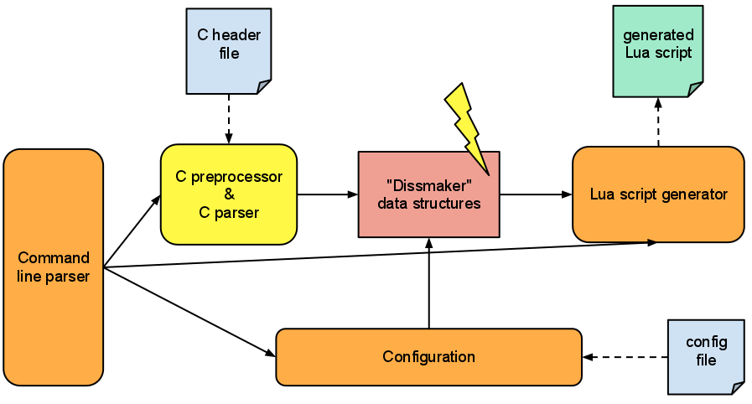
Preliminary design

Slide 18
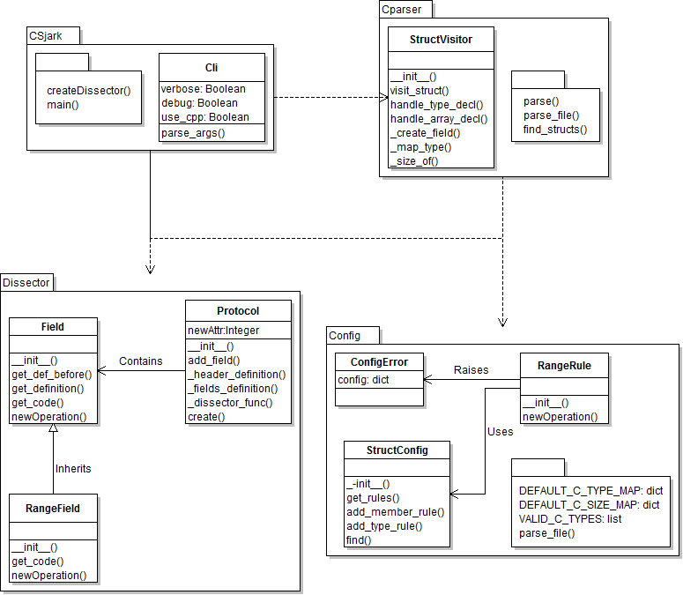
4 modules

Slide 19
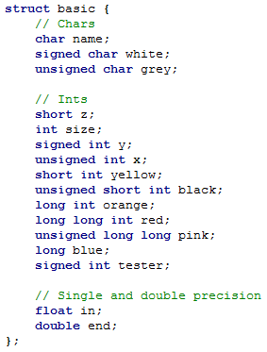
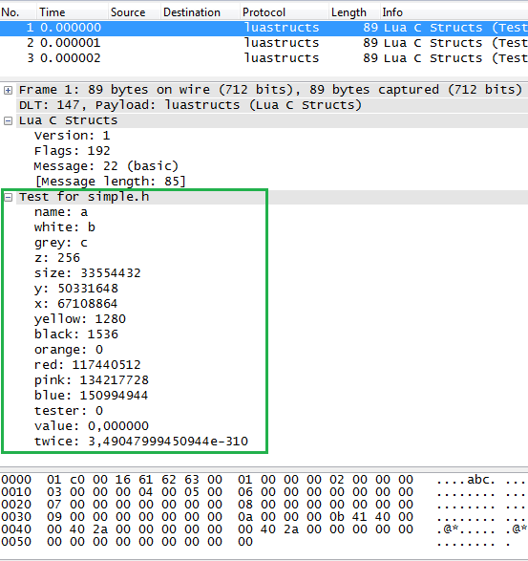
Header and Wireshark

Slide 20
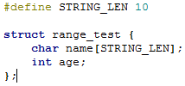
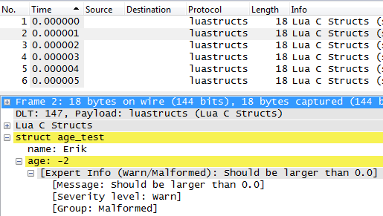
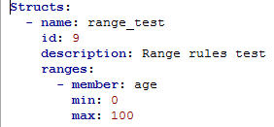
Config of range limit

Slide 21
Sprint 2

Slide 22
Sprint 3

Slide 23
Sprint 4

Slide 24
Limitations
Thales has the military as a customer, so the code is confedential.
Wireshark’s lua integration is under development, and buggy.

Slide 25
CSjark
A command line tool.
Takes header files, configuration files and some C macroes as input.
Gives lua dissectors as output.
Lua dissectors can be used together with Wireshark on Windows, Linux, Mac and Solaris.
Output semantics are very configurable.

Slide 26
The architecture.
Csjark consists of 6 major modules.
Csjark
CPP
CParser
Config
Dissector
Platform

Slide 27
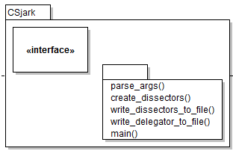
CSjark
Takes in command line arguments
Distributes these arguments to the right place.
Calles operations on the other modules.

Slide 28
CPP
Prepares the header files for parsing by feeding them to a C pre-processor.
Adds platform specific arguments for platforms.
Adds certain

Slide 29
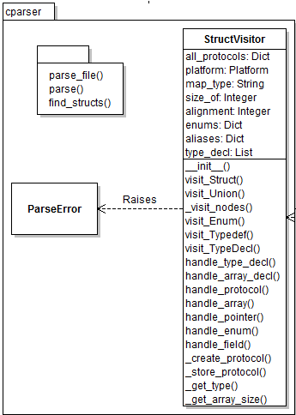
CParser
Parses the header files with the help of pycparser.
Finds the different c declerations.
Makes prototypes that represents the structs.

Slide 30
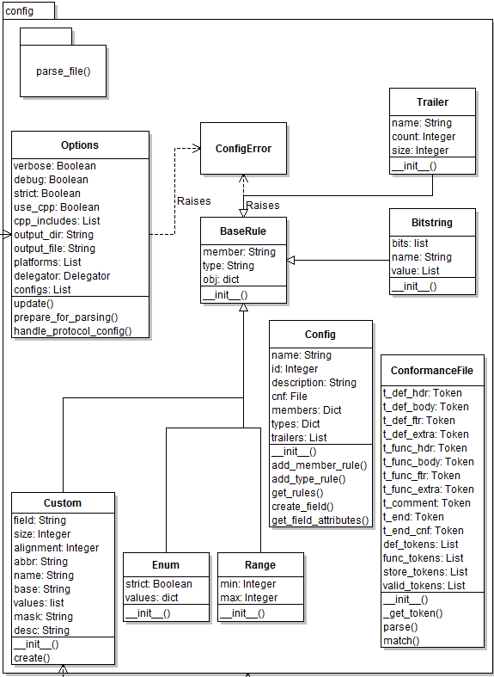
Config
Parses configuration files.
Extracts rules from these files.
Store the rules for later.

Slide 31
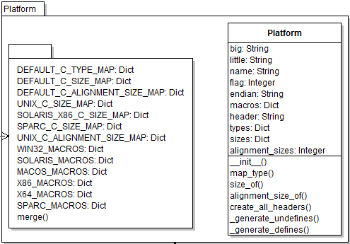
Platform
Contains information about different platforms.
The CParser and Dissector module uses this to make the dissectors conform with the specified platforms.

Slide 32
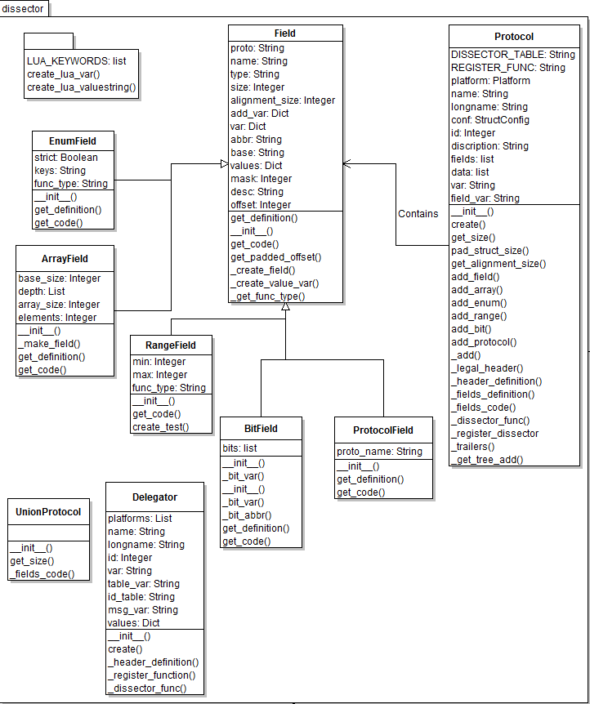
Dissector
Defines the Protocol class, that is used to represent a dissector.
Contains methods for writing the dissector.

Slide 33
Conclution
Automatic generation saves time.
No dependence of intimate C knowledge.
Less dependence on key personal.
Having dissectors reduces time spent on debugging.
Easier to debug remote locations.

