Slide 1
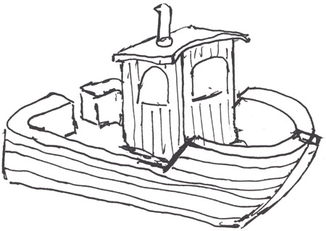
CSjark
Automated generation of protocol dissectors for Wireshark.

Slide 2
Outline
The team
TDT4290 Customer driven project
The task
The process
Demo
Questions and answers.

Slide 3
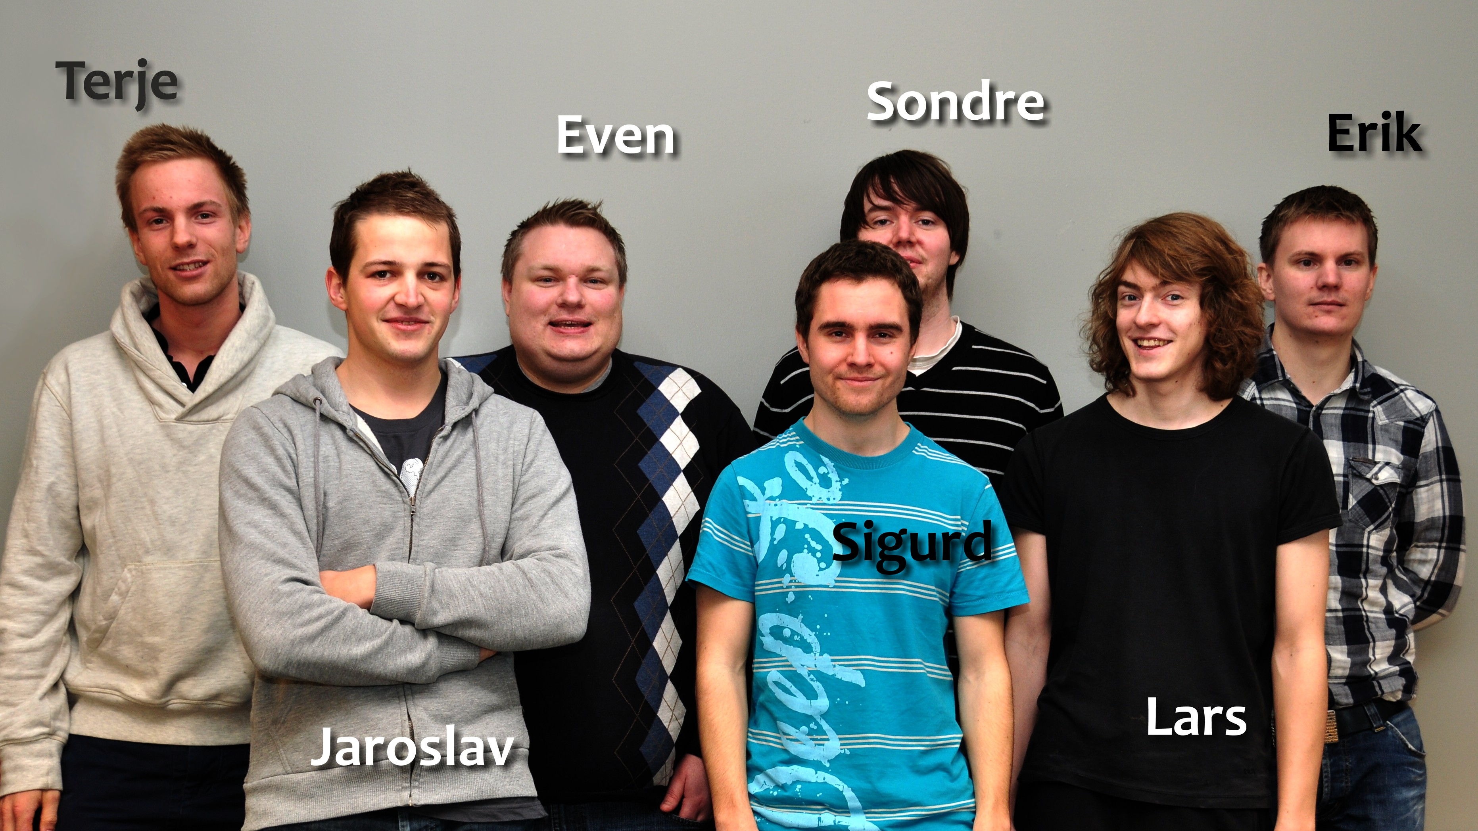
The team

Slide 4
Group goals
Improve programming skills.
Learn to develop software efficiently.
Learn to work in a realistic enviroment.
To fulfil the needs of the customer.

Slide 5
TDT4290 Customer driven project
Purpose: Give students experience in a realistic work enviroment
External customer defines the task
A group of 6-7 people are assigned randomly to each task
Should result in a product for the customer that is documented in a report

Slide 6
The task
Generate lua dissectors for C structs.
Provide various configuration options for the dissectors
Dissectors make debugging of inter-process communication easier
Thales has 3000 header files that may contain struct definitions.
The result should be able to run all of these.

Slide 7
Process 1
Process 2
struct message {
int a = 5;
int b = 6;
char* = ‘abc’
}
1001101010
struct message {
int a = 5;
int b = 6;
char* = ‘abc’
}
Wireshark
1001101010
struct message {
int a = 5;
int b = 6;
char* = ‘abc’
}

Slide 8
Dissectors
Wireshark can be extended with dissectors.
A dissector knows the structure of the message and and can represent it beautifully.
Takes from 15 minutes – 1 hour to make.
Hard or and tideous for large and complex structs.
Requires knowledge about C memory layout and Wireshark API.

Slide 9
The process
Pre-study
Libraries for preprocessing, parsing and configuration.
Python
Scrum
4 sprints
Incremental releases
Continues feedback

Slide 10
CSjark
A command line tool written in python
Takes header files, configuration files and some C macroes as input
Gives lua dissectors as output
Outputs semantics are very configurable

Slide 11
Demo

