Slide 1
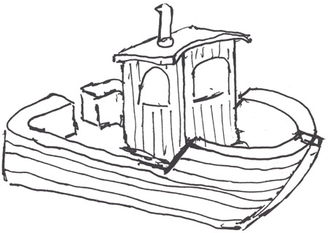
CSjark
Automated generation of protocol dissectors for Wireshark.

Slide 2
Agenda
The team
The customer
The task
Pre-study
The sprints
Demo
Questions and answers

Slide 3
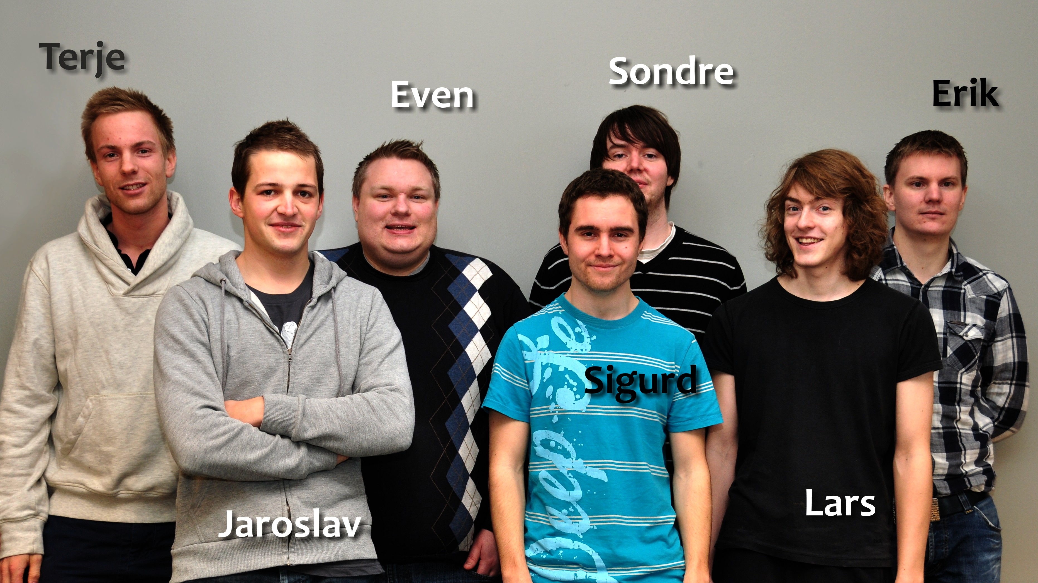
The team

Slide 4
Group goals
Improve programming skills.
Learn to develop software efficiently.
Learn to work in a realistic enviroment.
To fulfill the needs of the customer.

Slide 5

The customer
Thales
Specializes in security and mission critical components
Both military and civil customers

Slide 6
The customers situation
Process 1
Process 2
struct message {
int a = 5;
int b = 6;
char* c = ‘abc’;
};
1001101010
struct message {
int a = 5;
int b = 6;
char* c = ‘abc’;
};
Wireshark
1001101010
struct message {
int a = 5;
int b = 6;
char* c = ‘abc’;
};

Slide 7
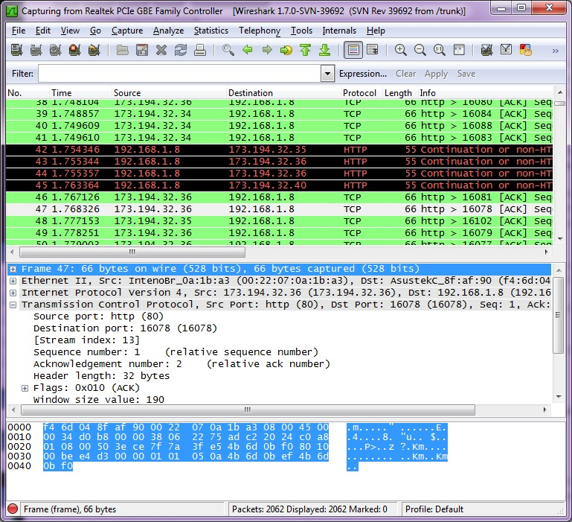
Wireshark

Slide 8
Dissectors
Wireshark can be extended with dissectors
A dissector decodes the structure of a message
Takes from 15 minutes – 1 hour to make.
Requires knowledge about C memory layout and Wireshark API.

Slide 9
The Task
Generate Lua dissectors for C structs automatically
3000 C-header files
Very complex
Provide configuration options for the dissectors
ID
Member and type semantic
Options to make it work in different enviroments

Slide 10





Pre-study
Programming language
Java
Python
Pre-processor
Parser
Configuration method
YAML
Developer methodology
Waterfall
Scrum

Slide 11
Sprint 1
A solid design foundation for the utility
Generate dissectors for simple structs
Primitive C types
#include directives
Simple configuration options
Important to find out if third party solution were sufficient.

Slide 12
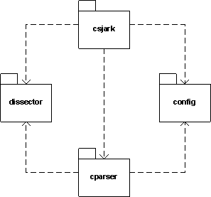
The architecture

Slide 13
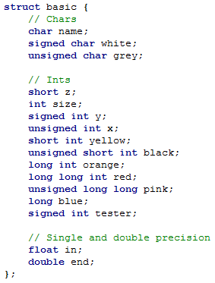
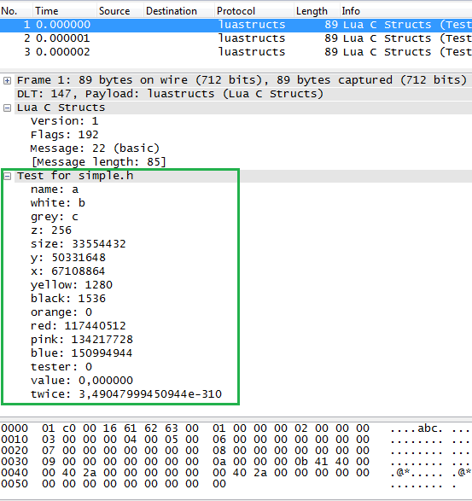
Header and Wireshark

Slide 14
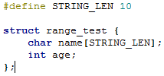
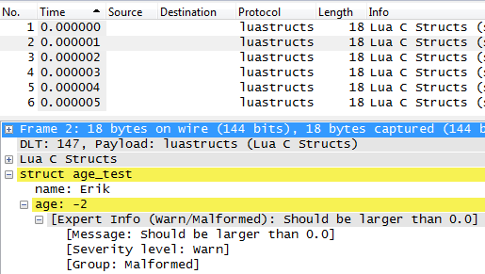
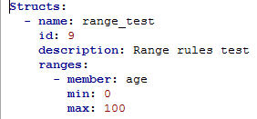
Config of range limit

Slide 15
Testing
No access to real test input or results from Thales
Customer has provided some examples
Most rest data must be hand made
Sprint 1 goals easy to test

Slide 16
Sprint 1 retrospect
Positive
Functional goals completed
Tests efficient at finding errors
Good feedback from the customer
Negative
Lack of scrum experience
Too short planning meeting
Tasks described in too high level
Tasks not spread according to their dependencies

Slide 17
Sprint 2
Have a better scrum process
Refactor code from sprint 1
Support for non-primitive C types
Configuration of type and member semantic
Support for 3. party dissectors to decode trailers of a message

Slide 18
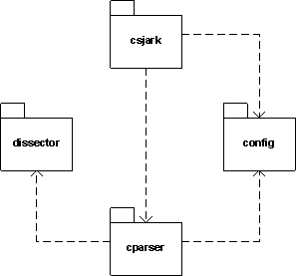
Moduler

Slide 19
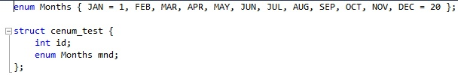
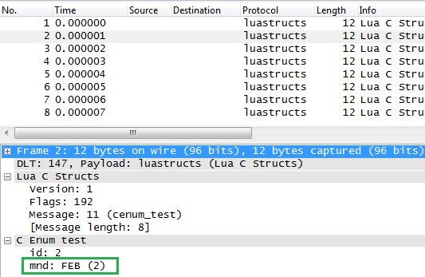
Support for enum

Slide 20
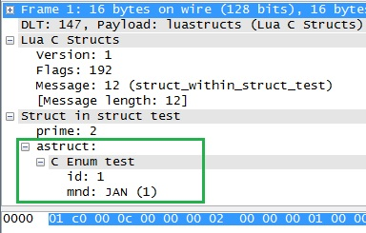
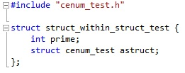
Struct in struct

Slide 21
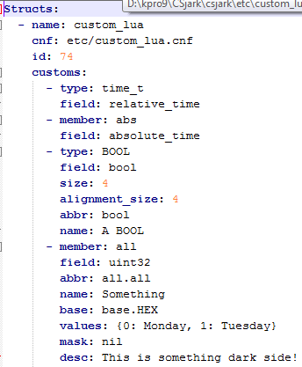
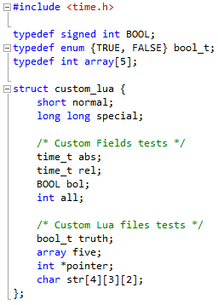
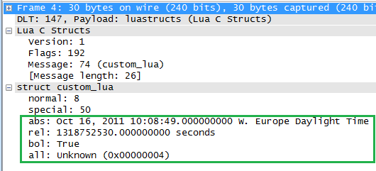
Custom lua type config

Slide 22
Sprint 2 testing
Code coverage
Improving unit tests

Slide 23
Sprint 2 retrospect
Positive
Better planning meeting
Raised effort
Presentation of progress to the customer gave a lot of good feedback
Negative
Postponed planning tasks
Documentation was postponed
Tasks still not distributed according to dependencies

Slide 24
Sprint 3
Better distribution of tasks.
Complete planning while planning
Support for multiple platforms
Endian
Member size
Memory alignment
Get utility to work on customers target code

Slide 25
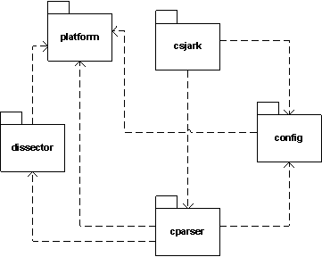
Module design

Slide 26
How platform support works
Message flag identifies originating platform
One dissector function per platform
Flag used to choose
MAKE FIGURE OF THIS!!!!!!!!ERRORERRORERROR

Slide 27
Sprint 3 - Testing
Availebility of alignment support meant that we could have a C program generate test data.
Needed to change all previous test data.

Slide 28
Sprint 3 retrospect
Positive
A better process
Easier to know what to do
All team member worked more
Negative
Too many taskes planned
Time used for project management underestimated
Needed to modify sprint backlog

Slide 29
Sprint 4
Find missing includes

Slide 30
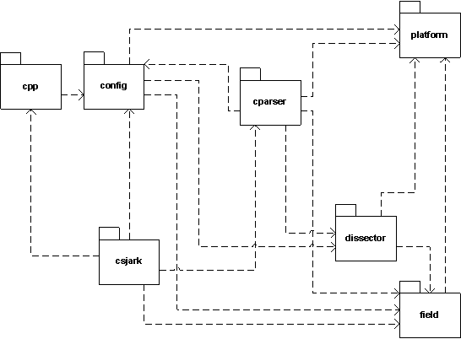
Sprint 4 architecture

Slide 31
CSjark
A command line tool.
Takes header files, configuration files and some C macroes as input.
Gives lua dissectors as output.
Lua dissectors can be used together with Wireshark on Windows, Linux, Mac and Solaris.
Output semantics are very configurable.

Slide 32
Conclusion
Automatic generation saves time.
No dependence of intimate C knowledge.
Less dependence on key personal.
Having dissectors reduces time spent on debugging.
Easier to debug remote locations.

