Slide 1
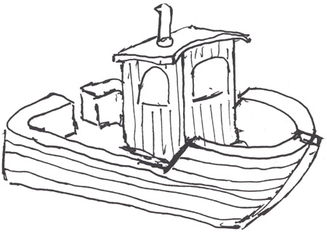
CSjark
Automated generation of protocol dissectors for Wireshark.

Slide 2
Agenda
The team
The customer
The task
Pre-study
The sprints
Demo
Questions and answers

Slide 3
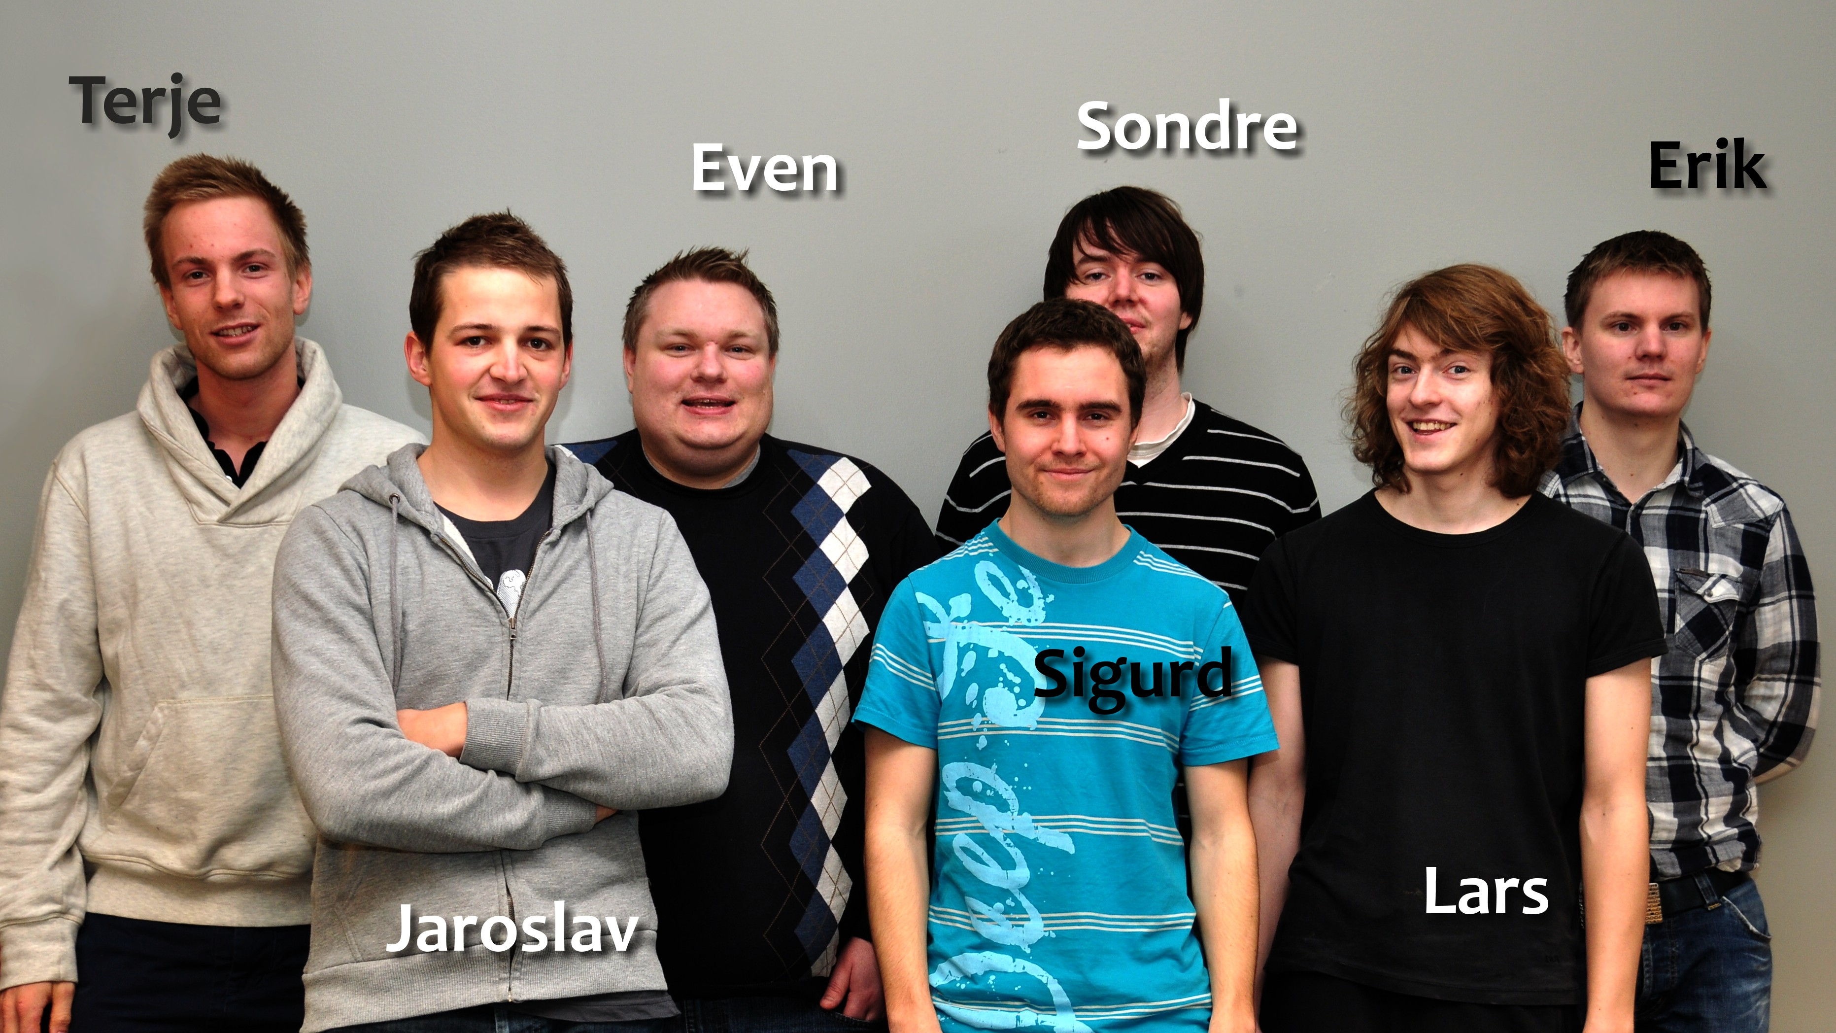
The team

Slide 4
Group goals
Improve programming skills.
Learn to develop software efficiently.
Learn to work in a realistic enviroment.
To fulfil the needs of the customer.

Slide 5

The customer
Thales
Specializes in security and mission critical components
Both military and civil customers.

Slide 6
The customer’s situation
Their product relies on communication between processes.
C structs are used as a container for this.
Debugging requires interception of messages.
Wireshark is a way to to this.

Slide 7
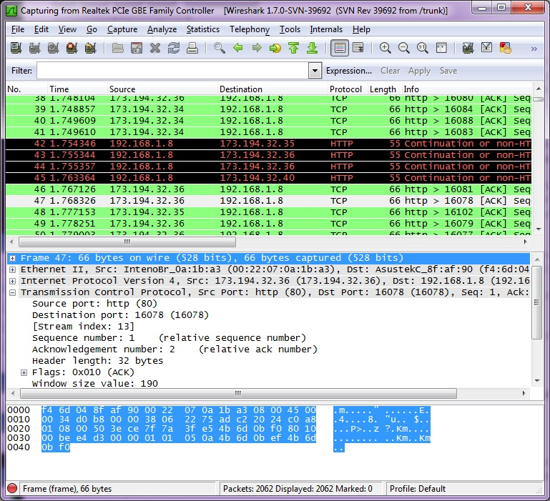
Wireshark

Slide 8
Process 1
Process 2
struct message {
int a = 5;
int b = 6;
char* c = ‘abc’;
};
1001101010
struct message {
int a = 5;
int b = 6;
char* = ‘abc’;
};
Wireshark
1001101010
struct message {
int a = 5;
int b = 6;
char* = ‘abc’;
};

Slide 9
Dissectors
Wireshark can be extended with dissectors.
A dissector knows the structure of the message and and can represent it beautifully.
Takes from 15 minutes – 1 hour to make.
Hard or and tideous for large and complex structs.
Requires knowledge about C memory layout and Wireshark API.

Slide 10
The Task
Thales currently has 3000 C header files containing struct defintitions.
Writing dissectors by hand too time consuming.
Therefore they want a utility that can:
Read the header files.
Find the struct definitions.
Generate dissectors for these dissectors.
Be able to configure extra semantics for certain structs and struct members.

Slide 11
Pre-study
Developer methodology
Waterfall
Scrum
Programming language
Java
Python
Pre-processor
Parser
Configuration method
YAML

Slide 12
Sprint 1
Making a solid design foundation for the utility.
Beeing able to generate dissectors for simple structs.
Support primitive C types.
Handling #include directives.

Slide 13
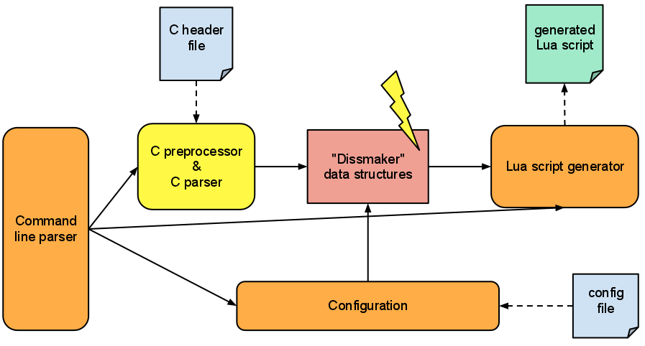
Preliminary design

Slide 14
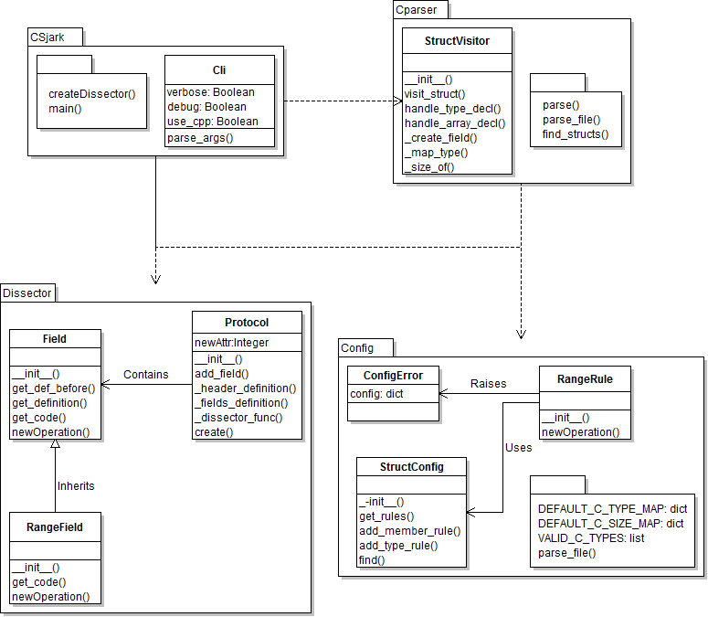
4 modules

Slide 15
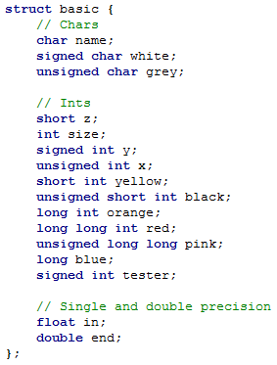
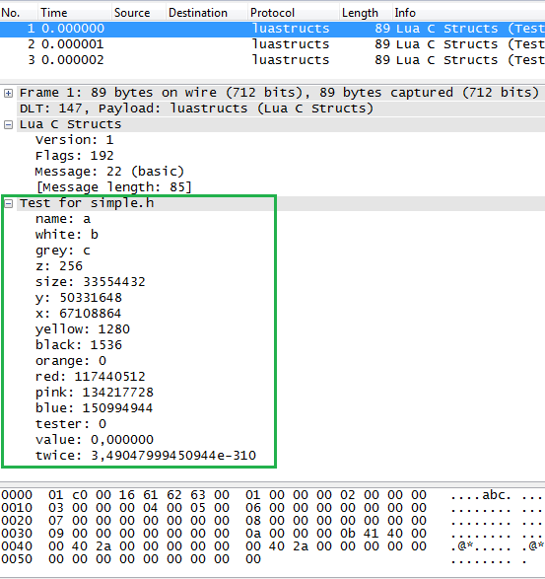
Header and Wireshark

Slide 16
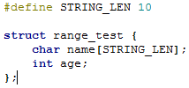
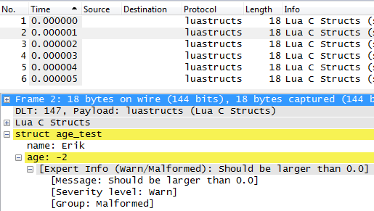
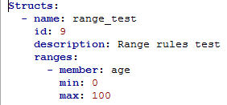
Config of range limit

Slide 17
Testing
No access to real test input or results
Customer has provided some examples
Most rest data must be hand made

Slide 18
Sprint 1 retrospect

Slide 19
Sprint 2
Support for non-primitive C types
Configuration of type and member semantic
Support for 3. party dissectors to decode trailers of a message
Refactor code from sprint 1

Slide 20
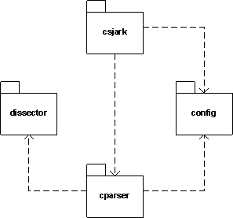
Moduler

Slide 21
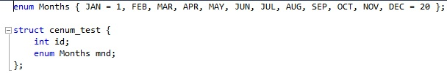
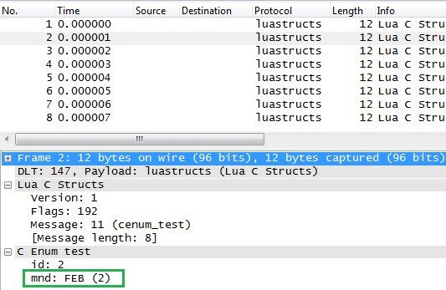
Support for enum

Slide 22
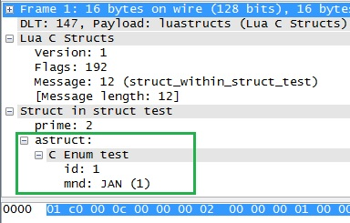
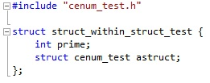
Struct in struct

Slide 23
Sprint 2 retrospect
Better, but not sufficient planning
Raised effort
Documentation was postponed
Lack of feedback to the advisor

Slide 24
Sprint 3
Support for multiple platforms
Endian
Member size
Memory alignment
Get utility to work on customers target code

Slide 25
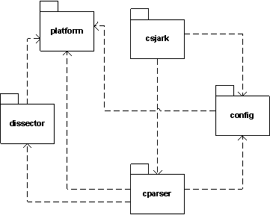
Module design

Slide 26
Sprint 3 - Testing
Availebility of alignment support meant that we could have a C program generate test data.
Needed to change all previous test data.

Slide 27
Sprint 3 retrospect
A better process
More effort
Too many taskes planned
Time used for project management underestimated

Slide 28
Sprint 4
Find missing includes

Slide 29
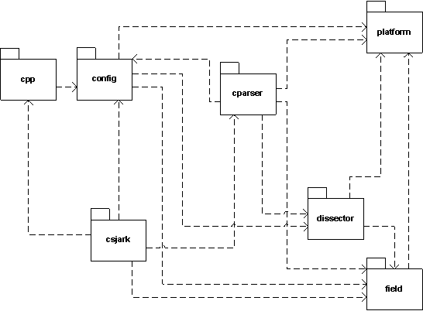
Module design

Slide 30
Limitations
Thales has the military as a customer, so the code is confedential.
Wireshark’s lua integration is under development, and buggy.

Slide 31
CSjark
A command line tool.
Takes header files, configuration files and some C macroes as input.
Gives lua dissectors as output.
Lua dissectors can be used together with Wireshark on Windows, Linux, Mac and Solaris.
Output semantics are very configurable.

Slide 32
The architecture.
Csjark consists of 6 major modules.
Csjark
CPP
CParser
Config
Dissector
Platform

Slide 33
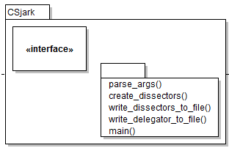
CSjark
Takes in command line arguments
Distributes these arguments to the right place.
Calles operations on the other modules.

Slide 34
CPP
Prepares the header files for parsing by feeding them to a C pre-processor.
Adds platform specific arguments for platforms.
Adds certain

Slide 35
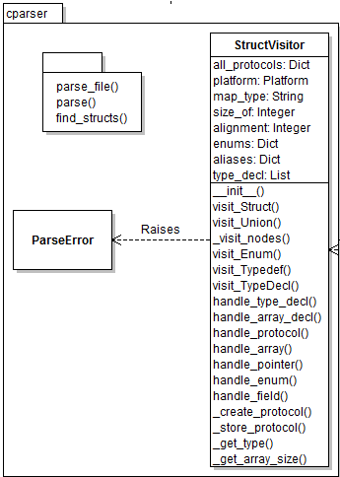
CParser
Parses the header files with the help of pycparser.
Finds the different c declerations.
Makes prototypes that represents the structs.

Slide 36
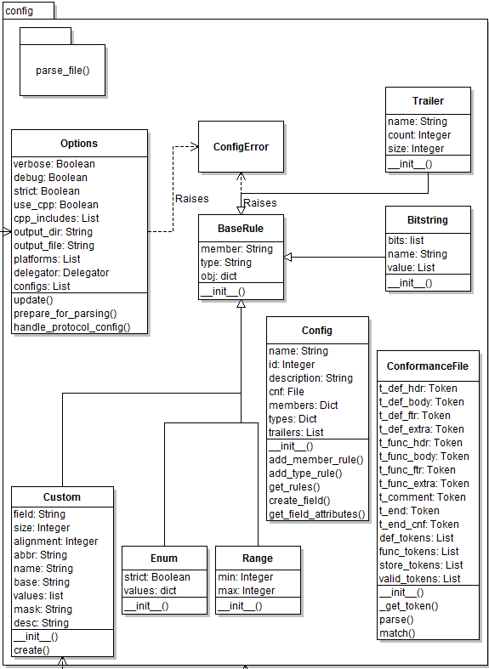
Config
Parses configuration files.
Extracts rules from these files.
Store the rules for later.

Slide 37
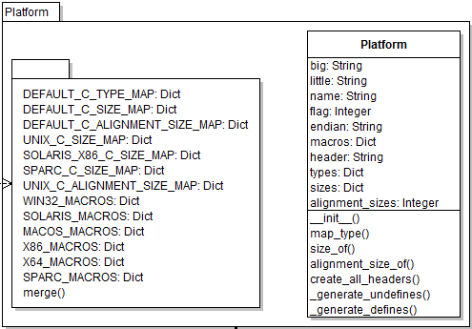
Platform
Contains information about different platforms.
The CParser and Dissector module uses this to make the dissectors conform with the specified platforms.

Slide 38
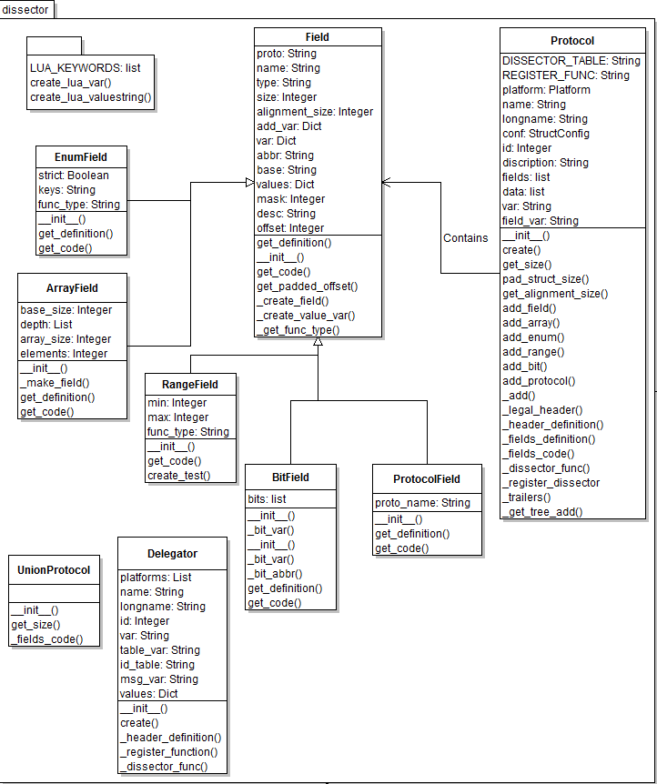
Dissector
Defines the Protocol class, that is used to represent a dissector.
Contains methods for writing the dissector.

Slide 39
Conclution
Automatic generation saves time.
No dependence of intimate C knowledge.
Less dependence on key personal.
Having dissectors reduces time spent on debugging.
Easier to debug remote locations.

