Slide 1
Labeless – NO more
Aliaksandr Chailytko | Team Leader
Aliaksandr Trafimchuk | Malware Researcher
Thanks to:
Stanislav Skuratovich
Notes:
Hello and welcome to the presentation about our tool for malware researchers and reverse engineers called “Labeless”.
First of all, let me introduce one of my team members, who has done most of the programming work for that project, Alexander Trafimchuk. His is working as Malware Researcher in my team. Unfortunately, he is not on the stage today.
And my name is Alexander Chailytko. I’m a Team Leader of Malware Research Team in Check Point Software Technologies. A little bit about myself: I’ve started to learn things about hacking, malware and all this stuff at the age of 14 (fourteen). My first serious project was at the age of 17 (seventeen), when I’ve fully reversed some legacy embedded system and modified its code to my personal needs. So, it’s more than 10 years of experience in the sphere of reverse engineering.
When we’ve started developing Labeless we haven’t realized that it will come up like that. Even at the stage of proof of concept, my whole team started to use that tool in our day to day work and it improved our productivity by significant amount. Now, we want to present this tool to you. By the way, it is available as open source at our Bit Bucket and we’ll put a link in the end of our presentation.
So, let’s start.
{CLICK_CHANGE_SLIDE}

Slide 2
Creation Purposes
Lack of tool for on-the-fly labels synchronization between IDA and Olly
Lack of tool for automatic on-the-fly imports fixing
Lack of tool for IDA-Olly scripting interaction
Notes:
Here are the problems that we’ve been facing in our day to day work:
The First problem: we cannot synchronize labels on-the-fly between IDA and Olly {CLICK}
The Second problem: we were using an inconvenient and manual way (basically Import Reconstructor Tool) to fix imports in our dumps {CLICK}
And finally, the third problem: if we needed some sort of data to be found, processed and sent back to IDA from the debugger, we were writing one script for OllyDbg, executing it there, exporting its results to the file, then writing another script for IDA to work on that exported data set… You’ve got the point. It’s not a seamless interaction and took too much time.
Now it’s all changed with the help of Labeless.
{CLICK_CHANGE_SLIDE}

Slide 3
Main Features
Labels synchronization (image base-independent)
Dumping code directly from Olly (IDADump)
Automatic on-the-fly imports fixing
Remote Olly Python scripts execution
IDA-Olly scripting synergy
Notes:
Let’s take a look at the main features of Labeless. They all will be discussed later in details:
1) Labels synchronization (and it is image base-independent) {CLICK}
2) Dumping code directly from Olly (we call that feature IDADump) {CLICK}
3) Automatic on-the-fly imports fixing {CLICK}
4) Remote Olly Python scripts execution {CLICK}
5) IDA-Olly scripting synergy
{CLICK_CHANGE_SLIDE}

Slide 4
ARCHITECTURE
Notes:
In order to better understand all further material, let’s start from quick overview of the architecture of Labeless.
{CLICK_CHANGE_SLIDE}

Slide 5


Labeless as Plugin System
IDA
Olly
1.10 backend
PyExCore
Notes:
Labeless is a two component system. One part of the system is running on the IDA side and the other on the Olly side. They share the same core interface called PyExCore. Basically, all communications are done through it.
{CLICK_CHANGE_SLIDE}

Slide 6
PyExCore Structure
PyExCore
RPC
Server/Client
Labels
Synchronization
User’s Python Script Execution
IDADump
Notes:
Since it is the most significant part of the system, let’s take a look at it in more details. PyExCore provides RPC Server\Client communication functionality. That’s how IDA and Olly are able to hear each other. If something needs to be done, RPC request will be issued. Then, it will trigger an underlying module, which is responsible for that type of requests.
Right now, there are 3 underlying modules:
1) IDADump module
2) Labels synchronization module
3) And Python Scripts execution and interaction module.
{CLICK_CHANGE_SLIDE}

Slide 7
Under The Hood
IDA API & Python for IDA side module
Python for Olly side module
Protobuf-based communication protocol
Notes:
So, what’s under the hood of Labeless?
- We are using IDA API & Python for IDA side plugin module {CLICK}
- Python for Olly side plugin module (basically, we are using SWIG-generated wrappers around OllyDbg API) {CLICK}
- And protobuf-based communication protocol for all kind of RPC server\client interactions
{CLICK_CHANGE_SLIDE}

Slide 8
LABELS Synchronization
Notes:
Now, let’s take a look at each feature of Labeless in details. Let’s start from labels synchronization.
{CLICK_CHANGE_SLIDE}

Slide 9

Synchronization of Labels
IDA
Olly
Loading Olly for dynamic analysis
IDB
Process
call fmfu_strstr
…
call fmfu_strlen
call 0xBA1060
…
call 0xBA3080
Notes:
For example, we’ve opened some executable in IDA and produced meaningful names for all functions. They are saved in IDB.
{CLICK}
Now, we start a debugger and have no information here, just dummy functions addresses instead of names. Of course, it makes debugging process an unpleasant experience. It’s like debugging without symbols.
{CLICK_CHANGE_SLIDE}

Slide 10
Existing Solutions Limitations
Using .map file
Requires a lot manual work
Automatic updating of labels is not supported
Rebasing is not supported
Applying manually
Time consuming
Error-prone
Notes:
What are the existing solutions for that?
We can use MAP file, but there are limitations, for example:
- It requires a lot of steps to be done manually (we need to export labels from IDA to file, transfer that file to the virtual machine or even worth an ESX server, manually select from the menu what to import, find that file, and finally apply it). {CLICK}
- Also, automatic updating of labels is not supported, so you need to perform aforementioned steps every time you update something in IDA. {CLICK}
- And rebasing is not supported. So, if the module that you are working on will be mapped to the different image base, you will be in trouble and forced into even more work. {CLICK}
Another possible solution is to apply labels manually by hand {CLICK}
- But its time consuming and getting worth when the IDB grows {CLICK}
- And error-prone
{CLICK_CHANGE_SLIDE}

Slide 11
Labeless Solution
Seamless synchronization of labels
Function names
Comments
Global variables syncing with demangling
Synchronization modes
On demand
On rename (update on-the-fly)
Supports image base-independent synchronization
Notes:
So, to address these problems Labeless was invented.
It allows seamless synchronization of labels, which include {CLICK} functions names {CLICK}, comments {CLICK} and global variables with demangling.
{CLICK}
We can synchronize all this information on demand by clicking “Sync Now” button in IDA {CLICK} and also automatically on any rename event. So, every time you change a label or function name or something else in IDB, this data will be automatically propagated to the debugger.
{CLICK}
And finally, we support image base-independent synchronization. We’ll talk about that in a minute.
{CLICK_CHANGE_SLIDE}

Slide 12
Without & With Labeless
push 0x0
push 0x0
push 0x40D2AC
push 0x0
push 0x0
call dword ptr ds:[CreateThread]
push eax
call 00402A82
call 0041563D
push 0x1
call 00411AFC
call 0040488C
push winhcfna.arl_ThreadWaitForObjects
call winhcfna.arl_CloseHandleOperations
call winhcfna.arl_RegistryKeyOperations
call winhcfna.arl_InitPeers
call winhcfna.arl_InitSecurityInterface
Notes:
Here is how the executable looks like in debugger if you have no labels. Even if we have a perfect IDB, we are still “blind” in that environment.
{CLICK}
And now we use Labeless.
{CLICK}{CLICK}{CLICK}{CLICK}{CLICK}
Now it looks much better, isn’t it? ☺
{CLICK_CHANGE_SLIDE}

Slide 13
base-independent synchronization
Notes:
So, what’s base-independent synchronization?
It means that even if the executable will be relocated on the next run to the different image base, for example, due to malware executable dynamically allocated memory in the different region, we will still be able to synchronize labels like nothing happened.
{CLICK_CHANGE_SLIDE}

Slide 14
Rebasing Example
Olly
Olly
Process
Process
0x0A00000:
0x0BC0000:
push 0x5
call fmfu_sqrt
mov [edi], eax
push 0x5
push 0x2
call fmfu_pow
mov [esi], eax
push 0x5
call 0xBC0524
mov [edi], eax
push 0x5
push 0x2
call 0xBC3020
mov [esi], eax
Notes:
Here is the example: on the left, we have a module mapped at image base that you can see on the screen. {CLICK} We have an IDB that contains that module also mapped at that address.
{CLICK}
On the right, we have the same module, but mapped at the different image base. {CLICK}
{CLICK_CHANGE_SLIDE}

Slide 15
Possible Solutions
Fill all labels by hand
Takes too much time
Routine work that may lead to unobvious errors
Rebase module in IDA (IDA native feature) and synchronize labels with Olly
May lead to problems with jumps, calls, offsets, etc.
Force binary to allocate a memory on address we need
Manual work every time
Notes:
What can we do?
Fill all labels by hand.
- Takes too much time {CLICK} and leads to unobvious errors. {CLICK}
We can also, rebase module in IDA itself. Usually, leads to problems with jmps, calls, offsets, etc. {CLICK}
And finally, we can force binary to allocate memory on address that we need. This requires a lot of additional tracing and controlling of the executable.
{CLICK_CHANGE_SLIDE}

Slide 16


Labeless Solution
IDA
Olly
Process {1}
ImageBase:
0xA00000
Process {1}
sub_A00546:
arl_pow:
Labels
push ebp
mov ebp, esp
IDB
ImageBase:
0x800000
Olly
Process {2}
ImageBase:
0xBC0000
arl_pow:
push ebp
mov ebp, esp
Process {2}
arl_pow:
sub_BC0546:
Labels
push ebp
mov ebp, esp
Notes:
Or we can use Labeless.
6 x {CLICK}{CLICK}{CLICK}{CLICK}{CLICK}{CLICK}
Despite three completely different image bases, we are still able to sync labels and other information.
{CLICK}
{CLICK_CHANGE_SLIDE}

Slide 17
IDADump
Notes:
Now, to the next, and from my point of view, the most powerful feature of Labeless: IDADump.
IDADump is a feature that allows you to dump any memory region of the executable directly to the IDB without using any third party tools, while automatically fixing imports on-the-fly.
{CLICK_CHANGE_SLIDE}

Slide 18
IDADump Use Cases
The debugged process has injected module which doesn’t appear in the modules list
A heap spray was performed
No valid PE header
Corrupted import table
The analyzed module contains stolen bytes
Multiple injections
Notes:
There are use cases, when using IDADump can be really beneficial. For example:
- The debugged process has injected module which doesn’t appear in the modules list {CLICK}
- A heap spray was performed {CLICK}
- No valid PE header {CLICK}
- Corrupted import table {CLICK}
- The analyzed module contains stolen bytes {CLICK}
- Or while following multiple injections
{CLICK_CHANGE_SLIDE}

Slide 19
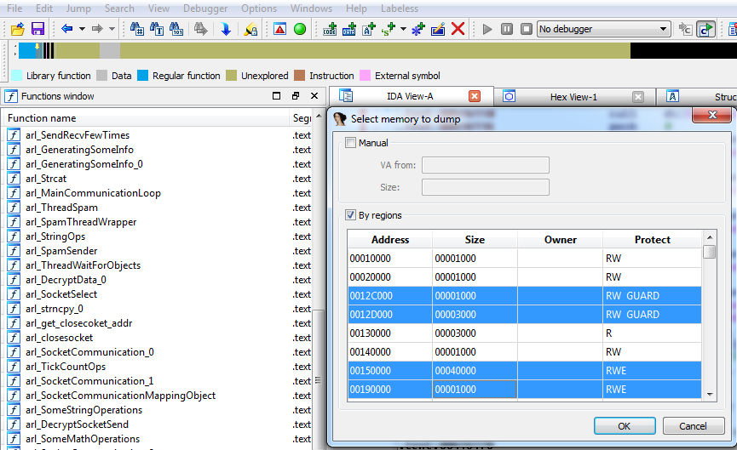
IDADump: Memory Map View
Notes:
Here is the how the main view of the IDADump looks like. You can select required regions of memory that needs to be dumped or provide them manually.
{CLICK_CHANGE_SLIDE}

Slide 20
Working Modes: Wipe & Import
IDA
Olly
IDB
Process
Notes:
There are 3 modes of operation of IDADump.
The first is “Wipe & Import”. It will wipe your current IDB
{CLICK}
And dump selected regions to it.
{CLICK_CHANGE_SLIDE}

Slide 21
Working Modes: Add Segment
IDA
Olly
IDB
Process
Notes:
The second is “Add segment”. It will preserve your current IDB
{CLICK}
And add a selected region to it.
{CLICK_CHANGE_SLIDE}

Slide 22
Working Modes: Overwrite segment
IDA
Olly
IDB
Process
Notes:
And the third one is overwrite segment. You can think of it like an update.
{CLICK}{CLICK}{WAIT}
{CLICK_CHANGE_SLIDE}

Slide 23
How Does IDADump Work?
Performs safe memory read (avoiding PageGuard tricks) of chosen segments
Performs exported functions scan in external modules. Fixes these functions references in target IDB
PE header analysis (if valid, helps IDA to decide where data is and where code is)
Performs post-processing analysis of dumped code
Notes:
How does it all work?
- IDADump performs safe memory read (avoiding PageGuard tricks) {CLICK}
- Also, it performs exported functions and APIs scan in external modules and fixes these functions references in target IDB. So, it’s basically imports fixing capability. {CLICK}
- PE header analysis is being performed (if it is valid it helps IDA to decide where the data is and where the code is) {CLICK}
- Finally, it performs post-processing analysis of dumped code
{CLICK_CHANGE_SLIDE}

Slide 24
Post-processing Analysis
IDA
IDA
Disassemble code referenced by jmp & call instructions
IDB
IDB
call dword_14C8 + ECh
…
jmp dword_14C8 + ABh
call sub_15B4
…
jmp sub_1573
Notes:
Here is how post-processing analysis is performed. We have calls and jmps like that. The code referenced by such calls and jumps will not be disassembled by IDA.
{CLICK}{CLICK}
We are tracking such situations, fixing them and forcing to disassemble.
{CLICK_CHANGE_SLIDE}

Slide 25

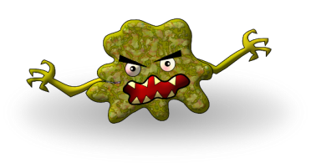
Multiple Injections
Process {1}
IDB {1}
Payload 1
Inject {1}
Process {2}
IDB {2}
Inject {2}
Payload 2
…
…
IDB {n}
Process {n}
Inject {n}
Payload n
Notes:
Now, let’s talk about how IDADump can be useful, when following multiple injections.
First of all, we’ll discuss the case, how to solve that problem without IDADump. Here is our malware ☺
{CLICK}
It injects itself into process #1.
{CLICK}{CLICK}{CLICK}
We dump that region using ordinary tools like LordPE, restore PE header and fix imports using Import Reconstructor Tool.
{CLICK}{CLICK}
Finally, we transfer the resulting dump from the virtual machine and load it to the IDA.
Then, malware performs another inject into the second process.
{CLICK}{CLICK}{CLICK}
We are performing all aforementioned actions again, while loading the resulting dump into separate IDA instance and separate IDB as well.
{CLICK}{CLICK}
Malware can perform a lot of injections like that.
{CLICK}{CLICK}{CLICK}
{CLICK}{CLICK}{CLICK}{CLICK}
We will end up with a lot of separate IDBs without any connections between them.
{CLICK}
{CLICK_CHANGE_SLIDE}

Slide 26

Multiple Injections
IDA
Process {1}
IDB
Inject {1}
Payload 1
…
…
Process {n}
Inject {n}
Payload n
Notes:
And here is the solution that IDADump provides.
Once again here is our malware. It injects itself into the first process.
{CLICK}{CLICK}{CLICK}
We are dumping that directly to IDB with automatic fixing of imports.
{CLICK}{CLICK}
It’s really just one click away.
Then, it injects itself into the second process.
{CLICK}{CLICK}{CLICK}{CLICK}
We are dumping it once again using “Add segment” mode of operation.
{CLICK}{CLICK}
That dumped region will be added to the same IDB.
{CLICK_CHANGE_SLIDE}

Slide 27
Multiple Injections
Advantages
All valuable information is located in one IDB file
No need to handle multiple IDA instances & look for correlation with other databases
The same EXTERN section for jmp & call operations
Sections relations are preserved
Notes:
Here are the advantages of using IDADump.
- All valuable information is located in one IDB file. We call it “Single research case – one IDB”. {CLICK}
- No need to handle multiple IDA instances & look for correlation with other databases {CLICK}
- The same EXTERN section for jmp & call operations. It’s basically a legitimate fixed imports table. {CLICK}
Also, sections relations are preserved
{CLICK_CHANGE_SLIDE}

Slide 28
Multiple Injections
Disadvantages
Mapping region of memory with address that is already used (Solution: may be solved using segments in IDA)
Notes:
We also have some disadvantages at the moment. For example:
Mapping region of memory with address that is already used. However, there is a solution for that. We can use segments in IDA to address that issue. We just need to implement that.
{CLICK_CHANGE_SLIDE}

Slide 29
Imports fixing
Notes:
Next… Imports fixing functionality.
{CLICK_CHANGE_SLIDE}

Slide 30

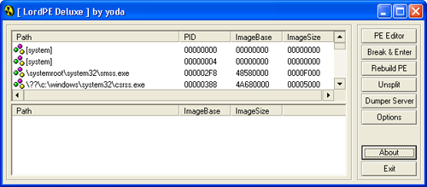
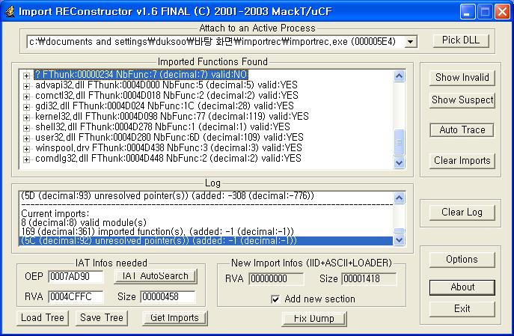
How to Make jmps & calls in Dumped Memory Human-Readable?
call near ptr 7529916Dh
…
jmp near ptr 752A2F2Fh
…
call near ptr 752B1DF5h
Notes:
Here is how we usually make jmps & calls human readable in dumped memory, without using IDADump. We use some dumping tool
{CLICK}
Then apply Import Reconstructor-like tool to that dump to restore imports.
{CLICK}
A lot of numbers, a lot of data, a lot of room for errors.
{CLICK}{WAIT}
{CLICK_CHANGE_SLIDE}

Slide 31
LordPE & ImpRec Solutions
Disadvantages
Manual search of import table(s) in already running binary
Manual calculation of relevant offsets and addresses
Import table may reside in multiple sections
Time consuming
Error-prone
Notes:
There are even more disadvantages. For example: {CLICK}
- You need to perform manual search of import table in already running binary {CLICK}
- You also need to manually calculate relevant offsets and addresses {CLICK}
- Import table may reside in multiple sections {CLICK}
- Its time consuming {CLICK}
- And error-prone {CLICK}
{CLICK_CHANGE_SLIDE}

Slide 32
Labeless Solution (Getting APIs)
IDA
Olly
IDB
Process
Module {1}
exported functions
…
Labeless internal structure
Module {n}
Notes:
Here is our solution to that problem.
We have an IDB with the dumped memory regions, but they have an unresolved imports table. So, Labeless is sending a request to enumerate all loaded modules in the target process.
{CLICK}{CLICK}
Then, it will gather all exported functions from these modules alongside with their addresses.
{CLICK}
This data will be transferred to IDA and stored in the Labeless internal structure.
{CLICK}{WAIT}
{CLICK_CHANGE_SLIDE}

Slide 33
Labeless Solution (Applying APIs)
IDA
IDA
Check if address 0x7C802446 is present
IDB
Internal Structure
exported func {1}
call 7C802446h
call Sleep
exported func {2}
Sleep() function
…
EXTERN
Sleep
exported func {n}
Notes:
Next, we find all unresolved calls, jmp, etc. in our IDB. We take that address and check if we have it in our internal structure.
{CLICK}
If yes, we return a label for that
{CLICK}
Create an EXTERN segment, place an appropriate import record here and fix it in the code to point to that record.
{CLICK}
Basically, we are restoring imports table on the fly.
{CLICK_CHANGE_SLIDE}

Slide 34
Labeless Solution
call near ptr 7529916Dh
…
jmp near ptr 752A2F2Fh
…
push 752B1DF5h
retn
call OpenProcess
…
jmp GetCommandLineW
…
push WriteProcessMemory
retn
Notes:
So, we go from this…
{CLICK}
To this.
{CLICK_CHANGE_SLIDE}

Slide 35
Labeless Solution
Advantages
No need to perform error-prone tasks
Searching for sections with imports
Offsets and addresses calculation
Automatic fixing of functions located in external modules
Quicker than any existent solution
Saves precious researcher’s time
Can be performed on the fly
Notes:
Advantages are obvious. For example:
{CLICK}
- No need to perform error-prone tasks such as:
Searching for sections with imports {CLICK}
Or manually calculate offsets and addresses {CLICK}
- The next advantage is automatic fixing of functions located in external modules {CLICK}
- Its quicker than any existing solution {CLICK}
- It saves precious researcher’s time {CLICK}
- And it can be performed on the fly, while dumping the process, resulting into the seamless experience
{CLICK_CHANGE_SLIDE}

Slide 36
IDA-OLLY SCRIPTING
Notes:
And the last feature of Labeless: IDA-OLLY Scripting interaction
{CLICK_CHANGE_SLIDE}

Slide 37
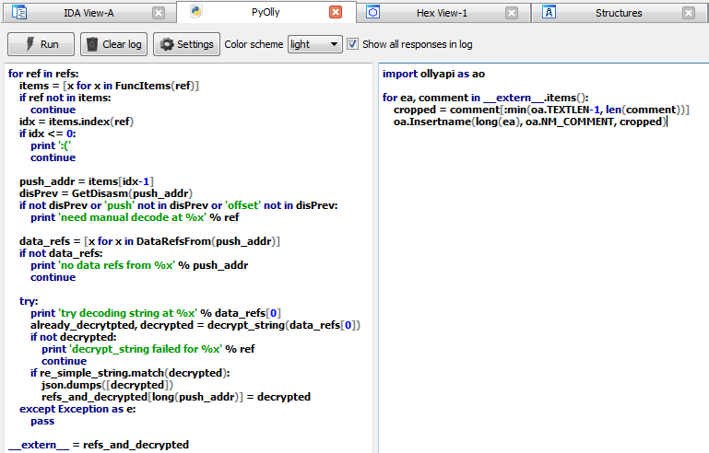
IDA-Olly Scripting: IDE View
Notes:
Here is the main IDE view of it. On the left side you can see the code that will be executed in IDA and on the right side the code that will be executed in Olly.
It has syntax highlighting, different color schemes, error reporting and lot of other stuff.
{CLICK_CHANGE_SLIDE}

Slide 38
IDA-Olly Scripting: Common Data
IDA
IDA-Olly Scripting IDE
IDA Script
Olly Script
tp = dict()
for i in range(100):
tp[i] = i * i
__extern__ = tp
for k in __extern__:
print ‘ext[%u] = %u‘ \
% (k, __extern__[k])
Notes:
These scripts can share data between them. For example:
We can produce a dictionary in IDA, place it into external variable
{CLICK}
And propagate it over some data on the Olly side.
{CLICK}
It’s a complete scripts interaction.
{CLICK_CHANGE_SLIDE}

Slide 39
Architecture
IDA
Olly
Labeless Scripting Engine(PyExCore)
Server
IDA Script
__extern__
and
Olly Script
Execute IDA Script
filling __extern__
Execute Olly Script
using __extern__
Olly Script
Notes:
Here is how it works internally:
We are feeding IDA & Olly python scripts provided by the user to Labeless Scripting Engine, which is the part of PyExCore.
{CLICK}
Then, we execute an IDA python script and filling external variable.
{CLICK}
It will be passed alongside with Olly python script to OllyDbg.
{CLICK}
Finally, it will be executed in Olly.
{CLICK}
External variable will be used as needed. We can pass any data here.
{CLICK_CHANGE_SLIDE}

Slide 40
Conclusion
Notes:
And the conclusion.
{CLICK_CHANGE_SLIDE}

Slide 41

Labeless
Automatic tool for on-the-fly labels synchronization between IDA and Olly that supports module rebasing
Automatic tool for on-the-fly imports fixing that is faster than any existing tool
Convenient tool for IDA-Olly scripting synergy
Easy to use memory dumping tool
Notes:
Labeless is: {CLICK}
- Automatic tool for on-the-fly labels synchronization between IDA and Olly that supports module rebasing {CLICK}
- Automatic tool for on-the-fly imports fixing that is faster than any existing tool {CLICK}
- Convenient tool for IDA-Olly scripting synergy {CLICK}
- And easy to use memory dumping tool
{CLICK_CHANGE_SLIDE}

Slide 42
Areas of Improvement
WinDBG support
Support of x64 architecture
Notes:
Of course, there are some areas of improvement
{CLICK}
We want to add a WinDBG support. It will virtually allow dumping code directly from kernel, while remote debugging.
{CLICK}
Also, we want to add an x64 architecture support.
{CLICK_CHANGE_SLIDE}

Slide 43
Labeless Repository
Labeless is available as open-source
Source code is released under Creative Commons BY-NC 4.0
Link to repository: https://bitbucket.org/a1ex_t/labeless
Notes:
And the best of all: Labeless is available as open source. You can find it in our BitBucket. You can see the link on the slide.

Slide 44
QUESTIONS?
Aliaksandr Chailytko | Team Leader
Aliaksandr Trafimchuk | Malware Researcher
Contacts:
alexanderc@checkpoint.com
Thanks to:
Stanislav Skuratovich
Notes:
That’s it. Questions?

