Slide 1
MS Endpoint Privacy and Security – What Works and What Does Not
Stephen Northcutt SANS Technology Institute www.sans.edu
You probably know much of this already, but it is amazing how we quit doing what we know we ought to do. So, we will go quickly and then you can follow up, all of this is pretty easy to do.
Notes:
Last researched April 20, 2010

Slide 2
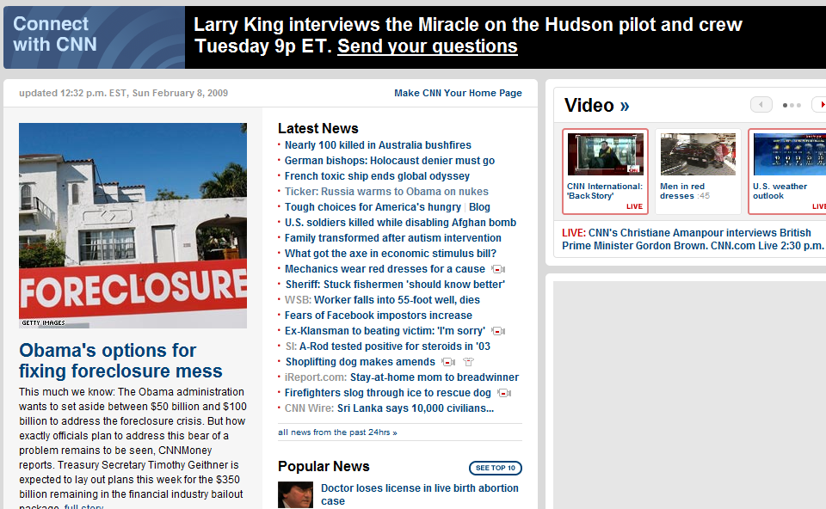
When we browse, we don’t really know what we are getting: CNN
Notes:
When we browse the web, we see the displayable content and our natural assumption is that it is all being displayed by a single web server. However, we know that it is more common to have a mashup of multiple servers and in addition to the content, there is also scripting.

Slide 3
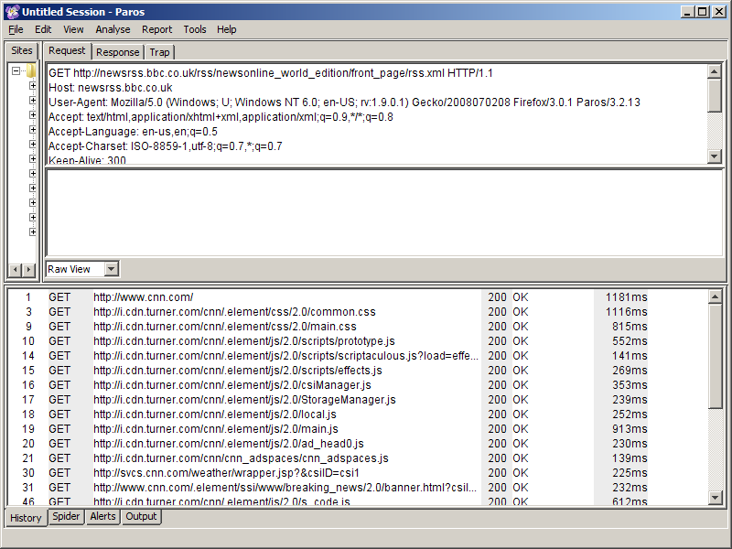
The Beginning of the Rest of the Story
Notes:
This is a collapsed view from Paros: http://www.parosproxy.org/index.shtml and we can look at the traffic in more detail. We see that when you go to CNN.COM you retrieve data from multiple web sites, much of it is non-viewable. You also potentially let Google know you have gone there. If you are using the Google Toolbar tons of information is being sent to Google including URLs and possibly even your physical location.

Slide 4
Managing the Browser
Never do online banking with multiple tabs open. Best to close and reopen browser.
Use two browsers AT MOST; if you use two, do all your downloads with one of them and keep the other as vanilla as possible. With that strategy use one browser ONLY for electronic banking.
Don’t click on a link in a pop up window, they are often opened by malicious or spyware oriented sites
Don’t click on a link in a mail message, copy paste the link in your browser
Notes:
A growing number of compromises are based on attacks against browser extensions. Therefore, to have more plugins is not better.
Keep in mind there have been cross browser exploits, where one browser downloads a file and another executes it. Consider using only one browser. If you must use two (and I must), consider doing all of your downloads with one. Jeremiah Grossman, who is far more knowledgeable than I, suggests using one browser for general purpose surfing and one for Internet banking only.

Slide 5
Are Cookies a problem?
Cookies personalize your web experience and are more beneficial than not. However . . .
Tracking cookies record your browsing experience.
3rd party cookies are cookies that happen from mash ups like the CNN example. A marketing firm might serve many web sites.
The Google cookie puts a unique ID on what you do, they also own Doubleclick and . . .
Notes:
Cookies are used to keep state. No sane person would try to surf the web without them, however it does not hurt to clean them out from time to time. In addition, you might want to intentionally delete your Google cookie. Not that there is only one of them, if you use Google checkout you will have that and Google Translate or Finance and they will not all be together since Google names them Translate.google.com etc.

Slide 6
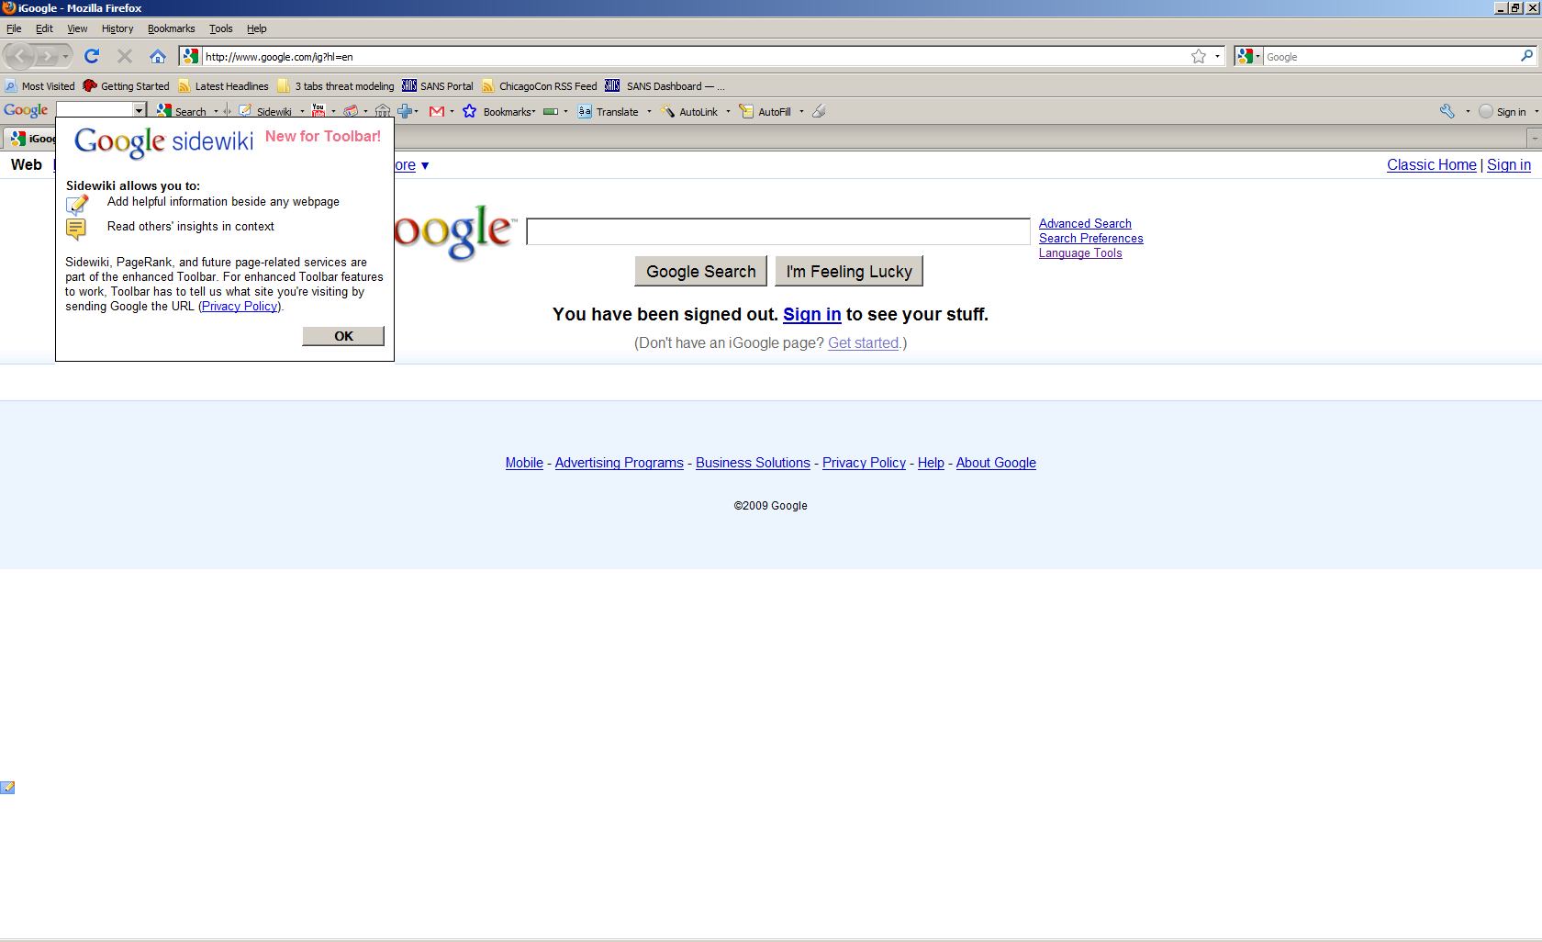
Google knows a lot about you
Notes:
When I updated Firefox 3.5.6 (currently running 3.6.3), this message popped up, this was late December 2009. At this point I disabled the Google Toolbar. Nothing against Google, I think the world of their products, but I want some privacy about what I do, especially with my research.

Slide 7
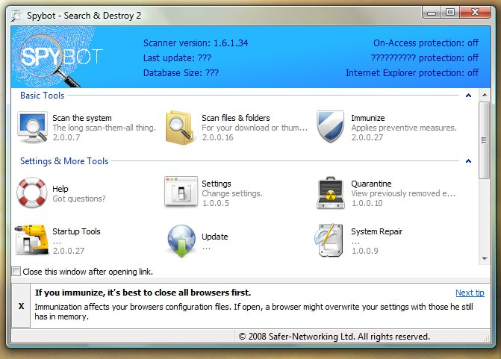
Spybot Immunize and Browsers
If you haven’t visited their web page in a while you should, they are still working.
Notes:
Once again, we see browser linkage issue illustrated. Only this is a totally different type of linkage. Instead of IE and Firefox, this has to do with the configuration files in a running browser overwriting configuration files Spybot writes while trying to “Immunize” the browser. Spybot Search and Destroy Immunize is a memory resident function to prevent tracking cookies from being added to your system. However, when you close a browser, its settings can overwrite the settings that allow Immunize to work. This is a classic problem in software to be aware of as the world becomes ever more browser and clicking centric.
Spybot is available in a corporate version and versions are available for Windows mobile and Symbian phones as well. They are working on Spybot 2.0 and it should be available in a few more months.

Slide 8
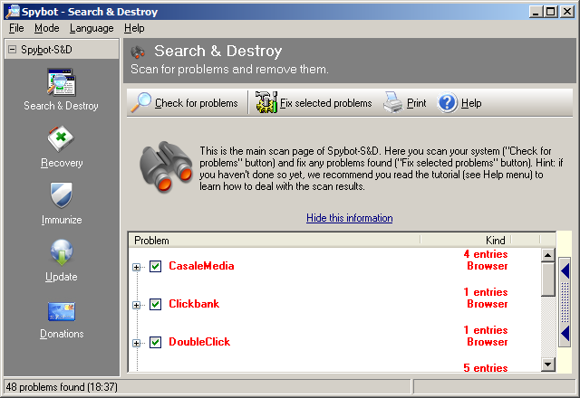
Immunize is not perfect
Notes:
Even with an Immunized system, you will still collect some tracking cookies over time.

Slide 9
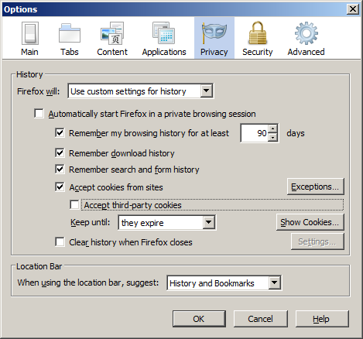
Tracking Cookies Firefox
Notes:
Here we see the Firefox setting to not accept third party cookies. This will increase your privacy, but may impact some functionality with some web sites.

Slide 10
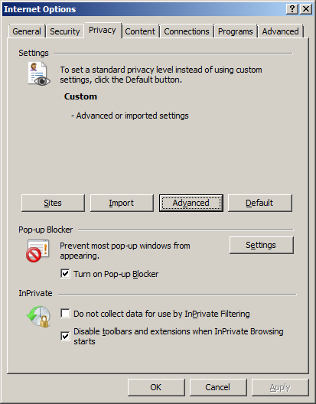
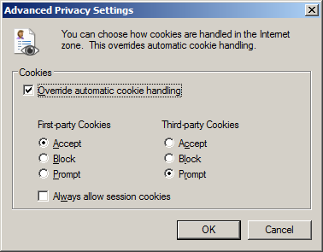
Tracking Cookies IE 9
Notes:
I tried to use the Medium high setting to accept 3rd party cookies if they have a privacy policy, but complex web pages seemed to break.

Slide 11
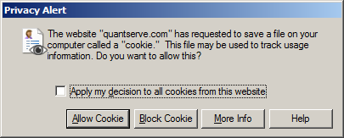
Now we trade off knowledge for time and effort
Notes:
OK, DO NOT set prompt for cookies on your spouse’s computer, however you might want to do this on your own, at least for a couple weeks so that you can familiarize yourself with the marketing groups trying to put cookies on your system to track your surfing habits.

Slide 12
Private Browsing Mode
Both Firefox 3.6 and Internet Explorer 9 support Private or InPrivate Browsing mode. When does it make sense to use it?
Anytime you are going anywhere your mother might not approve of AND
Anytime you are doing any kind of ecommerce, online banking or similar, what is done at Amazon needs to stay at Amazon
Anytime you are accessing your work portal
Notes:
A lot of people say they have nothing to hide. However

Slide 13
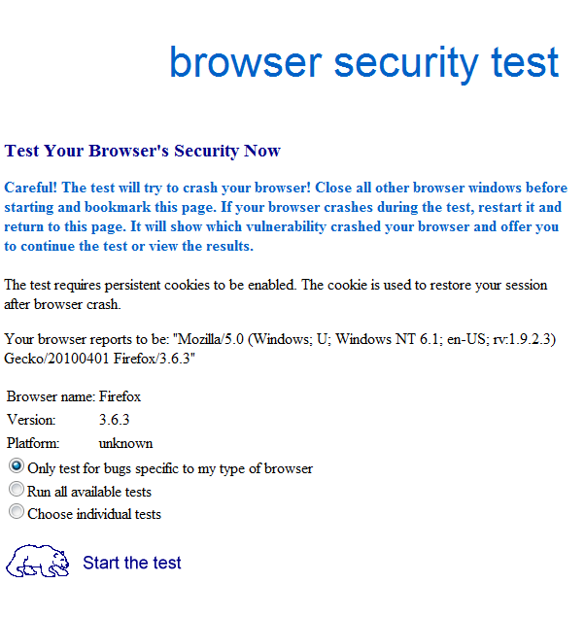
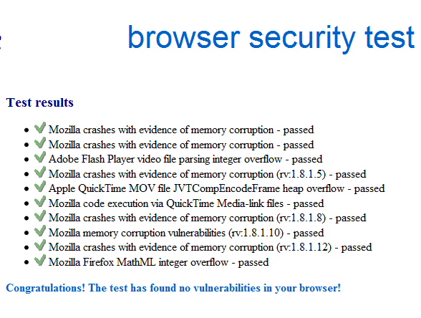
Browser Vulnerability http://bcheck.scanit.be/
An alternative to bcheck, http://www.jasons-toolbox.com/BrowserSecurity/
Notes:
If the browser is one of the two most significant threat vectors, partly because we spend so much time web surfing, then we need to validate that the browser is as secure as it can be. Scanit looks for known vulnerabilities in the browser. Keep in mind that you probably want to rerun the test every time you update an add-on. I list Jason’s toolbox still, but it does not appear to be that up to date. For instance it gives instructions to disable 3rd party cookies for Internet Explorer 6.

Slide 14
Host Table
# This hosts file is brought to you by Dan Pollock
# http://someonewhocares.org/hosts/
# Please forward any additions, corrections or comments by email
# hosts@someonewhocares.org
# The sites ads234.com and ads345.com
#hijack internet explorer, redirect requests through their servers.
127.0.0.1 ads234.com
127.0.0.1 ads345.com
127.0.0.1 www.ads234.com
127.0.0.1 www.ads345.com
Notes:
By putting a host table on the endpoint setting the loopback address to 127.0.0.1, if you did get redirected, you would have a degree of protection. Now at least on System 7 this is a bit complicated. C:\Windows\System32\drivers\etc is read only. So you have to right click on the host file and make it so users can modify and write. You also want to be very careful not to do a save as or notepad will write it as hosts.txt and it has to be hosts. Finally, I ran in to the famous carriage return / linefeed Unix to Windows problem so I had to open the file in wordpad and save it. However, it is all done and my system should be much safer for it.

Slide 15
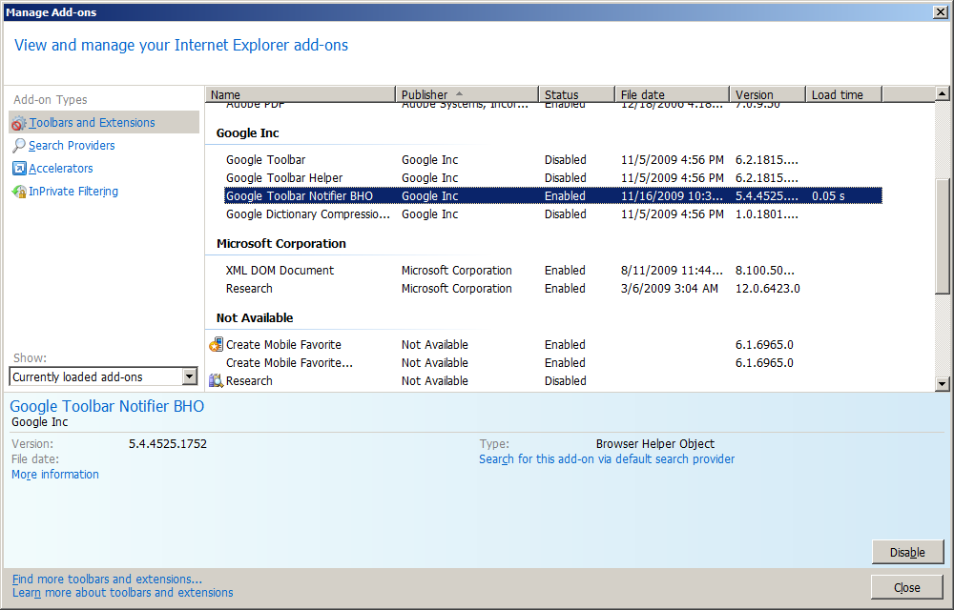
Internet Explorer 9 Manage Add-Ons
Notes:
To continue the previous discussion about Google, I have made the decision to limit the Google toolbar. I still have search in the upper right hand quadrant of the browser.

Slide 16
Firefox Specific Tips
Minimize the use of plug-ins, even security plug-ins can be exploited
NoScript if you are serious about safe surfing
Finjan Foxfire plug-in, warns about bad sites, however it slows the system down
Stay up to date!
Notes:
For the purpose of this talk we want to avoid a discussion about whether Internet Explorer is better than Firefox or vice versa. I think we can all agree that they are the two top browsers in use and so we want to know as much about them as possible.
NoScript is my primary line of defense for Firefox.

Slide 17
White and Black Listing
Warning: The White List technology we are going to discuss does work, but trying to uninstall it can be a real bear.

Slide 18
Anti-Virus Has Reached a Limit
Scanning, scheduled, manual, as a new file is accessed, email attachments
Scanning compressed files, at least .zip
Autoclean files, quarantine ones that cannot be cleaned, tools to empty the quarantine periodically
Web-based malicious code is a hard problem because you are pulling the info from the web server which can make it appear any way
Google research show 3 AV vendors, one detected 90%, one 60%, one 35% web-based attacks, so use a second product from time to time.
Notes:
The classic every Friday weekly scan with Symantec is just not that effective anymore. Stand-alone AV is not enough. You really want a suite such as Norton Internet Security or Trend Micro. Specifically, components for behavioral-based detection, anti-rootkit, and a strong web traffic analysis component. Also, you may want a tool that maintains scan history for enterprise compliance needs.
As is illustrated by the Google paper "All your iFrames belong to us",[1] malicious browser scripts are a popular attack vector, but these scripts are often polymorphic. The scanner cannot rely on signatures; to be effective it needs to have some JavaScript emulator that is fast—a difficult problem to solve. NoScript is useful for the present, but hopefully in the future we will be able to purchase more full-featured “browser firewall/scanner” functionality with security suites.
The biggest anti-virus issue is the rootkit problem: if the malware can get lower in the stack than the scanning tool, it can evade detection.
1 http://research.google.com/archive/provos-2008a.pdf

Slide 19
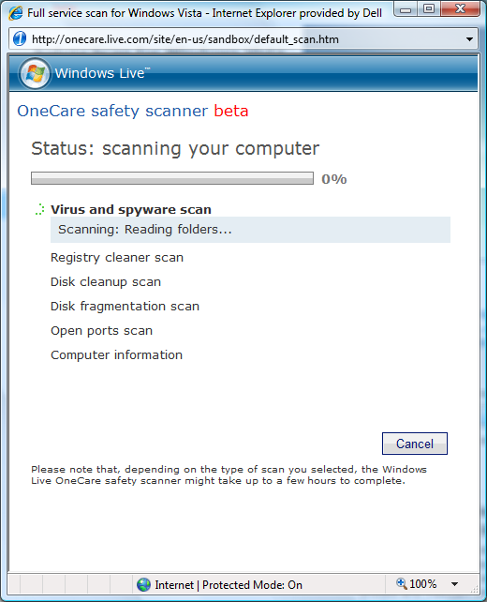
Microsoft is Working on a Next Generation of Regclean
I still run TeaTimer on my XP system.
I have not succeeded with System 7 version. Error code 0x0C600C03
Notes:
I wasn’t able to get the Microsoft scanner to work initially on either my XP or Vista. I do have my browser settings for high security and that was probably part of the problem. I was safe, but nothing was working. After I restored default settings, I was able to run the scanner. The document I used to increase security for Internet Explorer is: http://www.microsoft.com/protect/computer/advanced/browsing.mspx
Their new tool, Safety Scanner does more than clean up loose ends in the registry, it also checks to see if your disk needs defragmenting. Since this is a Vista box, it does not typically need defragmenting as Vista schedules a weekly defragmentation session.

Slide 20
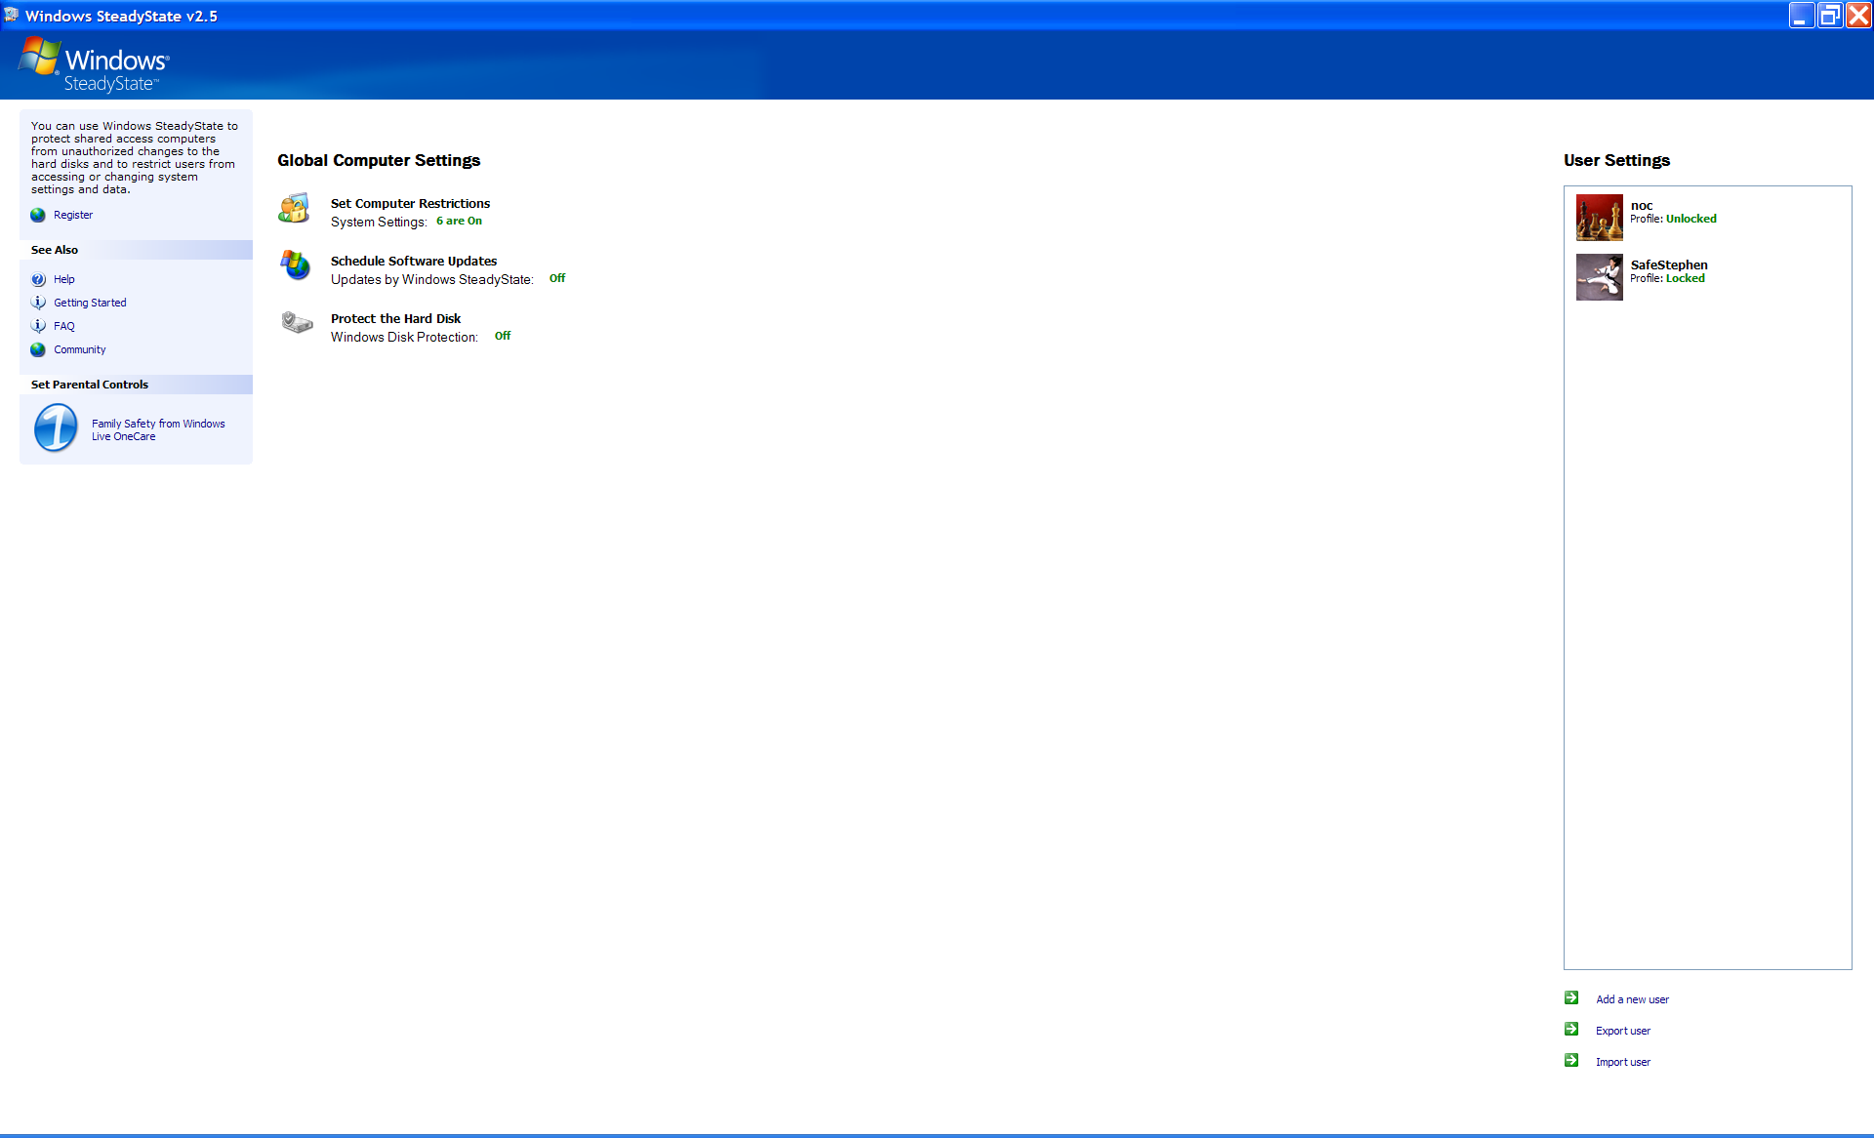
Windows SteadyState
SteadyState is primarily for shared users, but I use it on my personal non-shared laptop and simply turn almost everything off and rely primarily on the command to only allow programs in the program files to execute.
WARNING make a full backup of your system before installing SteadyState, there are many tales of woe.
Notes:
SteadyState will lock your configuration down pretty well and it is a free tool from Microsoft. You create a new user, in my case SafeStephen. And then that user runs with a lot more restrictions, no access to control panel, registry editors, that sort of thing. It is all configurable from a GUI control panel. I turned most of the controls off, but kept the one denying programs that try to execute other than from the Programs folder. This should keep a web page from being able to execute a program.

Slide 21
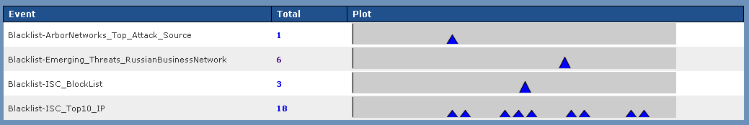
Blacklisting Is Still Useful!
Network Behavior Analysis Detection (NBAD) is really just a buzzword for some classic fundamentals, here we see hits from the Russian Business Network on a Tenable Security Center console. This is much easier to implement for endpoints within a corporate environment.
Notes:
NOTE: When you read whitelist blacklist, there is a chance of significant confusion. Much of the use of blacklists is related to email – spam management. We are focused on the use of lists of known bad software, known bad sites.
In a sense this is low hanging fruit, you collect the IP addresses associated with known bad actors like RBN or the Internet Storm Center top ten, and if any of your internal systems connect to them it is worth investigating.
Detection is really important. We can’t clean a system till we know it has a problem. One thing to consider is managed outsource providers such as SecureWorks. If you let them manage your IPS and Firewall log infrastructure, or even your internal logs, they can often find problems. One of the researchers on this project noted that *all* of the vendor systems they allowed to connect to their network were infected. Of course the ancient nemesis of detection, false positives is still a problem, you find your self responding to packets created by browser toolbars all too often.

Slide 22
Heuristics, Still Trying After 20 Years
Looking for the characteristics of malware
Not available in all anti-virus/anti-malware, hard to do well
Like signatures, typically reacting to advances by the attackers
Sophos’ heuristic detection is moving in the right direction. They have executable packer detection. The false positive rate is pretty low and authorizing a new program is quick and easy. The suspicious behavior detection is more prone to issues. With some testing you can find the right combo of different features to match your network.
Notes:
Quoted from http://mirror.sweon.net/madchat/vxdevl/vdat/epheurs1.htm
F = Suspicious file access. Might be able to infect a file. R = Relocator. Program code will be relocated in a suspicious way. A = Suspicious Memory Allocation. The program uses a non-standard way to search for, and/or allocate memory. N = Wrong name extension. Extension conflicts with program structure. S = Contains a routine to search for executable (.COM or .EXE) files. # = Found an instruction decryption routine. This is common for viruses but also for some protected software. E = Flexible Entry-point. The code seems to be designed to be linked on any location within an executable file. Common for viruses. L = The program traps the loading of software. Might be a virus that intercepts program load to infect the software. D = Disk write access. The program writes to disk without using DOS. M = Memory resident code. This program is designed to stay in memory. ! = Invalid opcode (non-8088 instructions) or out-of-range branch. T = Incorrect timestamp. Some viruses use this to mark infected files. J = Suspicious jump construct. Entry point via chained or indirect jumps. This is unusual for normal software but common for viruses. ? = Inconsistent exe-header. Might be a virus but can also be a bug. G = Garbage instructions. Contains code that seems to have no purpose other than encryption or avoiding recognition by virus scanners. U = Undocumented interrupt/DOS call. The program might be just tricky but can also be a virus using a non-standard way to detect itself. Z = EXE/COM determination. The program tries to check whether a file is a COM or EXE file. Viruses need to do this to infect a program. O = Found code that can be used to overwrite/move a program in memory. B = Back to entry point. Contains code to re-start the program after modifications at the entry-point are made. Very usual for viruses. K = Unusual stack. The program has a suspicious stack or an odd stack.

Slide 23
Industry Tipping Point – White Listing
Industry reversal from leading with black lists, signature, file names, known subject lines, file sizes, extensions
Now, much of the focus is on white listing/whiteware
Better interception rate with hybrid capacity to analyze malware out-of-band
Whiteware technical approaches
Policy-Based: Management intensive and capable of false positives
Signature Databases: Large databases of application signatures. Can present a single point of failure/injection.
Decentralized Execution Control: Low overhead without the vendor reliance. Added bonus of end user error tolerance.
Notes:
Since most of the attacks are targeting the human element (user interaction) the concept of whitelisting is being discussed again. This would work well for corporations that have common computing platforms. Once the "gold" image has been built, a whitelist of all the processes can be added to the whitelist. No process would be allowed to operate unless authorized. Basically this is the firewalling concept on a host (although most people still don't correctly configure firewalls for restricting outbound communication). The many variables will make this concept difficult to implement; however, it may offer another layer of protection at the end point. This is going to be a lot of work, it will have to be maintained, but it offers a lot of promise.
Policy-based Whitelist vendors include: McAfee, Lumension. Signature Database: Appsense, Bit9. Decentralized Execution Control: CoreTrace, Savant.
Whitelisting tools are really attractive, but some large organizations may find they don't have the political will to manage this. Imagine the remote sales guy who can't connect to Salesforce.com at the end of the quarter. All it takes is one MINOR hiccup with these tools and you have a MAJOR political issue. You can experiment with the concept with the free tool trust-no-exe:
http://www.beyondlogic.org/solutions/trust-no-exe/trust-no-exe.htm

Slide 24

Bit9 Parity and The Global Software Registry
Elimination of unauthorized software for security, compliance, and operational benefits via trust-based whitelisting
Comprehensive approach:
Adaptive Application Whitelisting simplifies the creation and updating of the whitelisting of known trusted entities
Software identification for the approval or banning of unknown applications
Only vendor with both approaches
Automation for trusting authorized update
Massive application catalog (GSR) for determining trust for new and unknown applications
Testimonials of the company’s leadership from customers, eWeek product review, Gartner coverage
Notes:
Bit9 centrally controls which applications and devices are allowed to operate, thereby preventing malicious software and data leakage. There are two other key points that could be made:
Whitelisting is more than an endpoint security play, it also provides compliance and operational benefits with its ability to eliminate unauthorized software
As is true in most emerging markets, there are varying definitions of whitelisting. The incumbent AV vendors frame whitelisting more as what not to scan to shore up the inefficiencies of a blacklisting approach. By not scanning known goods, AV vendors try to make their engines faster. But that does not address our view of whitelisting – what not to run. So, what not to scan versus what not to run. Fundamentally different approach.
http://www.bit9.com/

Slide 25

CoreTrace
CoreTrace Bouncer does more than just whitelisting, it provides full platform coverage
Autogenerated File Policies mean rapid deployment and protection against all threats – including zero-day and targeted attacks
Network Policies protect against DDoS attacks or malformed packets
Buffer overflow protection prevents known-good content from being exploited
Trusted Change allows for secure, automatic updates to the whitelist from Trusted Sources (Trusted Updaters, Applications, Network Shares), and via Trusted Users
Notes:
From their webpage: http://www.coretrace.com/products/default.aspx :
* No malware running rampant compromising security, availability and performance
* Fewer security patches consuming all your IT staff time
* No unmanaged or unauthorized configuration changes
* Improved regulatory compliance through increased security and visibility
* A more secure, more available and lower cost endpoint infrastructure by employing auto-generated and custom-tailored application whitelists
* Higher employee productivity due to NEW “Trusted Change” (patent pending) that allows users to install and upgrade applications from trusted sources without involving IT staff each time
* A turnkey, low impact and tamper-proof solution rooted in a patented network that operates at the lowest levels of the operating system
* Security beyond simple application whitelisting, including protection from memory buffer overflow exploits (even if they’re using approved applications) and network filtering
* Visibility into endpoint configurations and security

Slide 26
Savant Protection
Distributed, differential whitelisting engine
Designed to provide several key security enhancements
Malware spread elimination
System lockdown regardless of mgmt state
Extremely lightweight runs on my Atom processor
Use a whitelist derivation technique which creates unique keys for every object
Very hard for hackers to derive
Inherent tolerance for human error
Notes:
Savant gives you a "come as you are" approach. If there is already malware on the system, it will add the signature of the malware to its list. However, it will not allow the system to get in worse shape by adding more malware nor will it allow the existing malware to update.

Slide 27
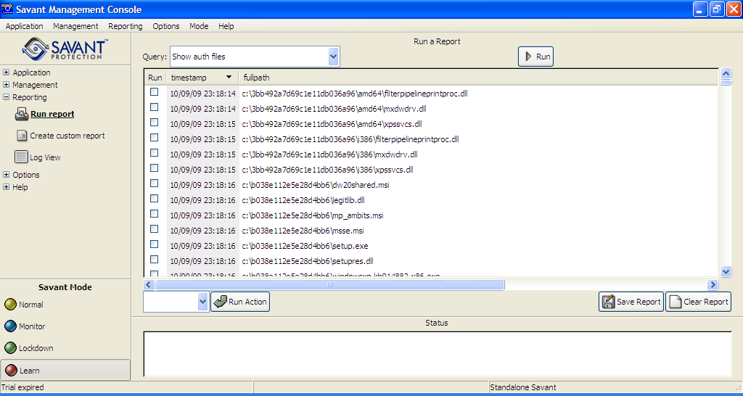

Slide 28
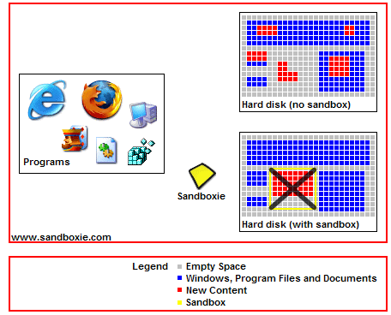
Sandboxie
Sandboxie, puts a wrapper around Internet Explorer, Firefox, Outlook applications
http://www.sandboxie.com/ at the time of this update Sandboxie does support 64 bit systems and Windows 7
Notes:
Under Tools -> Internet Options -> Security you can increase the slider bar to High Security. The minimum you should run is Medium High. However, you will break some functionality on High. For example, even after adding the Marriott San Diego Marina to my trusted sites, I could not buy Internet access, the box did not pop up (probably because it came from a different source). However, with Firefox and NoScript, this was not a problem. If you know the sites that you need to work with are trustworthy, you can add them. At a minimum, you need MS Update listed here.
Sandboxie, has a lifetime fee of 30.00 US and runs IE virtually. If you want to surf around, this is recommended.
If you must be local administrator and surf the web, you probably want DropMyRights. It launches the browser as a regular user.
Install and keep up to date a host table.
If you are at risk of clicking on links in Outlook before you have your first cup of coffee, you may want to render messages as text. http://www.microsoft.com/protect/computer/advanced/browsing.mspx suggests consider setting, Read All Messages as Plain Text. For Office 2007 Tools -> Trust Center -> Email Security, but it makes messages harder to read and you can still click on links, so I do not do that.

Slide 29
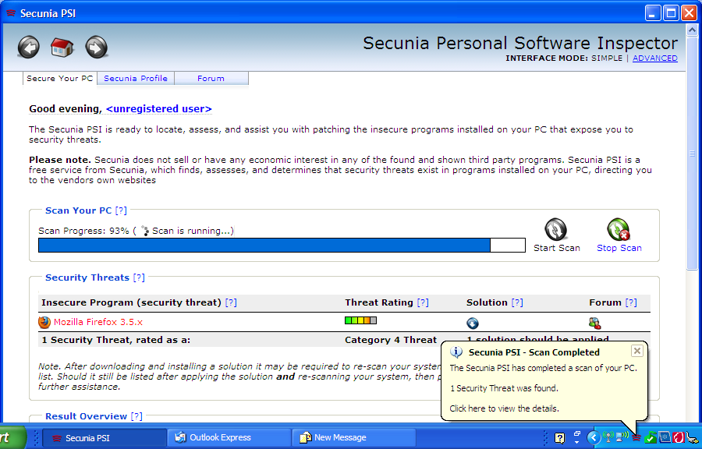
Secunia PSI
Also consider F-Secure Health Check
Notes:
Secunia Personal Software Inspector can help you identify software that needs to be updated and they give you a nice interface, but it still may not be possible to fix things. Many of the manufacturers, including Microsoft, have flawed update systems.

Slide 30
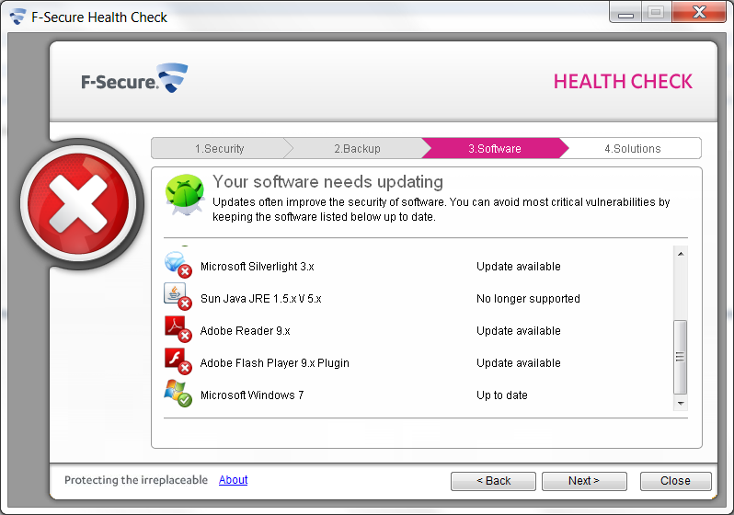
F-Secure Health Check
Notes:
Also consider F-Secure Health Check. F-Secure is web-based. I was not able to get it to run on my Vista box during the research phase for this presentation, it requires Internet Explorer and something that I have done with the security settings to protect my browser seems to be interfering with their software. I was able to run it on my XP box and System 7; on XP, I had to install the ActiveX control and authorize a registry change with TeaTimer. Of the two programs, I think Secunia is better, but I would love your feedback.
System 7 had zero issues on the install. However, when I tried to update the programs, they do a URL redirect and Internet Explorer 9 default setting does not like that. Also, the Sun Java message you see on the slide is in error, I have the latest Java. The issue of how to distribute non-Microsoft client-side patches is a big one: products to accomplish this are expensive and smaller companies don’t know what to do.

Slide 31
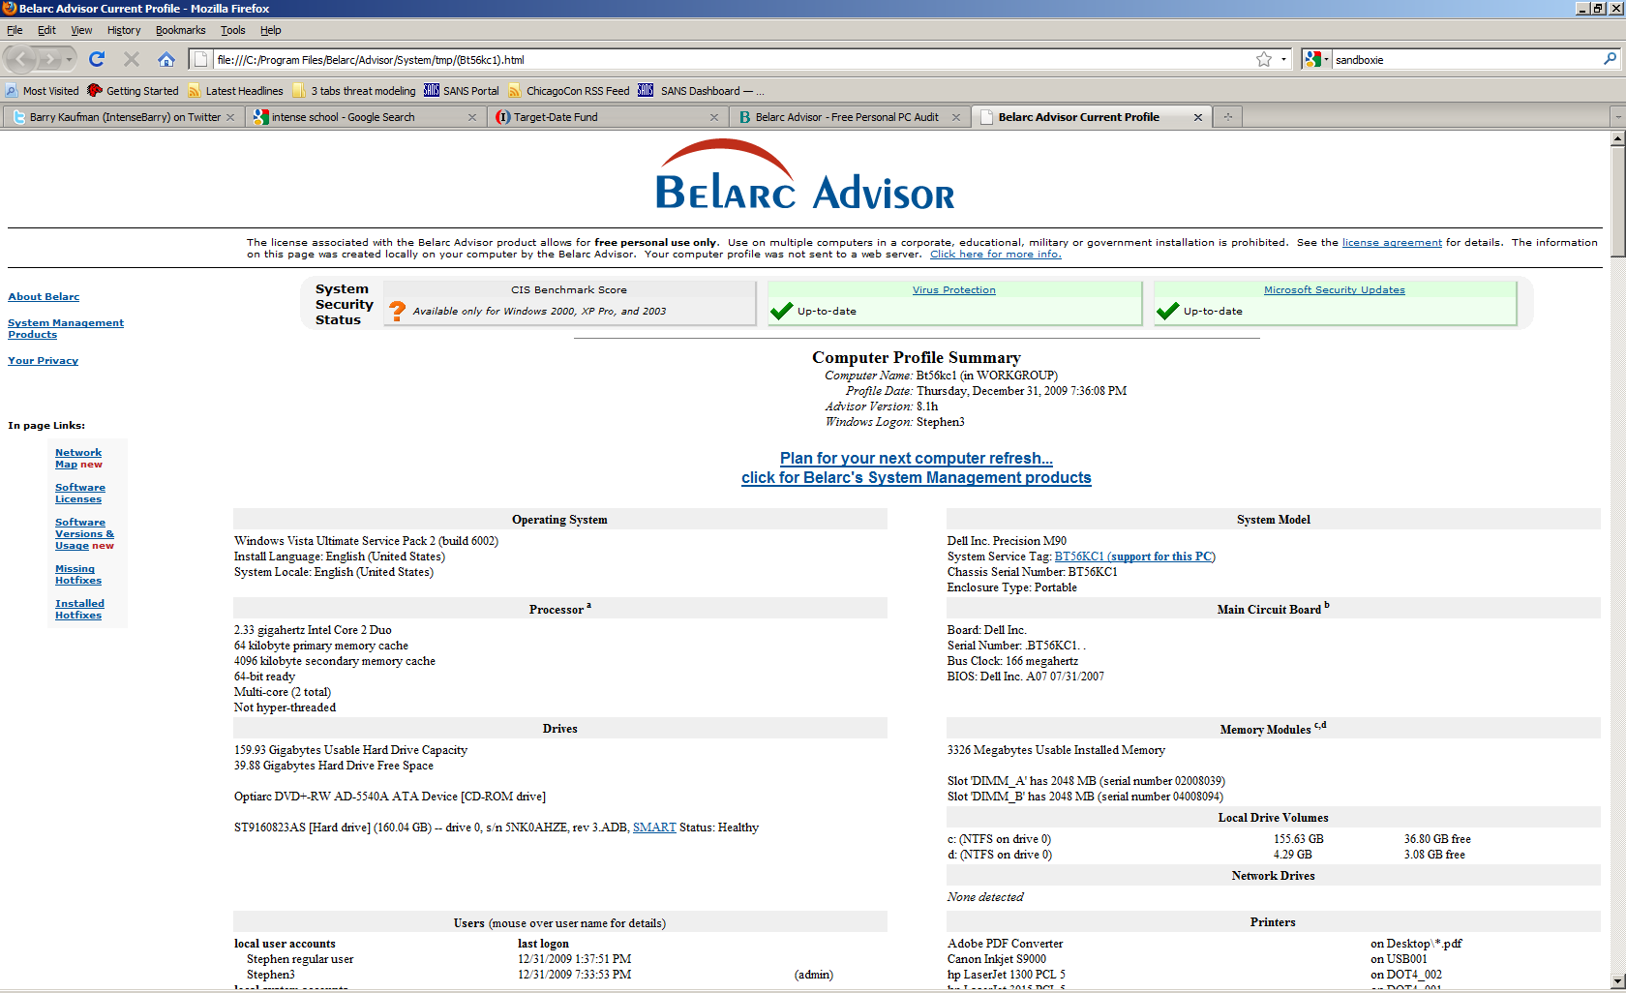
Belarc Security Advisor
Notes:
Finally, there is the Belarc Advisor (http://www.belarc.com/free_download.html), also free for personal use. It is unique in that it compares your configurations against the Center for Internet Security (www.cisecurity.org) benchmarks though they do not have a benchmark for Vista as of Jan 2010.

Slide 32
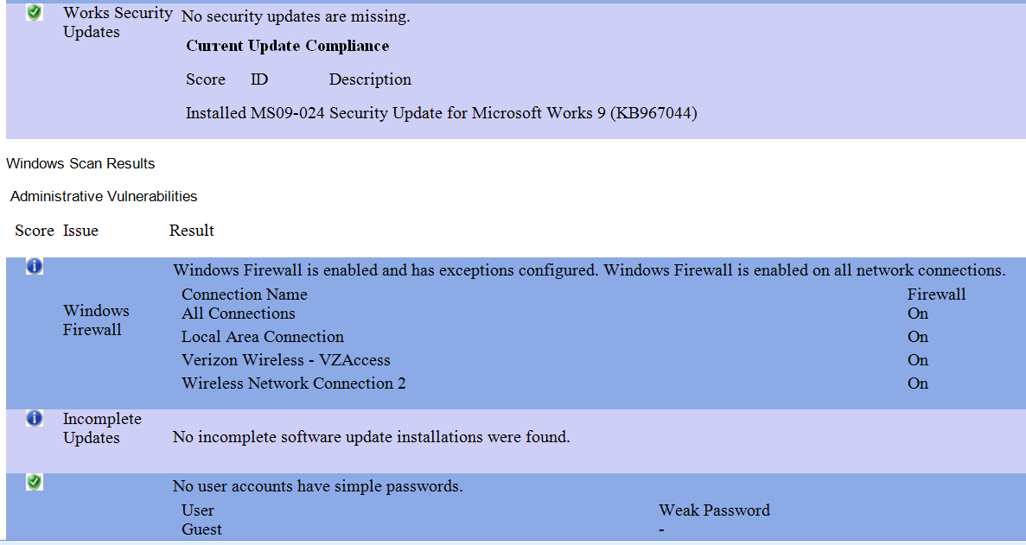
Microsoft Baseline Security Analyzer 2.1.1
Notes:
Failed to install on my Vista box. I was able to get 2.1.1 running on my XP without any problems. The report is much bigger than the piece I harvested with the Snipping Tool.

Slide 33
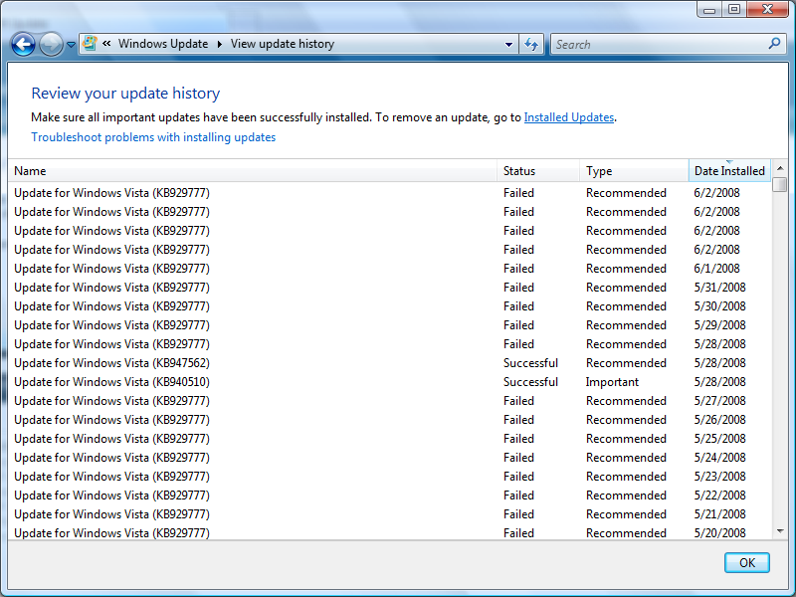
Run Windows Update To See History
Notes:
Here we see that a Microsoft patch is not installing on my Microsoft Vista system. That is amazing because just about everything else installs just fine, including malware. The standard client/server model consists of three parts: the server system, the client system and the network. In the old days, hackers attacked the server because that’s where the access was. Good sysadmin practices, such as patch maintenance, detection tools, logging tools, etc., helped reduce the threat to the server system. The hacker then shifted their attacks to the network by installing sniffers. This was an attempt to capture the cleartext traffic and hopefully grab userid and password information. The sysadmins countered this threat by installing encryption tools such as Kerberos, SSH or PGP. The hackers are now shifting their attacks to the client systems. If the client is a Unix variant then the same server defense mechanisms could be applied to the client system. However, if the client is a PC or Mac, there is no effective defense because the OS design allows anyone who can access the machine to install a program on it. Viruses are the classic example of this scenario.
It’s quite easy to install a trojan program on a PC/Mac client via email attachments. The FBI installed a keystroke recorder on an organized crime figure’s laptop recently. The suspect was using PGP to encrypt his files and the keystroke recorder captured his personal/private key. The files could be decrypted since the private key was no longer “private”. There is no effective security until this basic security flaw in client OS is corrected.

Slide 34
Conclusion
Average user may not have a chance!
No single vendor fully supports endpoint security to the extent I would like to see.
As for me, I watch where I surf, open as few attachments as possible, stay updated, pray a lot and am starting to use Ubuntu Linux. Here is what I am currently using:
System 7, McAffe, Bit 9, Spybot, NoScript, Sandboxie, Secunia PSI
Vista Premium: MS Security Essentials, Bit 9, Spybot, NoScript, Sandboxie, Secunia PSI
XP: Microsoft Security Essentials, Spybot, TeaTimer, NoScript,
Sandboxie, Savant Protection, Secunia PSI
Notes:
This project helped me see just how dicey it is for home and small office systems. Also, the major software vendors for the PC market need to really improve the ability to patch their systems, especially Adobe.
It should be noted that if we cannot secure the endpoint, the problem may be that the Internet is broken. Here is an interesting paper by Roger Grimes who helped me with the research for this section. http://weblog.infoworld.com/securityadviser/archives/Fixing_the_Internet_Final.pdf
I am not sure I believe that the average home user can download and run Ubuntu/Open Office as an alternative to Microsoft/Microsoft Office, but I am willing to give it a go.

