Slide 1


welcome to

Slide 2
Beril Sirmacek
www.BerilSirmacek.com
Artificial Intelligence
Augmented Reality
Computer Vision
Remote Sensing
Medical Applications
create4D www.create4D.com
farmAR

Slide 3

https://www.youtube.com/user/DrSirmacek/videos

Slide 4
Review questions:
Which one is NOT true for AUTOENCODERS?
It is an unsupervised algorithm similar to Principal Component Analysis
It is a neural network
It is ideal output is one neuron
The neural network’s output must be very similar to its input
Notes:
Our goals for today are…

Slide 5

Review questions:
What is the behavior of the linear regression algorithm?
Train
Test
Result
???
???
???
Notes:
Our goals for today are…

Slide 6
Generative Adversarial Networks (GANs)
First reported in 2014 (Ian Goodfellow et al.)
GANs have capability to generate new samples similar to the data that they were trained on.
Notes:
Our goals for today are…

Slide 7
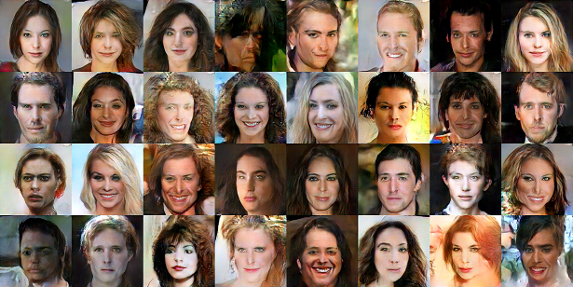
For instance generating new faces after being trained on faces.

Slide 9
We need to build 2 networks:
Generator
Discriminator
These networks COMPETE against each other.

Slide 10
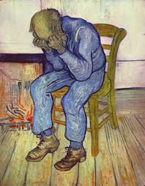
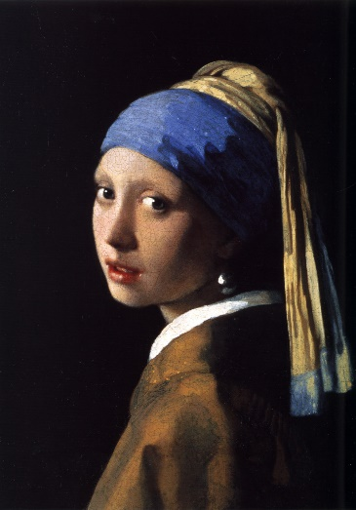
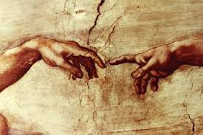
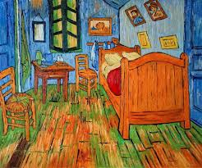
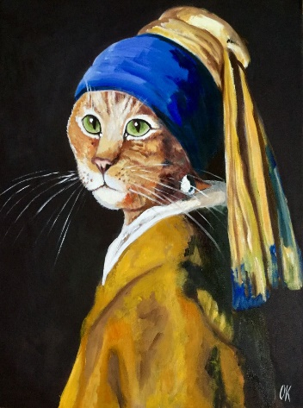
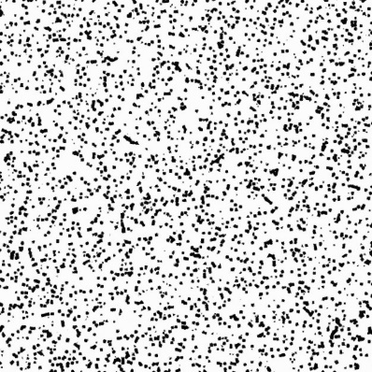
Discriminator
0: Fake
Generator

Slide 11
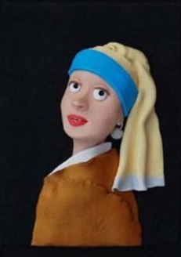
Discriminator
1: Real
Generator

Slide 12
Coding out a GAN can be simple;
Create 2 separate networks:
the discriminator and the generator

Slide 13
What can go wrong…
Discriminator overpowering the Generator:
Discriminator begins classifying all examples as fake

Slide 14
What can go wrong…
Mode collapse:
The Generator discovers some weakness in the discriminator
The Generator continually produces a similar example regardless of variation in input

Slide 15
How to fix…
Mode collapse
Can try adjusting training rate or changing layers of the discriminator in order to make it better

Slide 16
Very new tech

Slide 17
Keep in mind…
Only GPU can handle training of a GAN
Even then the training can take a long time (around weeks)

