Slide 1

Vulas – Gradle integration
Mihaly Nyeste, SAP
Feb 15, 2018

Slide 2
Agenda
Motivation and context
Show current state of the plugin
Elaborate on implementation details
Get your feedback
Discuss further steps

Slide 3
Motivation
Developing Mobile SDKs
Projects
Android libraries and applications
Plain Java project – Android Studio/IDEA extension
Gradle is the mainstream build tool for Android projects since 2014
Plugin responsibility
coupling, granularity
Feed CLI?
Full integration?

Slide 4
Plugin demo

Slide 5
Implementation
MVP
run APP and REPORT goals
Next step
run A2C goal
Next-next steps
Run other goals
CLEAN seems to be trivial
Others are not
”Porting” maven plugin – adapting the logic to Gradle specialities

Slide 6


Maven vs Gradle
Project API
stable
concise
mostly well documented
Dependency model
easy to understand
few terms (scope, transitiveness)
well documented
the model is same for all plugins
Project API (and plugin APIs)
changing frequently
requires deeper knowledge to understand
some parts poorly documented
Dependency model
way more complex
key term: configuration
configurations defined by plugins (e.g Java, Android plugin)
dependency “scopes” are more flexible
Java Plugin example #1, example #2

Slide 7

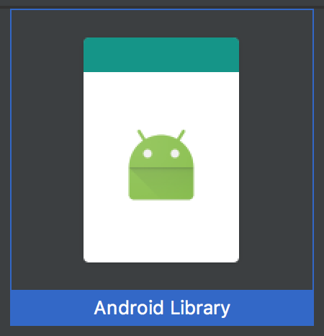
AAR files
Anatomy of an AAR file
android-database-sqlcipher
AAR files structure
byte code
classes.jar
additional jars in libs folder
Resources
Native code
Current solution - partial
Unpack AAR type dependencies and add classes.jar to analysys
Missing optional libs folder
Ideal solution
Create AAR analyzer like for war files

Slide 8
Mapping dependencies to maven scopes
Difficulties
Java and Android plugin using different configurations
There is no trivial mapping between Gradle configurations and maven scopes
Current solution
every dependency added which might appear runtime on classpath (test related configs excluded)
all dependencies mapped to RUNTIME scope
Ideal solution
determine configurations to be analyzed
model them in backend

Slide 9
Other
Determining the output type of a project is not straightforward – i.e. no packaging attribute in project model.
//TODO: packaging is not straightforward with gradle, leave it empty for now VulasConfiguration.setProperty(CoreConfiguration.APP_CTX_PACKA, "", "", true);
Setting the GoalClient to MAVEN_PLUGIN:
this.goal.setGoalClient(GoalClient.MAVEN_PLUGIN);
Incompatible Guava classes
vulas-core dependency soot-trunk.jar contains couple classes from a guava version not compatible with gradle-android-plugin

Slide 10
Further steps
I’d like to use the plugin in Android projects in our organization (~10 projects)
Gather experiences based on that, enhance plugin, add a2c goal
I’d opt in to write AAR analyzer
I believe modelling Gradle configurations is not that critical, RUNTIME is good enough
In the current form the plugin is not mature for the general public
No bandwidth to support
Having bad experience with Gradle awareness with regards of other teams

Slide 11
Thank you.
Partner logo

