Slide 1
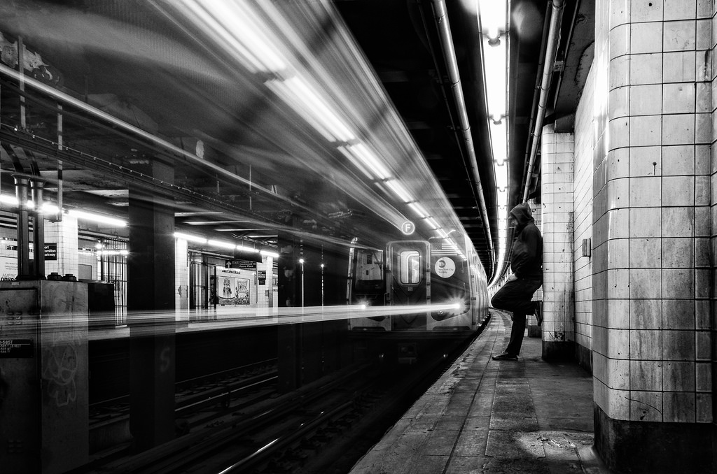
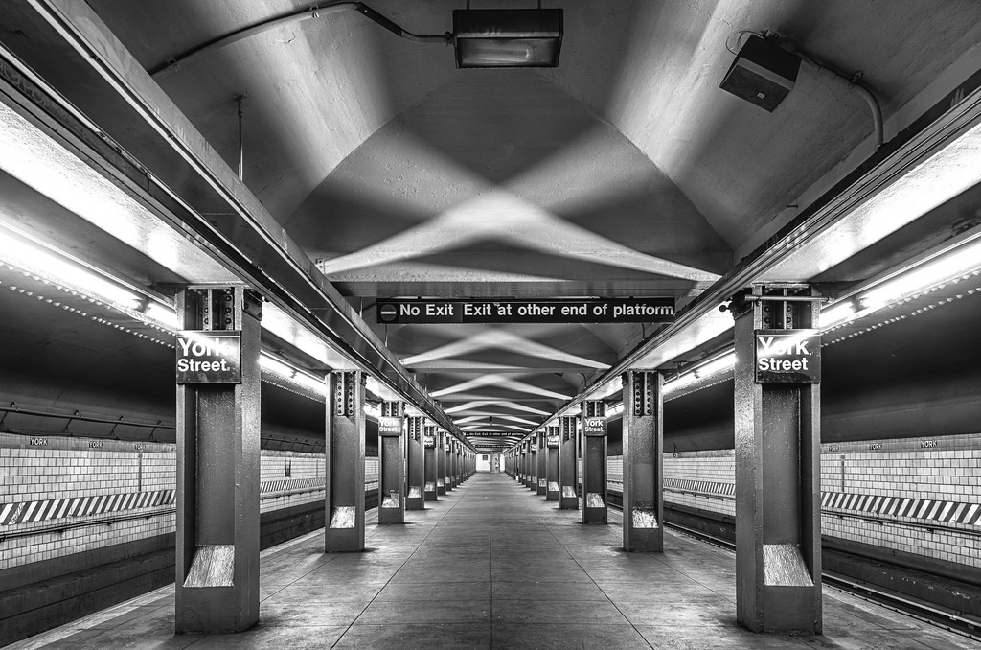


Metropolitan Transportation Authority
Cyber
CIRT # Here | TITLE HERE
INTEL
TLP: GREEN

Slide 2
< CIRT # HERE | TITLE HERE>
TLP: GREEN
TLP: GREEN
INCIDENT TYPE
DISCOVERED DATE
STATUS
SEVERITY
AGENCY
ZONE
INTRUSION | 02/09/2018 | FALSE-POSITIVE | LOW | MTA-HQ | PCI
OVERVIEW
Alert Event
Cybersecurity monitoring detected PCI database connections after normal business hours from one PCI Desktop Computer. Datamart confirmed this event as unusual.
Achievements
Root Cause determine to be a False Positive
User of PCI machine did not log-off/close his programs before leaving shift
This caused subsequent connections to the database while his session was active
Next Steps
Pursue remediation to observed GAPS, and improvements
Gaps
Defective AntiVirus Installation, Inadequate Audit/Log settings
POTENTIAL IMPACT
Confidentiality Loss | - Not Applicable
Integrity Loss | - Not Applicable
Availability Loss | - Not Applicable
Lateral Movement | - Not Applicable

Slide 3
< CIRT # HERE | TITLE HERE>
TLP: GREEN
TLP: GREEN
Technical Context Here

