Slide 1


Using Containers, Kubernetes and Serverless to Automate App Sec and OSINT Workflows

Slide 2
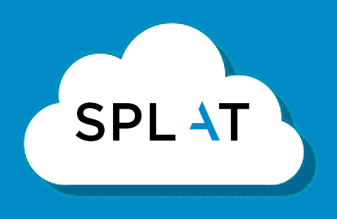

A/B Test for Logo
Option A
Option B

Slide 3
Workshop Steps
Setup
Reports
Internals
Future
We will take you through all the pre-requisites needed
How to get them ready
Do the cluster setup
We will run our workflow against a target
Go through generated report
Demo our OAuth configurations
We will discuss our infra & security tool choices
Limitations of the system
Doing state management
We will demo how to add a new security tool
Map tools used here with cloud native services
Talk a bit about our plan for SPLAT
in about 30 minutes
in about 15 minutes
in about 30 minutes
in about 15 minutes

Slide 4
Workshop Checklist
Setup that we are going to use
Run our security tooling against a target domain
Get a report generated
Understand how to automate this when using bunch of tools together
How you can get started with this
Explain our choices of tools, architecture and patterns
What else to integrate as a security tool
How to repeat this in a cloud native manner

Slide 5
How to get the best value from this workshop
Step | Time | Outcomes | Useful if
1 | 30 | Learn all the building blocks Get everything in place Cluster is up and running | You are new to Docker & Kubernetes You want to try at home later You want your cluster running
2 | 15 | See a scan complete See the report See how to add OAuth for security | You want to see and understand the report You want to protect the reporting website
3 | 30 | Discussion about our tool choices Discussion about the current limitations How state management is difficult here | You want to know why we chose those tools Understanding the limitations is important for you
4 | 15 | Demo on how to add a new security tool Mapping this to Cloud Native Our plans for SPLAT | You want to integrate your tools You prefer to do this outside Kubernetes

Slide 6
Basic Building Blocks – Complete Picture
Serverless
Object Storage
Pub Sub
Website with OAuth
Kubernetes Cluster with Services & Deployments
Docker Hub
Security Tools
Docker file
Docker build
App Sec
OSINT

Slide 7

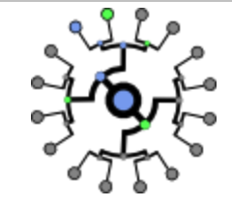

Basic Building Blocks – Security Knowledge
Knowledge of OWASP ZAP
Knowledge of Certificate Transparency Logs
Knowledge of nmap
Security Tools
App Sec
OSINT

Slide 8

Basic Building Blocks – Docker Parts
Choose a security tool
Write a Docker file
Build the Docker
Push the Docker image to the hub
Pull the image when required
Docker Hub
Docker file
Docker build

Slide 9



Basic Building Blocks – Enterprise Message Patterns
Where will we store stuff?
How will we pass messages?
What will tell us that something has happened and now something needs to be done
Serverless Functions
Events & Triggers
Pub Sub
Object Storage

Slide 10
Basic Building Blocks – Kubernetes
How do we add a new service on a cluster?
How do we deploy our software?
How do we expose it?
How do we deploy functions?
Where do we store the configs?
Serverless Functions
Configurations
Helm Charts
Manifests
Services
Deployments
Ingress
Kubernetes Cluster

Slide 11
Basic Building Blocks
Docker
Dockerfile
Dockerbuild
Docker hub
Enterprise Messaging Patterns
NATS PubSub
Kubernetes
Deployment
Services
Serverless
Deployment

Slide 12
Time | Outcomes | Useful if
30 | Learn all the building blocks Get everything in place Cluster is up and running | You are new to Docker & Kubernetes You want to try at home later You want your cluster running
Setup

Slide 13
Deploy the Cluster
Use gcloud command line to create a managed Kubernetes cluster on Google Cloud Platform
5 node cluster
Autoscaling enabled
By default only 1 node is alive
Auto scaled to max 5 nodes based on load

Slide 14
Deploy Apps and Services
Infrastructure Services
NATS (PubSub)
Minio (Object Storage)
Kubeless (Kubernetes native Serverless Platform)
App Services
Sub-domain Enumeration (Serverless function)
OWASP ZAP Scanner (Pod)
Nmap Scanner (Pod)
Reporting Engine (Pod)
Ingress
Expose API to submit a scan
Expose API to generate report

Slide 15
Execute the OSINT Workflow
Sub-domain enumeration using CRT.SH
Input is received from NATS (PubSub)
Output is stored in object storage

Slide 16
Execute the Appsec Workflow
OWASP ZAP Passive Scan
Input is received from NATS (PubSub)
Output is stored in object storage

Slide 17
Kubernetes SideCar Adapter
Generic Go-lang program used as a adapter to integrate external tools such as OWASP ZAP, Nmap etc.
Listens on NATS (PubSub) Topic
Executes external tool based on PubSub input
Persists output to object storage

Slide 18
Target
appseck8sworkshop.com

Slide 19
Time | Outcomes | Useful if
15 | See a scan complete See the report See how to add OAuth for security | You want to see and understand the report You want to protect the reporting website
Reports

Slide 20
Results
Output of a scan

Slide 21
Tech being used
Static website generator based on aggregation of tool output
JSON as data source for EJS views
A random static website generator being used called Nanogen
Custom EJS views for templating
Basic CSS using Bulma

Slide 22
Oauth Configuration
Our simple way to enable OAuth

Slide 23
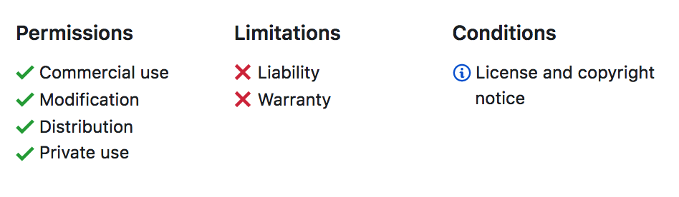
If you want to get started
Get the code, config and documentation from https://github.com/appsecco/using-docker-kubernetes-for-automating-appsec-and-osint-workflows
We will release this tomorrow 2nd of March 2019

Slide 24
Time | Outcomes | Useful if
30 | Discussion about our tool choices Discussion about the current limitations How state management is difficult here | You want to know why we chose those tools Understanding the limitations is important for you
Internals

Slide 25
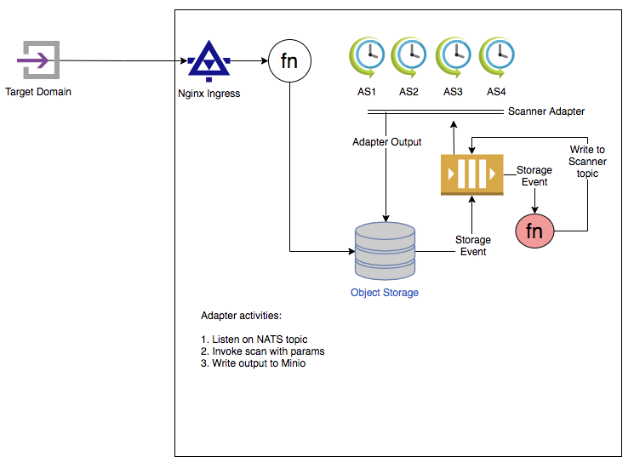
Architecture – How everything is glued in

Slide 26
Current Known Limitations
Report is generated based on manual trigger through HTTP API
This is due to limitations in scan state management
Running NATS in preemptible node results in issues with persistent connection with clients

Slide 27
Time | Outcomes | Useful if
15 | Demo on how to add a new security tool Mapping this to Cloud Native Our plans for SPLAT | You want to integrate your tools You prefer to do this outside Kubernetes
Future

Slide 28
Adding a new tool
Lets add dnsrecon as a tool for sub-domain enumeration

Slide 29
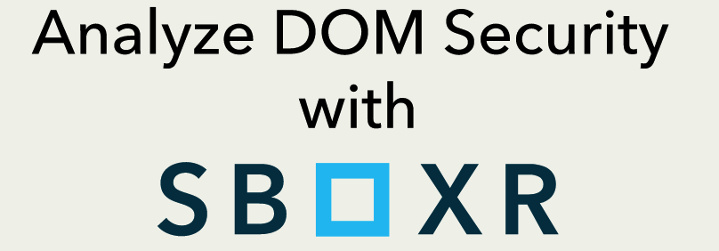
Another tool that we will be adding soon

Slide 30
Cloud Native Alternatives
Technology | Current Setup | AWS | Google Cloud Platform
Serverless | Kubeless | Lambda | Cloud Functions
Object Storage | Minio | S3 | Cloud Storage
PubSub | Nats and Nats Queue | SQS | Cloud PubSub
Containers | Docker | ECS | GKE
Orchestrator | Kubernetes | AKS | GKE
Events and Triggers | Nats Triggers | CloudWatch Events | Cloud PubSub

Slide 31
Security Platform Led Automated Testing (SPLAT)
SPLAT is an automation platform, which allows for easy deployment of application security workflows supported by OSINT workflows such as security testing and variety of tasks traditionally carried out by InfoSec teams

Slide 32

Primary Actors
Uber Ops – Madhu Akula
Uber Dev – Abhisek Datta

Slide 33
Advantages for a product security team
Continuous Security is becoming a requirement
All security tooling and servers which need to run all the time require operational security since these become high value targets
Product Security Teams should embrace Infrastructure As Code and Immutable Infrastructure to deploy tooling to complete their application security workflows
Once the workload is completed, tear down the infrastructure

Slide 34
DevOps & SecOps Parity
Security workloads can be committed just like code
These workloads can be triggered as part of CI/CD pipelines
While the infrastructure is generating data, the data can be consumed by other tools, ticketing systems, alerting and monitoring systems

Slide 35
Cluster Tear Down
Use gcloud command to tear down the cluster

Slide 36
Any Questions or thoughts?
Akash Mahajan
akash@appsecco.com

