Slide 1
Whitebox Proto-type
January 2009

Slide 2
Presentation Overview
Problem Statement
Solution Statement
Introduction to Whitebox
Architecture
Implementation
Environment Integration
On the road map
Summary
Questions

Slide 3
Problem Statement
“How to detect 0day targeted attacks via
E-Mail attachments against an increasing set of applications”

Slide 4
Solution Statement
“A system activity monitor which integrates into
a mirror of a standard desktop build within a
controlled environment. The monitor should be
able to ignore ‘normal’ activity for the targeted
application and flag only activity which is
potentially suspicious”

Slide 5
Introduction to Whitebox
Whitebox is a system activity monitor
File system, Registry & Network currently
Whitebox is filter driven
Allowing a high degree of customization
Whitebox is designed to process attachments
Feed the attachments in and let it report
Whitebox is NOT real-time
Designed to augment existing security solutions

Slide 6
Introduction to Whitebox
Code is at a proto-type stage, it’s stable
but requires a lot of initial environment configuration. This is to remove the
‘normal activity’ from the reports.

Slide 7
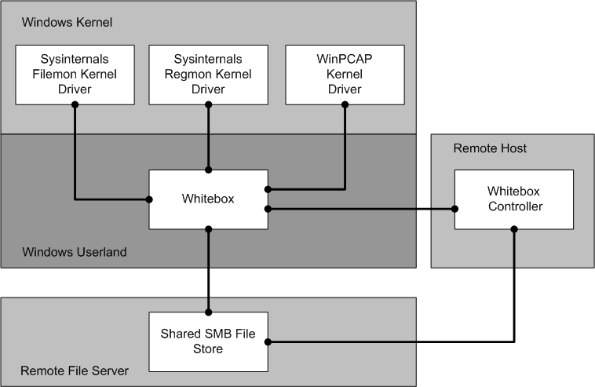
Architecture

Slide 8
Architecture
Uses numerous kernel drivers
Filemon, Regmon and WinPCAP
Uses SMB for file sharing
Input directory (RO) and Output directory (RW)
Receives jobs from the controller
via TCP
Allows the Whitebox host to restart
Allows the Whitebox host to be re-imaged

Slide 9
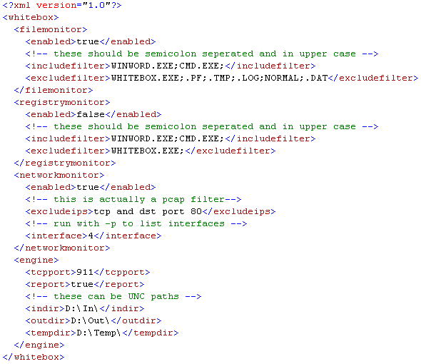
Implementation
XML based configuration file

Slide 10
Implementation
Filemon filters
Semi colon delimited include /exclude filters
Regmon filters
Semi colon delimited include /exclude filters
Network filters
PCAP compatible network filters
Uses ShellExecute to map attachment to application (as Outlook would)

Slide 11
Implementation
Engine can be selectivity enabled / disabled
File, Registry and/or Network monitor
Three directories
Input – SMB – shared
Output – SMB – shared
Temp – Local – not shared
Report generation
Written (.report) when activity detected
Includes all detected activity

Slide 12
Implementation
Controller
Scans the input directory
Tells Whitebox to process
Waits for failure, success or activity notification from Whitebox
Reconnects and gives next job
Allows linear scalability
Allows re-image/restarts to occur between sample processing

Slide 13
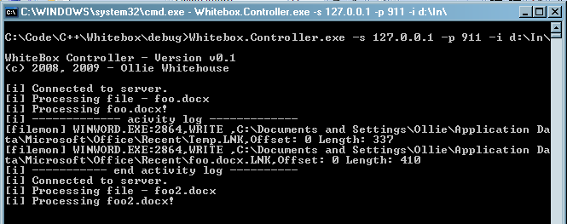
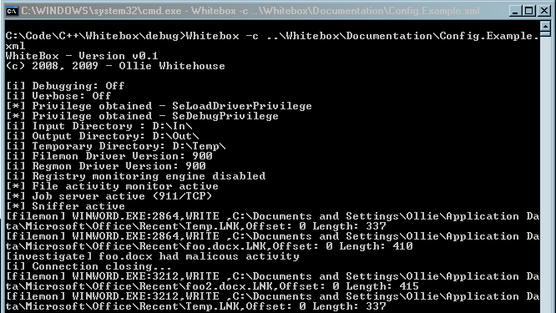
Implementation

Slide 14
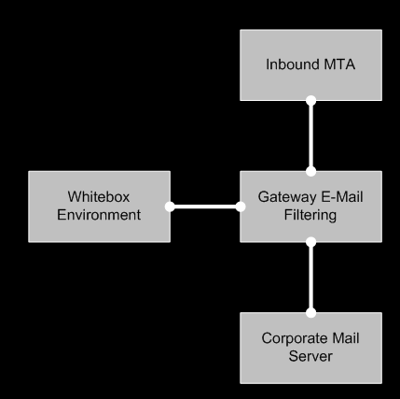
Environment Integration

Slide 15
Environment Integration
Existing Filter Integration
Most gateway filters allow a script to be run on attachments
This is used to copy the attachment to the Whitebox SMB ‘In’ directory
Whitebox Controller continually scans this directory
When new attachments are found they are sent to Whitebox for processing

Slide 16
On The Road Map
Process creation logging support
Process handles, modules logging support
Memory dumping support
VMWare API support
General refinement

Slide 17
Summary
It works!
Will need more testing
Will probably need some refinement
Provides an way to run attachments through a desktop build and detect ‘suspicious’ activity
Which potentially allows the detection of 0day attacks

