Slide 1
Analyzing Customer Sentiment of United Airlines on Twitter
- Li Jiang, Vlad Obukhanich, Fangyuan Wen
Notes:
Different stages of our data analytics:
Business objective
Data preparation
Data cleaning
Descriptive analysis
Visualizations
Predictive modeling
Logistic Regression model
Training and building the predictive model
Hyper parameter tuning and cross validation
Prediction and evaluation
Recurrent Neural network
Training and building the predictive model
Hyper parameter tuning and cross validation
Prediction and evaluation

Slide 2

Business Problem/Opportunity
The difficulty of capturing all the customer feedback accurately.
The difficulty of collecting large samples of feedback in an automated way.
United Airlines can cut cost from not design surveys and questionnaires
United will have the ability to analyze the large scale of customer feedback and improve customer relationship management strategies.
Notes:
The business issue addressed in our project has to do with customer feedback. More specifically, the problem with customer feedback is that although it is being generated very frequently in customers’ heads, it is difficult to capture all of it and further translate it into a verbal or written form. More so, it is difficult to do without succumbing to various biases, e.g. the ones posed by the imperfect design of such feedback tools as surveys and questionnaires.
Another challenge in collecting customer feedback is doing so consistently – ideally in an automated way – with large samples of customers. This is precisely where our project comes in – a logistic regression and a neural network for natural language processing – with the goal of helping United Airlines analyze customer sentiment on Twitter.
Sentiment Analysis is a process of identifying and cataloging a piece of text based on its words and context. This text can be from any place, such as tweets, comments, feedback forms. We now have a dataset with known tags of positive, negative and neutral. We train our models based on these samples, and hopefully can generalize to any future texts.
Our project provides numerous business opportunities by tackling the customer feedback problem. First, by performing sentiment analysis, businesses (in our case, United Airlines) can reduce marketing spending from not having to design countless surveys and questionnaires – and as a consequence, from not having to finance large marketing departments. Second, United Airlines will have the ability to analyze feedbacks of many customers, and to devise the company’s CRM (customer relationship management) strategies accordingly. More specifically, UA can gauge customer needs better, then take advantages of the ideas generated by its customers. In addition, UA can use it to understand areas where they underperform and improve on these areas.

Slide 3
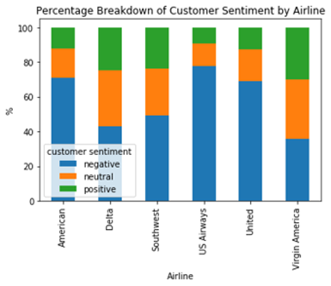
Data Set - Overview
Name: Twitter US Airline Sentiment
Source: Kaggle
Original Provider: Figure Eight
Date Collected: February 2015
Brief Summary: Twitter data was scraped from February of 2015 and contributors were asked to first classify positive, negative, and neutral tweets, followed by categorizing negative reasons
Notes:
The dataset we are using to better understand the customer feedback problem is a Twitter US Airline Sentiment dataset from Kaggle (originally provided by Figure Eight). This dataset supplies customer sentiment on 6 major US airlines, including United. This dataset will be used to train our models to recognize whether a given tweet contains positive, neutral, or negative sentiment about the airline.

Slide 4
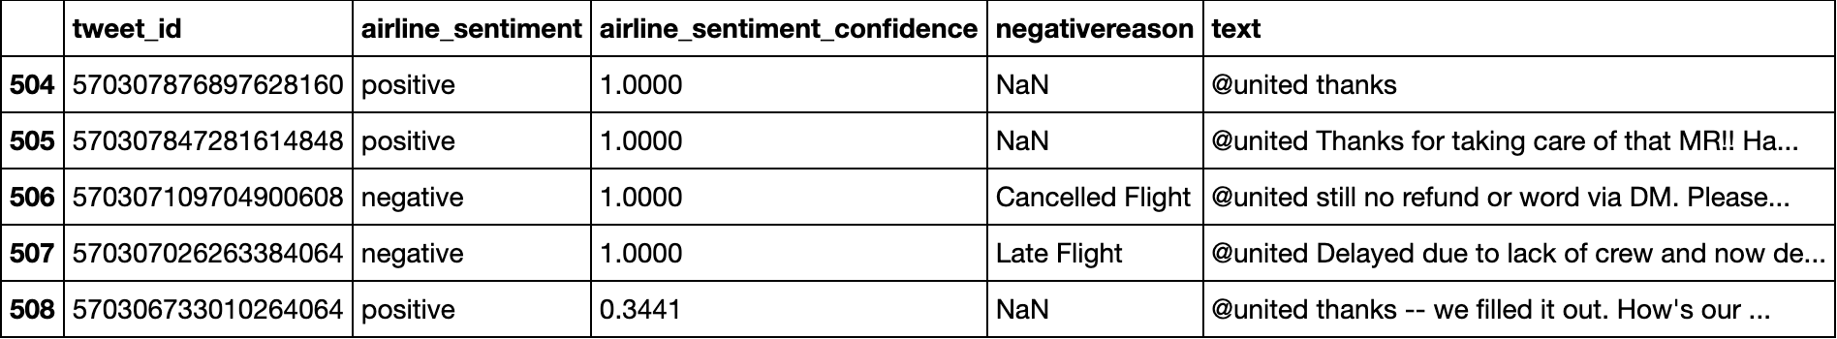
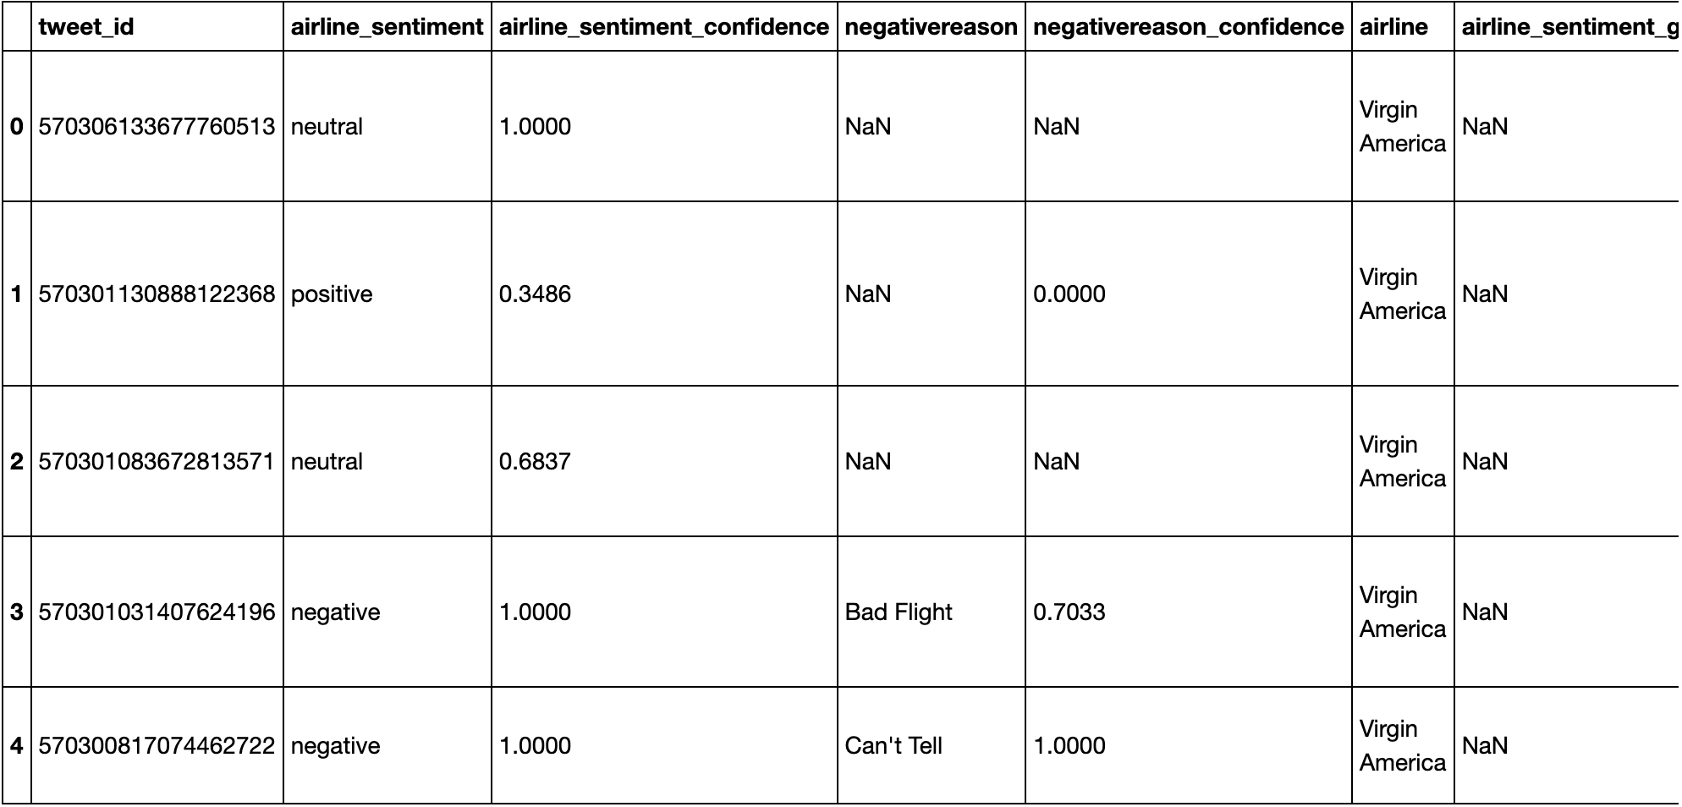
Data Set - Cleaning
AFTER: 3,822 rows & 5 columns
BEFORE: 14,640 rows & 15 columns
Remove all non-United entries and unnecessary columns
Notes:
The original dataset is comprised of the following fields:
tweet_id (index column)
airline_sentiment (qualitative – “positive/neutral/negative”)
airline_sentiment_confidence (quantitative – from 0 to 1)
negativereason (qualitative – e.g., “bad flight”)
negativereason_confidence (quantitative – from 0 to 1)
airline (qualitative – “American/Delta/Southwest/United/US Airways/Virgin America”)
name (qualitative – original poster’s username)
retweet_count (quantitative – number of associated retweets)
text (qualitative – raw tweet)
tweet_coord (qualitative – tweet’s coordinates)
tweet_created (date – when tweet was posted)
tweet_location (qualitative – where tweet was posted)
user_timezone (qualitative – in which time zone tweet was posted)
However, after we cleaned the data, we were left with only the following fields: tweet_id, airline_sentiment, airline_sentiment_confidence, negativereason, text. In addition, we removed all rows that were not about United since we are only interested in analyzing the sentiment of United customers for the scope of this project.

Slide 5
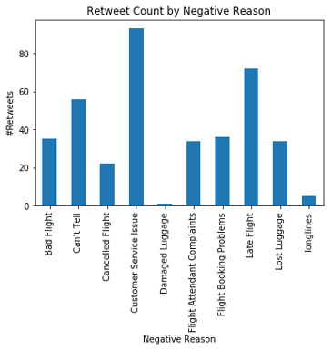
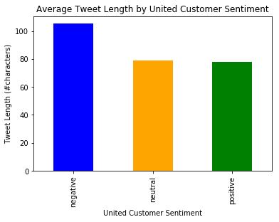
Data Set - Visualizations

Slide 6

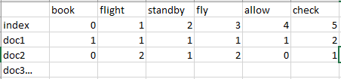
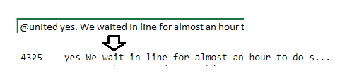


Data Mining Methods - Preprocessing
Tokenization
Lemmatization
Vectorization
CountVectorizer
TF/IDF Scaling
Notes:
Data Mining Methods:
- Tool used: python
- Preprocessing part:
- Tokenization: To use tokenizer function to delete special Twitter handle "@", and remove punctuation and special characters.
- Lemmatization: To group together the different inflected forms of a word, so they can be analyzed as a single item.
- Vectorization: To transform text into a meaningful vector of numbers.
- TF/IDF scaling: To rescale the data. TF-IDF is a common term weighting scheme. Tf means term-frequency and tf-idf means the product of term-frequency inverse document-frequency. Unlike the raw frequencies of occurrence of a token. The TF term calculates the number of times the term appears in "a" document. The IDF term reduces the impact of tokens that occur very frequently in a given corpus because if a word appears in many documents, it is likely not that important to any individual document.

Slide 7
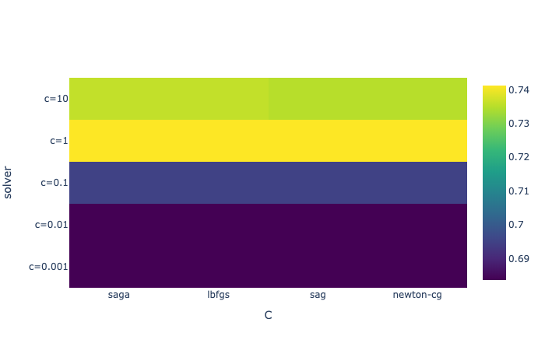
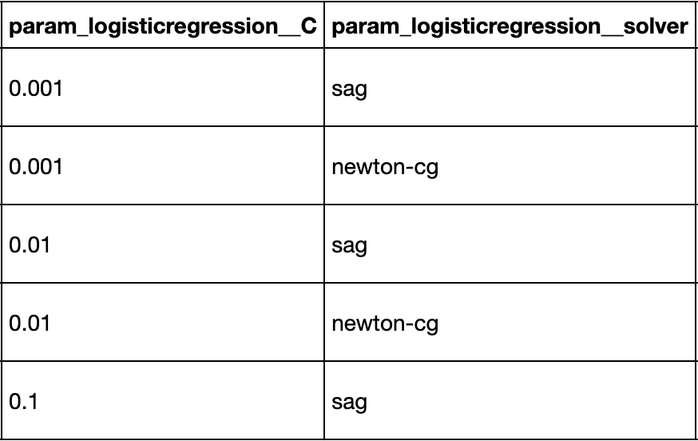
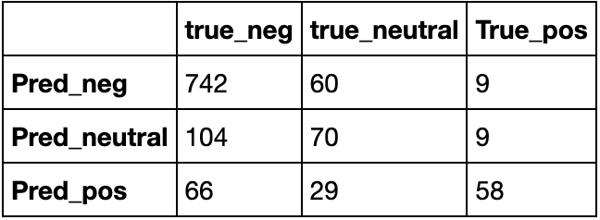
Data Mining Methods - Logistic Regression
Parameter Tuning (first 5 iterations):
Confusion
Matrix:
Notes:
After completing the Preprocessing part, we split the dataset into the training (80%) and testing (20%) subsets. We then conducted parameter tuning of C (inverse regularization parameter) with the following values: [0.001, 0.01, 0.1, 1, 10] and “solver” using the following values: ['saga’, 'lbfgs’, 'sag’, 'newton-cg’]. For each combination of parameters, we also conducted cross-validation with 5 splits. As a result, we have 100 iterations in total. The best parameters are chosen based on the average accuracy rate of the five-fold cross-validations. We then fit the entire training set using the best parameters and make predictions on the testing set.

Slide 8
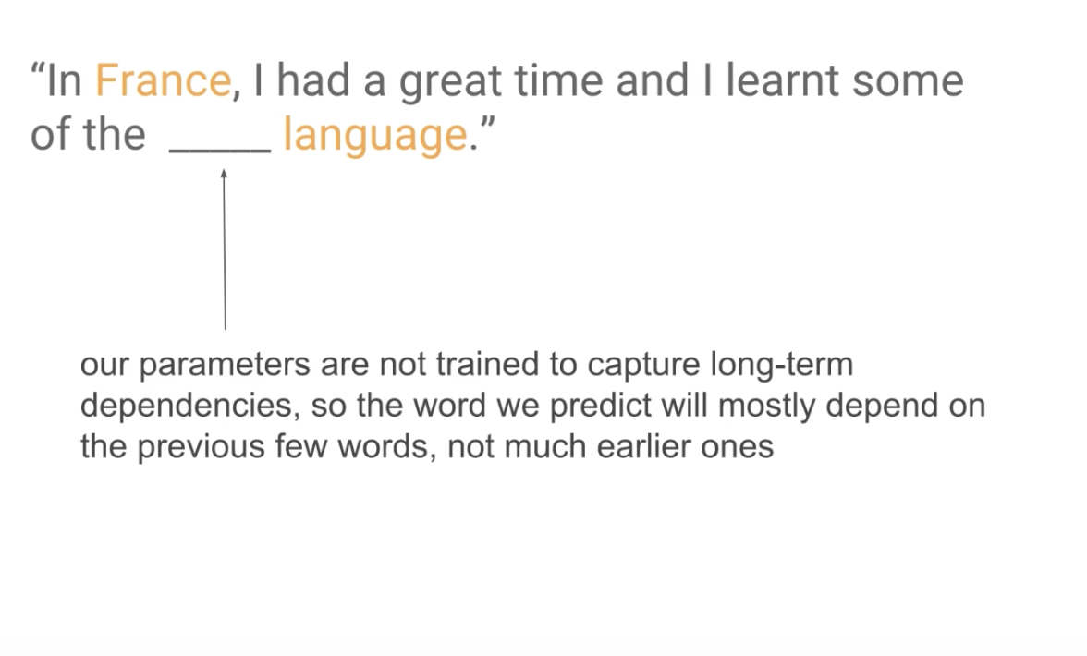
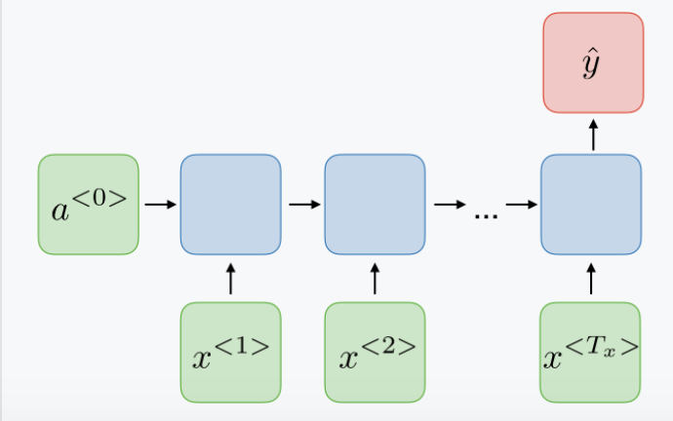
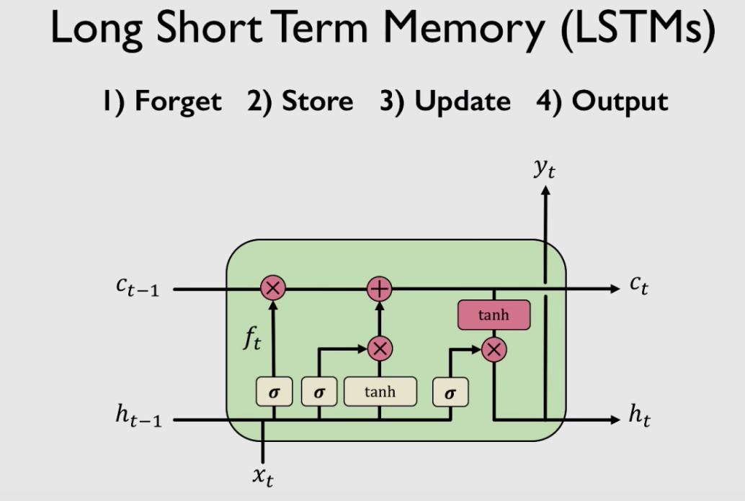
Data Mining Methods - RNN with LSTM
RNN does a better job at processing sequence data because an output of a previous node feeds into the node after that.
LSTM addresses the long-term dependency problem of RNNs. LSTM can alter information stored in the cell state, through a structure called gates.
Notes:
# Why we use RNN instead of a traditional neural network
The problem with a naive neural network architecture is that it doesn't share features learned across different positions of texts. a Recurrent Neural Network (RNN) does a better job at processing sequence data because an output of a previous node feeds into the node after that. More specifically, it creates a hidden state that contains information about what the network has seen so far. Through RNNs, sentences are fed into the network one word at a time, thereby keeping memory of the words that came before. This enhances the model's ability to give contexts/semantic meanings. In other words, unlike traditional feedforward networks that process each input independently, an RNN allows information from a previous output to be fed as input into the current state.
# Why we use LSTM
The vanilla form of RNNs usually has a problem called "vanishing gradient." As we back-propagate through time, the gradient could become extremely small. This means that we lose information from the earlier layers. And the deeper (having more nodes) the network is, the more likely 'vanishing gradient' is going to happen. An LSTM algorithm addresses this problem by allowing the neural network to carry information across multiple time steps. The control gates of LSTM can retain crucial information and prevent the gradients from vanishing. In addition, a LSTM cell can determine what information to remove as well. Therefore, it can learn to recognize an important input and store it for the future while removing unnecessary information.

Slide 9
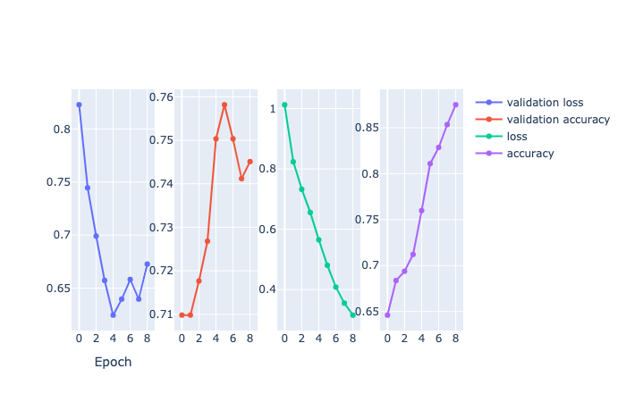
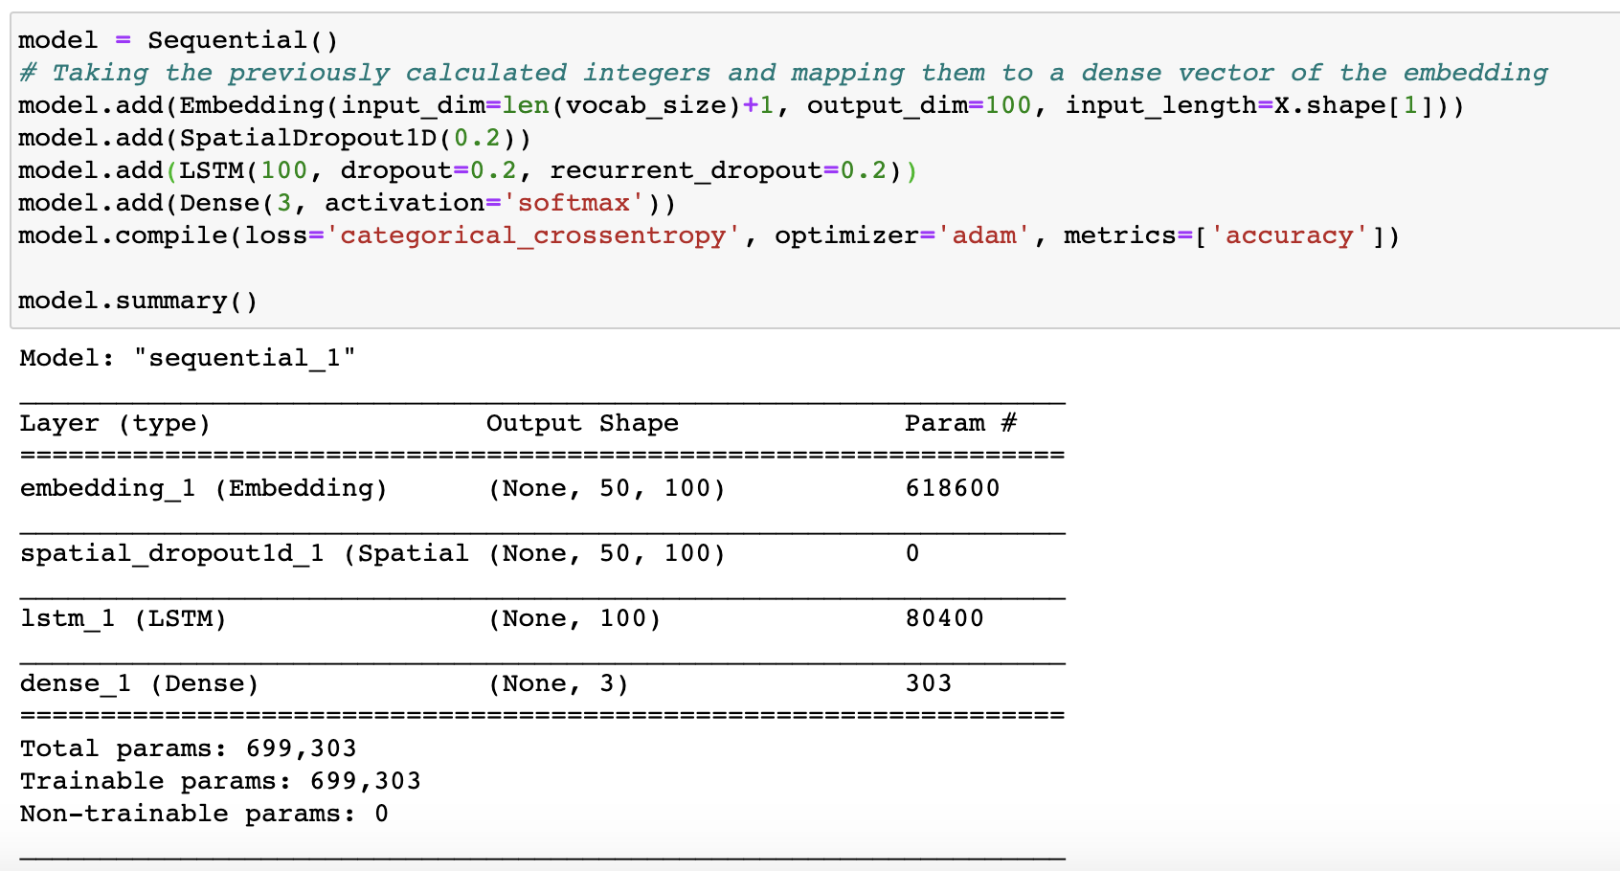
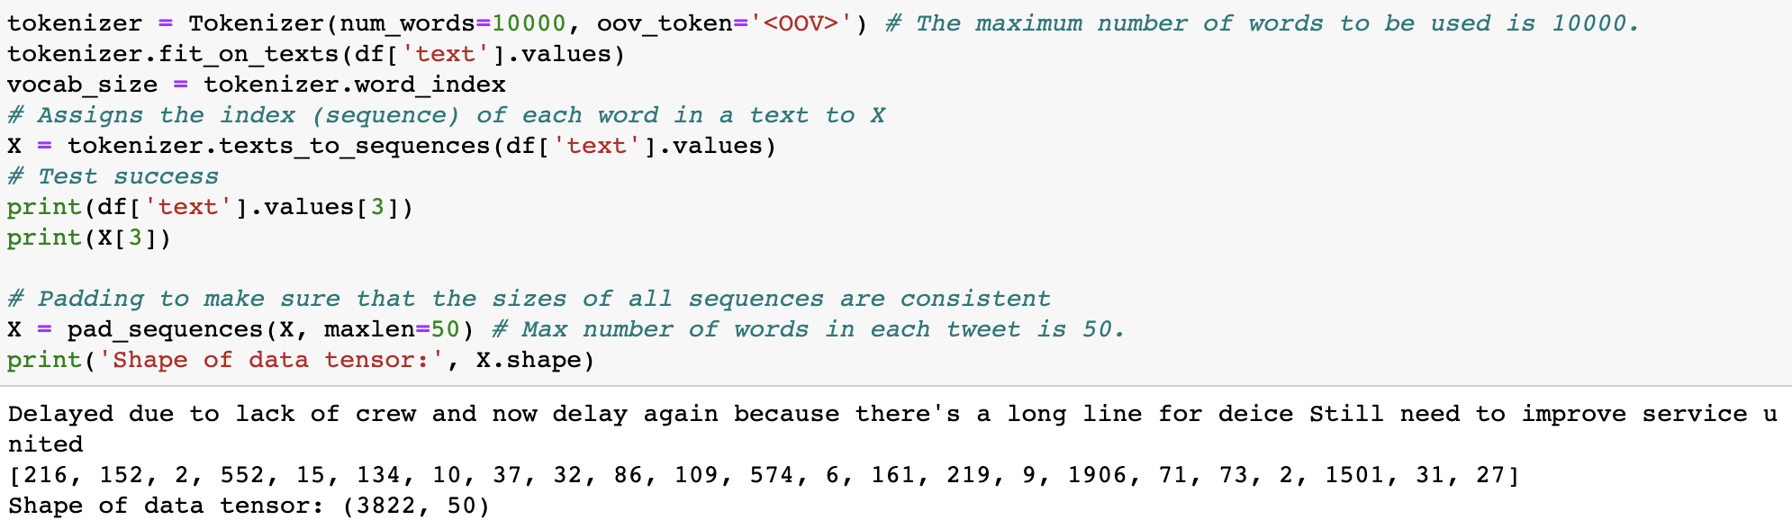
Data Mining Methods - RNN with LSTM
The neural network has four layers, including one input layer(embedding layer) and one output (dense) layer. We have 699,303 parameters, which is vocab_size times the embedding_dim. The weights of the embedding layer are initialized with random weights and are then adjusted through backpropagation during training.
Notes:
The "fit_on_texts" method uses the 'text' column to update its internal vocabulary. Each word in the vocabulary is then assigned an index based on its word frequency. The more frequent a word is in the vocabulary list (corpus), the smaller the index is (often the first few are stop words because they appear a lot). The list is 1-indexed because 0 is reserved for padding.
The "texts_to_sequences" method transforms each text in texts to a sequence of integers, replacing each word in the text and replaces it with its corresponding integer value (its index) from the tokenizer's internal dictionary. For example, "Delayed due to lack of crew and now delay again because there's a long line for deice Still need to improve service united" is replaced with [216, 152, 2, 552, 15, 134, 10, 37, 32, 86, 109, 574, 6, 161, 219, 9, 1906, 71, 73, 2, 1501, 31, 27]. We also make the length of each text consistent by padding those of <=50 words with 0s and by clipping those of more than 50 words.
Embedding layer: The purpose of this layer is to turn the original encodings to a dense featurized vector, where the positions of words are taken into account so that the relative distances between words can be considered.
Dropout: "Each hidden unit in a neural network trained with dropout must learn to work with a randomly chosen sample of other units. This should make each hidden unit more robust and drive it towards creating useful features on its own without relying on other hidden units to correct its mistakes." (Srivastava el al.,2014) Dropout regularization for reducing overfitting and improving the applicability.
Softmax: Softmax ensures that all probabilities of the output add up to 1. This additional constraint helps training converge faster.
Summary: The neural network has four layers, including one input layer(embedding layer) and one output (dense) layer. We have 699,303 parameters, which is vocab_size times the embedding_dim. The weights of the embedding layer are initialized with random weights and are then adjusted through backpropagation during training.

Slide 10
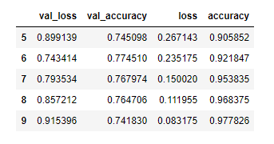
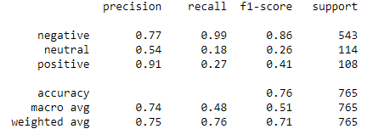
Results
Logistic regression model
Neural network
Notes:
Two methods for sentimental analysis.
The Logistic regression model has an accuracy of 75%.
The neural network has an accuracy of around 75%. Though the training data reaches an accuracy above 90%, the testing data is still around 75%. There is an overfitting problem.

Slide 11
Limitations and Improvements
Unsatisfactory prediction accuracy because of the small sample size, especially for the neural network
Could have taken advantage of other information provided in the dataset, such as the confidence level for the sentiment
Could perfect the analysis by providing keyword/sentence extraction functionalities so the company could get additional information from the tweets in addition to the sentiments.

Slide 12
Sources
Li, S. (2019, December 8). Multi Class Text Classification with LSTM using TensorFlow 2.0. Retrieved from https://towardsdatascience.com/multi-class-text-classification-with-lstm-using-tensorflow-2-0-d88627c10a35
Bird, S., Klein, E., & Loper, E. (2019, September 4). 6. Learning to Classify Text. Retrieved from https://www.nltk.org/book/ch06.html
Géron, A. (2019). Hands-On Machine Learning with Scikit-Learn, Keras, and TensorFlow: Concepts, Tools, and Techniques to Build Intelligent Systems. Sebastopol, CA: O'Reilly Media.
Albon, C. (2018). Machine Learning with Python Cookbook: Practical Solutions from Preprocessing to Deep Learning. Sebastopol, CA: O'Reilly Media.
Sentiment classification LSTM. (n.d.). Retrieved from https://keras.io/examples/imdb_lstm/

