Slide 1
QA
BSc(Hons) Computing
System
March 2023
Online Doctor Appointment System
Pradip Raut
Project Supervisor:Iftikhar Afridi

Slide 2
ABSTRACT
In the verge of Pandemic, it was big problem to visit hospital for doctor’s counseling session. The purpose of Online Doctor Appointment system is to have managing of different appointments through the help of web. This system offers different counseling and recommendation through doctor and helps requesting an appointment through patient. This system is an example of remote medicine. Online Doctor Appointment system is GUI friendly, easy to use for anyone and secure for everyone. This system is time saving as well as gives transparency between doctors and patients. It allows an interaction between admin, doctor and patient. Basically, is usable for different aspects of healthcare system

Slide 3
ACKNOWLEDGEMENT
It is a tremendous honor to be able to express our deepest appreciation to everyone who assisted us. We would like to convey our gratefulness towards Mr.Iftikhar Afridi who helped us complete this report for his expert guidance, ever willingness to spare time from his busy schedule for the document’s reviews. His continuous inspiration has made us achieve the target.
We would also like to extend our heartfelt gratitude for the faculty of Computing engineering and , for this occasion. We'd like to express our gratitude to our friends and colleagues for their tireless efforts in completing the project

Slide 4
INTRODUCTION
Background
Online doctor appointment system is the system where a patient can ask for the treatments through the home. In the verge of COVID-19 Pandemic, this system is useful for everyone in the home. This system manages the appointment requested by the patient through the help of website. Patient can give different symptoms to the system in the form of message and request for the doctor. This system can be used by anyone and patient can give different complications. This system helps for the remote patients where doctor is unavailable.

Slide 5
Project Objectives
The primary objectives of the project is: -
-To build the web-based application which manages appointment in the front-end section and store data in the back-end section, and have analysis and design for the Online doctor appointment system.
Secondary objectives are:
- To check the previous appointment history and medical records.
- To have uplift the healthcare system through the help of E-medicine.
- To get information of the patient and doctor as well as information real time availability of doctor.

Slide 6
LITERATURE REVIEW
Technical Background
Hardware and Software resources
Hardware:
Windows 7 or higher
I3 processor system or higher
4 GB RAM or higher
100 GB ROM or higher
Software:
Laptop or PC
Python/Django
HTML/CSS
Sublime Text Editor
XAMP Server

Slide 7
Requirements Gathering
Requirements analysis involves in understanding of the process, structure of data based on requirement of the project. System analysis helps in making better and efficient system.
I have gathered requirement from various sources such as
Interviewing users
Surfing the Internet
Research through similar projects documentation.

Slide 8


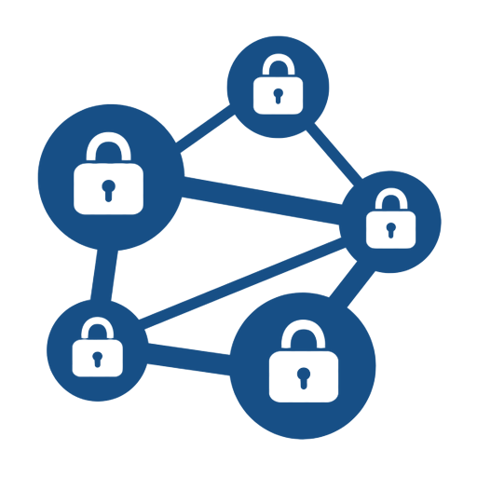
Functional requirements
Computer Algorithm Database
A computer for making and handling assignments
A Database to store Patients , Doctor and Hospital’s Data.
Mathematical algorithm to suggest doctor based on symptoms.

Slide 9
Non-functional requirements
Reliability requirements
The program's accuracy ought to be greater than 90%.
Scalability requirements
ability to appropriately handle increasing (and decreasing) workloads
Usability requirements
It should be simple to modify the model.
Availability requirements
It should be easily accessible for use on other platforms, such as Mac OS.
Data Integrity requirements
It should not collect data without people's permission.

Slide 10
Risk table
Risk Description | Severity | Impact
Hardware and software break | critical | catastrophic
Bugs and errors in coding | medium | tolerable
Internet failure | critical | serious
Missing key dates and milestones | medium | serious
Main requirement not being fulfilled | low | catastrophic
Uncertain medical issues | low | Serious

Slide 11
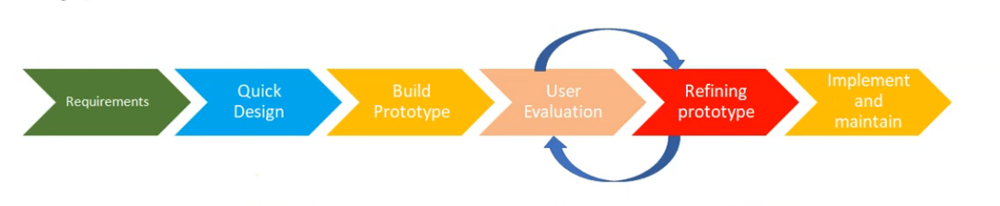
Methodology
Prototyping Methodology
Prototyping involves creating a initial prototype consisting of fundamental features and refining and including other features until finalization.

Slide 12
Summary of Risk Mitigation Strategy
Risk Description | Mitigations
Hardware and software break | Backup the data and resource file in cloud or drive.
Bugs and errors in coding | Check online solution in GitHub or community
Internet failure | Have Safe and secure connection
Missing key dates and milestones | Adjust the timetable accordingly
Main requirement not being fulfilled | Try other algorithms and get help from supervisor
Uncertain medical issues | The last option will be applying for deadline extension

Slide 13
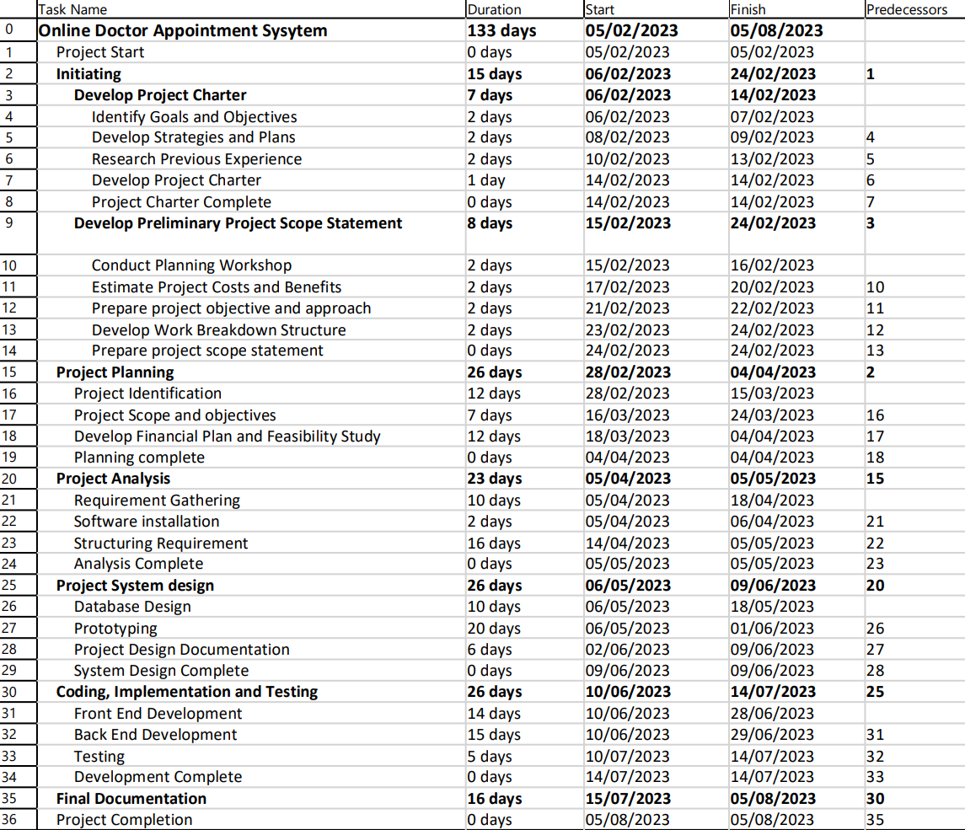
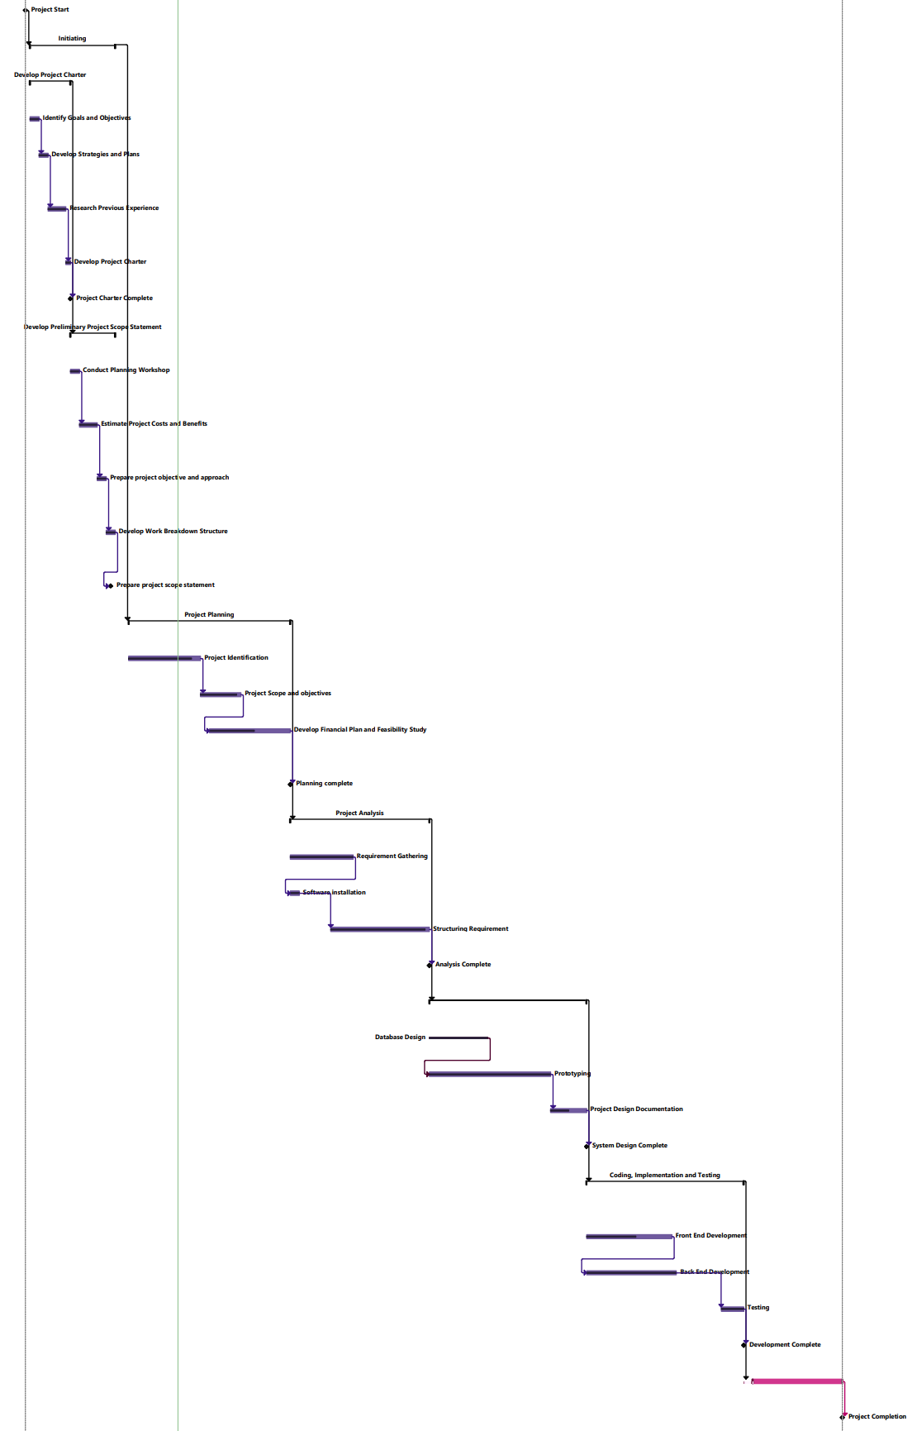
Gantt Chart

Slide 14



Progress and learnings
Development of Project charter
I have developed project charter and I am currently on planning phase.
Learning Phase
I have started learning required algorithms.
Setting up Development Environment
I have been learning how to set-up environment in python and how to use Django.

Slide 15
Implementation
System implementation involves in building proper working system, installation of it in to the organization, replacing previous system into a new one and providing the documentation and training for the user. System implementation also prepares a support system to assist users when a client gets into some difficulties.
Our project Online Doctor Appointment system is now implemented using different tools (HTML, CSS, Python and Django ).

Slide 16
Evaluation
Evaluation Criteria
User Experience: The system should be easy to use . The user interface should be simple and responsive, making it enabling the patients to book appointments and doctors to manage their schedules.
Features : The system should be able to provide features for booking appointments, including the ability to view doctor profiles, select appointment date, and cancel appointments.
Security: The system should be secure and protect patient information. Privacy should not be harmed
Performance: The system should be fast and responsive.
Online Doctor appointment system will meet the above criteria and provide efficient way for patients to book an appointment.

Slide 17
Future plan
To review the literature and summarize my learnings.
To analyze and select best model from the available models.
To code and run
To create proper Documentation
To create Report

Slide 18
CONCLUSION
To sum up, the online doctor appointment system is a great way to book medical appointments. It has a lot of advantages, such as convenience, availability, and adaptability. Patients can make appointments anytime and from any place, so there's no need to go to a clinic or hospital in person. Doctors get to manage their work and patients more efficiently, cutting down time and reducing the chances of double-booking. Furthermore, it enhances communication between doctors and patients which is essential for successful treatment results. In conclusion, this system is very useful in improving healthcare delivery and the patient experience.

