Slide 1


Bounded Synthesis for Streett, Rabin, and CTL*
Ayrat Khalimov, Roderick Bloem
Rigorous Systems Engineering

Slide 2

LTL synthesis problem
Given: LTL formula $φ$, system inputs and outputs
Return: system that satisfies $φ$, else “unrealizable”

Slide 3
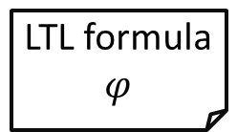
Bounded Approach to LTL Synthesis [SF]
LTL formula
$$φ$$
k = 1
search a system of size k
bounded synthesizer
increase k
not found
found
is limit on k
reached?
NO
system
YES
unrealizable
Notes:
simplify, no need for “bound reached”

Slide 4
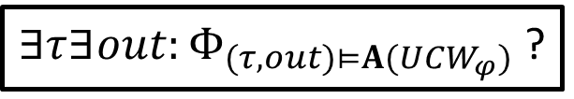

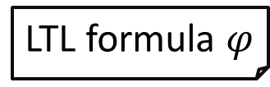
SMT-based bounded synthesizer [SF]
LTL formula $φ$
system size k
$$UCW_{φ}$$
$∃τ∃out:Φ_{(τ,out)⊨A(UCW_{φ})}$ ?
unrealizable for k
system
of size k
Notes:
add formula here

Slide 5
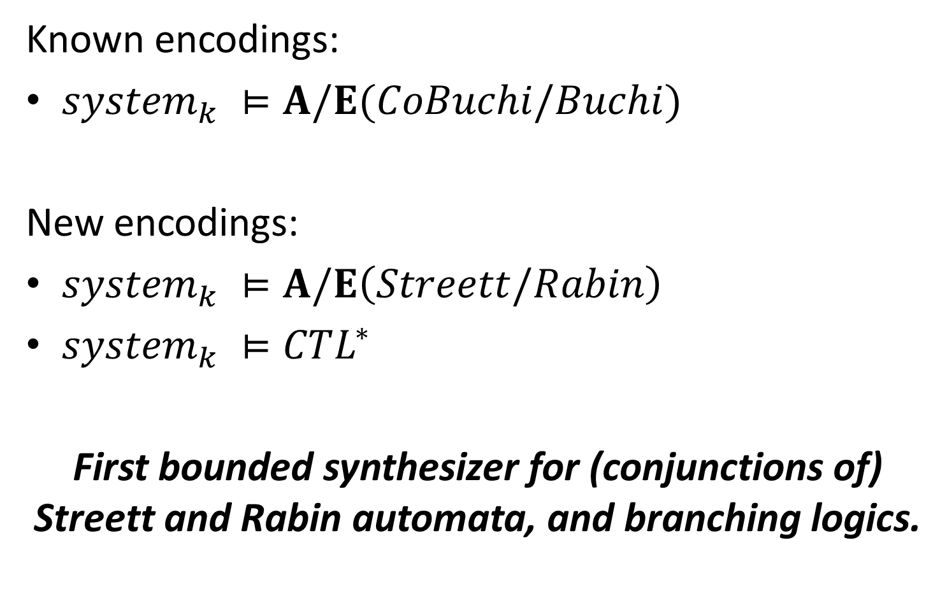
Our results
Known encodings:
${system}_{k} ⊨A/E(CoBuchi/Buchi)$
New encodings:
${system}_{k} ⊨A/E\left(Streett/Rabin\right)$
${system}_{k} ⊨CTL^{∗}$
First bounded synthesizer for (conjunctions of) Streett and Rabin automata, and branching logics.
Notes:
join with prev

Slide 6
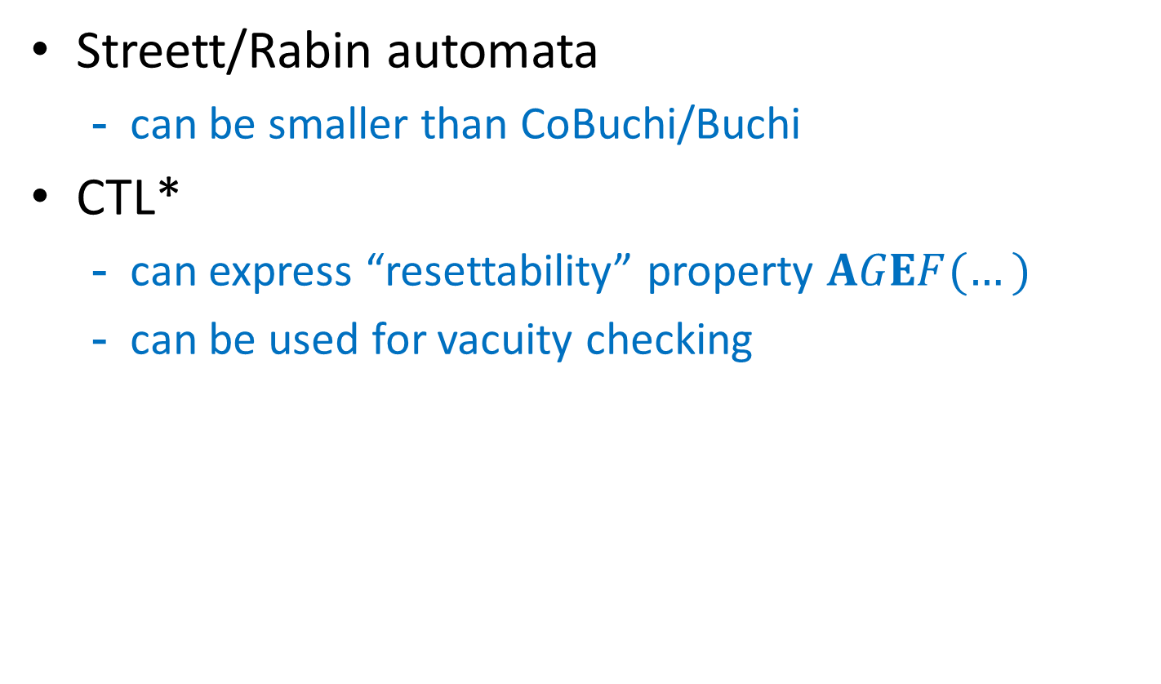
Why Streett/Rabin and CTL*?
Streett/Rabin automata
can be smaller than CoBuchi/Buchi
CTL*
can express “resettability” property $AGEF(…)$
can be used for vacuity checking

Slide 7



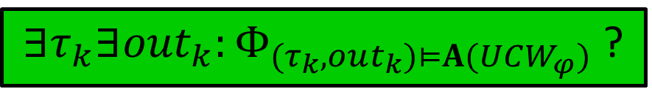
We can focus on model checking synthesis
$∃τ_{k}∃out_{k}:Φ_{(τ_{k},out_{k})⊨A(UCW_{φ})}$ ?
size
(declare-datatypes () ((S s0 s1)))
(declare-fun tau (S Bool) S)
(declare-fun out (S) Bool)
; assertions to check
; $(τ,g_{0},g_{1})⊨A(UCW_{φ})$
$$∃τ$$
$$∃out$$
Notes:
join with the prev slide

Slide 8
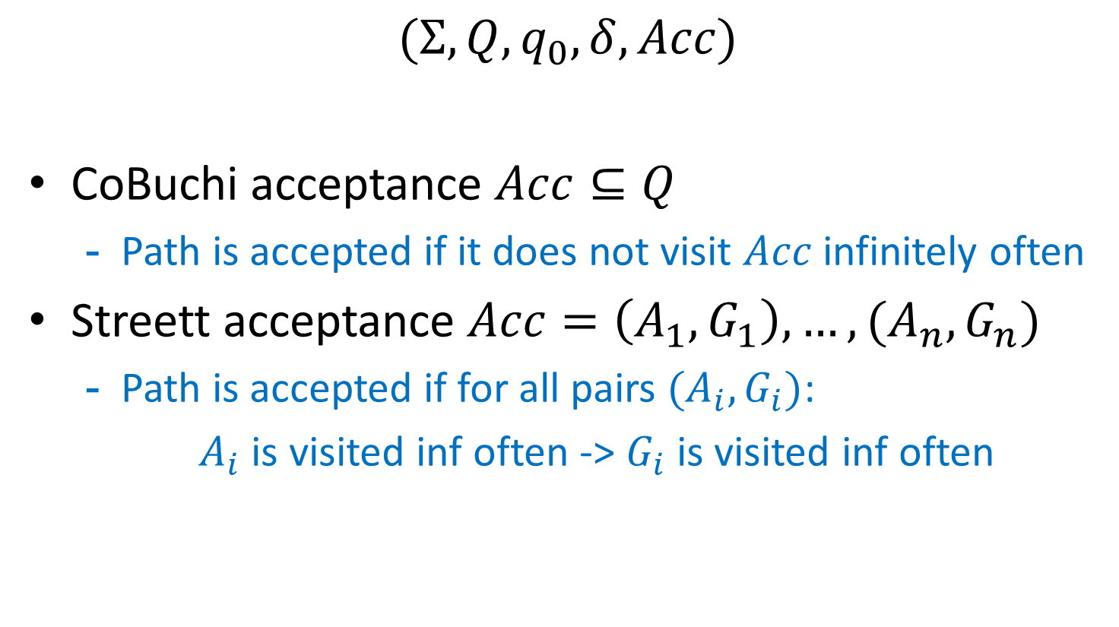
CoBuchi and Streett automata
$$(Σ, Q,q_{0},δ, Acc)$$
CoBuchi acceptance $Acc⊆Q$
Path is accepted if it does not visit $Acc$ infinitely often
Streett acceptance $Acc=\left(A_{1},G_{1}\right),…,(A_{n}, G_{n})$
Path is accepted if for all pairs $(A_{i},G_{i})$:
$A_{i}$ is visited inf often -> $G_{i}$ is visited inf often

Slide 9







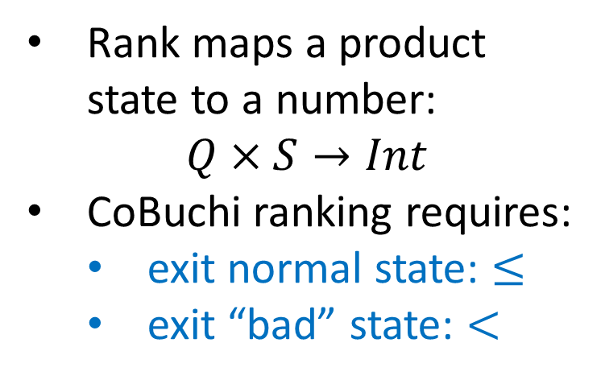
Searching for “bad” cycles in graph
$system×automaton$
with CoBuchi ranking [SF]
5
Rank maps a product state to a number:
$$Q×S→Int$$
CoBuchi ranking requires:
exit normal state: $≤$
exit “bad” state: $<$
$$≤$$
$$≤$$
5
$$≥$$
5
$$<$$
$$≥$$
4
$$≤$$
UNSAT if require all paths to be “good”

Slide 10

Searching for one good path in graph
$system×automaton$
with CoBuchi ranking [SF]
5
Rank maps a product state to a number:
$$Q×S→Int$$
CoBuchi ranking requires:
exit normal state: $≤$
exit “bad” state: $<$
$$≤$$
$$≤$$
5
$$≥$$
$$<$$
5
$$≥$$
5
$$≤$$
SAT if search for one “good” path

Slide 11





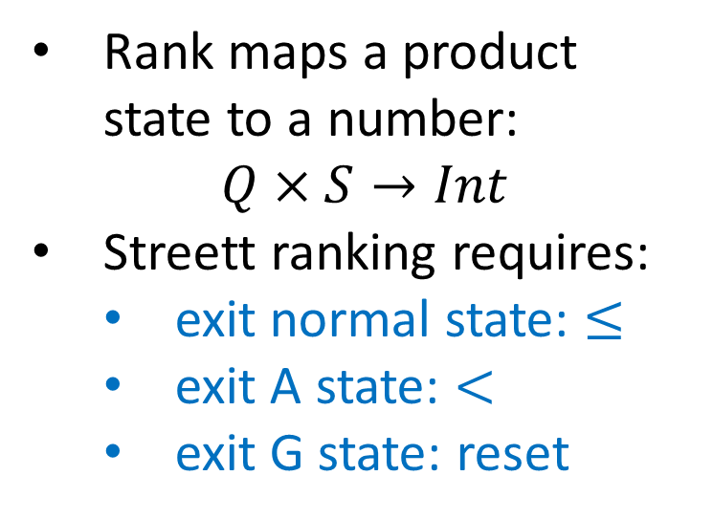


New ranking for Streett acceptance $Inf\left(A\right)→Inf\left(G\right)$
5
Rank maps a product state to a number:
$$Q×S→Int$$
Streett ranking requires:
exit normal state: $≤$
exit A state: $<$
exit G state: reset
$$≤$$
$$≤$$
5
$$≥$$
$≤$
5
$$>$$
10
$$reset$$
Notes:
add examples:
CoBuchi cycle
Streett acc cycle
normal cycle

Slide 12

Conjoining E- and A- properties
$$system⊨A\left(…\right)∧E(…)$$
We can solve SMT query for
$system⊨A(…)$ $∧$ $system⊨E(…)$
Notes:
add two pictures

Slide 13



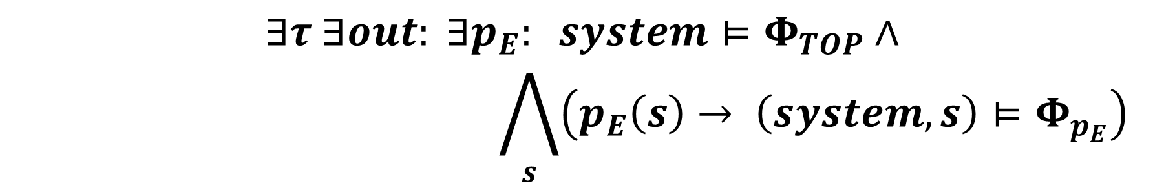



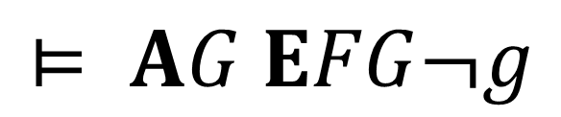


Encoding $system⊨CTL^{∗}$ into SMT
Introduce propositions for sub-formulas
Encode $system⊨AGp_{E}$
Encode $p_{E}\left(state\right)→\left(system,state\right)⊨EFG¬g$
$$r$$
$$⊨ AG EFG¬g$$
$$¬g$$
$$g$$
$$¬r$$
$$¬r$$
$$r$$
$$p_{E}$$
$$∃τ ∃out: ∃p_{E}: system⊨Φ_{TOP}∧$$
$$\bigwedge_{s}{\left(p_{E}\left(s\right)→ \left(system,s\right)⊨Φ_{p_{E}}\right)}$$

Slide 14
Conclusion
First bounded synthesizer for (conjunctions of) Streett and Rabin automata, and CTL*.
https://github.com/5nizza/party-elli
(branch cav17)
Future directions:
How to check unrealizability efficiently? [SYNT]
Extend to “multi-agent” logics
Efficiency: reduce to safety games and use BDDs

