Slide 1
Bounded Synthesis of Register Transducers
Roderick Bloem¹, Ayrat Khalimov^{1✡}, Benedikt Maderbacher¹
¹ TU Graz & ARiSE, Austria
✡ Hebrew University, Israel

Slide 2
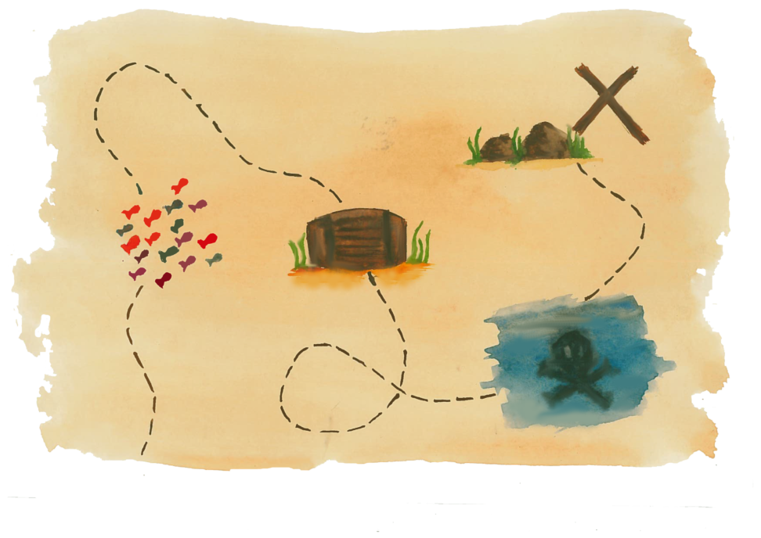
path to synthesis
synthesis
universal
automata
emptiness
determinization

Slide 3
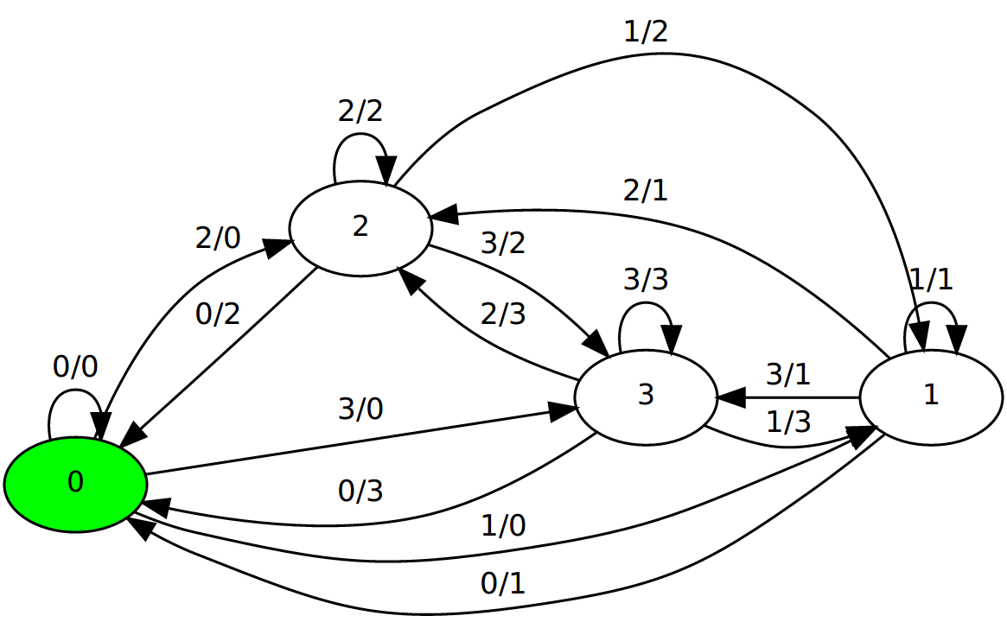
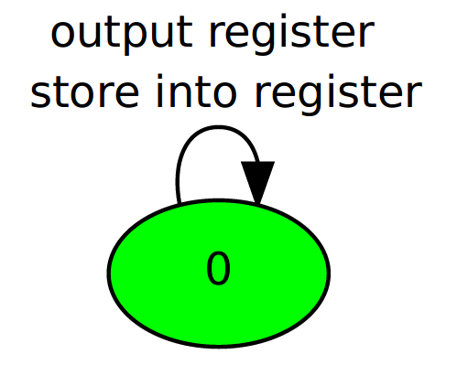
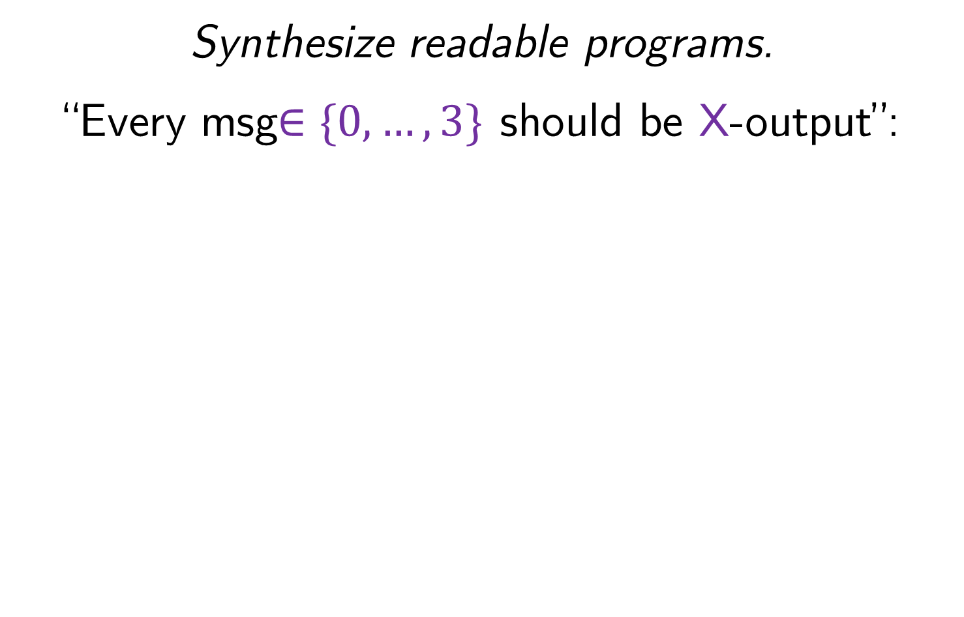
Motivation
Synthesize readable programs.
“Every msg$∈\{0,…,3\}$ should be X-output”:

Slide 4
Motivation
Synthesize readable programs.
Programs separate data/control, but synthesizers do not distinguish. This:
makes programs unreadable
doesn’t scale
doesn’t work for infinite data domains
=> handle data directly in synthesis

Slide 5
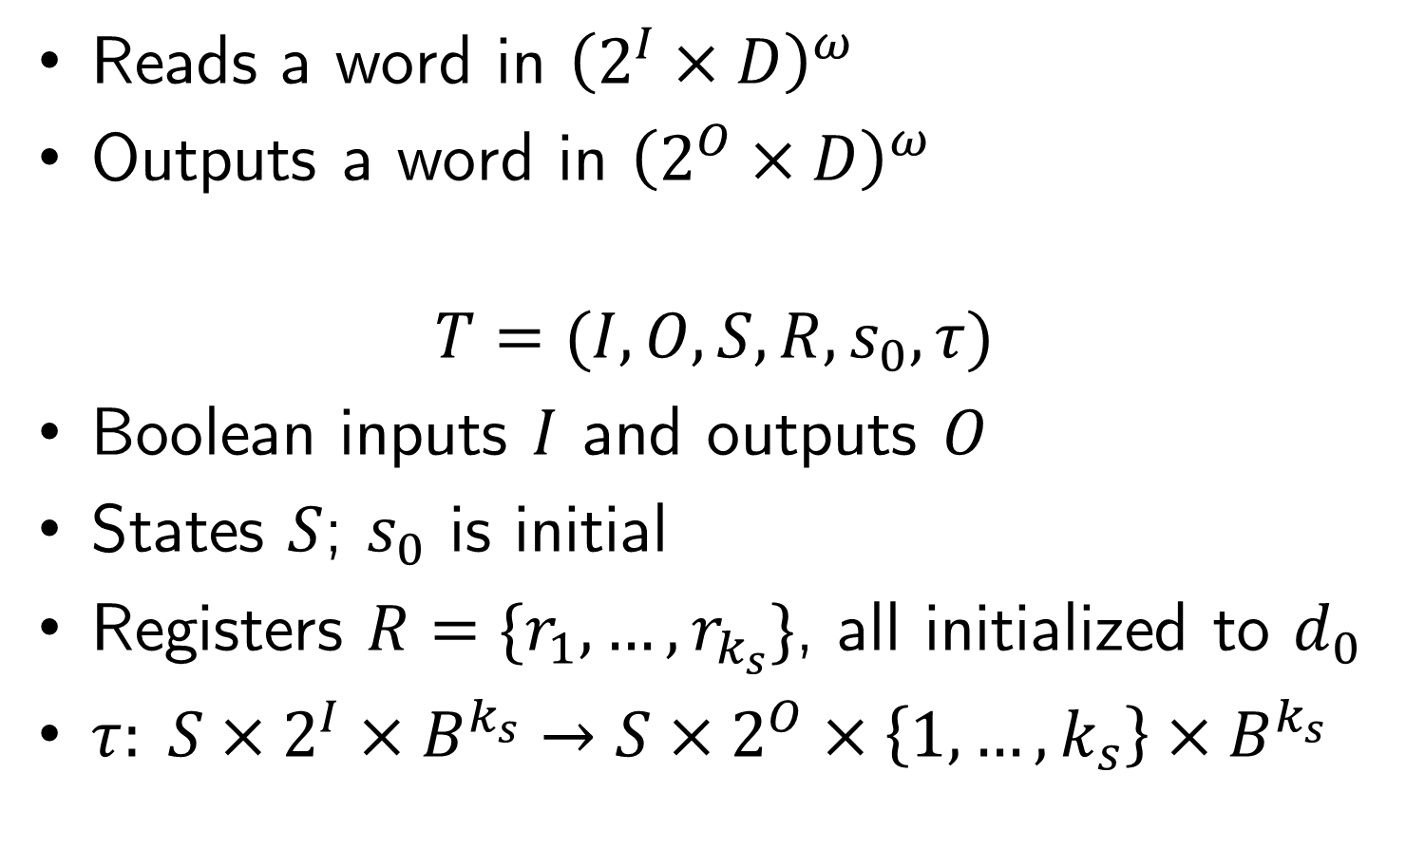
Register Transducers
Reads a word in ${\left(2^{I}×D\right)}^{ω}$
Outputs a word in ${\left(2^{O}×D\right)}^{ω}$
$$T=(I,O,S,R,s_{0},τ)$$
Boolean inputs $I$ and outputs $O$
States $S$; $s_{0}$ is initial
Registers $R=\{r_{1},…,r_{k_{s}}\}$, all initialized to $d_{0}$
$τ: S×2^{I}×B^{k_{s}}→S×2^{O}×\left\{1,…,k_{s}\right\}×B^{k_{s}}$

Slide 6
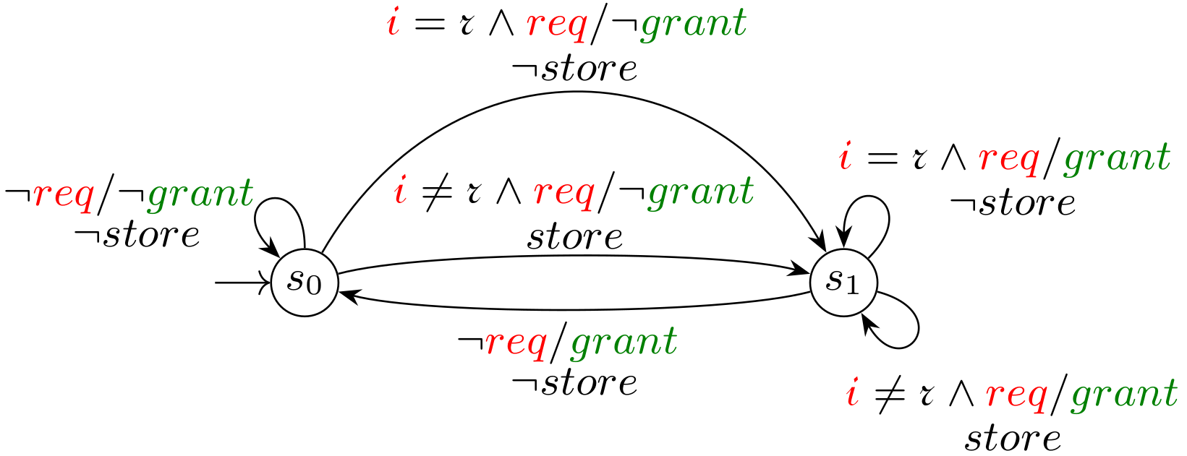
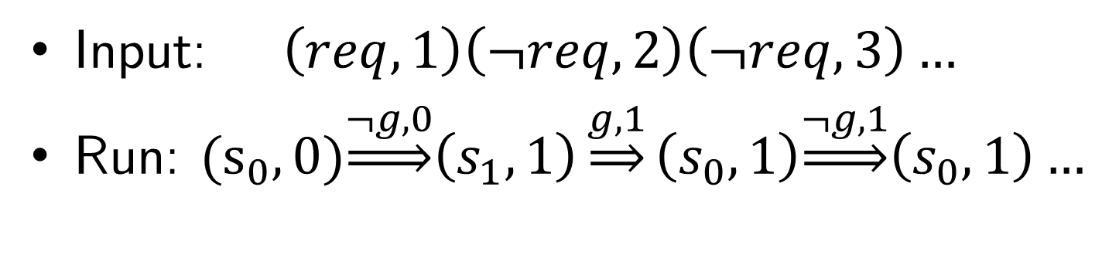
Arbiter (1-Register Transducer)
Input: $\left(req,1\right)\left(¬req,2\right)\left(¬req,3\right)…$
Run: ${(s}_{0},0)\underset{⇒}{¬g,0}\left(s_{1},1\right)\underset{⇒}{g,1}\left(s_{0},1\right)\underset{⇒}{¬g,1}\left(s_{0},1\right)…$

Slide 7
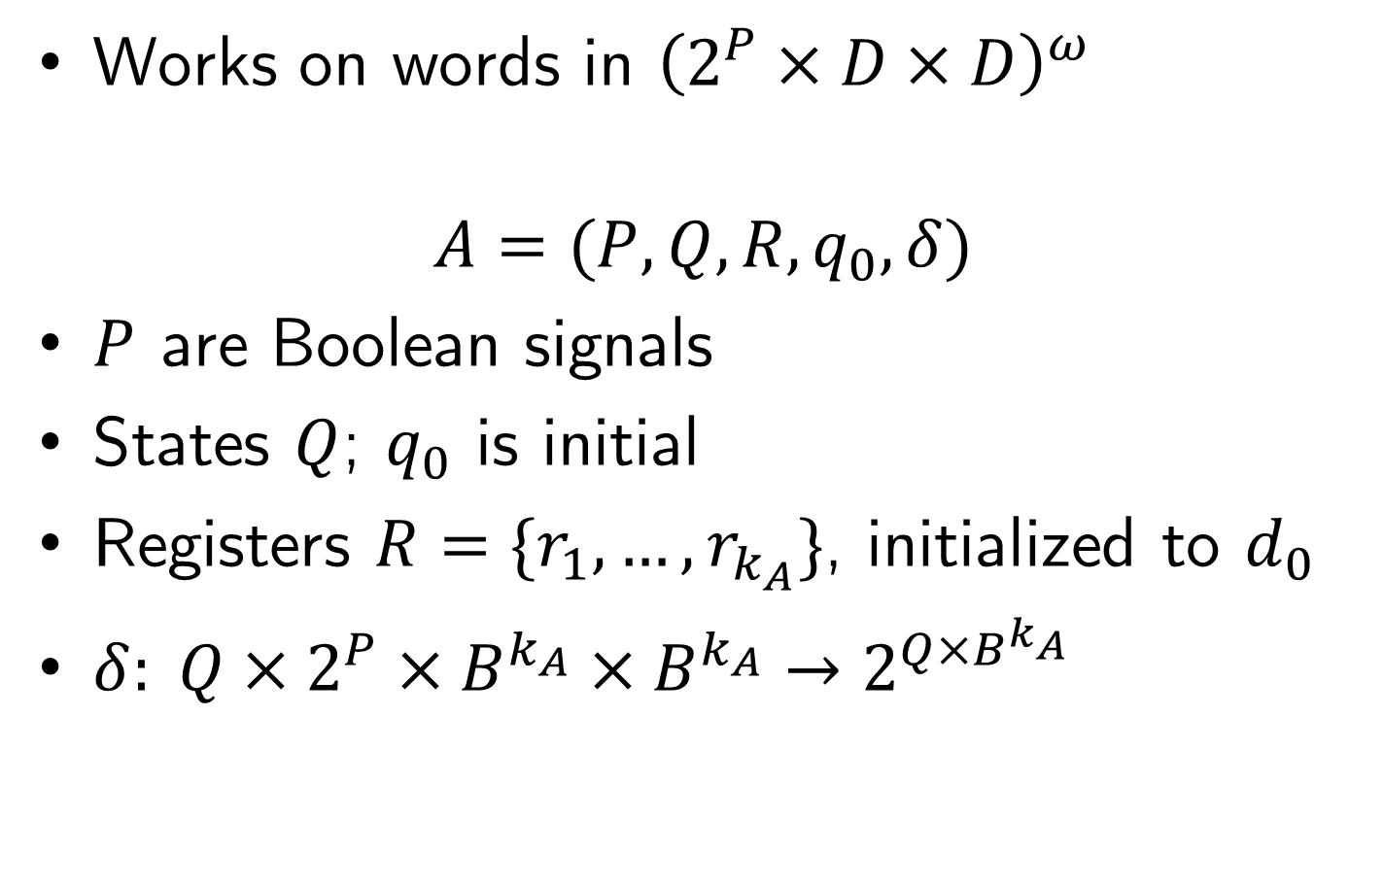
Register Automata (Universal CoBuchi)
Works on words in ${\left(2^{P}×D×D\right)}^{ω}$
$$A=(P,Q,R,q_{0},δ)$$
$P$ are Boolean signals
States $Q$; $q_{0}$ is initial
Registers $R=\{r_{1},…, r_{k_{A}}\}$, initialized to $d_{0}$
$δ: Q×2^{P}×B^{k_{A}}×B^{k_{A}}→2^{Q×B^{k_{A}}}$

Slide 8
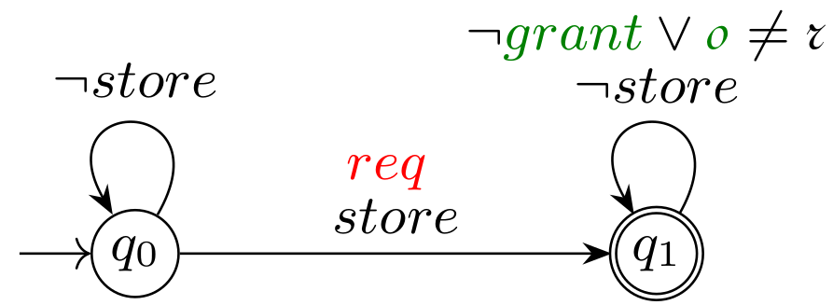

Spec for Arbiter (1-Register Automaton)
$$∀d∈D: G(req∧i=d → X F(grant∧o=d))$$

Slide 9






1-Register Automaton
Word: $\left({req,1 \atop ¬grant,0}\right)\left({¬req,2 \atop grant,1}\right)\left({¬req,3 \atop ¬grant,1}\right)…$
Run-graph:
$$\left(q_{0},0\right)$$
$$\left(q_{0},0\right)$$
$$\left(q_{0},0\right)$$
$$\left(q_{0},0\right)$$
$$\left(q_{1},1\right)$$

Slide 10
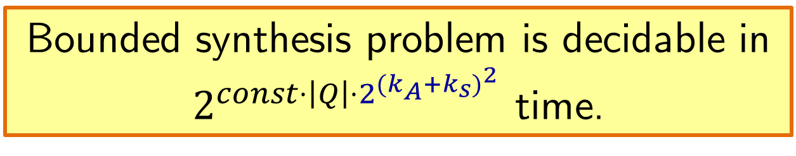
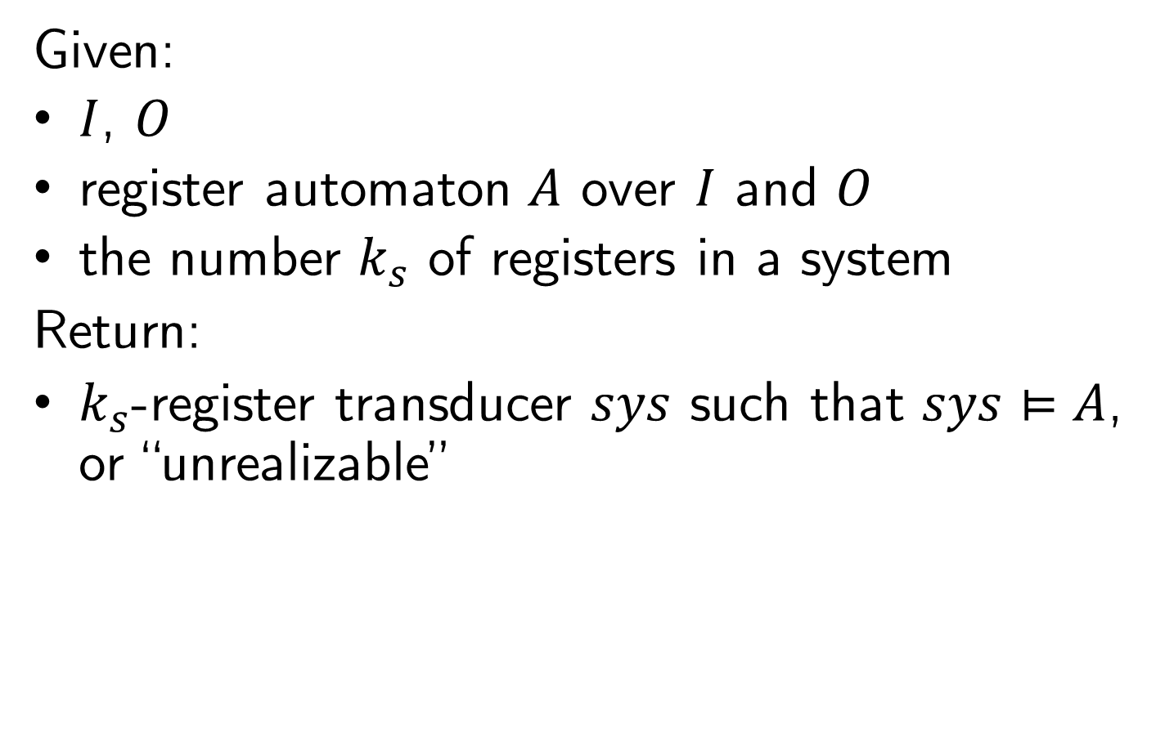
Bounded Synthesis Problem
Given:
$I$, $O$
register automaton $A$ over $I$ and $O$
the number $k_{s}$ of registers in a system
Return:
$k_{s}$-register transducer $sys$ such that $sys⊨A$, or “unrealizable”
Bounded synthesis problem is decidable in
$2^{const⋅\left|Q\right|⋅2^{{(k_{A}+k_{s})}^{2}}}$ time.

Slide 11



Synthesis
Standard approach:
$$A$$
$$A$$
$$\det{A}$$

Slide 12
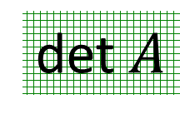




Synthesis
Standard approach:
$$A$$
undecidable
for register
automata
$T$
det $A$
$$\det{A}$$
find $T$

Slide 13
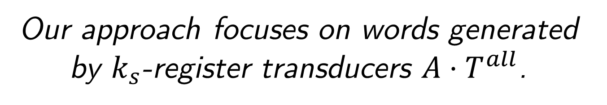



Synthesis
Our approach focuses on words generated by $k_{s}$-register transducers $A⋅T^{all}$.
$$T^{all}$$
$$A$$
H
$T$

Slide 14
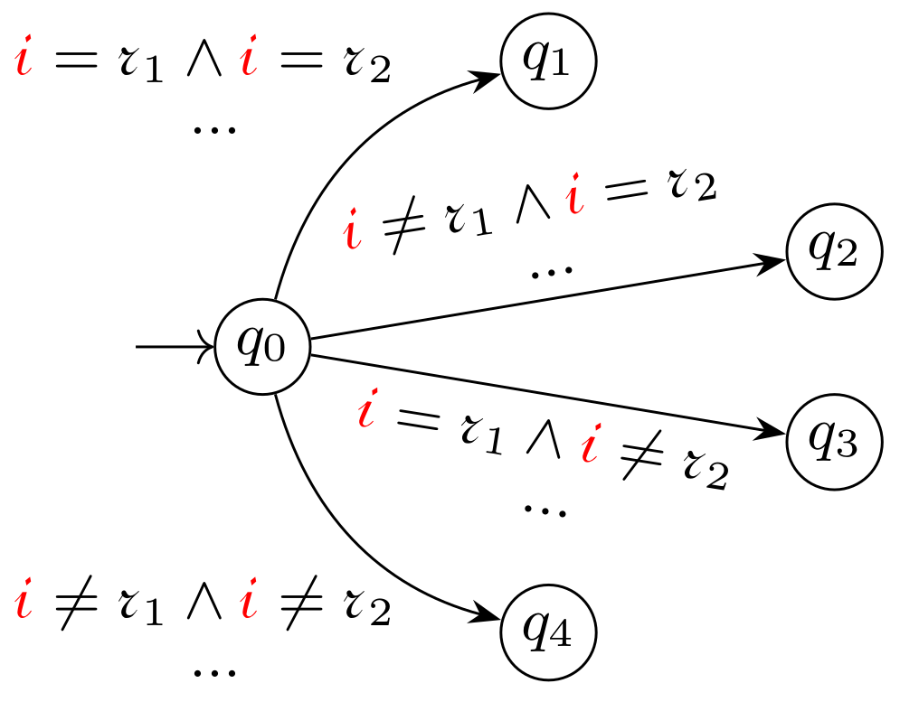
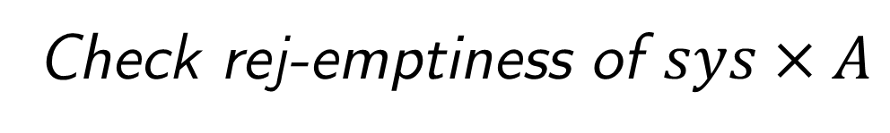
Abstraction for Model Checking
Find a rejecting word in a register automaton
Check rej-emptiness of $sys×A$

Slide 15
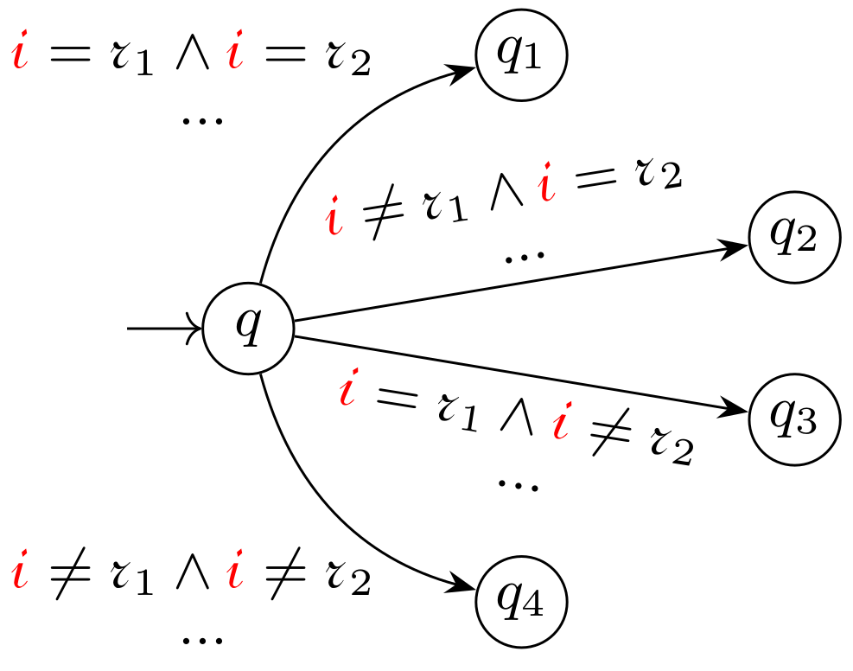

Abstraction for Model Checking
Find a rejecting word in a register automaton
impossible
$$r_{1}=r_{2}$$

Slide 16
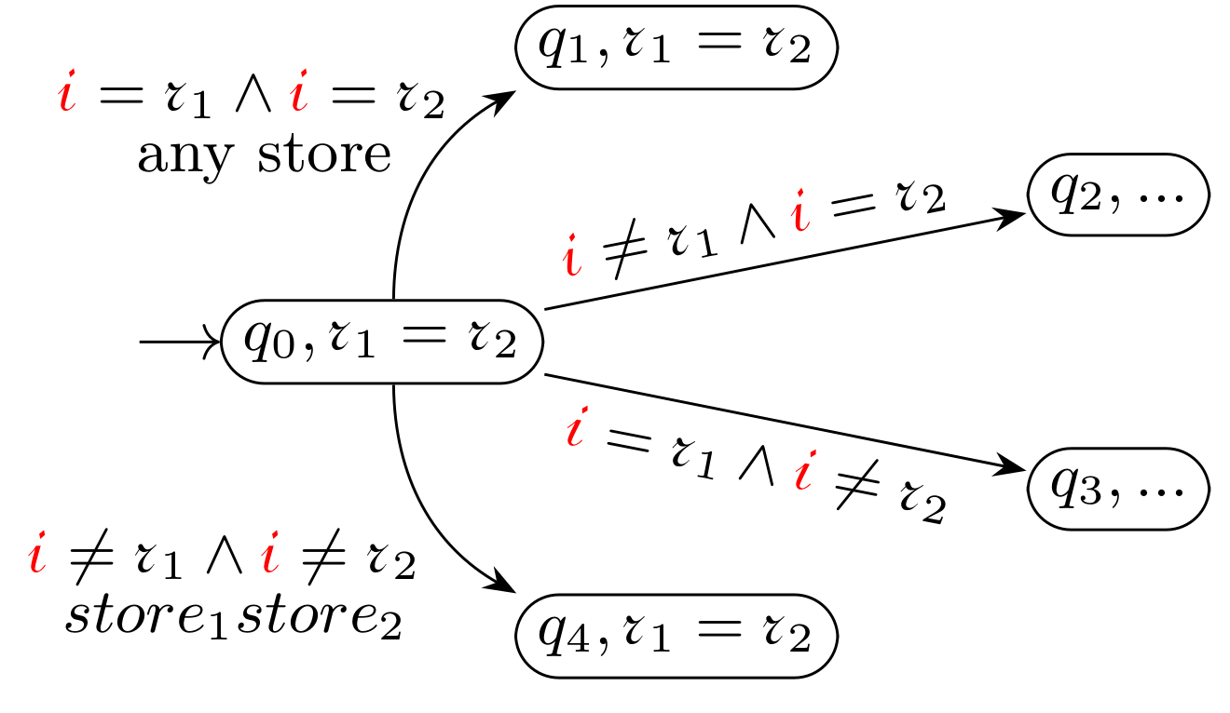
Abstraction for Model Checking
Find a rejecting word in a register automaton
impossible
for example

Slide 17

Abstraction for Model Checking
Find a rejecting word in a register automaton
impossible
$$store_{1}¬store_{2}$$
another example

Slide 18
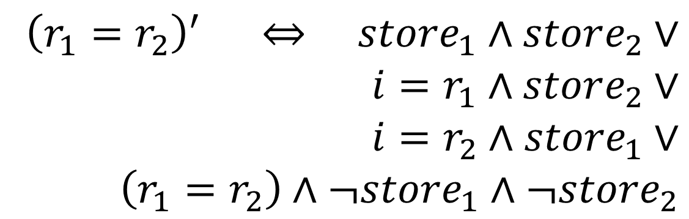
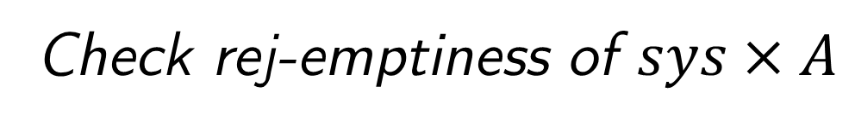
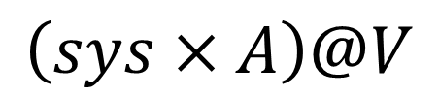
Abstraction for Model Checking
Check rej-emptiness of $sys×A$
Find a rejecting word in a register automaton
==
find a rejecting word in register-less abstraction
$$\left(sys×A\right)@V$$
$${\left(r_{1}=r_{2}\right)}^{′} ⇔ store_{1}∧store_{2}∨$$
$$i=r_{1}∧store_{2}∨$$
$$i=r_{2}∧store_{1}∨$$
$$\left(r_{1}=r_{2}\right)∧¬store_{1}∧¬store_{2}$$

Slide 19
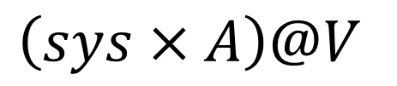
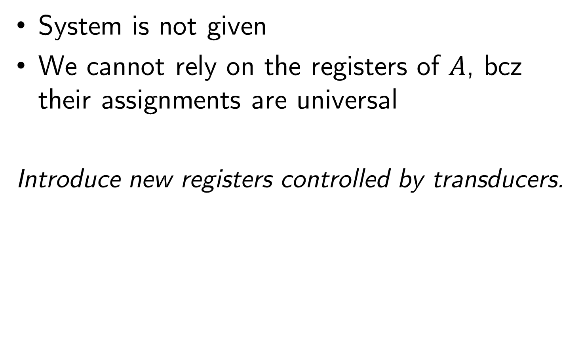
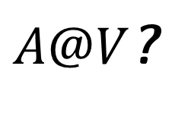
Synthesis
$\left(sys×A\right)@V$
System is not given
We cannot rely on the registers of $A$, bcz their assignments are universal
Introduce new registers controlled by transducers.
$A@V$?

Slide 20
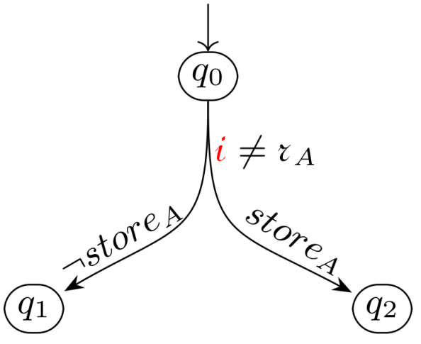
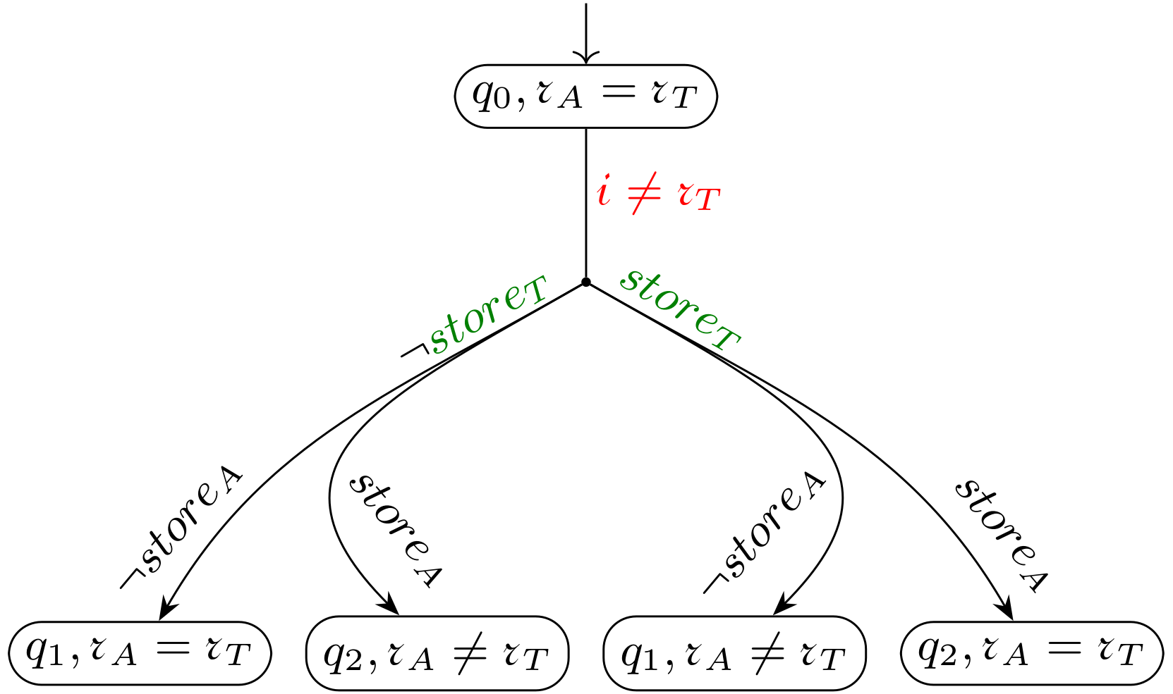
Synthesis
Introduce new registers controlled by transducers.

Slide 21
Synthesis
Introduce new registers controlled by transducers.

Slide 22






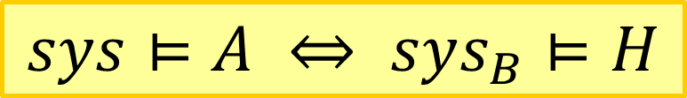
Abstraction for Synthesis
Automaton $H$:
$Q_{H}⊆Q_{A}×Π_{R_{A}∪R_{s}}$
$P_{H}=I∪O∪Guards_{s}∪Asgn_{s}$
no registers
Systems are Boolean:
$$Guards_{s}$$
$$Asgn_{s}$$
$$sys_{B}$$
$$I$$
$$O$$
$$sys⊨A ⇔ sys_{B}⊨H$$

Slide 23
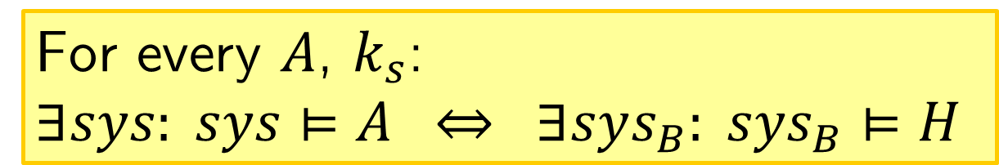


Synthesis
For every $A$, $k_{s}$:
$$∃sys: sys⊨A ⇔ ∃sys_{B}: sys_{B}⊨H$$
Time complexity: in $2^{const⋅\left|Q\right|⋅2^{{(k_{A}+k_{s})}^{2}}}$
$$T^{all}$$
H
$$A$$
$$sys$$

Slide 24
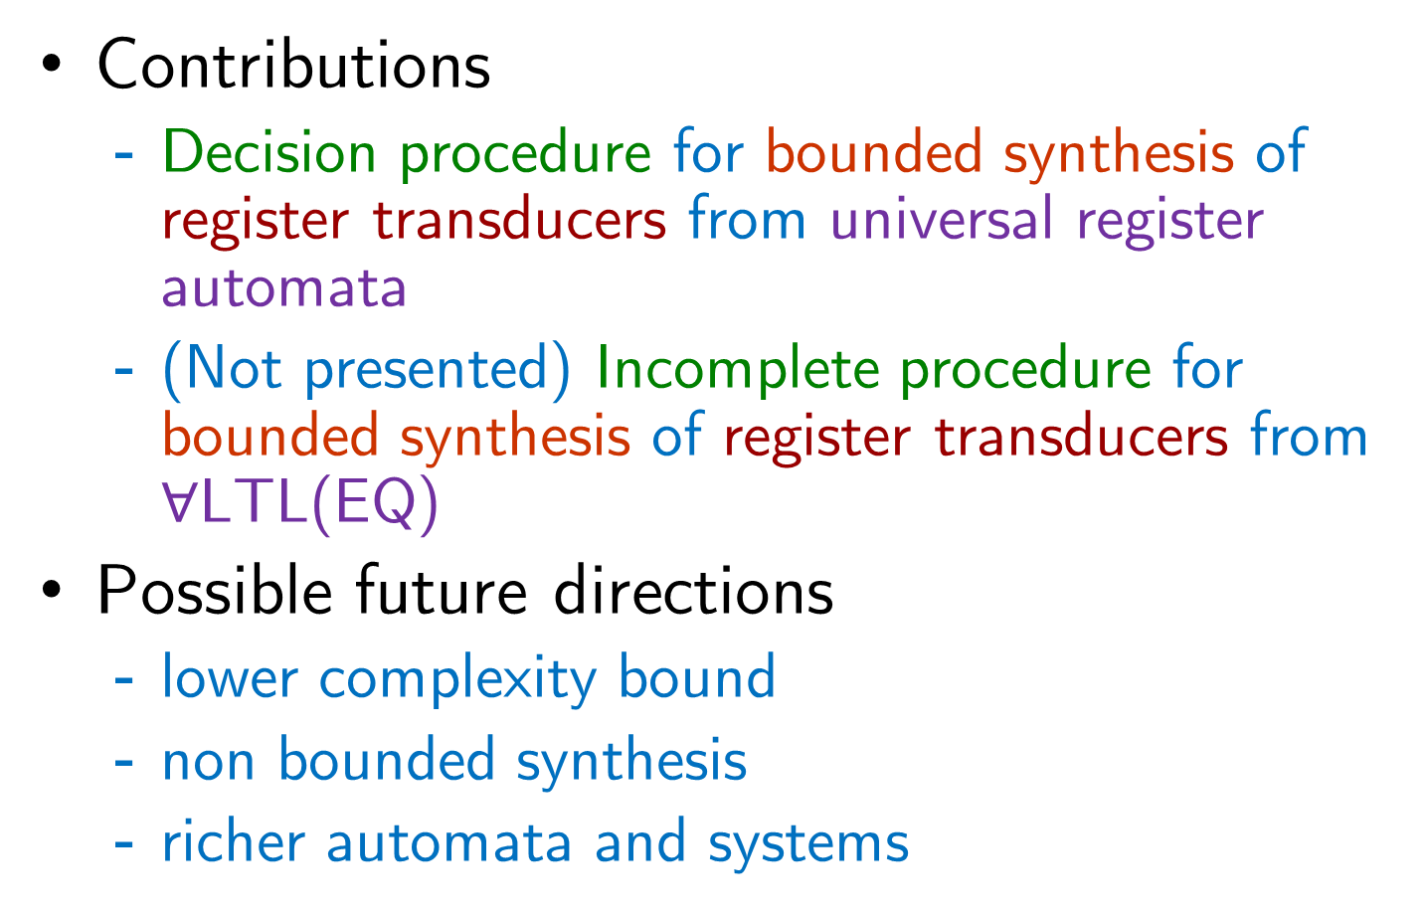
Conclusion
Contributions
Decision procedure for bounded synthesis of register transducers from universal register automata
(Not presented) Incomplete procedure for bounded synthesis of register transducers from $∀$LTL(EQ)
Possible future directions
lower complexity bound
non bounded synthesis
richer automata and systems

