Slide 1


parameterized synthesis of token rings
PARTY
Ayrat Khalimov, Swen Jacobs, Roderick Bloem

Slide 2



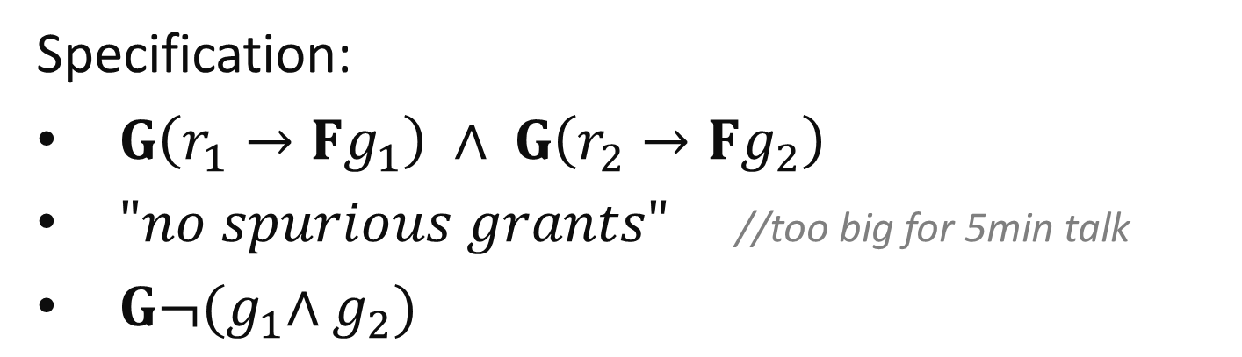



synthesis of reactive systems
$$r_{1}$$
arbiter
(FSM)
$$g_{1}$$
$$r_{2}$$
$$g_{2}$$
Specification:
$G\left(r_{1}→Fg_{1}\right) ∧ G\left(r_{2}→Fg_{2}\right)$
$"no spurious grants"$ //too big for 5min talk
$G¬{(g}_{1}∧g_{2})$

Slide 3
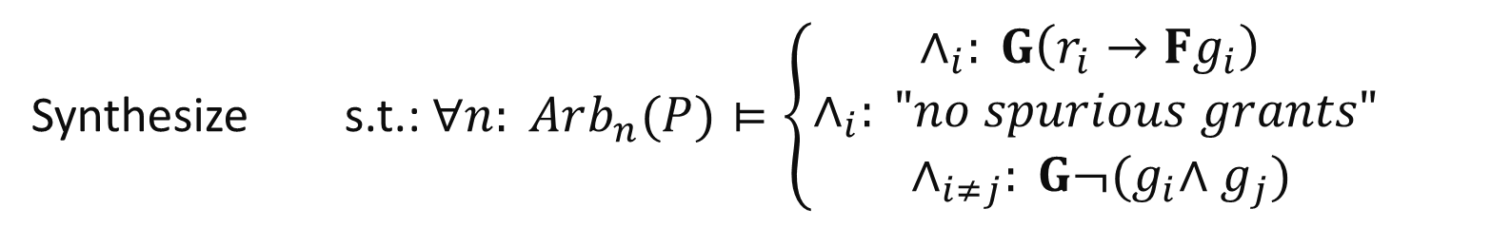
P
P
P
P
P
P
P
P
P
P
P
P
Synthesize s.t.: $∀n: Arb_{n}(P)⊨\left\{\begin{aligned}∧_{i}: G\left(r_{i}→Fg_{i}\right) \\ ∧_{i}: "no spurious grants" \\ ∧_{i≠j}: G¬{(g}_{i}∧g_{j})\end{aligned}\right.$
P
Notes:
- hm, not really happy, people may mess: can you create a new processes at runtime?

Slide 4
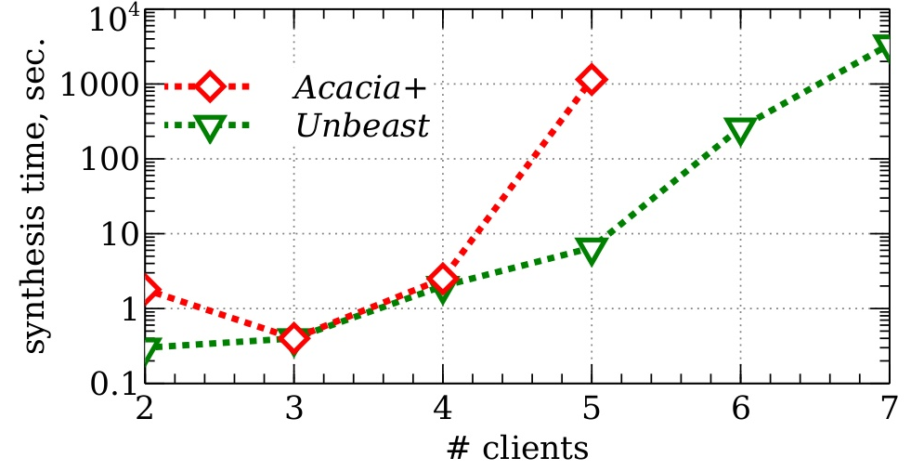
why?
Synthesis time for an arbiter for different number of clients:
because synthesis tools do not scale
Notes:
+ exp behaviour on log scale

Slide 5
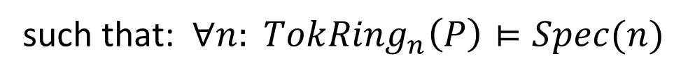

parameterized synthesis problem that PARTY solves
given parameterized specification Spec
synthesize FSM
P
such that: $∀n: Tok{Ring}_{n}\left(P\right)⊨Spec(n)$
asynchronous composition
of n processes (FSM) P
one-directional token ring
$$∀\vec{k}: A\left(\vec{k}\right)→ ∀\vec{m}:G(\vec{m})$$
e.g. n=4:
Notes:
+ the problem is undecidable => semi-decidable

Slide 6
ideas behind PARTY
1. Cutoffs in token rings [EN95]:
a large token ring satisfies a spec
if and only if
a small token ring of cutoff size satisfies the spec
2. SMT-based bounded synthesis [FS07]:
bound the number of states in the implementation,
synthesize,
if solution not found – increase the bound
Notes:
+ cutoffs: extended results to any quantifiers, mention [CTTV04]
+ numerous optimizations that give at least 3 orders of magnitude speed up

Slide 7

an example: synthesis of an arbiter
Specification:
$∀_{i}: G\left(r_{i}→Fg_{i}\right)$
$∀_{i}: "no spurious grants"$
$∀_{i≠j}: G¬{(g}_{i}∧g_{j})$
According to [EN95] cutoff=4:
P
P
,
,
,
…
P
P
P
Notes:
check the [EN]

Slide 8
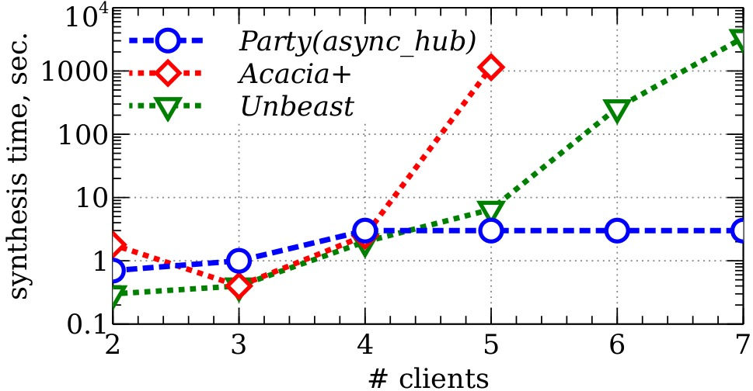
an arbiter example: PARTY show case
Synthesis time for ‘full arbiter’ for different number of clients:
Notes:
+ mention the minimal size: around 10x smaller
+ it takes less than 10seconds to synthesize a parameterized version of an arbiter

Slide 9
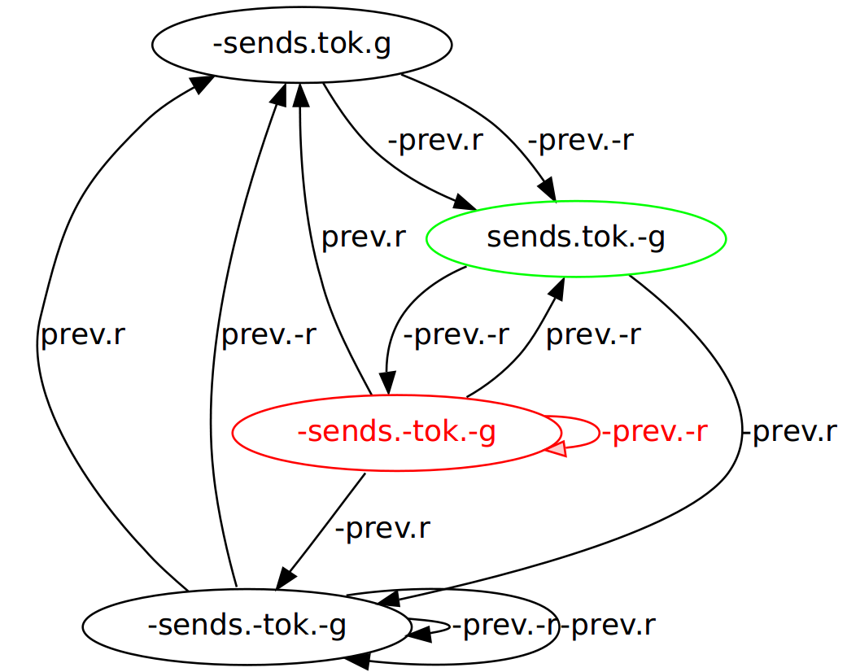
an arbiter: Moore implementation
P

Slide 10
conclusion
PARTY supports:
parameterized synthesis of token rings [KJB13]
SMT-based bounded synthesis [FS07]
Available at https://github.com/5nizza/Party
Notes:
+ will be glad to discuss possible directions and ideas after the next session

