Slide 1


Towards Efficient Parameterized Synthesis
Ayrat Khalimov
Swen Jacobs
Roderick Bloem
Notes:
In evaluation – clarify that we don’t need to synthesize bigger rings.

Slide 2

A reactive system is a system that
responds to external events
Reactive System

Slide 3
Parameterized Reactive System

Slide 4
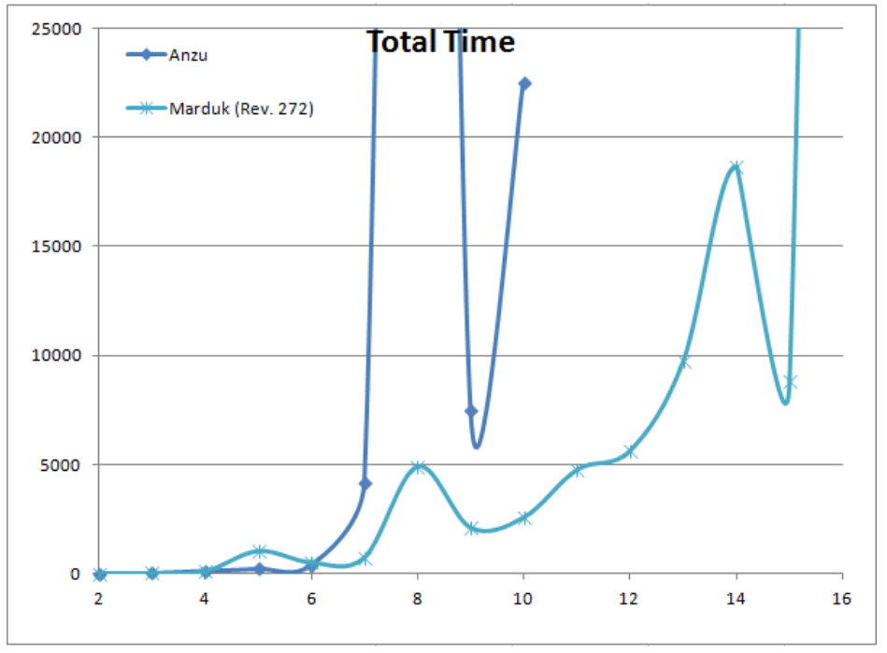
Synthesis time of AMBA arbiter
Notes:
Questionable

Slide 5
Outline
1. Preliminaries
Parameterized specifications and systems
Parameterized synthesis problem
Method to solve parameterized synthesis problem
2. Motivation for the current work
3. The main part
4. Conclusion

Slide 6
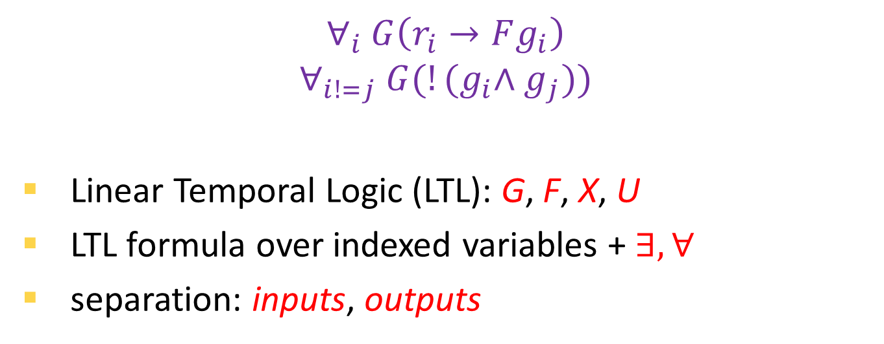
Parameterized Specification
$$∀_{i} G\left(r_{i}→Fg_{i}\right)$$
$$∀_{i!=j} G(!{(g}_{i}∧g_{j}))$$
Linear Temporal Logic (LTL): G, F, X, U
LTL formula over indexed variables + $∃,∀$
separation: inputs, outputs
Notes:
Indexed temporal logic was introduced in 1989:
M. C. Browne, E. M. Clarke, and O. Grumberg.
Reasoning about networks with many identical ﬁnite state processes

Slide 7
Parameterized Systems
The concrete system
A_{n}, scheduler, (P₁, …, P_{n})
The parameterized system is a ‘mapping’ from parameter n to a concrete system with n processes:
n -> A_{n}, scheduler , (P₁, …, P_{n})

Slide 8
Parameterized Token Rings
set of isomorphic processes (P₁ = … = P_{n})
scheduler: asynchronous
architecture: token rings
. . .
Notes:
mention left-right
we don’t synthesize scheduler
scheduler is a bad guy but it is fair
some optimizations work for all
what is an architecture?
what is a token ring? what is a token?
ADD animation – changing states, transmitting tokens

Slide 9
Parameterized Synthesis Problem
Given parameterized specification φ,
find a process implementation P
/and parameterized architecture A/:
A_{n}, P ⊨ φ_{n}
for any number n of processes
Undecidable /even for token rings/
=> semi-decision procedures
Notes:
I did not introduce parameterized architecture
What is a root of undecidability?

Slide 10
Parameterized Synthesis Method [JB12]
LTL
Reduce to
Token Ring of cutoff size
Synthesize Token Ring
of cutoff
size
Process model
Cutoff reductions from verification community [EN95]
Bounded synthesis approach [SF07]
Notes:
Decision procedure != synthesis
Point with arrows

Slide 11
Cutoffs in Token Rings
Reasoning about Rings, E. A. Emerson, K.S. Namjoshi, 1995
Given
a token ring architecture
isomorphic processes
specifications LTL\X of a special form
then enough to verify:
synthesize:
∧φ(i, j)
∧φ(i)
∧φ(i, i+1)
Notes:
Beautify these figures – make it similar to token rings

Slide 12

Synthesis of Parameterized Arbiter
$$∧_{i!=j}G(!{(g}_{i}∧g_{j}))∧G\left(r_{i}→Fg_{i}\right)$$
∧φ(i, j) => cutoff of 4
r
g

Slide 13
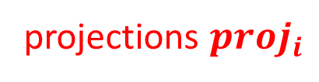
Adaption of Bounded Synthesis to Parameterized Synthesis [JB12, SF07]
transition function
Encoder
SMT Solver
output functions
spec
automaton
architecture specific
output functions
projections $proj_{i}$
+ constraints to specify token rings architecture

Slide 14
The Problems
1. Language
Cannot handle an “arbiter without spurious grants” in assume-guarantee specification
2. Slow on non-trivial examples
an “arbiter without spurious grants” cannot be synthesized in 2 hours
3. Limited architectures (future work)
only token rings are supported

Slide 15
Outline
1. Preliminaries
2. Motivation for the current work
3. Language
4. Optimizations
5. Conclusion

Slide 16
Language: more indices
[EN95] does not handle ∧ a -> ∧ g
Verification by Network Decomposition [CTTV4]:
general token passing networks
any number of indices in specifications
cutoff result depends on the architecture
We refined [CTTV4]:
Th. For k-indexed specifications in token rings
the cutoff is 2k.
Notes:
f(i,j,k) to Exists j Forall i f(i,j) forall(j) (forall(i) a_i -> g_j) forall(j) (exists (i) !a_i \/ g_j)
forall(j) (exists (i) !a_i \/ g_j) exists(i)forall(j) (!a_i \/ g_j)

Slide 17
Outline
1. Preliminaries
2. Motivation for the current work
3. Language
4. Optimizations
Optimizations of encoding
General optimizations
5. Conclusion

Slide 18
Optimizations of Encoding
Original
‘Top-Down’ Approach [JB12]
Proposed
‘Bottom-Up’ Approach
Use constraints to specify the system of components
Compose the system from the components
Global:
state t
transition ta
Global:
state (s1,s2,s3)
transition (tau,tau,tau)
tau
projection functions
Local s1
Local s2
Local s3
Local s1
Local s2
Local s3
out
out
tau

Slide 19
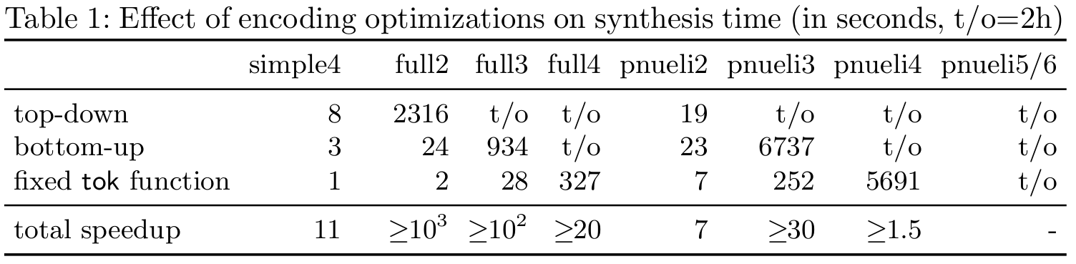
Evaluation of Bottom-Up Encoding
Why it works?
Decreases # of unknowns – no projection functions.
Domain of transition function tau also decreased.
Notes:
Add speed up xx
The size of queries gets bigger, due to non-bounded number of global states. With projection functions we could bound # of global states.
For example SMT query for full2: 230K -> 307K
full3: 892K -> 3.4M
full4: 734K -> 23M

Slide 20
Outline
1. Preliminaries
2. Motivation for the current work
3. Language
4. Optimizations
Optimizations of encoding
General optimizations
Strengthening of specifications
Modular synthesis
Environment abstraction
5. Conclusion

Slide 21
Strengthening of Specifications
Sound rewriting of the specification
to make it easier for synthesis procedure.

Slide 22
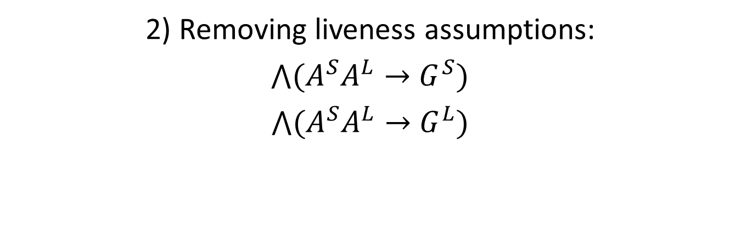




Idea of Strengthening
$\bigwedge{A^{S}A^{L}}→$ $\bigwedge{G^{S}G_{}^{L}}$
1) Localizing:
$\bigwedge{(A^{S}A^{L}}→$ $G^{S}G^{L})$
$\bigwedge{A^{S}A^{L}}→$ $\bigwedge{G^{S}G_{}^{L}}$
2) Removing liveness assumptions:
$\bigwedge{{(A}^{S}A^{L}}→$ $G^{S})$
$\bigwedge{{(A}^{S}A^{L}}→$ $G^{L})$
$\bigwedge{{(A}^{S}}→$ $G^{S})$
$\bigwedge{{(A}^{S}A^{L}}→$ $G^{L})$
Strengthenings are sound, but incomplete

Slide 23
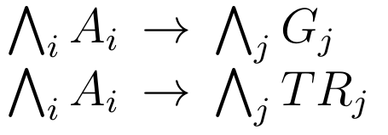
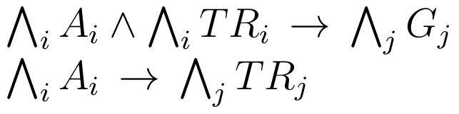

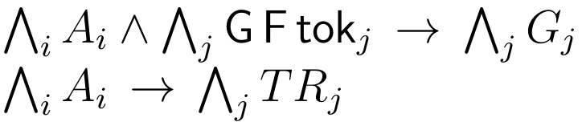
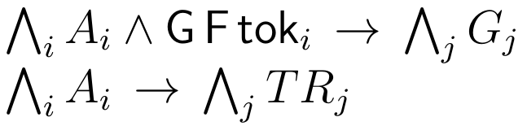
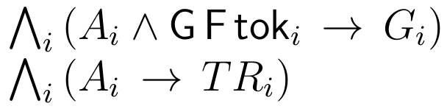
Localizing: in depth
localization step

Slide 24
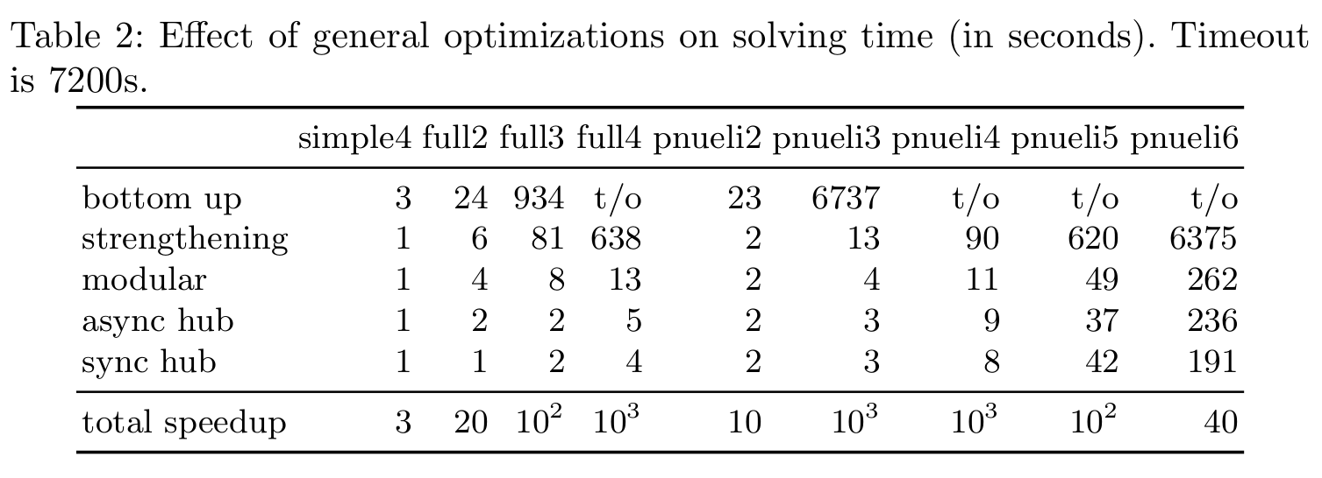
Evaluation of Strengthening
Why it works?
It reduces the size of specification automaton
(for pnueli4 - from 1700 to 30 nodes, cutoff 6 -> 4)
Notes:
TODO --- mention cutoff size reduction

Slide 25
Outline
1. Preliminaries
2. Motivation for the current work
3. Language
4. Optimizations
Optimizations of encoding
General optimizations
Strengthening of specifications
Modular Synthesis of properties
Environment abstraction
5. Conclusion

Slide 26

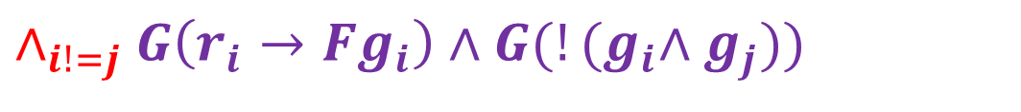


Non-Modular Synthesis
$$∧$$
$$∧_{i}G\left(r_{i}→Fg_{i}\right)$$
$$∧_{i!=j}G(!{(g}_{i}∧g_{j}))$$
$$∧_{i!=j}G\left(r_{i}→Fg_{i}\right)∧G(!{(g}_{i}∧g_{j}))$$
synthesize
Notes:
TODO: is it clear that modular synthesis is correct?
To understand the idea of modular synthesis lets consider an example of a simple arbiter. It specification is on the slide.
There are two different properties: every request should be granted, it talks about one process only, and hence is one-indexed property.
Recall that for a synhtesis of one-indexed property according to EN results a token ring of size 2 is enough.
A token ring of size 2 is not enough for second property that is 2indexed. For 2indexed property a token ring of size 4 is required.
The idea of modular synthesis is to synthesize token ring of size 2 and token ring of size 4 at the same time. To do this at the same time we add constraints for both token rings into the same SMT query. In both SMT constraints – for token ring 2 and token ring 4 – we use the same symbols to denote process transition and output functions. Therefore, if we manage to find a solution to such a hybrid SMT query, then it will be a solution for our initial synthesis problem.
Does this work?

Slide 27
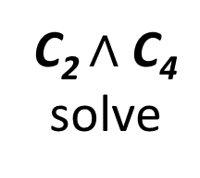
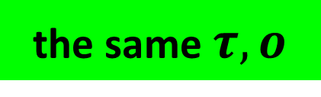
Modular Synthesis
$$∧$$
$$∧_{i}G\left(r_{i}→Fg_{i}\right)$$
$$∧_{i!=j}G(!{(g}_{i}∧g_{j}))$$
the same $τ, o$
encode C₂
encode C₄
C₂ $∧$ C₄
solve
Notes:
TODO: is it clear that modular synthesis is correct?
To understand the idea of modular synthesis lets consider an example of a simple arbiter. It specification is on the slide.
There are two different properties: every request should be granted, it talks about one process only, and hence is one-indexed property.
Recall that for a synthesis of one-indexed property according to EN results a token ring of size 2 is enough.
A token ring of size 2 is not enough for second property that is 2indexed. For 2indexed property a token ring of size 4 is required.
The idea of modular synthesis is to synthesize token ring of size 2 and token ring of size 4 at the same time. To do this at the same time we add constraints for both token rings into the same SMT query. In both SMT constraints – for token ring 2 and token ring 4 – we use the same symbols to denote process transition and output functions. Therefore, if we manage to find a solution to such a hybrid SMT query, then it will be a solution for our initial synthesis problem.
Does this work?

Slide 28
Evaluation of Modular Synthesis
Why it works?
Parts of the specification are synthesized in smaller rings => smaller queries
full4: 6MB → 0.6MB
pnueli4: 21MB → 4MB

Slide 29
Outline
1. Preliminaries
2. Motivation for the current work
3. Language
4. Optimizations
Optimizations of encoding
General optimizations
Strengthening of specifications
Modular synthesis
Environment abstraction
5. Conclusion

Slide 30
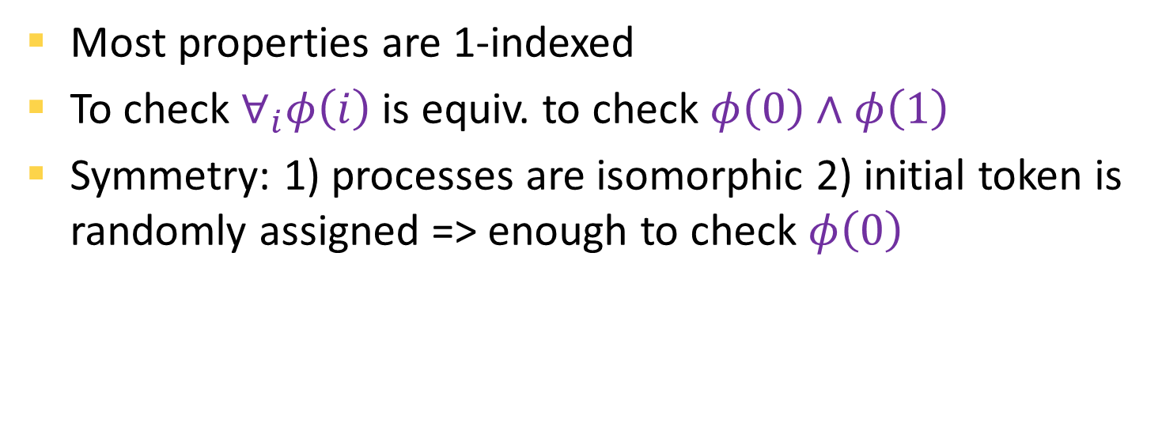



Environment Abstraction
Most properties are 1-indexed
To check $∀_{i}φ\left(i\right)$ is equiv. to check $φ\left(0\right)∧φ\left(1\right)$
Symmetry: 1) processes are isomorphic 2) initial token is randomly assigned => enough to check $φ\left(0\right)$
$$∀_{i}φ\left(i\right)$$
$$φ\left(0\right)∧φ\left(1\right)$$
$$φ\left(0\right)$$
Notes:
Next optimization applies to token ring of size 2. Aren’t rings 2 too special? No, rings 2 are very common. Most of the specifications (AMBA bus), our arbiters, have lots of 1index properties and the number of higher-index properties is very small (the only). 1-index properties for its correct synthesis require a cutoff of size 2. Hence optimization of synthesis of rings 2 is crucial for the synthesis.

Slide 31
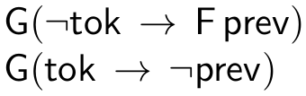
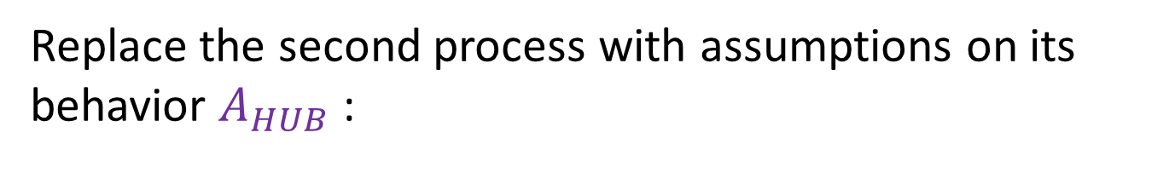


Environment Abstraction (cont.)
Replace the second process with assumptions on its behavior $A_{HUB}$:
prev
sends
$$φ\left(0\right)$$
$$A_{HUB}→φ\left(0\right)$$
async hub – normal setting
sync hub – the process is always scheduled
Notes:
Next optimization applies to token ring of size 2. Aren’t rings 2 too special? No, rings 2 are very common. Most of the specifications (AMBA bus), our arbiters, have lots of 1index properties and the number of higher-index properties is very small (the only). 1-index properties for its correct synthesis require a cutoff of size 2. Hence optimization of synthesis of rings 2 is crucial for the synthesis.

Slide 32
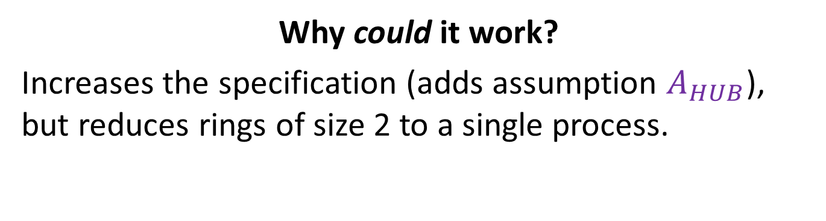
Evaluation of Environment Abstraction
Why could it work?
Increases the specification (adds assumption $A_{HUB}$), but reduces rings of size 2 to a single process.
Notes:
We further extend the idea of hub-processes and introduce hub-abstraction. Hub-abstraction replaces a hub process with LTL specification of its behavior. For the synthesis it means that instead of synthesizing a token ring 2 with a hub-process we synthesize one process under additional assumptions on behavior of hub process. Thus we increase the size of the specification but reduce the size of ring.

Slide 33
General Optimizations: sum up
S
Strengthening of specifications
Modular synthesis of properties
async hub abstraction
sync hub abstraction
S
C
S
C
C

Slide 34
Prototype Implementation
Architecture
Mealy/Moore
model
ILTL
Optimizer
LTL3BA
Encoder
Z3
+
-
increase bound
available at http://github.com/5nizza/Party

Slide 35
Conclusion
Current work:
Extends language of parameterized synthesis method
Introduces optimizations leading to 10³ speedup
Future directions:
Optimize bounded synthesis approach – LTL to automaton conversion is a bottleneck
Utilize lazy synthesis approach [FJ12]
Extend the prototype tool to a distributed synthesis

Slide 36
Thank you

