Slide 1


Parameterized Synthesis Case Study: AMBA Arbiter
SYNT 2014
Roderick Bloem, Swen Jacobs, Ayrat Khalimov

Slide 2
Outline
What is AMBA? Why AMBA?
What is Parameterized Synthesis Problem?
Existing approach for Parameterized Synthesis
Challenges for the existing approach
Addressing the challenges
Optimizations and Experiments
Conclusion

Slide 3
What is AMBA Arbiter?
m₀
…
m_{n}
Arbiter
bus
s₀
…
s_{k}
AMBA bus
Masters, Slaves and the Arbiter:
masters request from the arbiter an access to the bus, and communicate with slaves.

Slide 4
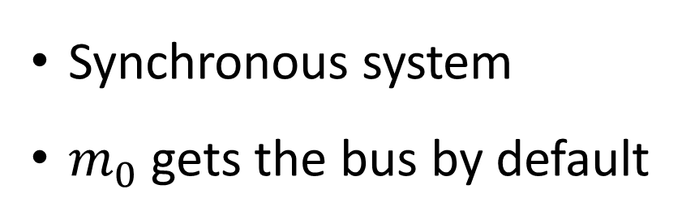
AMBA Arbiter: Simplified [J07]
HBUSREQ[i]
HLOCK[i]
HBURST
m₀
…
m_{n}
Arbiter
HGRANT[i], etc.
HREADY
Synchronous system
$m_{0}$ gets the bus by default

Slide 5
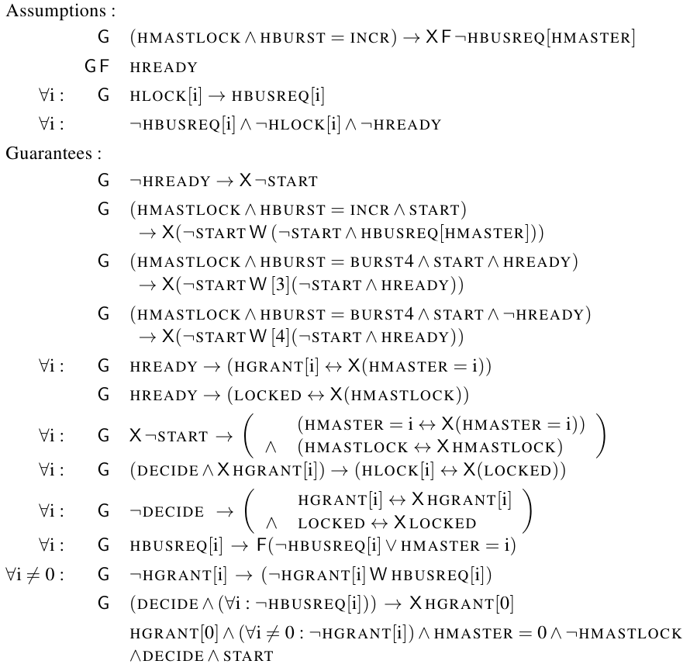
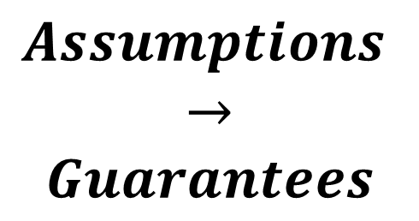
GR1 Specification of AMBA [J07]
$$Assumptions$$
$$→$$
$$Guarantees$$

Slide 6
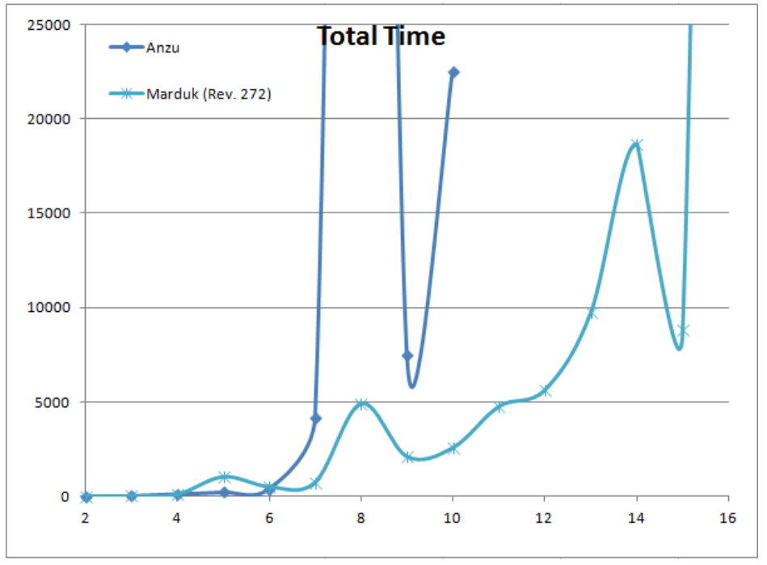
Why AMBA Arbiter?
Synthesis Time of AMBA Arbiter
Notes:
Questionable

Slide 7
What is parameterized synthesis?

Slide 8
System Model: Token Rings
Isomorphic processes
Interleaving composition
Token ring architecture

Slide 9

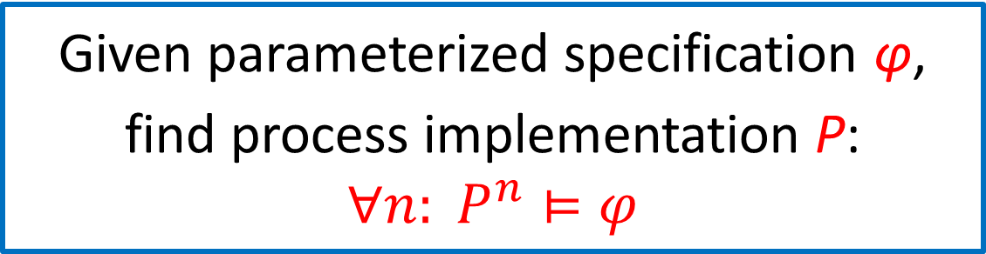



Parameterized Synthesis Problem [JB12]
Given parameterized specification φ,
find process implementation P:
$$∀n: P^{n}⊨φ$$
$$⊨φ$$
$$⊨φ$$
$$⊨φ$$
$$⊨φ$$

Slide 10
parameterized synthesis METhod [JB12]

Slide 11
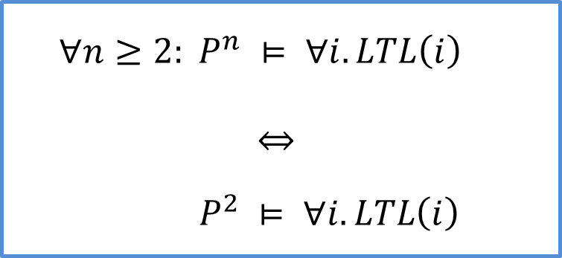
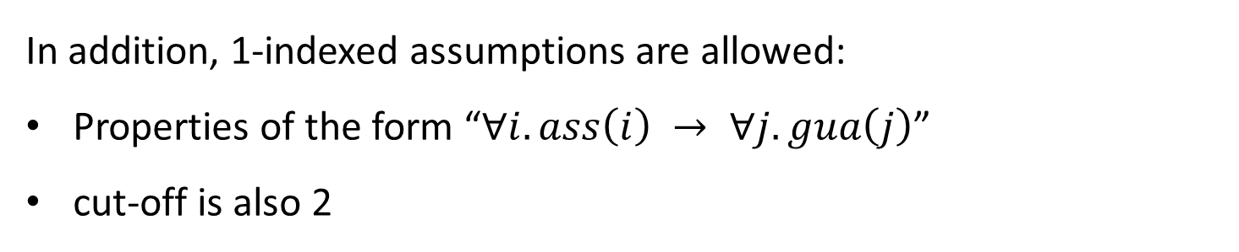
Cut-offs in Token Rings [EN95,03]
$$∀n≥2: P^{n} ⊨ ∀i.LTL\left(i\right)$$
$$P^{2} ⊨ ∀i.LTL\left(i\right)$$
In addition, 1-indexed assumptions are allowed:
Properties of the form “$∀i.ass\left(i\right) → ∀j.gua\left(j\right)$”
cut-off is also 2
Notes:
Beautify these figures – make it similar to token rings

Slide 12

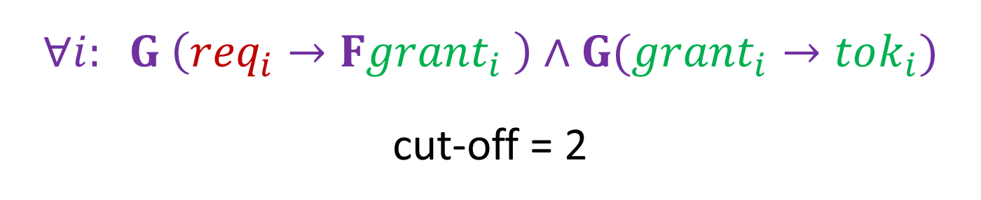
Cut-offs in Token Rings: Example
$$∀i: G \left({req}_{i}→Fgrant_{i} \right)∧G(grant_{i}→tok_{i})$$
cut-off = 2
$$⊨φ$$
$$⊨φ$$

Slide 13
Parameterized Synthesis Method [JB12]
iLTL
calculate
cut-off
Synthesize Token Ring
of cut-off
size
Process model
Cut-offs from [EN95]
Bounded synthesis approach [SF07]
Notes:
Decision procedure != synthesis
Point with arrows

Slide 14
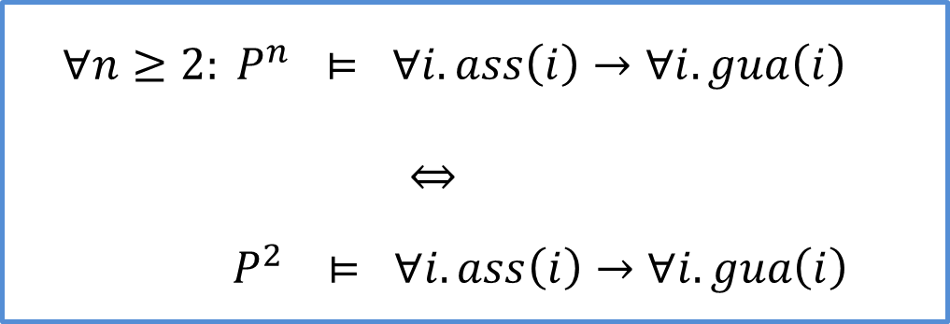
Challenges for the Existing Method
$$∀n≥2: P^{n} ⊨ ∀i.ass\left(i\right)→∀i.gua\left(i\right)$$
$$P^{2} ⊨ ∀i.ass\left(i\right)→∀i.gua\left(i\right)$$
Cut-offs are for interleaving systems, but AMBA is synchronous
Global inputs
Global outputs
Special zero process

Slide 15
Addressing the challenges

Slide 16
Synchronous AMBA
Why not prove cut-offs for synchronous rings?
Because there are no process-independent cut-offs
But cut-offs hold for fully asynchronous rings!
If a property holds in fully asynchronous token ring,
then it holds in synchronous and interleaving rings

Slide 17
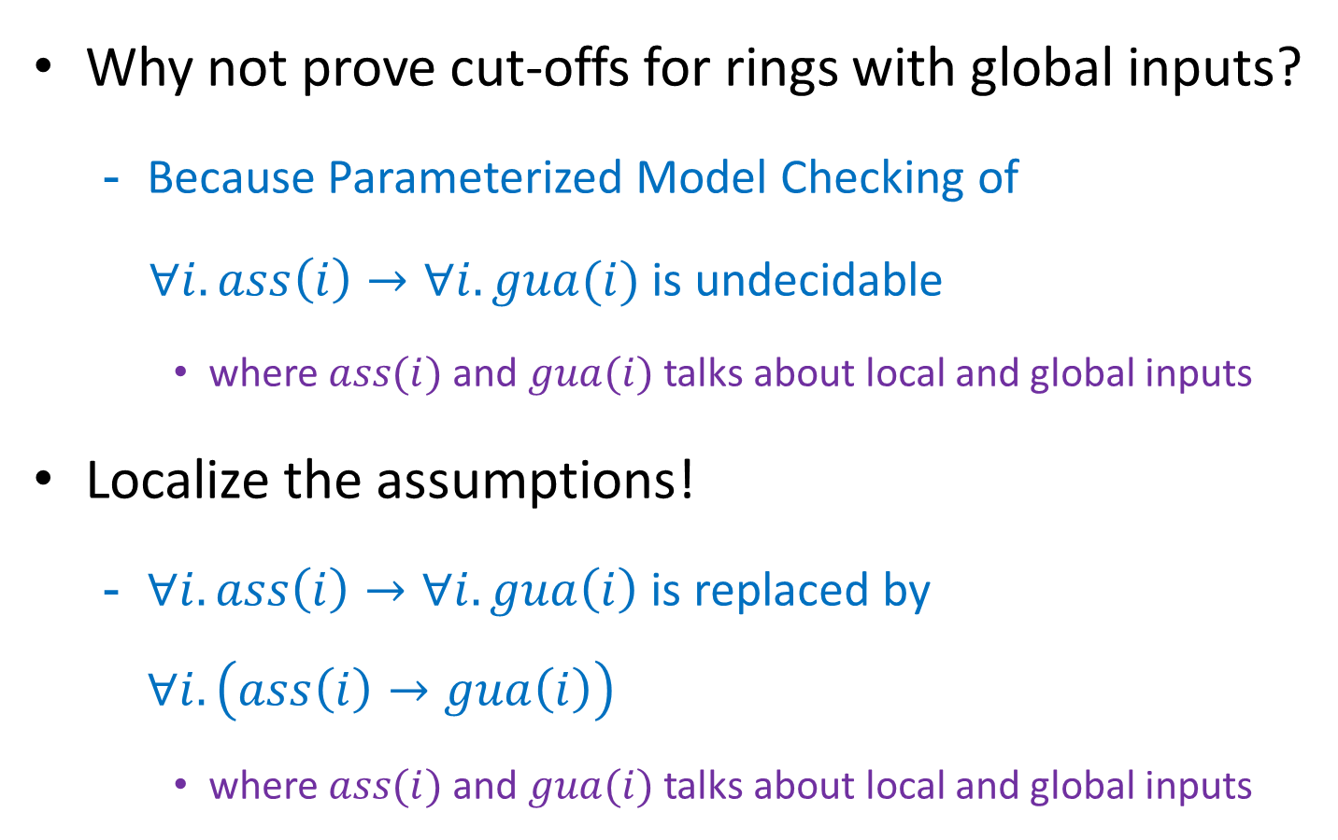
Global Inputs and Outputs
Why not prove cut-offs for rings with global inputs?
Because Parameterized Model Checking of
$∀i.ass\left(i\right)→∀i.gua(i)$ is undecidable
where $ass(i)$and $gua(i)$ talks about local and global inputs
Localize the assumptions!
$∀i.ass\left(i\right)→∀i.gua\left(i\right)$ is replaced by $∀i.\left(ass\left(i\right)→gua\left(i\right)\right)$
where $ass(i)$and $gua(i)$ talks about local and global inputs

Slide 18
Special Zero Process
$$∀i≠0: G ¬GRANT_{i}→\left(¬GRANT_{i} W REQ_{i}\right)$$
$$G \left(DECIDE_{0}∧∀i:¬REQ_{i}\right) → X GRANT_{0}$$
a. Special zero process
b. Immediate reaction
c. Global information

Slide 19
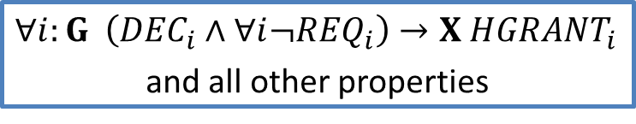
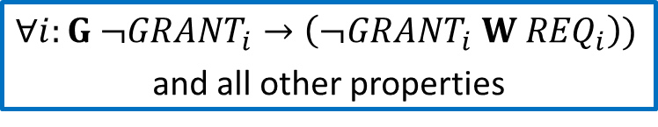
a. Special Zero Process
$$∀i≠0: G ¬GRANT_{i}→\left(¬GRANT_{i} W REQ_{i}\right)$$
$$G \left(DECIDE_{0}∧∀i:¬REQ_{i}\right) → X GRANT_{0}$$
$$∀i:G ¬{GRANT}_{i}→\left(¬{GRANT}_{i} W {REQ}_{i}\right))$$
and all other properties
$$∀i:G \left({DEC}_{i}∧∀i¬{REQ}_{i}\right)→X {HGRANT}_{i}$$
and all other properties
synthesize
synthesize
combine into token ring
0

Slide 20
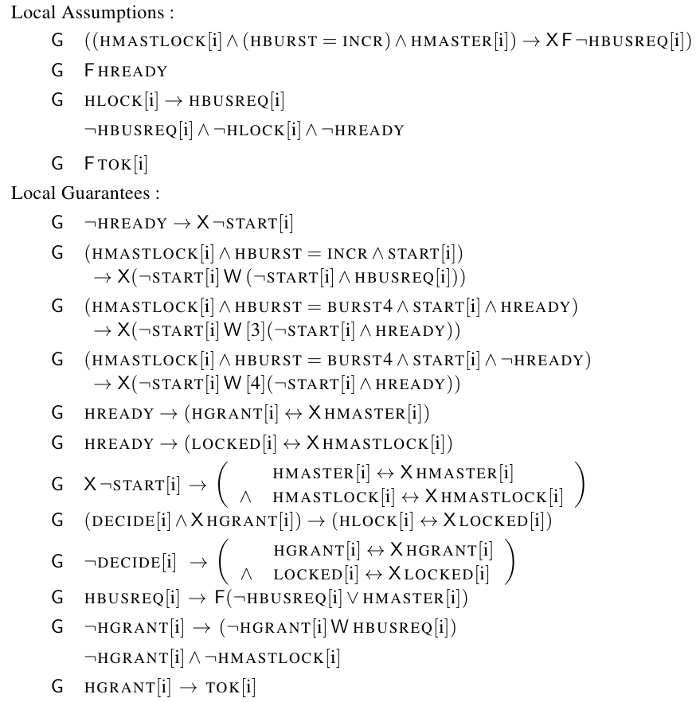
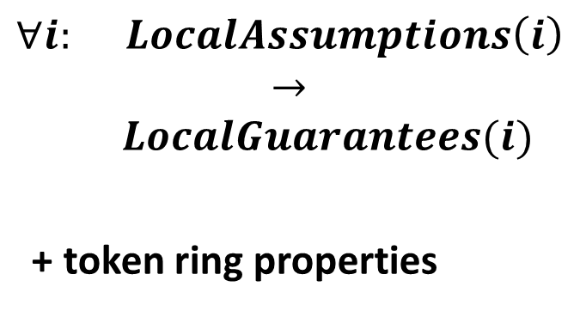
Final Specification (non zero process)
$$∀i: LocalAssumptions\left(i\right)$$
$$→$$
$$LocalGuarantees(i)$$
+ token ring properties

Slide 21
Optimizations and Experiments

Slide 22
Optimizations
Synchronous Hub Abstraction [vmcai13]
Hardcoding States with the Token [vmcai13]
Decompositional Synthesis of Properties
Optimization of SMT Encoding for Simple GR1

Slide 23


Synchronous Hub Abstraction [vmcai13]
prev
sends
$$φ$$
$$A_{HUB}→φ$$
Environment emulates the behaviour of the second process
optimization is sound and complete

Slide 24


Hardcoding States with the Token [vmcai13]
$$¬TOK$$
$$TOK$$
In AMBA processes do nothing without the token, hence:
One state – without the token
All other states – with the token
optimization is sound and complete*

Slide 25
Decompositional Synthesis
Synthesizing properties ‘incrementally’
Add additional assumption on inputs
synthesize the model
Relax the assumption on inputs
synthesize the model assuming the previous one
Continue, until all additional assumptions are removed

Slide 26
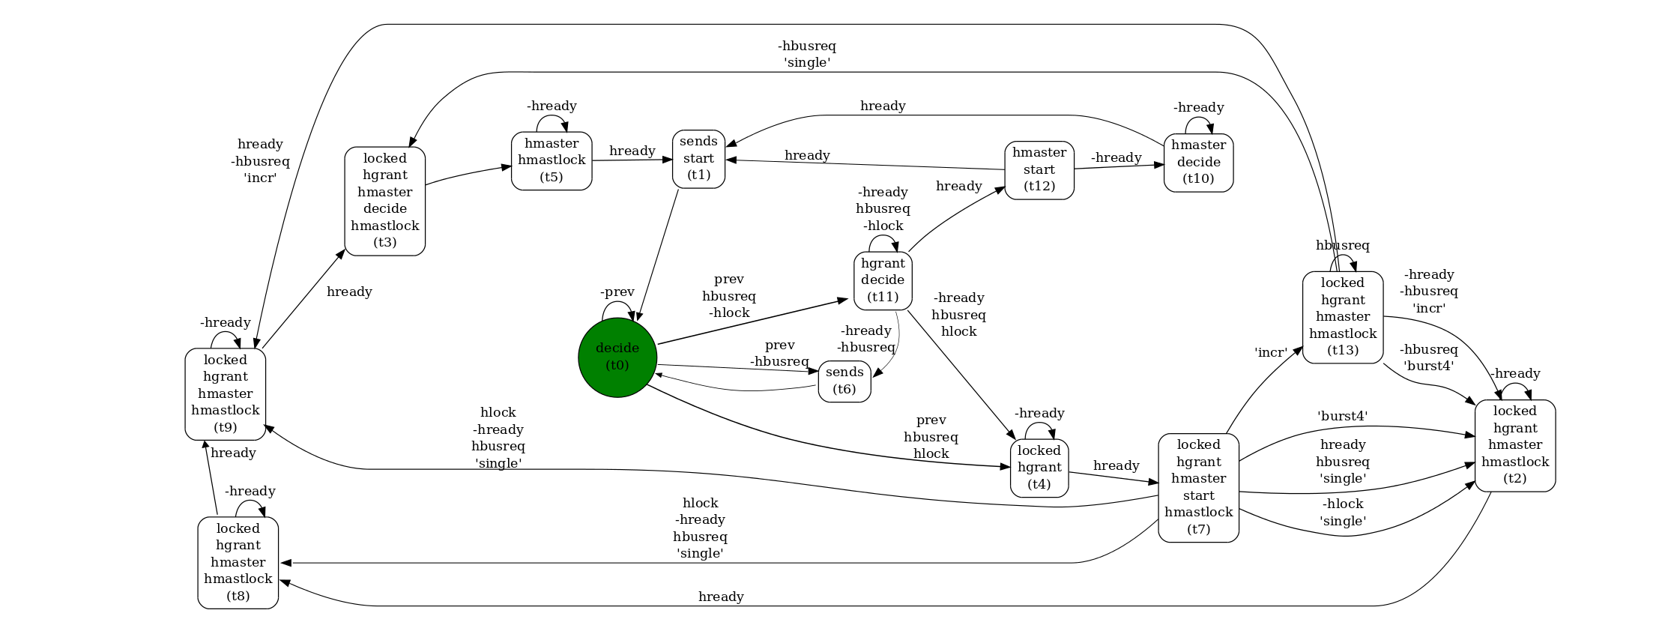
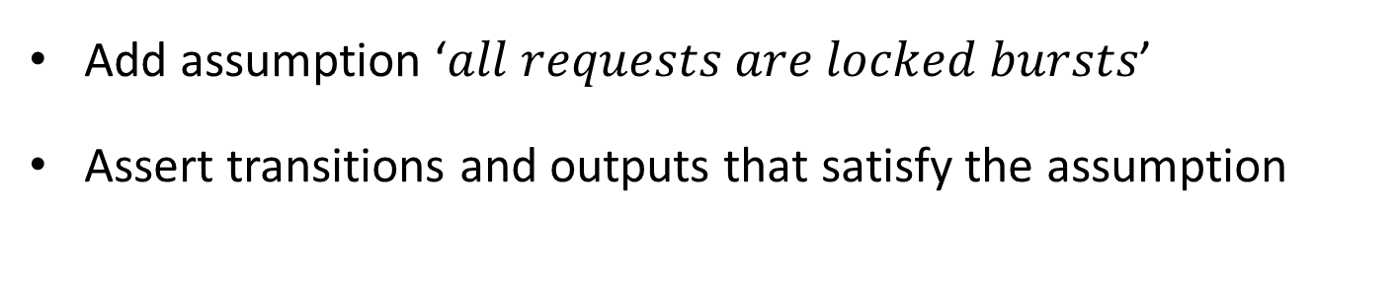
Decompositional Synthesis: non-0-process
Add assumption ‘$all requests are locked bursts$’
Assert transitions and outputs that satisfy the assumption

Slide 27
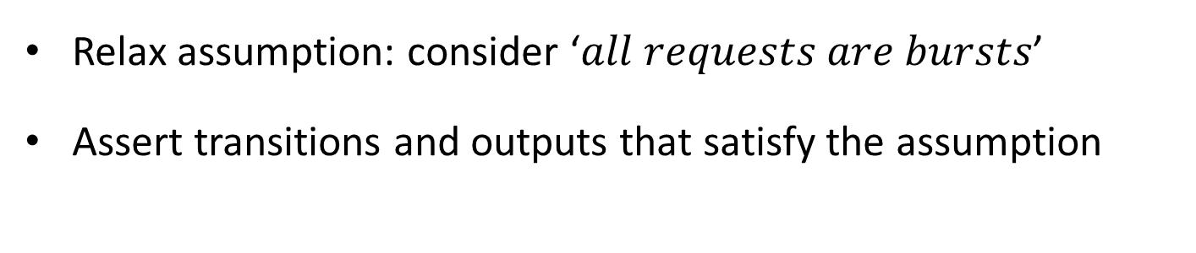
Decompositional Synthesis: non-0-process
Relax assumption: consider ‘$all requests are bursts$’
Assert transitions and outputs that satisfy the assumption

Slide 28
Decompositional Synthesis: non-0-process
Synthesize original specification

Slide 29

Decompositional Synthesis: Notes
This paper does not analyze the optimization
Not clear how general it is – does not work if:
start with assumption ‘$locked bursts$ and $hready$’

Slide 30

Direct Encoding of ‘Simple GR1’
$$Gα\left(i\right) → Gβ(i,o, o^{′})$$
Strengthening: $G \left(α\left(i\right)→β\left(i,o,o^{′}\right)\right)$
Can be encoded directly on SMT level
optimization is sound but incomplete

Slide 31
Direct Encoding of ‘Simple GR1’: Notes
All safety assumptions are simple GR1
8 out of 13 guarantees are simple GR1
57 vs 16 minutes (42 vs 24 states)

Slide 32
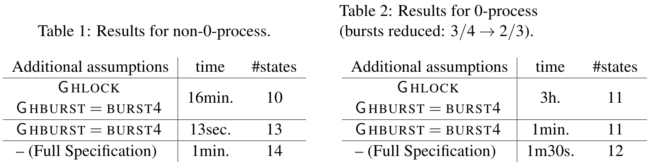
Synthesis Timings

Slide 33
Show Case

Slide 34
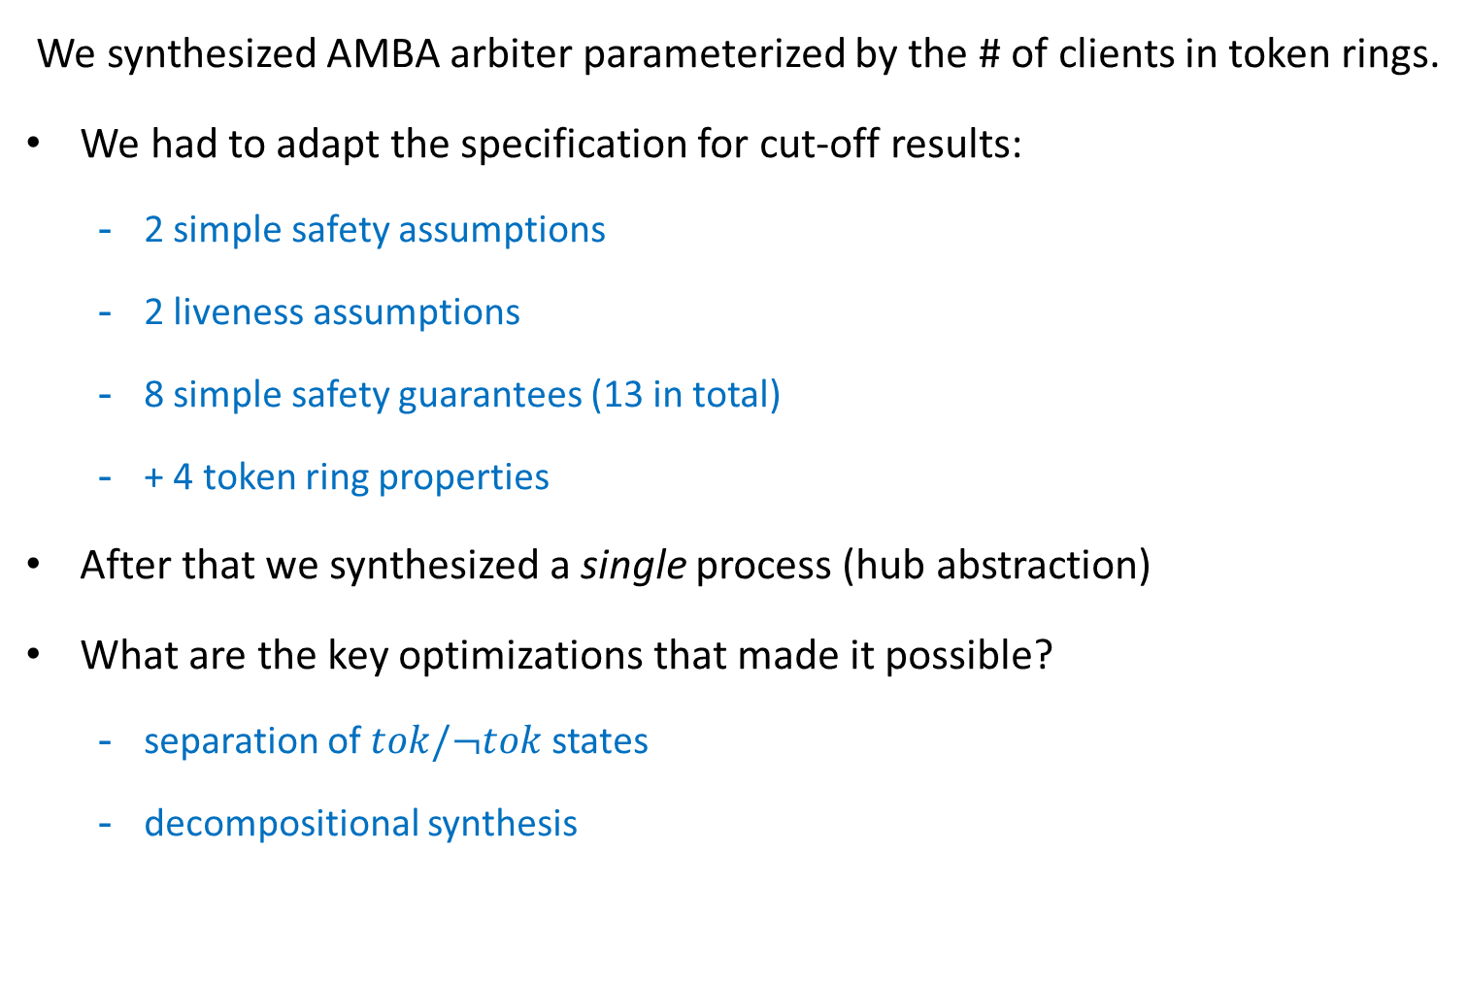
Conclusion
We synthesized AMBA arbiter parameterized by the # of clients in token rings.
We had to adapt the specification for cut-off results:
2 simple safety assumptions
2 liveness assumptions
8 simple safety guarantees (13 in total)
+ 4 token ring properties
After that we synthesized a single process (hub abstraction)
What are the key optimizations that made it possible?
separation of $tok/¬tok$ states
decompositional synthesis

Slide 35

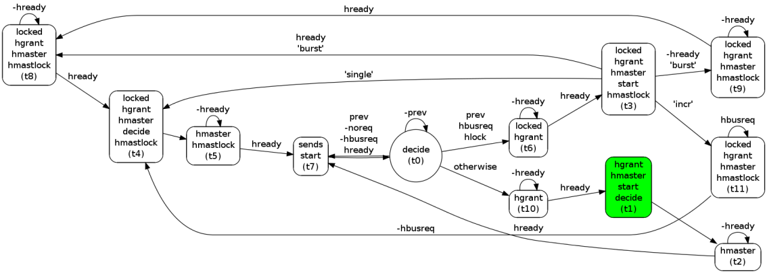
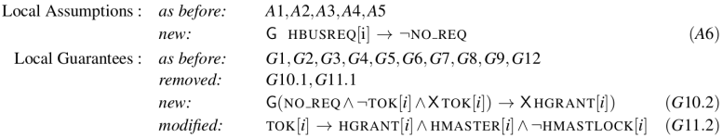
Thanks!

Slide 36
References
[J07] Barbara Jobstmann, Applications and Optimizations for LTL Synthesis, 2007, PhD thesis, TU Graz

Slide 37

Note on mutual exclusion
The token guarantees mutual exclusion:
$G\left(grant_{i}→tok_{i}\right)$
ensures mutual exclusion of grants

Slide 38
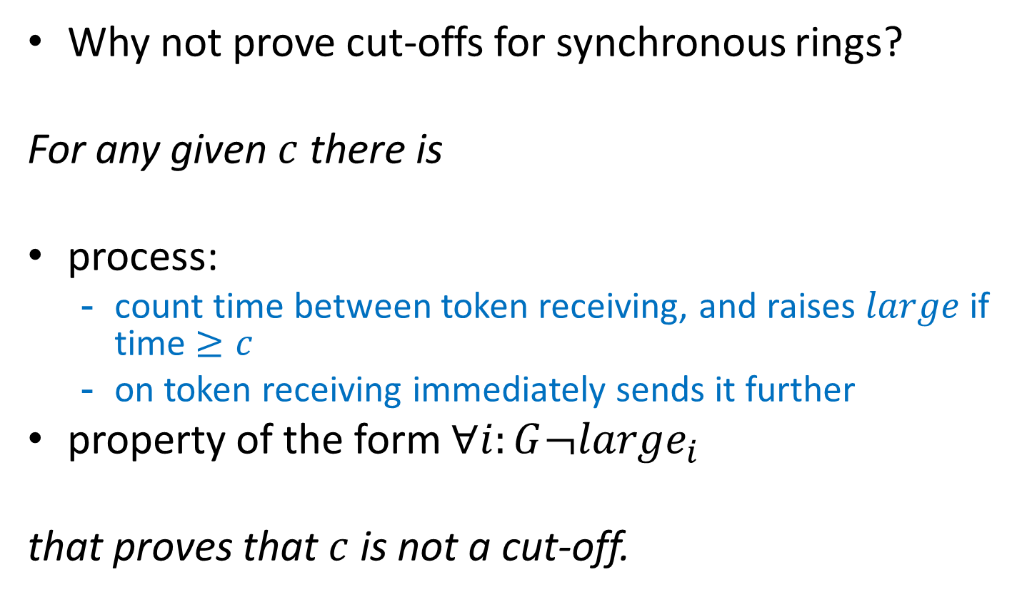
Synchronous AMBA
Why not prove cut-offs for synchronous rings?
For any given $c$ there is
process:
count time between token receiving, and raises $large$ if time $≥c$
on token receiving immediately sends it further
property of the form $∀i:G¬large_{i}$
that proves that $c$ is not a cut-off.
true
false

Slide 39
Global Outputs
HMASTER, HMASTLOCK,
LOCKED, START, DECIDE
different ways to define global outputs via process states
we introduce local output for each global output and use local version instead of global, e.g.:
STATE -> STATE[i] in the specification

Slide 40
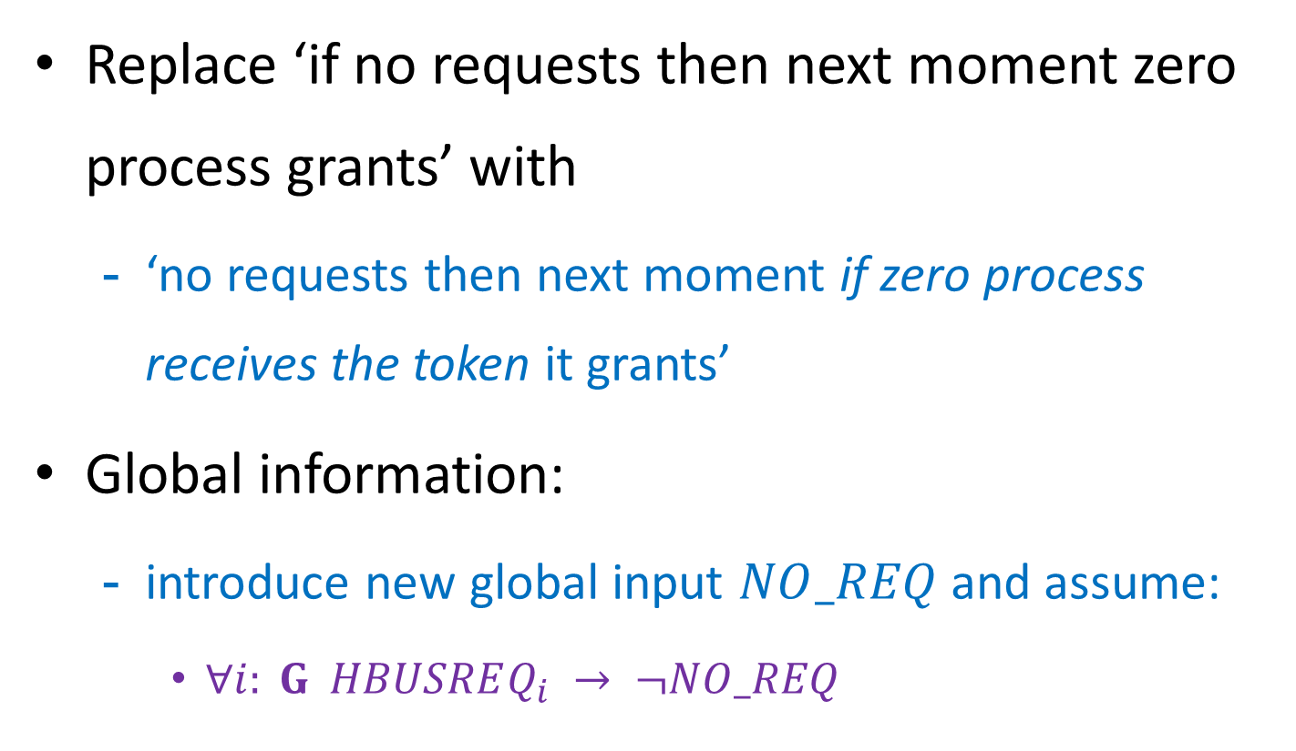
Immediate Reaction, Global Information
Replace ‘if no requests then next moment zero process grants’ with
‘no requests then next moment if zero process receives the token it grants’
Global information:
introduce new global input $NO_REQ$and assume:
$∀i: G HBUSREQ_{i} → ¬NO_REQ$

Slide 41
4b. Immediate Reaction
$$∀i: G \left(DECIDE_{i}∧∀i:¬REQ_{i}\right) → X GRANT_{i}$$
is replaced by
$$∀i: G ¬TOK\left[i\right]∧X TOK\left[i\right]∧∀i:¬HBUSREQ\left[i\right] → X HGRANT[i]$$

Slide 42



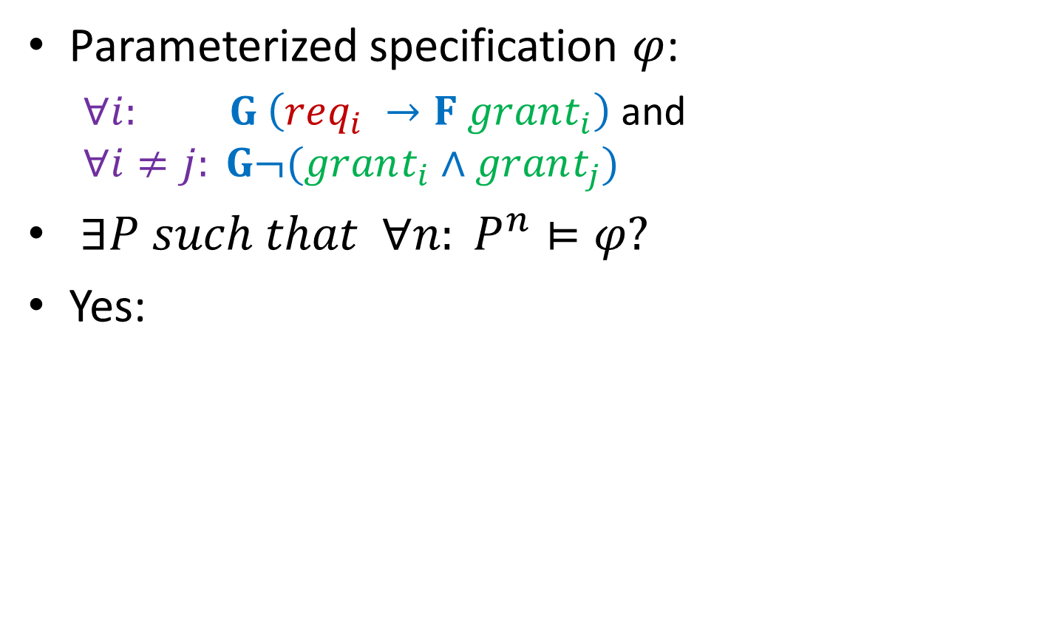






Example
Parameterized specification $φ$:
$∀i: G \left(req_{i} →F grant_{i}\right)$ and
$$∀i≠j: G¬(grant_{i}∧grant_{j})$$
$∃P such that ∀n: P^{n}⊨φ?$
Yes:
$$¬prev$$
$$tok$$
$$grant$$
$$sends$$
$$¬tok$$
$$¬grant$$
$$¬sends$$
$$T$$
$$prev$$
…
$$⊨φ$$
$$⊨φ$$
$$⊨φ$$
$$⊨φ$$

Slide 43
Direct Encoding of ‘Simple GR1’: Notes
All safety assumptions are simple GR1
8 out of 13 guarantees are simple GR1
Direct encoding
Encoding via automata
automaton = 24 states
synthesis = 16 minutes:
14 min – checking UNSAT
2 min – checking SAT
automaton = 42 states
synthesis = 57 minutes:
53 min – checking UNSAT
4 min – checking SAT

