Slide 1


Specification Format for Reactive Synthesis Problems
Ayrat Khalimov
SYNT 2015

Slide 2
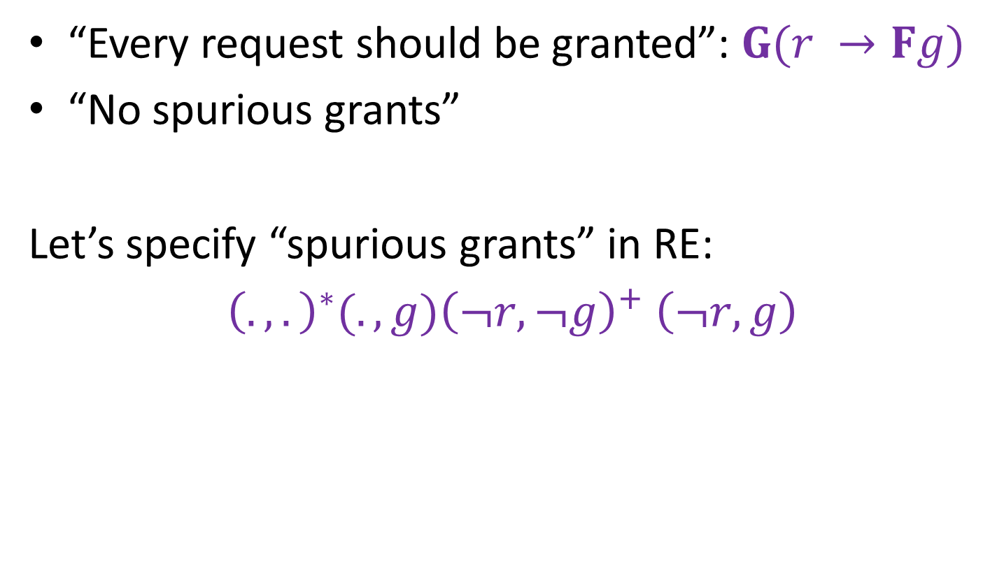
Simple arbiter
r
g
“Every request should be granted”: $G(r →Fg)$
“No spurious grants”
Let’s specify “spurious grants” in RE:
${{\left(.,.\right)}^{∗}(.,g)\left(¬r,¬g\right)}^{+}$ $\left(¬r,g\right)$

Slide 3
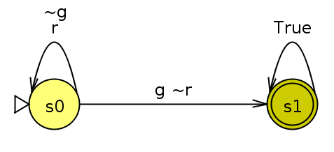
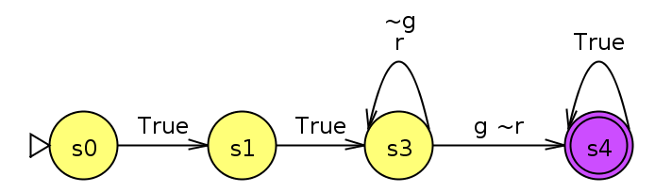
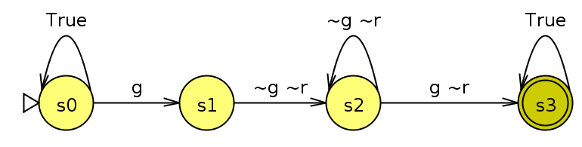


In LTL: ${\left(.,.\right)}^{∗}\left(.,g\right){\left(¬r,¬g\right)}^{+} (¬r,g)$
$F\left(g U ¬r¬g U ¬r g\right)$?
(NO! It accepts $(r ¬g)(¬r g)$)
$F\left(g U X(¬r¬g U X¬r g)\right)$?
$F(g∧ (g U (¬r¬g∧ (¬r¬g U ¬r g))))$

Slide 4
Synthesis flow
synthesizer
LTL properties
implementation

Slide 5

Synthesis flow
synthesizer
LTL properties
implementation
$ω$RE
automata
synthesizer that can handle the format
partial
implementations
format that supports these all

Slide 6

Synthesis flow
translator
into
SYNTCOMP
any
SYNTCOMP
synthesizer
LTL properties
implementation
$ω$RE
automata
partial
implementations

Slide 7

Outline of the talk
translator
into
SYNTCOMP
any
SYNTCOMP
synthesizer
LTL properties
implementation
$ω$RE
automata
partial
implementations
new format
(extended SMV)
translator
extended SMV -> SYNTCOMP
synthesis example:
a Huffman encoder

Slide 8

Format requirements
embedded into existing programming language
modular
property language agnostic (LTL, $ω$RE, automata…)
fast synthesizers

Slide 9
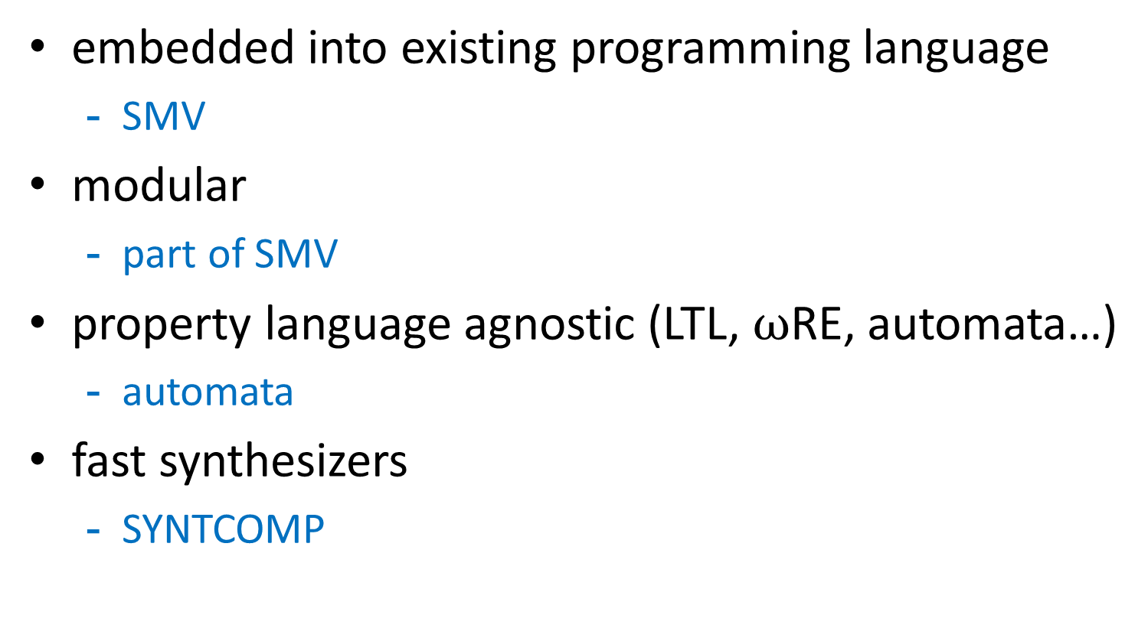
Proposed format
embedded into existing programming language
SMV
modular
part of SMV
property language agnostic (LTL, $ω$RE, automata…)
automata
fast synthesizers
SYNTCOMP

Slide 10
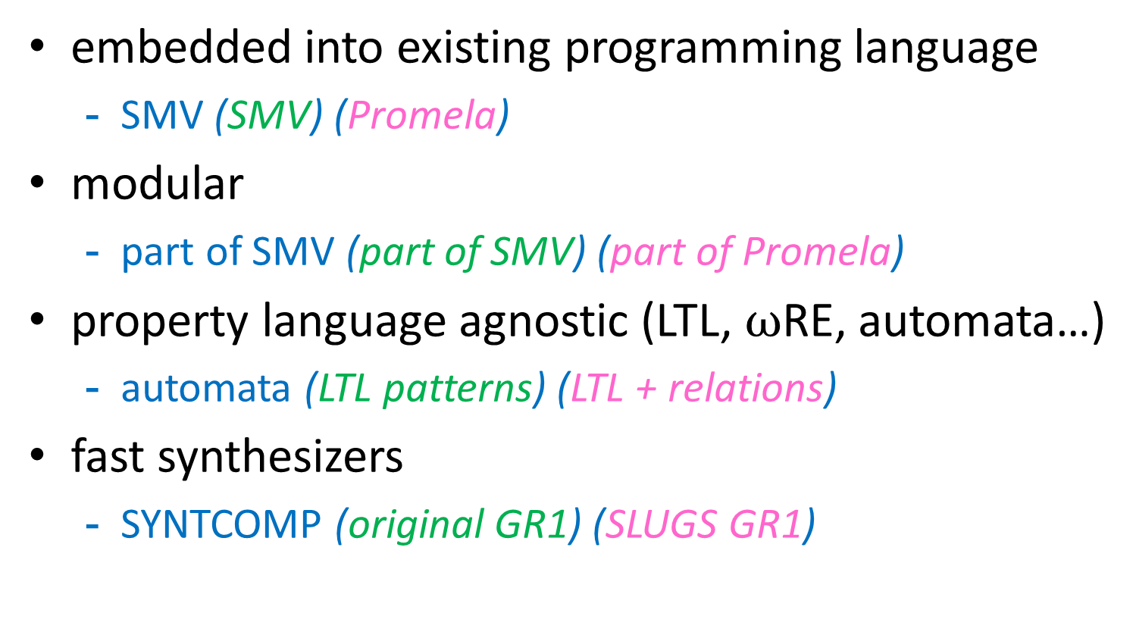
Comparison with ([1])([2])
embedded into existing programming language
SMV (SMV) (Promela)
modular
part of SMV (part of SMV) (part of Promela)
property language agnostic (LTL, $ω$RE, automata…)
automata (LTL patterns) (LTL + relations)
fast synthesizers
SYNTCOMP (original GR1) (SLUGS GR1)

Slide 11
Extended smv
FORMAT DESCRIPTION

Slide 12
SMV format
MODULE main
VAR
input: 0..10;
state: boolean;
x: 0..10;
DEFINE
x_is_2input := (x=input+input);
ASSIGN
init(state) := FALSE;
next(state) := (x=0 | x_is_2input);
init(x) := 0;
next(x) := x+input;
LTLSPEC
G(state | (x!=10))
variables
macros
variables
behaviour
specification

Slide 13
SMV format (cont.)
MODULE module1(i1,i2)
VAR
x: ...
...
MODULE module2(i1)
VAR
out : ...
MODULE main
VAR
input: ...
VAR
m1: module1(input, m2.out);
m2: module2(m1.x);
i1
module1
i2
i1
module2
input
i1
m2
out
m1
i2
x

Slide 14
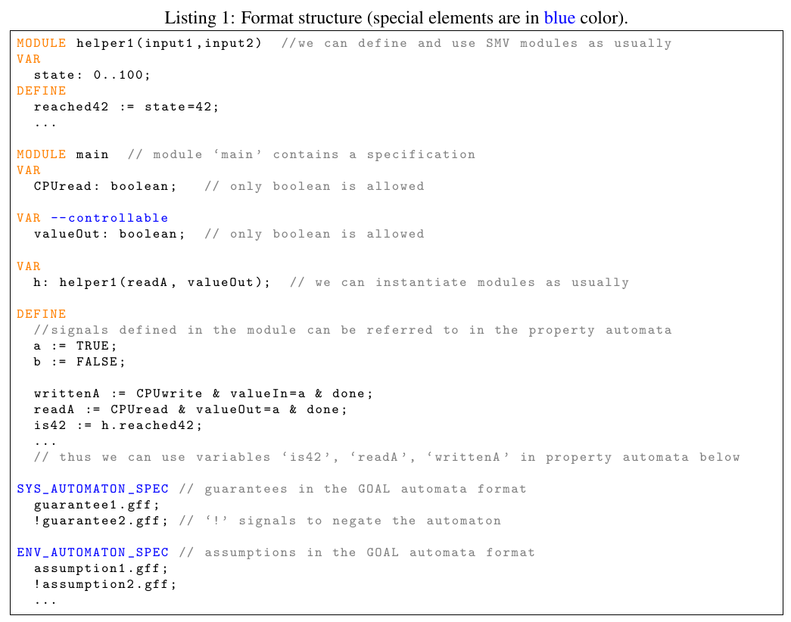
Extended SMV

Slide 15
Extended SMV
Only main can have specifications
LTL, LDL, RE, patterns? relations?
only safety assumptions

Slide 16
translation into syntcomp

Slide 17
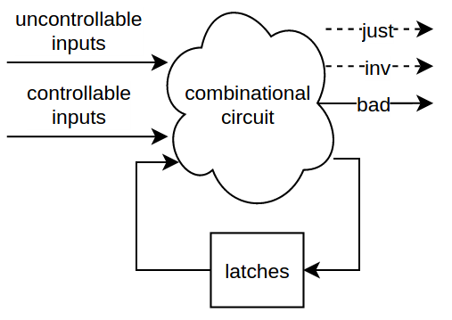
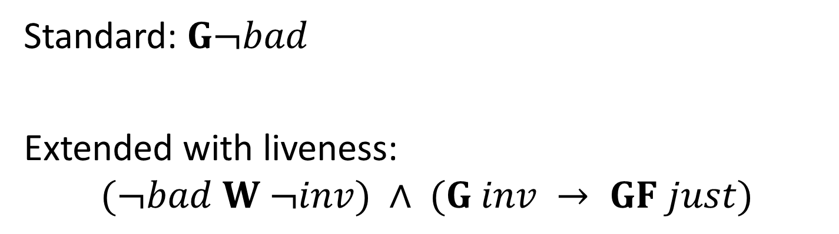
SYNTCOMP format
Standard: $G¬bad$
Extended with liveness:
$$(¬bad W ¬inv) ∧ (G inv → GF just)$$

Slide 18
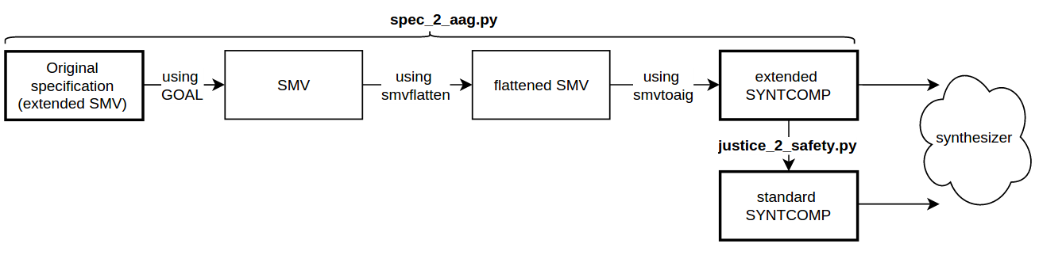
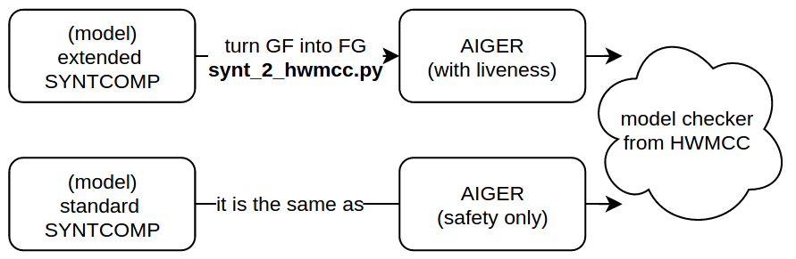
Working flow
automata:
determinization
complementation
flattening into a
boolean SMV
module
boolean SMV
to AIGER
translation
aisy.py
or from
SYNTCOMP

Slide 19
synthesizing Huffman encoder

Slide 20
Huffman encoding
A,B,C,...
encoder
01,101,1101,...
decoder
A,B,C,...
“more often appearing letters have shorter ciphers”

Slide 21
Letters frequency table
+-------------( )---------------+
| |
+-------( )------+ +------( )-----+
| | | |
| | | |
+----( )----+ ( ) +--( )--+ ( )
| | / \ | | / \
| | | | | | | |
+--( )--+ ( ) [E] ( ) ( ) ( ) [ ] ( )
| | / \ / \ / \ / \ / \
| | | | | | | | | | | |
( ) ( ) [S] ( ) ( ) [A] [I] [O] [R] [N] ( ) [T]
/ \ / \ / \ / \ / \
| | | | | | | | | |
[U] [P] [F] [C] ( ) [L] [H] ( ) [D] ( )
/ \ / \ / \
| | | | | |
+----( ) [W] [G] [Y] ( ) [M]
| \ / \
| | | |
( ) ( ) [B] [V]
/ \ / \
| | | |
[Q] ( ) [K] [X]
/ \
| |
[Z] [J]

Slide 22
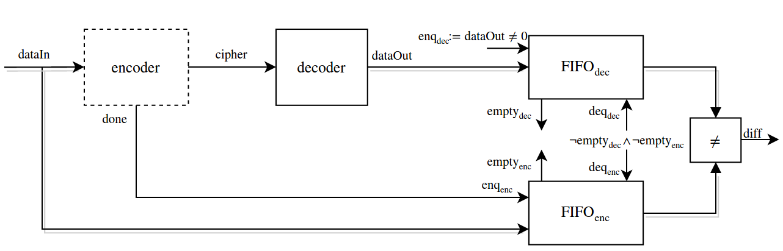
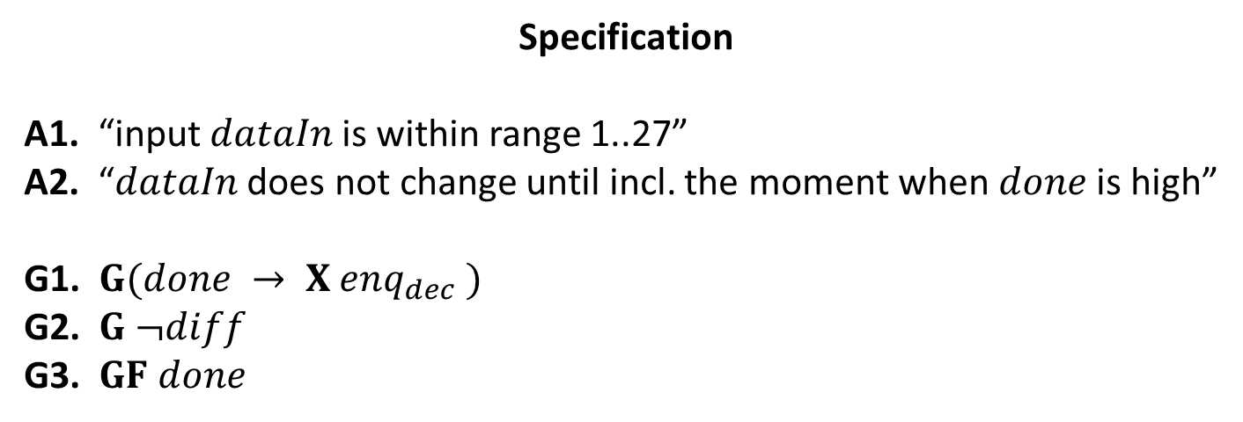
Synthesizing a Huffman encoder
Specification
A1. “input $dataIn$is within range 1..27”
A2. “$dataIn$does not change until incl. the moment when $done$is high”
G1. $G(done → X enq_{dec} )$
G2. $G ¬diff$
G3. $GF done$

Slide 23
Info about the synthesis
The specification:
# latches = 45
# AND gates = 3k
The model has:
# AND gates = 130k (120k)
Timings:
2min (4min)
The model is as expected

Slide 24
Conclusion & discussion
Adapted the SMV format to synthesis tasks
Provided scripts to translate into the SYNTCOMP
Is SMV good enough or Verilog should be used?
Should we support LTL/RE formats?
Should we support GR1 or full LTL semantics?
Should we support partial information?
Simpler ways to translate?
thank you

Slide 25
