Slide 1


Reactive synthesis: branching logics and parameterized systems
Ayrat Khalimov
PhD defense
TU Graz, March 9, 2018
Rigorous Systems Engineering

Slide 2








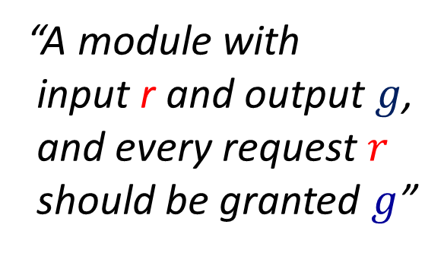


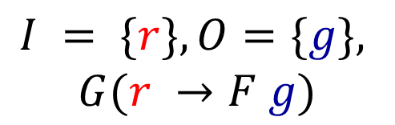
What is reactive synthesis?
$$r$$
$$g$$
requirements
programmer
system
“A module with
input r and output $g$,
and every request $r$
should be granted $g$”
$$r$$
$$I = \{r\}, O=\{g\},$$
$$G(r →F g)$$
$$¬r$$
$$¬g$$
$$g$$
$$¬r$$
$$r$$
Notes:
Usually, a client comes and says “i want this HW module that reads input “req” and outputs “grant” for every “req” ”.
Can you do that?
Then a HW designer/programmer goes to her desk and writes the code [in verilog] that implements the client’s requirements.
So we have:
requirements → programmer → code.
In that example, the programmer would probably write smth like:
[pic of normal arbiter]
The idea of the automatic synthesis is that the client writes her requirements in some logic.
Then we push a button and the automatic synthesizer produces the code. There is no programmer in the loop.
So we have:
requirements written in some logic → [push the button] → code.
Continuing with the toy example, the specification would be:
G( req → Fg )

Slide 3
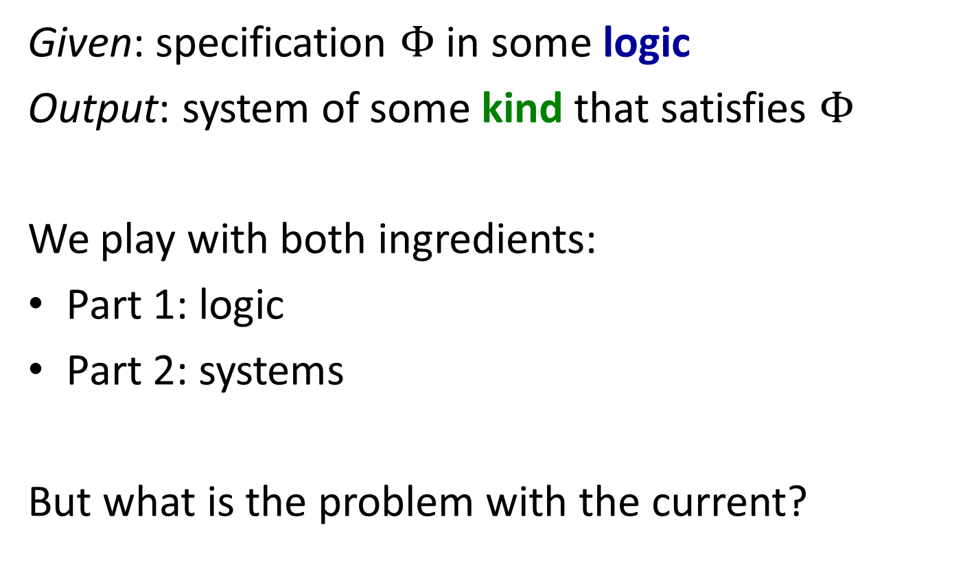
Reactive synthesis problem
Given: specification $Φ$ in some logic
Output: system of some kind that satisfies $Φ$
We play with both ingredients:
Part 1: logic
Part 2: systems
But what is the problem with the current?
Notes:
A bit more formally, the reactive synthesis problem is:
given:
return:
There are two key ingredients here.
What is kind of specifications---in which logic?
What kind of systems do we synthesize?

Slide 4
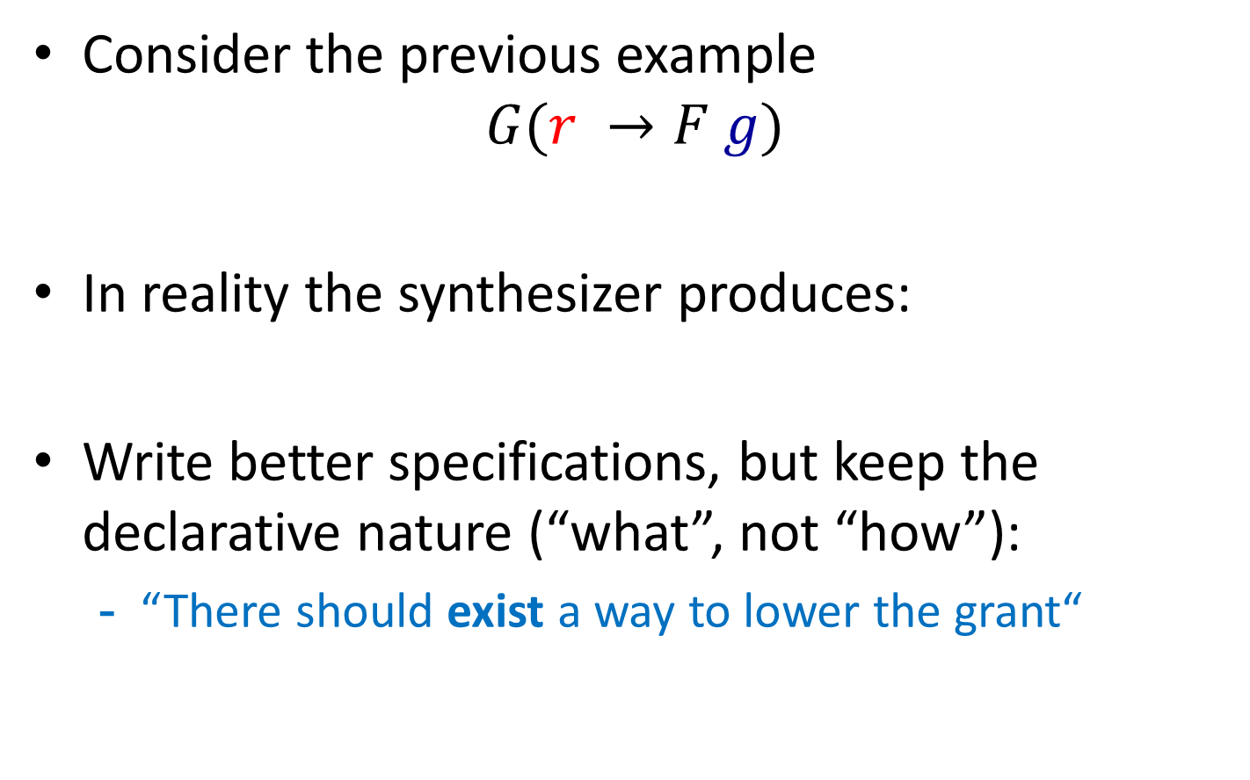



Motivation for my research in Part I
Consider the previous example
$$G(r →F g)$$
In reality the synthesizer produces:
Write better specifications, but keep the declarative nature (“what”, not “how”):
“There should exist a way to lower the grant“
$$g$$
$$r$$
$$¬r$$
Notes:
There are several directions in which reactive synthesis was studied.
-- extending logics
-- extending systems
-- faster algorithms
On the practical side,

Slide 5
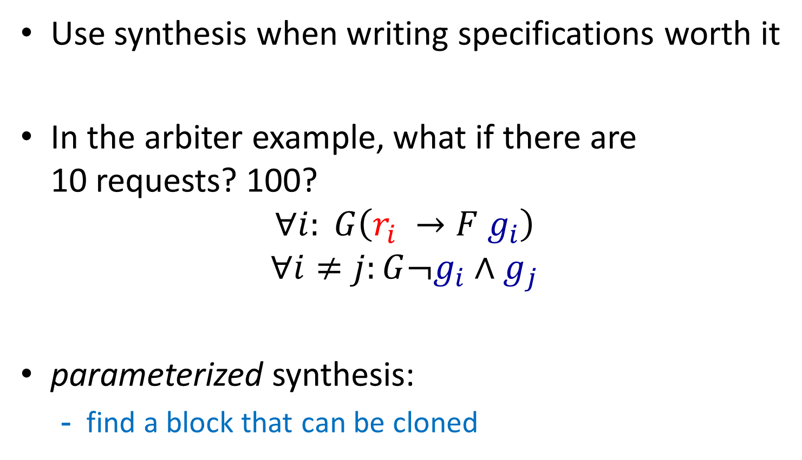
Motivation for my research in Part II
Use synthesis when writing specifications worth it
In the arbiter example, what if there are 10 requests? 100?
$$∀i: G\left(r_{i} →F g_{i}\right)$$
$$∀i≠j:G¬g_{i}∧g_{j}$$
parameterized synthesis:
find a block that can be cloned

Slide 6
Thesis overview
It is hard to write good specifications for synthesis.
Part I studies synthesis from richer languages
Two new approaches for CTL* synthesis
Part II studies synthesis of richer systems
New cutoffs and a case study

Slide 7
Part I Approaches to CTL* synthesis

Slide 8



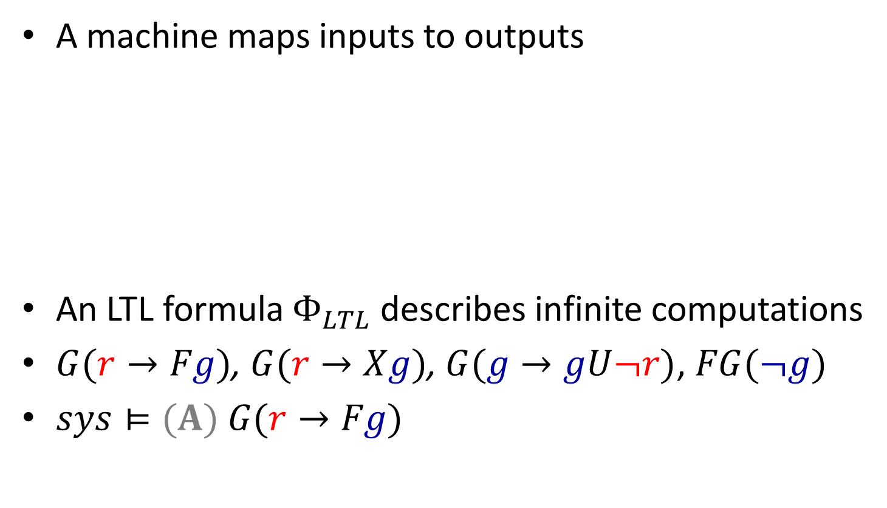




What is Linear Temporal Logic (LTL)?
A machine maps inputs to outputs
An LTL formula $Φ_{LTL}$ describes infinite computations
$G(r→Fg)$, $G(r→Xg)$, $G(g→gU¬r)$, $FG(¬g)$
$sys⊨(A) G(r→Fg)$
$$r$$
$$¬r$$
$$¬g$$
$$g$$
$$(¬r¬g)(rg)(rg)(¬r¬g)…$$
$$¬r$$
$$r$$

Slide 9
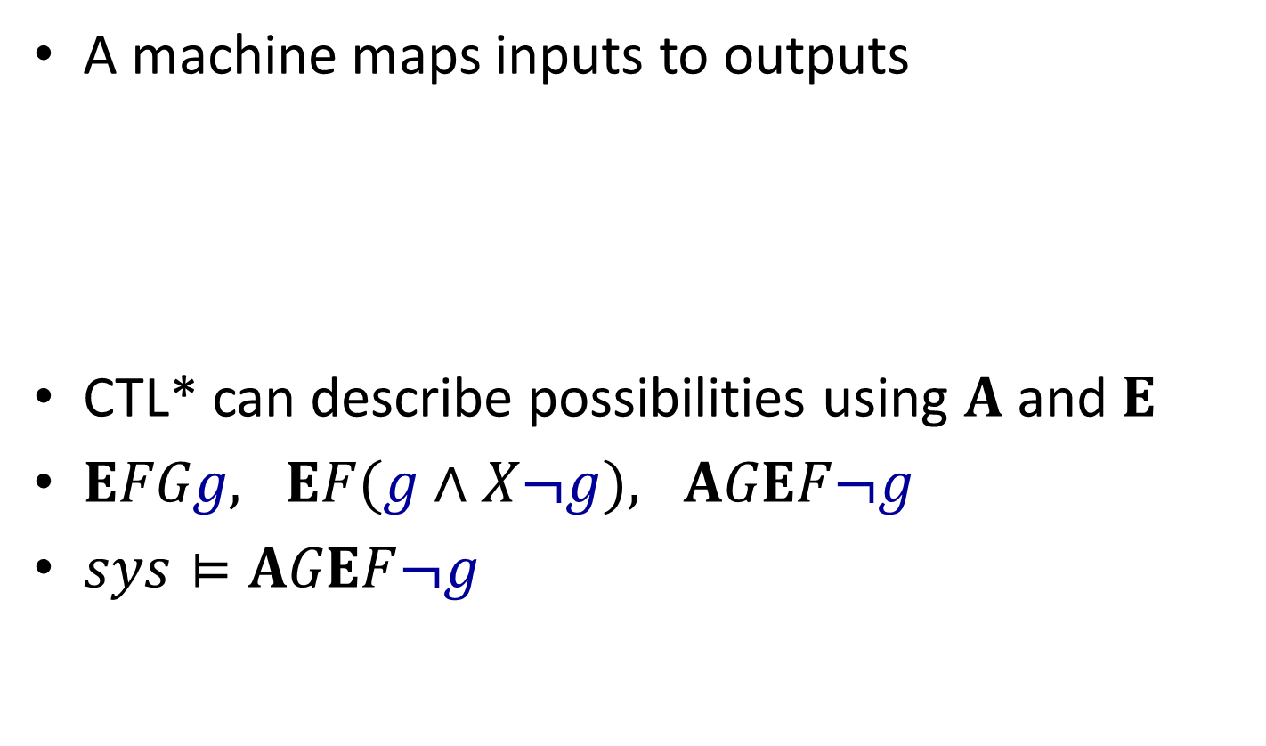
What is Computation Tree Logic (CTL*)?
A machine maps inputs to outputs
CTL* can describe possibilities using $A$ and $E$
$EFGg, EF(g∧X¬g), AGEF¬g$
$sys⊨AGEF¬g$
$$r$$
$$¬r$$
$$¬g$$
$$g$$
$$¬r$$
$$r$$

Slide 10
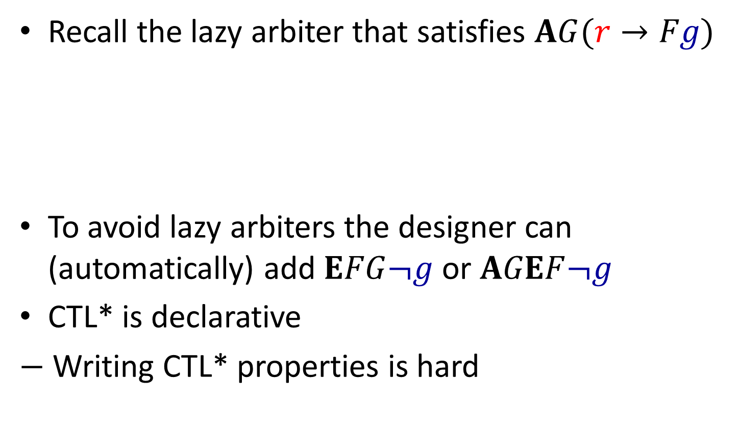
Why CTL* is (not) useful?
Recall the lazy arbiter that satisfies $AG(r→Fg)$
To avoid lazy arbiters the designer can (automatically) add $EFG¬g$ or $AGEF¬g$
CTL* is declarative
$−$ Writing CTL* properties is hard
$$g$$
$$r$$
$$¬r$$

Slide 11
Thesis contribution to CTL* synthesis
Already known
“Safra-full” CTL* synthesis [62]
New:
Bounded synthesis approach
Synthesis via reduction to LTL

Slide 12

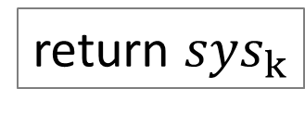


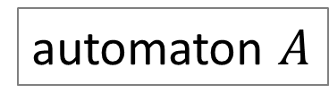
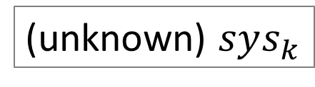
Bounded synthesis for LTL [46]
Encode model checking into SMT
the query is satisfiable ⬄ $sys⊨Φ$
Synthesis: replace system with the unknown
$∃sys: sys⊨Φ$?
$$Φ_{LTL}$$
automaton $A$
return $sys_{k}$
SMT query
$$∃sys_{k}⊨A?$$
return
unrealizable for k
(unknown) $sys_{k}$

Slide 13
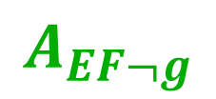
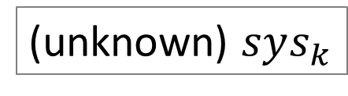
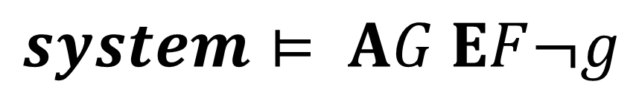


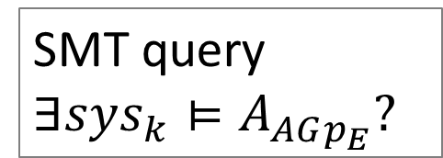
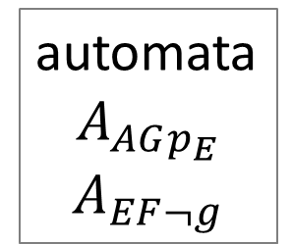

Bounded synthesis for CTL*
$$A_{AGp_{E}}$$
$$system⊨ AG EF¬g$$
$$A_{EF¬g}$$
automata
$$A_{AGp_{E}}$$
$$A_{EF¬g}$$
$$Φ_{CTL∗}$$
return $sys_{k}$
SMT query
$$∃sys_{k}⊨A_{AGp_{E}}?$$
(unknown) $sys_{k}$
return
unrealizable for k

Slide 14
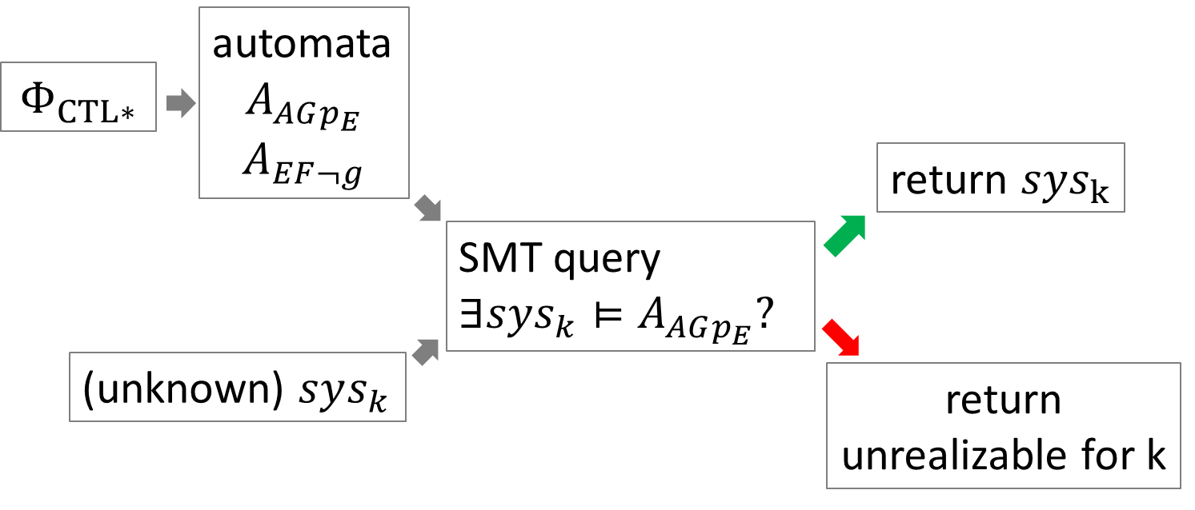
Bounded synthesis for CTL*
+ Finds smallest models
+ Flexible
+ Inherits progress in SMTs
- Bad at establishing unrealizability
- Requires additional development
- SMTs are not very fast…

Slide 15
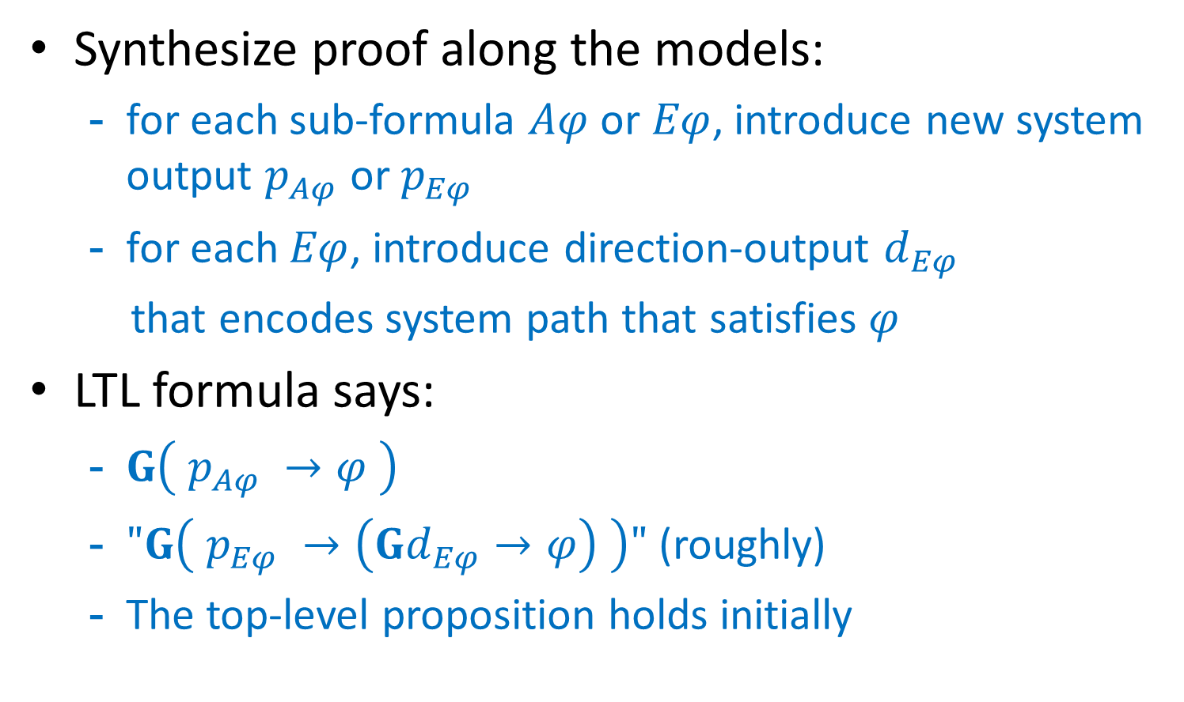
CTL* synthesis via LTL synthesis
Synthesize proof along the models:
for each sub-formula $Aφ$ or $Eφ$, introduce new system output $p_{Aφ}$ or $p_{Eφ}$
for each $Eφ$, introduce direction-output $d_{Eφ}$
that encodes system path that satisfies $φ$
LTL formula says:
$G\left( p_{Aφ} →φ \right)$
$"G\left( p_{Eφ} →\left(Gd_{Eφ}→φ\right) \right)"$ (roughly)
The top-level proposition holds initially

Slide 16
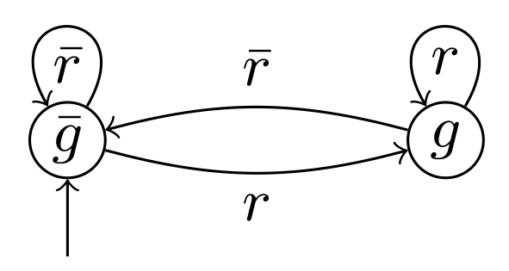
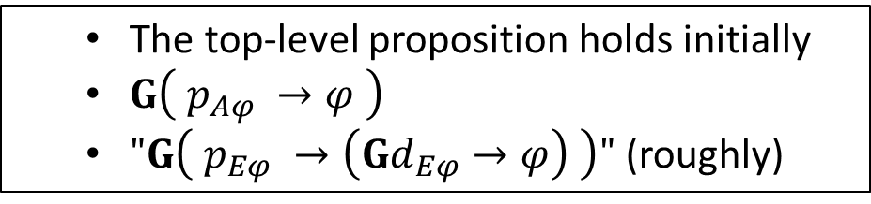



Example
The top-level proposition holds initially
$G\left( p_{Aφ} →φ \right)$
$"G\left( p_{Eφ} →\left(Gd_{Eφ}→φ\right) \right)"$ (roughly)
$Φ_{CTL∗}=EX\left(g ∧F\overline{g }\right)$, inputs={r}, outputs={g}
inputs={r}, outputs=$\{g, p, d\}$
$$Φ_{LTL}=p∧G(p∧Gr=d→X\left(g∧F\overline{g}\right))$$
$$p$$
$$d=1$$
$$d=0$$

Slide 17
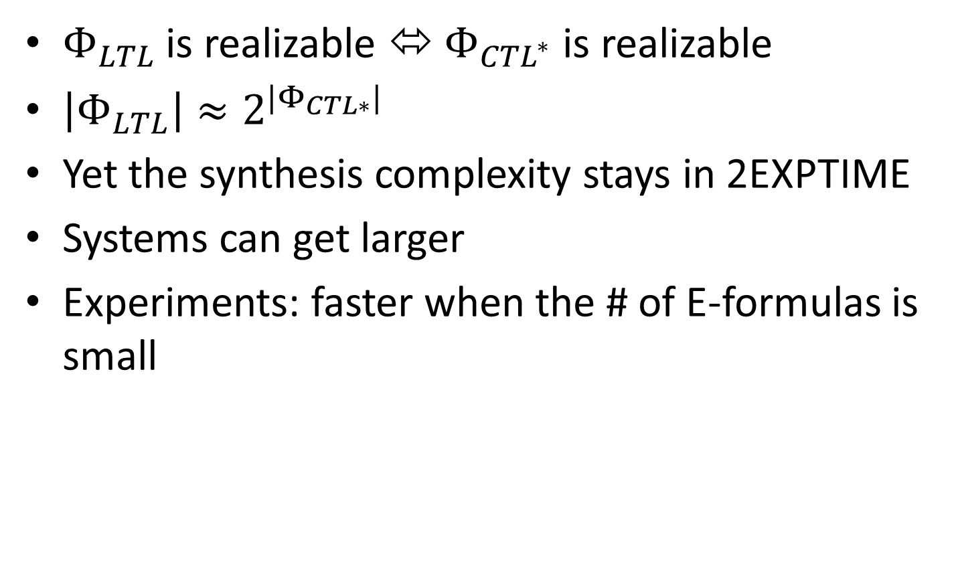
Properties of the reduction
$Φ_{LTL}$ is realizable ⬄ $Φ_{CTL^{∗}}$ is realizable
$\left|Φ_{LTL}\right|≈2^{|Φ_{CTL∗}|}$
Yet the synthesis complexity stays in 2EXPTIME
Systems can get larger
Experiments: faster when the # of E-formulas is small

Slide 18
Concluding Part I
Two approaches to CTL* synthesis
bounded synthesis approach
reduction via LTL

Slide 19
Part II Parameterized synthesis

Slide 20
Distributed synthesis

Slide 21
Distributed uniform synthesis

Slide 22
Token rings

Slide 23
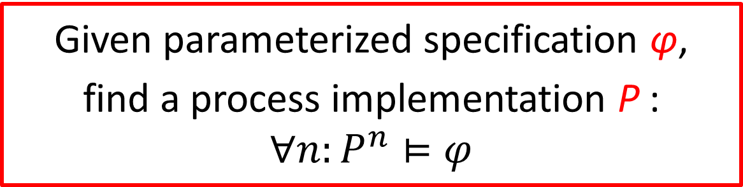
Parameterized synthesis problem
Given parameterized specification φ,
find a process implementation P :
$$∀n:P^{n}⊨φ$$

Slide 24
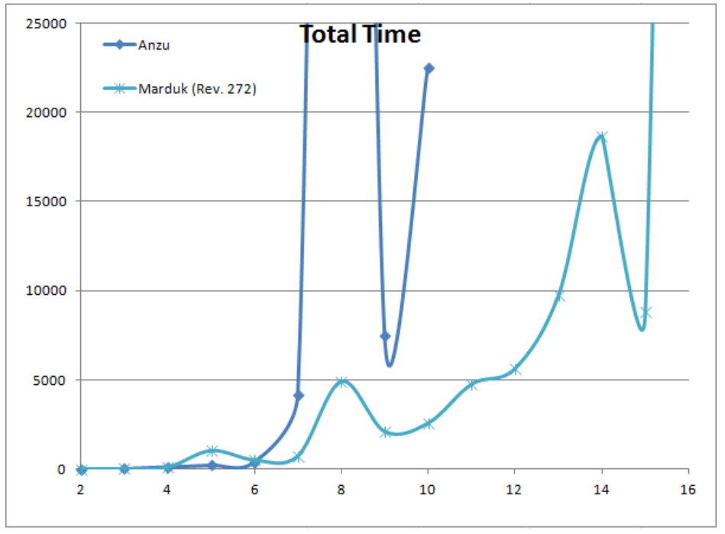
Why?
# of clients
Synthesis time of AMBA protocol

Slide 25

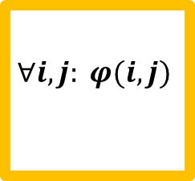

Cutoffs in token rings [40,50]
$$∀i,j: φ(i,j)$$
$$∀i.φ(i)$$
$$∀i.φ(i, i+1)$$
Notes:
Beautify these figures – make it similar to token rings

Slide 26
Contributions in Part II
Token ring architectures:
Optimizations of bounded synthesis
modular cutoffs
hub abstraction
AMBA case study
cutoff extensions
incremental property synthesis
Guarded systems:
we significantly extended cutoffs of [37]

Slide 27
Conclusion
1. Two new synthesis approaches for CTL*:
using bounded synthesis (flexible but slow)
by reducing to LTL synthesis (often faster)
2. New cutoffs and tricks for parameterized synthesis
token-rings: small cutoff extensions, efficient optimizations
guarded systems: new cutoffs
Future work:
other reductions to LTL synthesis
synthesis with parameterized data

Slide 28
Other works
Decidability of parameterized verification, book
Parameterized Model Checking of Token-Passing Systems
Semi-Formal Methods for Soft Error Analysis

