Slide 1
Binary search

Slide 2
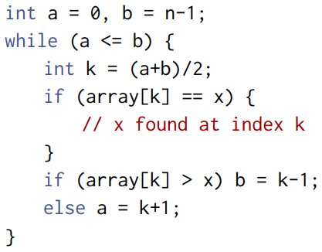
Binary search – Method 1

Slide 3
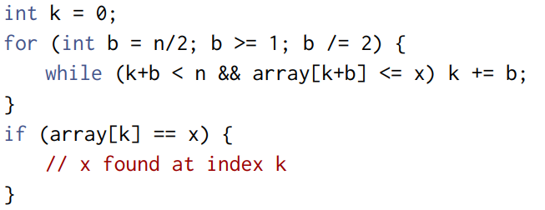
Binary search – Method 2

Slide 4
C++ functions
lower_bound Returns an iterator pointing to the first element in the range [first, last) that is not less than (i.e. greater or equal to) value, or last if no such element is found.
upper_bound Returns an iterator pointing to the first element in the range [first, last) that is greater than value, or last if no such element is found.
equal_range returns both above pointers
Defined in header <algorithm>

Slide 5
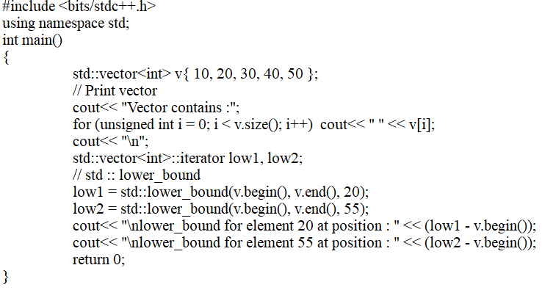
lower_bound
Notes:
Vector contains : 10 20 30 40 50
lower_bound for element 20 at position 1
lower_bound for element 55 at position 5

Slide 6
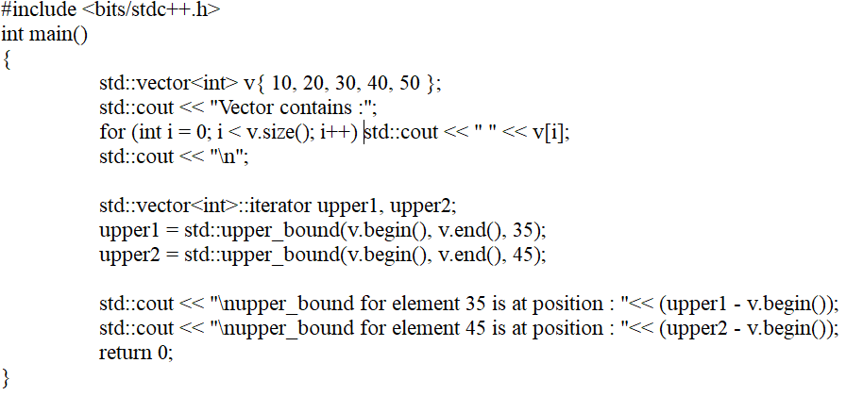
Upper_bound
Notes:
Vector contains : 10 20 30 40 50
upper_bound for element 35 is at position : 3
upper_bound for element 45 is at position : 4

Slide 7


equal_range
Return std::pair containing a pair of iterators defining the wanted range: the first pointing to the first element that is not less than key and the second pointing to the first element greater than key.

Slide 8
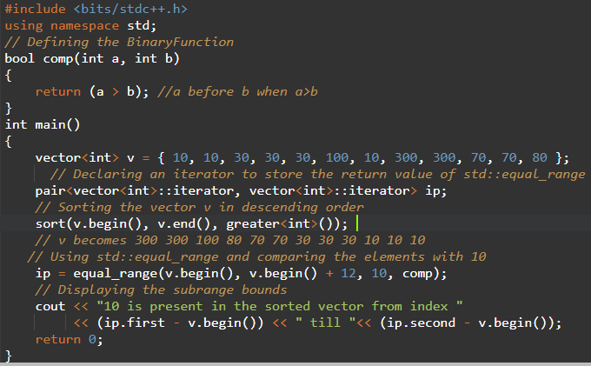
Notes:
#include <bits/stdc++.h>
using namespace std;
// Defining the BinaryFunction
bool comp(int a, int b)
{
return (a > b); //a before b when a>b
}
int main()
{
vector<int> v = { 10, 10, 30, 30, 30, 100, 10, 300, 300, 70, 70, 80 };
// Declaring an iterator to store the return value of std::equal_range
pair<vector<int>::iterator, vector<int>::iterator> ip;
// Sorting the vector v in descending order
sort(v.begin(), v.end(), greater<int>());
// v becomes 300 300 100 80 70 70 30 30 30 10 10 10
// Using std::equal_range and comparing the elements with 10
ip = equal_range(v.begin(), v.begin() + 12, 10, comp);
// Displaying the subrange bounds
cout << "10 is present in the sorted vector from index "
<< (ip.first - v.begin()) << " till "<< (ip.second - v.begin());
return 0;
}

