Slide 1


Slide 2
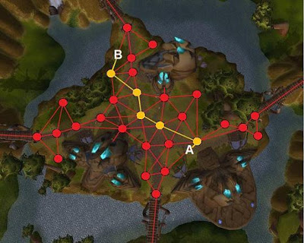
Punto 1

Slide 3
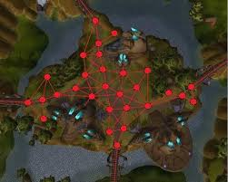
Punto 1

Slide 4

Punto 1
Vértices / Vertices
Vertice / Vertex
2
3
0

Slide 5


Punto 1
{ (1,1), (1,2), (1,3), (2,1), (2,2),
(3,2), (3,3)
}
Simulators: https://www.cs.usfca.edu/~galles/visualization/DFS.html
https://visualgo.net/en/graphds
Notes:
http://latex2png.com/
g=(V,E),E\subseteq V\times V
g=(V,E),E = V\times V
|V\times V|

Slide 6
Punto 1
Simulators: https://www.cs.usfca.edu/~galles/visualization/DFS.html
https://visualgo.net/en/graphds
Notes:
http://latex2png.com/
g=(V,E),E\subseteq V\times V
g=(V,E),E = V\times V
|V\times V|

Slide 7
Punto 1
Simulators: https://www.cs.usfca.edu/~galles/visualization/DFS.html
https://visualgo.net/en/graphds
Notes:
http://latex2png.com/
g=(V,E),E\subseteq V\times V
g=(V,E),E = V\times V
|V\times V|

Slide 8
Punto 1
Los amigos de facebook en Colombia con matrices ocupa 100 TB
Con listas ocupa 500 MB
Simulators: https://www.cs.usfca.edu/~galles/visualization/DFS.html
https://visualgo.net/en/graphds
Notes:
http://latex2png.com/
g=(V,E),E\subseteq V\times V
g=(V,E),E = V\times V
|V\times V|

Slide 9
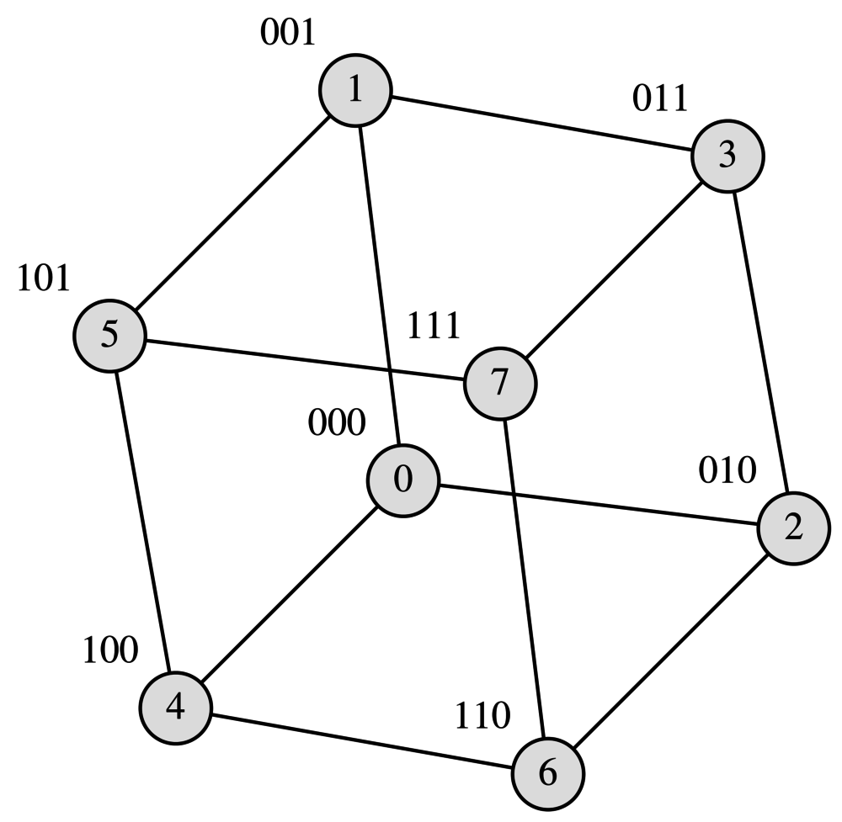
Punto 2

