Slide 1


FPGA Laboratory
School of Electrical Engineering
Faculty of Engineering
Tel Aviv University
Version 1.73 By Kostya Berestizshevsky

Slide 2
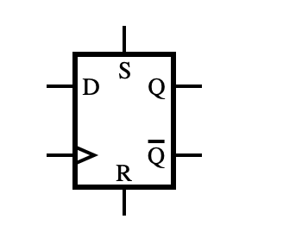
Metastability, Clock Domain Crossing (CDC), Synchronizer

Slide 3
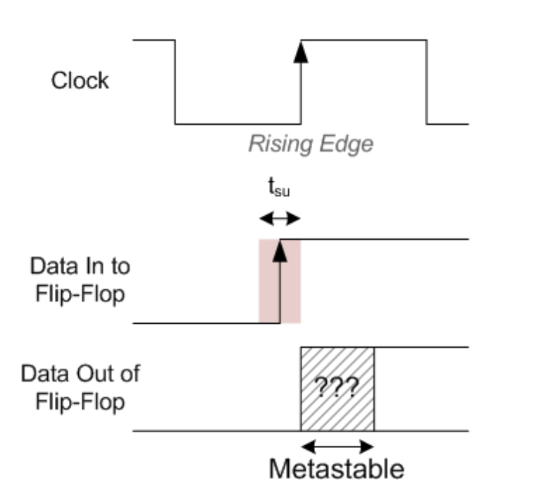
Metastability
What is Metastability?
Metastability is a condition where a digital circuit is unable to resolve to a stable '0' or '1' state within the time frame required by the system.
Most metastable conditions occur in one of two ways:
You are sampling a signal external to the FPGA
You are crossing clock domain

Slide 4
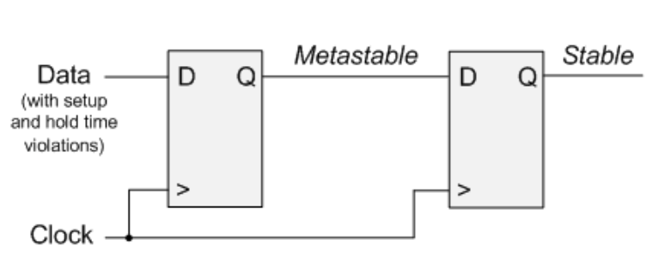
Metastability - How to Prevent
Use two flip-flops in series to synchronize asynchronous signals.
Notes:
In the figure, a signal that is asynchronous to the clock is being sampled by the first Flip-Flop. This will create a metastable condition at the output. If you again sample this output, you can now fix your metastable event. The output of the second Flip-Flop will be stable.

Slide 5
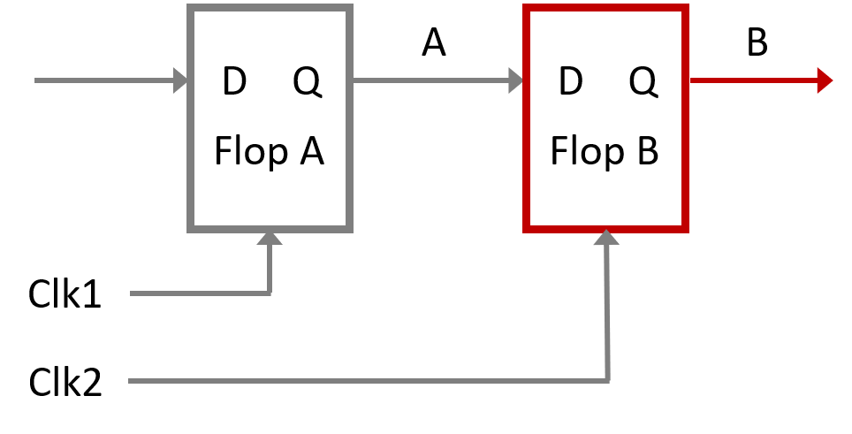
Crossing Clock Domains
Clock Domain Crossing (CDC) refers to the process of transferring data between two different clock domains.
CDC poses significant challenges due to the risk of metastability, which occurs when a signal transitions near the clock edge, causing unpredictable behavior.
Notes:
To avoid unpredictable behavior related to metastability, ASIC and FPGA designs must properly implement the synchronization logic: synchronizers must be robust to metastability effects and handshaking procotocol logic must ensure that buses are resynchronized only when they are stable.

Slide 6
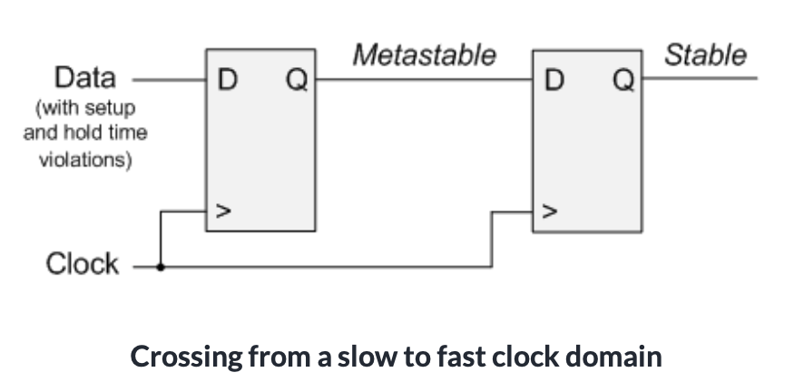
CDC– Slower clock domain to faster clock domain
“double-flop” the data:
Notes:
The slower clock is your source clock domain. The faster clock is your destination clock domain. In the faster clock domain, the first Flip-Flop has a metastable output. The reason this occurs is that when performing this crossing, there will be violations of setup and hold time which are the cause of metastability. We can work around this by simply re-registering or double-flopping the data on in the faster clock domain as shown in the figure above. The output of the second Flip-Flop will be stable and now the data can be used in the faster clock domain.

Slide 7
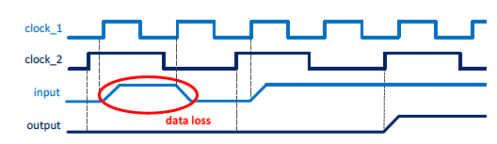
CDC – Faster clock domain to slower clock domain
The target clock frequency is lower than the source clock one - some signal event may not be sampled by the destination domain
Notes:
To avoid unpredictable behavior related to metastability, ASIC and FPGA designs must properly implement the synchronization logic: synchronizers must be robust to metastability effects and handshaking procotocol logic must ensure that buses are resynchronized only when they are stable.

Slide 8
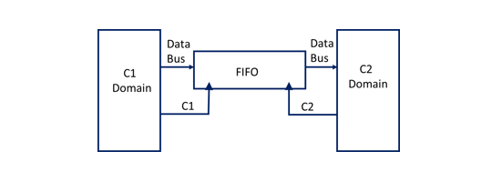
CDC – Faster clock domain to slower clock domain
Notes:
FIFOS
Asynchronous FIFO can be used to transmit data between two clock domains. Write operation to FIFO will happen in the clock C1 domain. Read operation from FIFO will happen in clock C2 domain. FIFO depth should be taken care based on frequency of the clocks C1 and C2

Slide 9
Crossing Clock Domains
The target clock frequency is lower than the source clock one - some signal event may not be sampled by the destination domain
Notes:
To avoid unpredictable behavior related to metastability, ASIC and FPGA designs must properly implement the synchronization logic: synchronizers must be robust to metastability effects and handshaking procotocol logic must ensure that buses are resynchronized only when they are stable.

