Slide 1
Linear Regression

Slide 2
Definition
In statistics, linear regression is a linear approach to modeling the relationship between a scalar response (or dependent variable) and one or more explanatory variables (or independent variables).
The case of one explanatory variable is called simple linear regression.
For more than one explanatory variable, the process is called. multiple linear regression
This term is distinct from multivariate linear regression, where multiple correlated dependent variables are predicted, rather than a single scalar variable

Slide 3
Approaches
Ordinary least square
Gradient Descent
RIDGE
LASSO
Elastic Net
Polynomial
Isotonic
Huber
Bayesian
Robust

Slide 4
Ordinary least square
In statistics, ordinary least squares (OLS) is a type of linear least squares method for estimating the unknown parameters in a linear regression model.
OLS chooses the parameters of a linear function of a set of explanatory variables by the principle of least squares: minimizing the sum of the squares of the differences between the observed dependent variable (values of the variable being observed) in the given dataset and those predicted by the linear function.

Slide 5

simple linear regression.

Slide 6
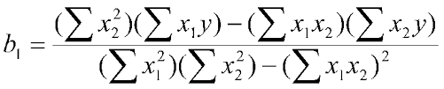
Multiple Linear Regression
Multiple linear regression (MLR) is a multivariate statistical technique for examining the linear correlations between two or more independent variables (IVs) and a single dependent variable (DV).
y = m1x1 + m2x2+ m3x3+ b
Price=m1*área+m2*bedrooms+m3*age+ b

Slide 7

Gradient Descent
Loss Function
The loss is the error in our predicted value of m and c. Our goal is to minimize this error to obtain the most accurate value of m and c.
We will use the Mean Squared Error function to calculate the loss. There are three steps in this function:

Slide 8
Steps
Find the difference between the actual y and predicted y value(y = mx + c), for a given x.
Square this difference.
Find the mean of the squares for every value in X.

Slide 9

Contd…
Here yᵢ is the actual value and ȳᵢ is the predicted value. Lets substitute the value of ȳᵢ

Slide 10
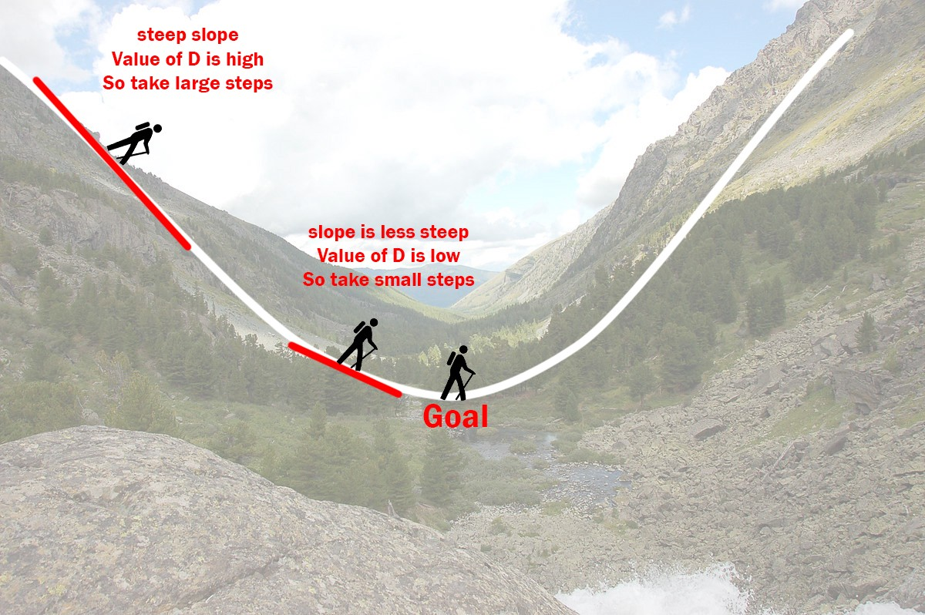
The Gradient Descent Algorithm
Gradient descent is an iterative optimization algorithm to find the minimum of a function. Here that function is our Loss Function.

Slide 11
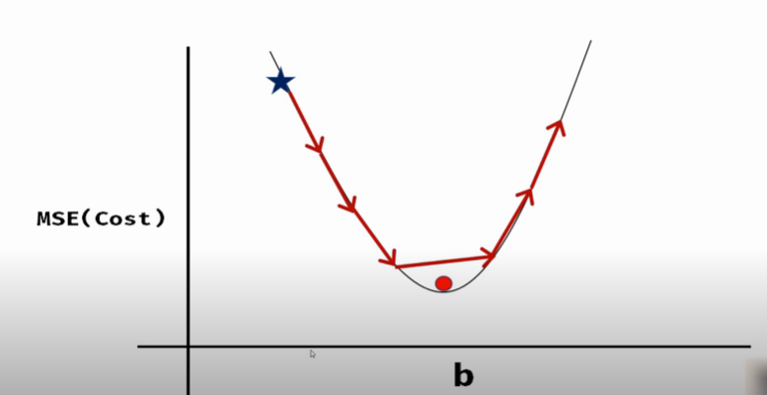

Slide 12
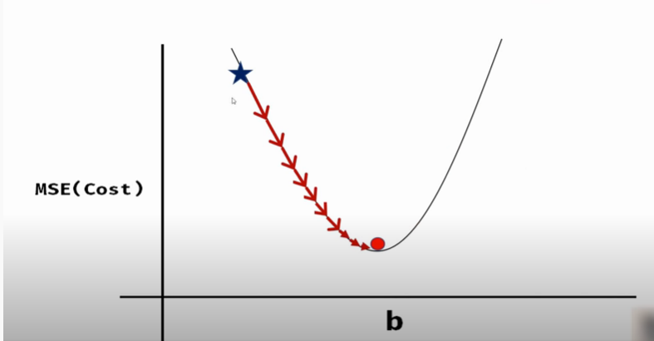

Slide 13
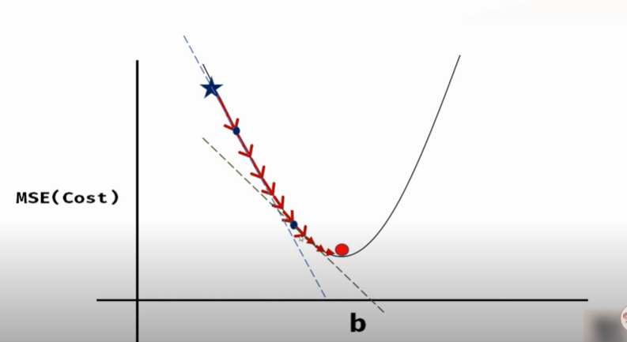

Slide 14
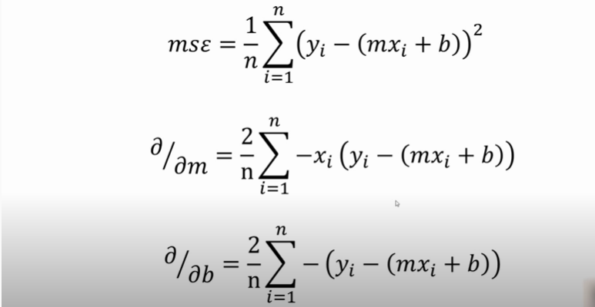

Slide 15
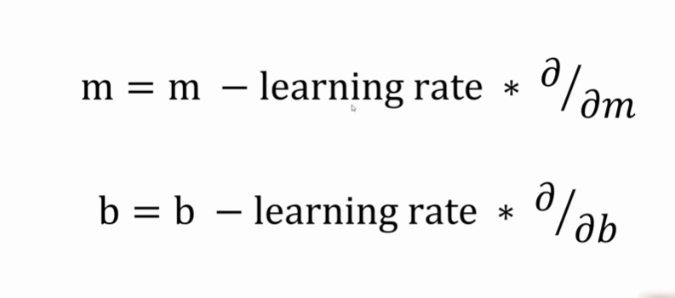

Slide 16
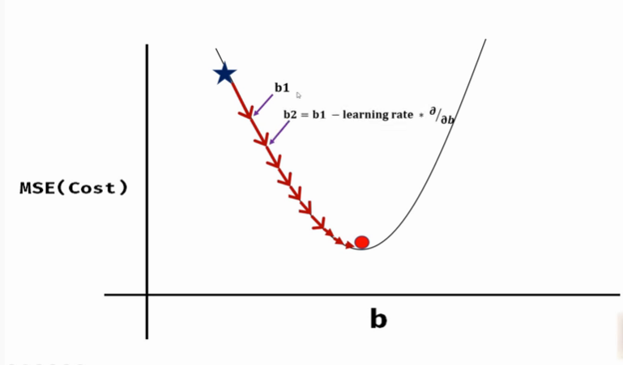

Slide 17
Contd..
4. Initially let m = 0 and c = 0. Let L be our learning rate. This controls how much the value of m changes with each step. L could be a small value like 0.0001 for good accuracy.

Slide 18
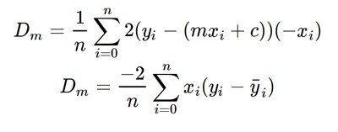
Contd…
5. Calculate the partial derivative of the loss function with respect to m, and plug in the current values of x, y, m and c in it to obtain the derivative value D.

Slide 19

Contd..
Dₘ is the value of the partial derivative with respect to m. Similarly lets find the partial derivative with respect to c, Dc :

Slide 20
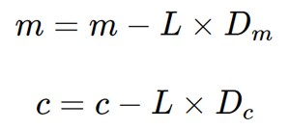
Contd..
6. Now we update the current value of m and c using the following equation:
7. We repeat this process until our loss function is a very small value or ideally 0 (which means 0 error or 100% accuracy). The value of m and c that we are left with now will be the optimum values.

