Slide 1
Naïve Bayes

Slide 2
What is it
Naive Bayes is a probabilistic machine learning algorithm that can be used in a wide variety of classification tasks.
Typical applications include filtering spam, classifying documents, sentiment prediction etc.
But why is it called ‘Naive’?

Slide 3
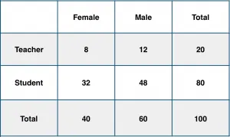
Conditional Probability
What is the conditional probability that a certain member of the school is a ‘Teacher’ given that he is a ‘Man’?

Slide 4
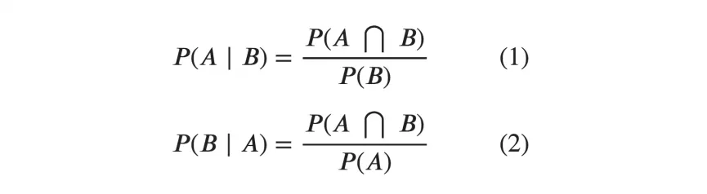
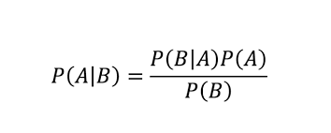
Bayes Rule

Slide 5
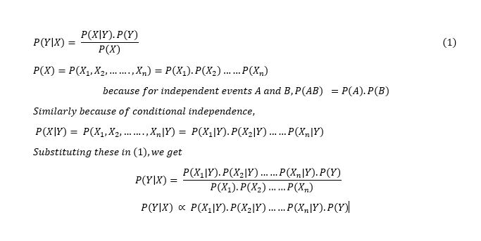
Naïve Bayes Rule
When there are multiple X variables ,we simplify it by assuming the X’s are independent, so the Bayes rule becomes Naive Bayes

Slide 6
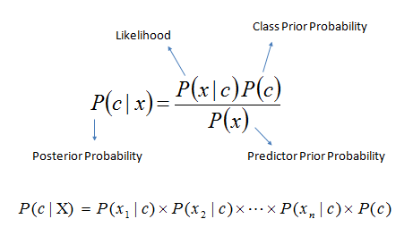
Using Bayes
Bayes theorem provides a way of calculating the posterior probability, P(c|x), from P(c), P(x), and P(x|c). Naive Bayes classifier assume that the effect of the value of a predictor (x) on a given class (c) is independent of the values of other predictors. This assumption is called class conditional independence.

Slide 7
P(c| x) is the posterior probability of class (target) given predictor (attribute).
P(c) is the prior probability of class.
P(x|c) is the likelihood which is the probability of predictor given class.
P(x) is the prior probability of predictor.

Slide 8
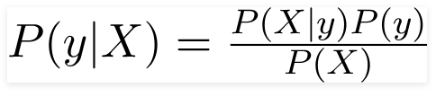

Simple Bayes theorem:
The variable y is the class variable(play golf), which represents if it is suitable to play golf or not given the conditions. Variable X represent the parameters/features.
X is given That

Slide 9
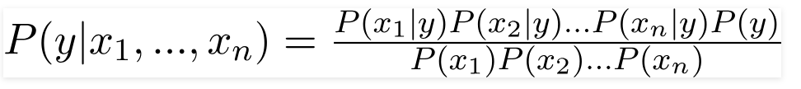

Here x_1,x_2….x_n represent the features, i.e they can be mapped to outlook, temperature, humidity and windy. By substituting for X and expanding using the chain rule we get,
Now, you can obtain the values for each by looking at the dataset and substitute them into the equation. For all entries in the dataset, the denominator does not change, it remain static. Therefore, the denominator can be removed and a proportionality can be introduced.

Slide 10

In our case, the class variable(y) has only two outcomes, yes or no. There could be cases where the classification could be multivariate. Therefore, we need to find the class y with maximum probability.

Slide 11
Consider a given Data Set
outlook | temp | humidity | windy | play
rainy | hot | high | FALSE | no
rainy | hot | high | TRUE | no
overcast | hot | high | FALSE | yes
sunny | mild | high | FALSE | yes
sunny | cool | normal | FALSE | yes
sunny | cool | normal | TRUE | no
overcast | cool | normal | TRUE | yes
rainy | mild | high | FALSE | no
rainy | cool | normal | FALSE | yes
sunny | mild | normal | FALSE | yes
rainy | mild | normal | TRUE | yes
overcast | mild | high | TRUE | yes
overcast | hot | normal | FALSE | yes
sunny | mild | high | TRUE | no

Slide 12
Question:
In this example we have 4 inputs (predictors). The final posterior probabilities can be standardized between 0 and 1.
Outlook | Temp | Humidity | Windy | Play
Rainy | Cool | High | True | ?

Slide 13
The posterior probability can be calculated by first, constructing a frequency table for each attribute against the target.
Then, transforming the frequency tables to likelihood tables and finally use the Naive Bayesian equation to calculate the posterior probability for each class.
The class with the highest posterior probability is the outcome of prediction.

Slide 14
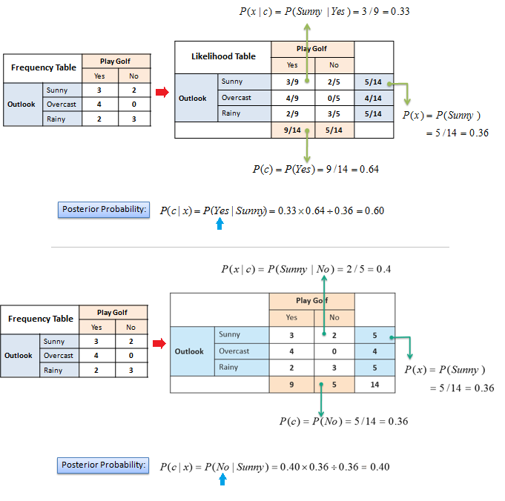

Slide 16
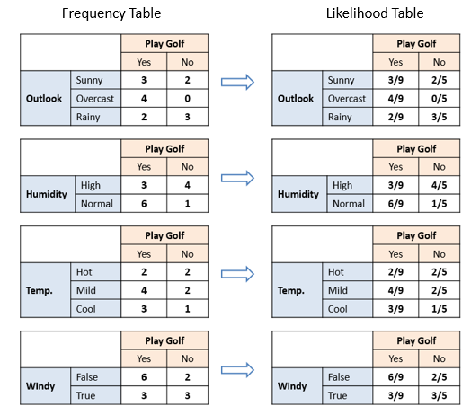

Slide 17
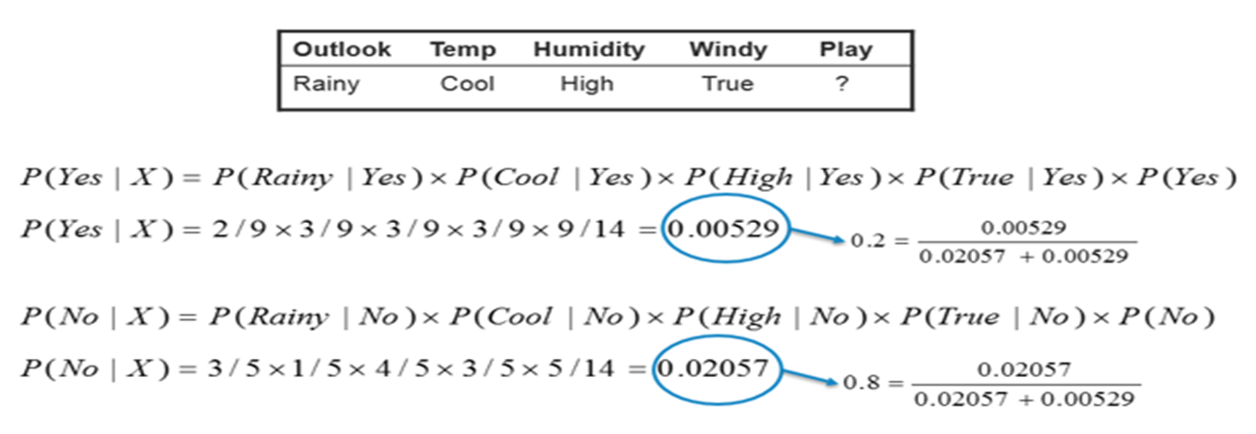

Slide 18
Types of Naive Bayes Classifier:
Multinomial Naive Bayes:
This is mostly used for document classification problem, i.e whether a document belongs to the category of sports, politics, technology etc. The features/predictors used by the classifier are the frequency of the words present in the document.
Bernoulli Naive Bayes:
This is similar to the multinomial naive bayes but the predictors are boolean variables. The parameters that we use to predict the class variable take up only values yes or no, for example if a word occurs in the text or not.
Gaussian Naive Bayes:
When the predictors take up a continuous value and are not discrete, we assume that these values are sampled from a gaussian distribution.

Slide 19
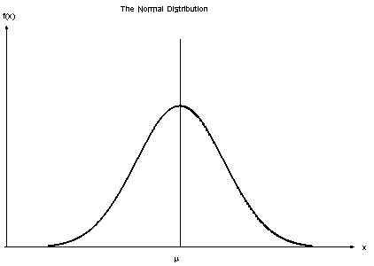
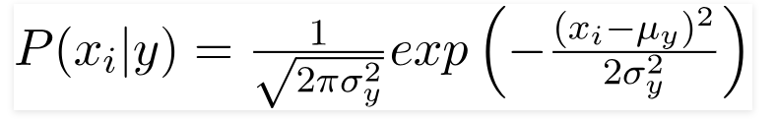
Since the way the values are present in the dataset changes, the formula for conditional probability changes to,

Slide 20
Naive Bayes algorithms are mostly used in sentiment analysis, spam filtering, recommendation systems etc. They are fast and easy to implement but their biggest disadvantage is that the requirement of predictors to be independent. In most of the real life cases, the predictors are dependent, this hinders the performance of the classifier.

Slide 21
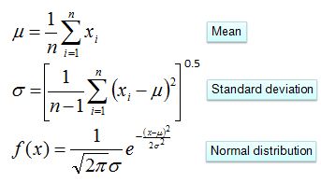
Numerical Predictors
Numerical variables need to be transformed to their categorical counterparts (binning) before constructing their frequency tables. The other option we have is using the distribution of the numerical variable to have a good guess of the frequency. For example, one common practice is to assume normal distributions for numerical variables.
The probability density function for the normal distribution is defined by two parameters (mean and standard deviation).

Slide 22
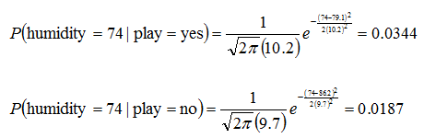
 |  | Humidity |  |  |  |  |  |  |  |  | Mean | StDev
Play Golf | yes | 86 | 96 | 80 | 65 | 70 | 80 | 70 | 90 | 75 | 79.1 | 10.2
 | no | 85 | 90 | 70 | 95 | 91 |  |  |  |  | 86.2 | 9.7

Slide 23

Predictors Contribution
Kononenko's information gain as a sum of information contributed by each attribute can offer an explanation on how values of the predictors influence the class probability.

